Slide 1
Exploring synergies between Digital Innovation Hubs and Agri-food Partnerships

Slide 2
PARTNERS

Slide 3
Proud member of

Slide 4
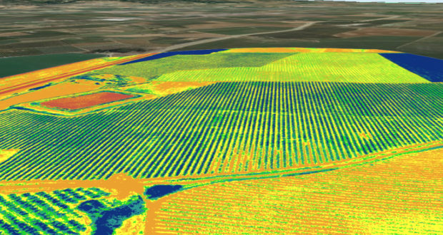
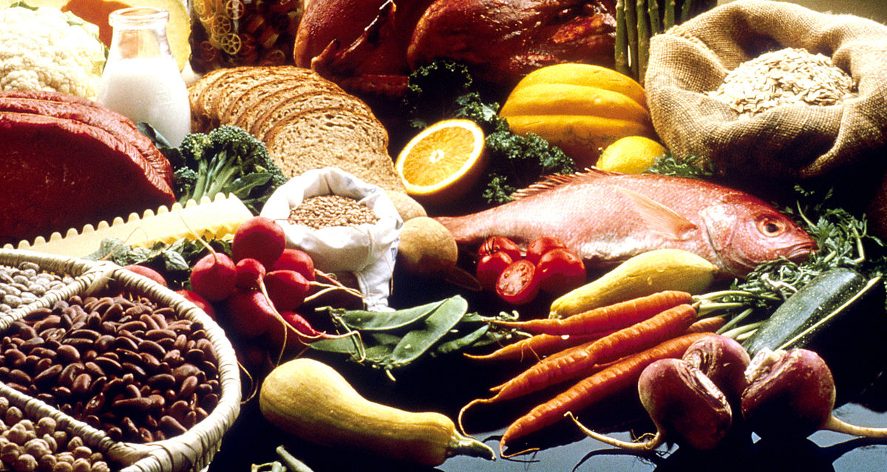
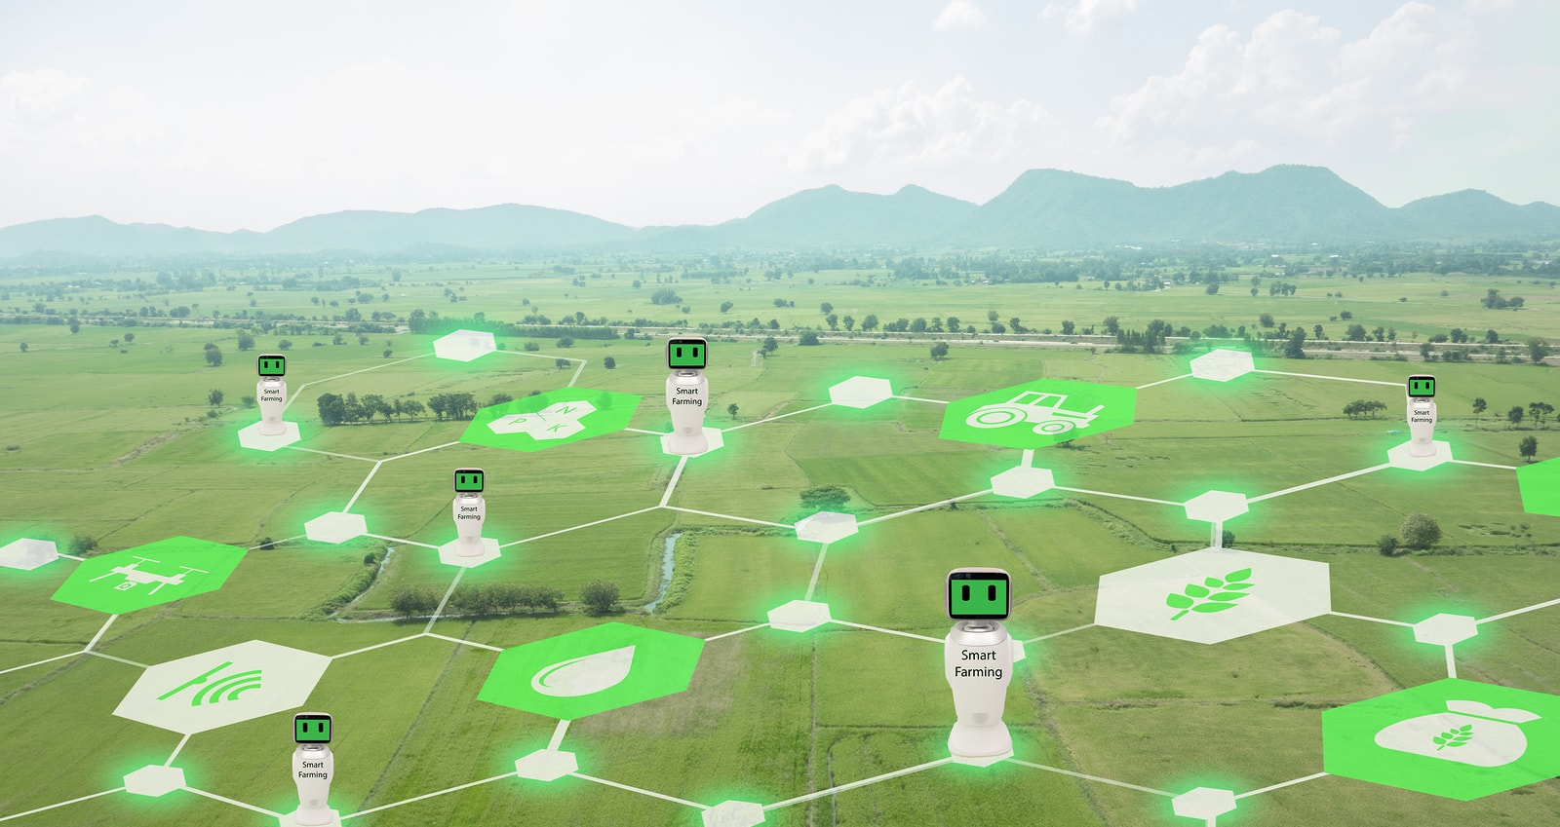
OUR COMPETENCES
PRECISE FARMING
FOOD SAFETY
SENSING TECHNOLOGIES
AI / DATA ANALYTICS

Slide 5
The THREE PILLARS
THE PROMISE
THE RESULT
WHY?
WHEN?
HOW?

Slide 6
Why?
TO MAKE TECHNOLOGY ADDOPTION EASY
THE NETWORK OF NETWORKS

Slide 7
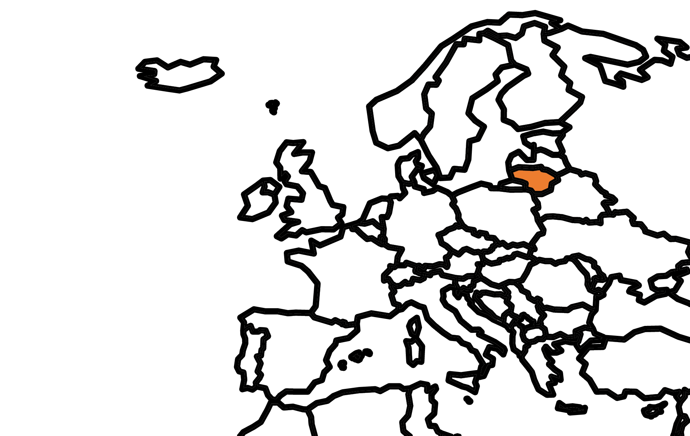
WHEN?
YOU DON‘T KNOW WHAT YOUR NEIGHBOUR DOES

Slide 8
HOW?
BY COMBINING TECHNOLOGIES, DEMAND AND SKILLS

Slide 9
THE PROMISE
COLLABORATION TO BRING THE BEST FROM LITHUANIA AND TO LITHUANIA

Slide 10
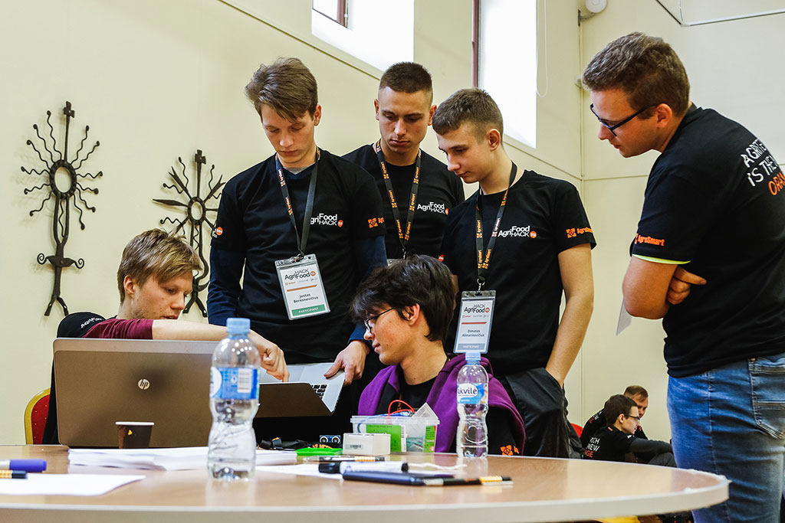
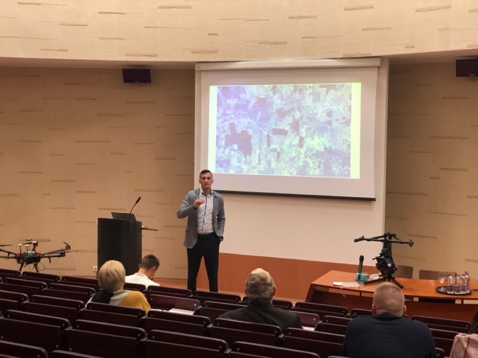
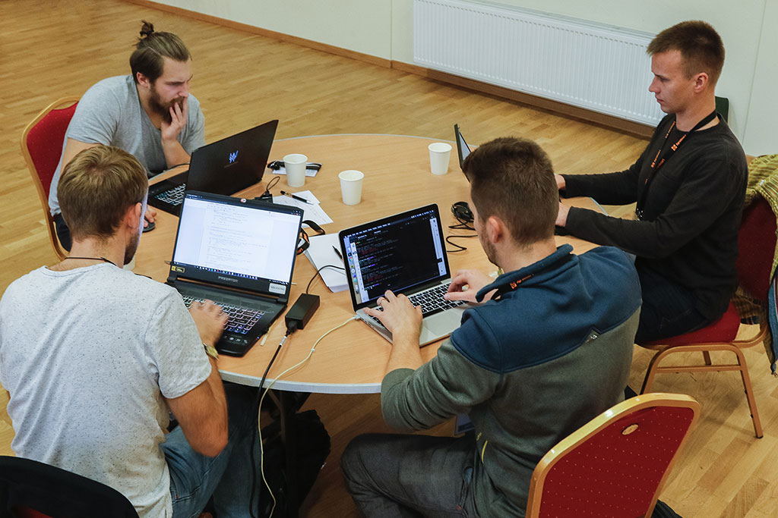
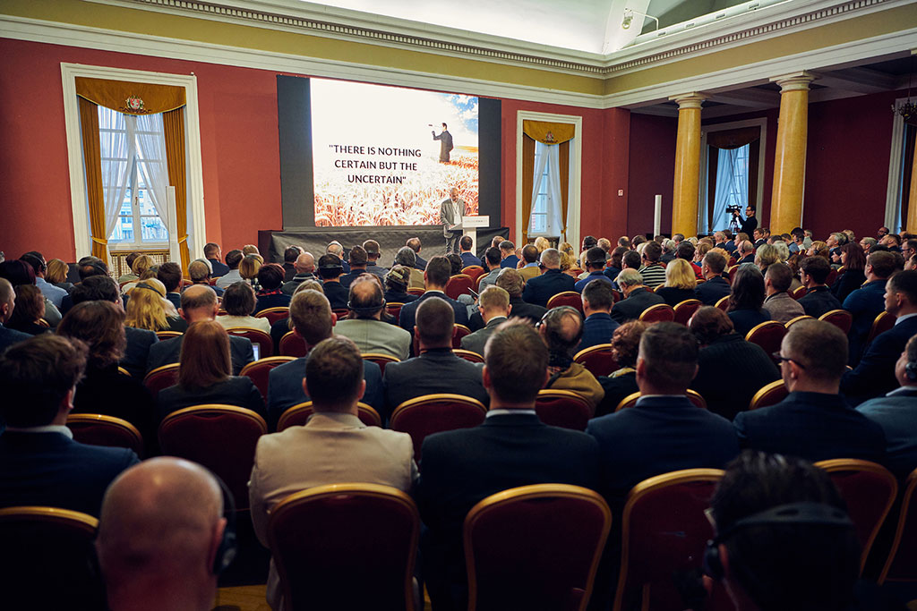
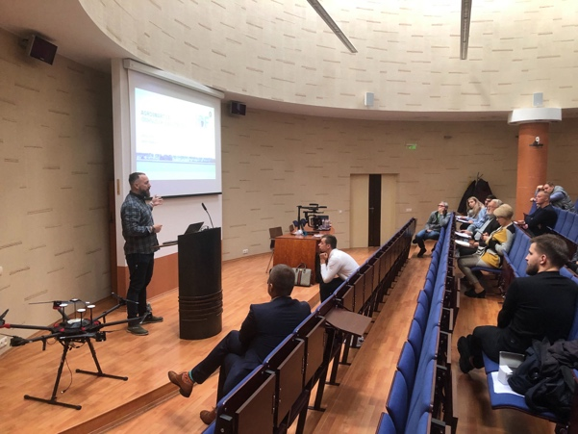
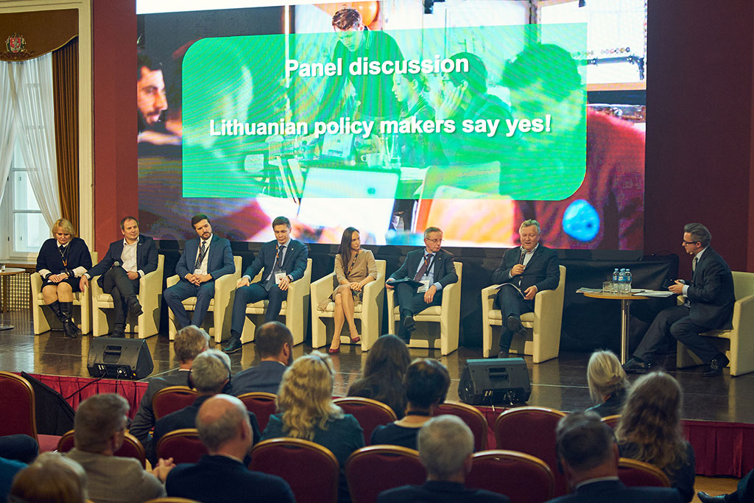
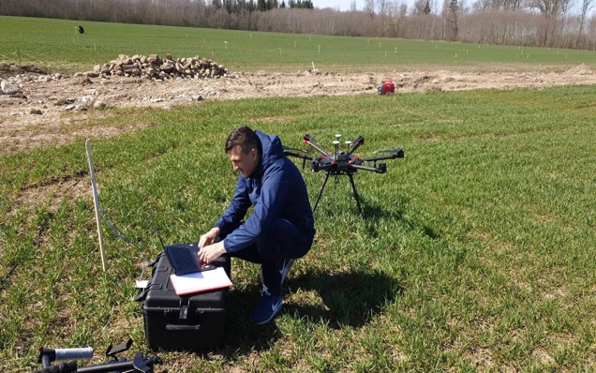
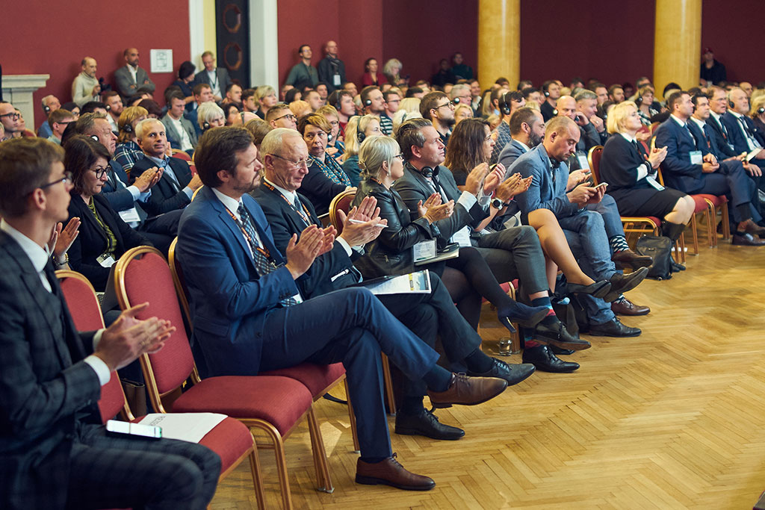
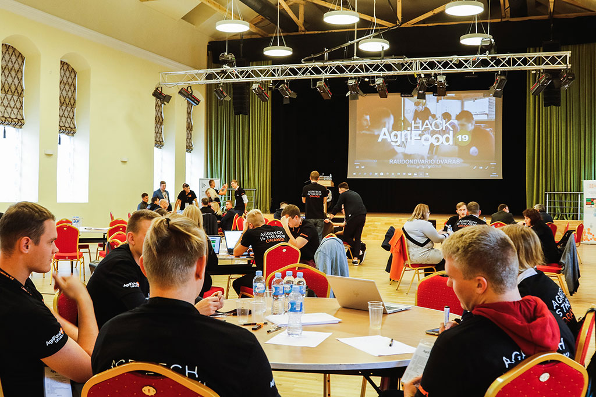
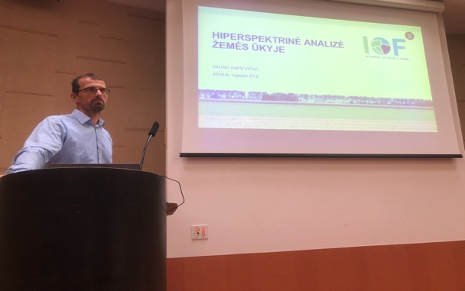
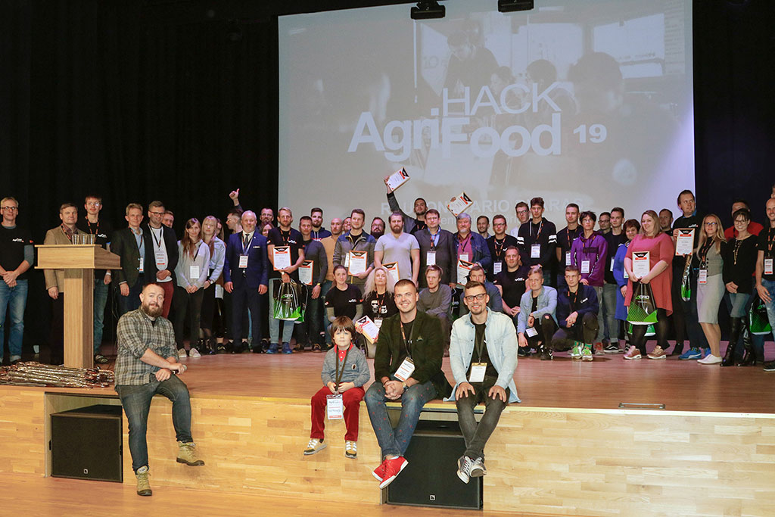
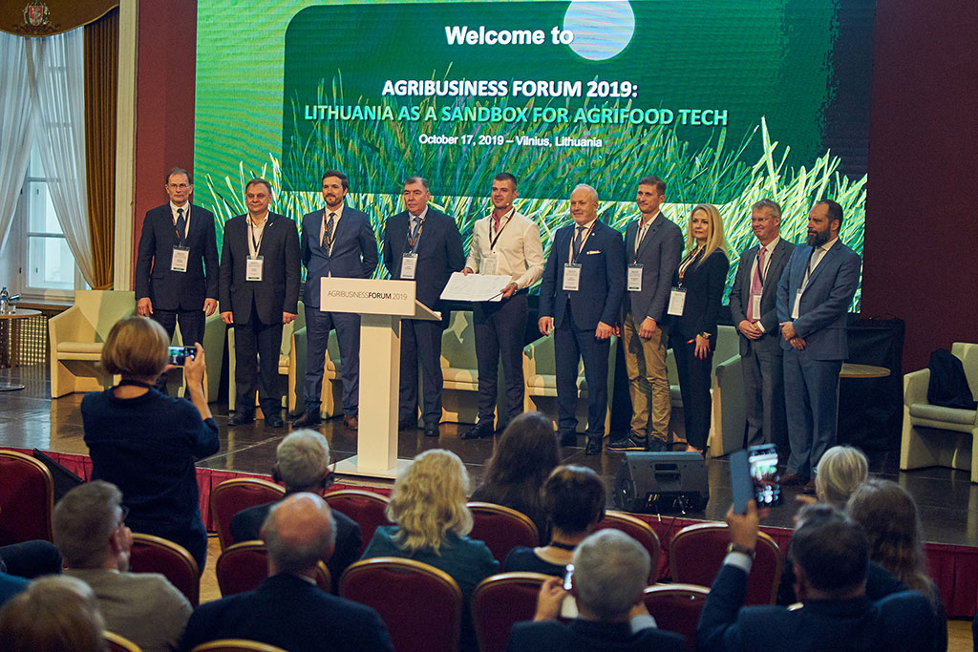
THE RESULT
ORGANIZED EVENTS:
2000+ farmer consultations
50+ field demos
2 conferences
1 hackathon

Slide 11
THE RESULT
SIGNING OF MEMORANDUM FOR INTERNATIONAL COOPERATION

Slide 12
THE RESULT
Parties involved in the development of solutions:
6 Public & Social institutions
6 Science & Research institutions
5 Enterprice companies
9 Innovation & Technology providers
1 Legal support company
Hyperspectral imaging solutions for agriculture

Slide 13
THANK YOU FOR YOUR ATTENTION!
Kristina
Sermuksnyte-Alesiuniene
+370 650 22269
kristina@art21.lt
Augustas Alesiunas
+370 655 62313
augustas@art21.lt

