Slide 1
HOW FAR DO YOU WANT TO GO WITH YOUR AGRIFOOD BUSINESS?

Slide 2
About Hispatec
30
5
More than 30 years of experience developing and supporting ICT solutions for Agro sector.
Local presence, partners and customers in Spain, Mexico, Chile, Peru, Morocco.
400
10 B
Organizations using our solutions to take better decissions.
Total turnover in Agro products from our customers.
120
Multi
Experts in software engineering, data analytics and precission farming.
Market segment, language, currency, organisation, modular, customisable.
Corporate– Hispatec

Slide 3
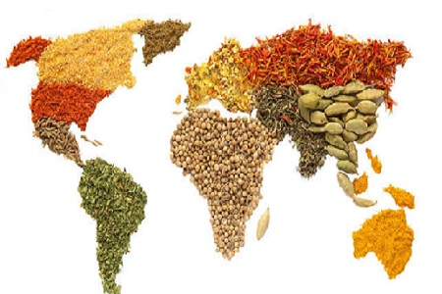
Challenges: Profitability, Social and Environmental sustainability
Corporate– Hispatec

Slide 4
ICT solutions providing full Support to Agrifood chain
Integration and process support from field to market
Crops / Farmer
Agronomic Advice
Transformation
Logistics
Commercial
Cost control & Profit
Traceability & food safety
Corporate– Hispatec

Slide 5
Capturing data from many sources along the chain
Corporate– Hispatec

Slide 6
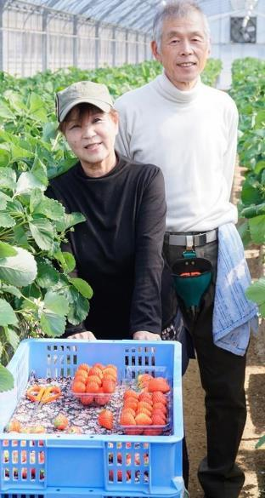
Supporting food quality and standards compliance
Corporate– Hispatec

Slide 7
Operational processes control and synchronization end-to-end
Take real control of all your key business processes end-to-end with the most powerful global solution specialized in Agro sector
Corporate– Hispatec

Slide 8
Data-Driven Analytical solutions company for Agribusiness
Hispatec Analytics
Which is the best action?
What will it happen?
What does it happen?
Why is it?
Descriptive Analytics
Diagnostic Analytics
Predictive Analytics
Prescriptive Analytics
Corporate– Hispatec

Slide 9
Field & post-harvest full integration and analytics
Data everywhere
Data integration with fertigation, crop sensors, machinery, satellites, drones, etc…
Crop monitoring solutions deployment, linked to Agribusiness end-to-end management
Data analytics platform integrating internal and external data to take better decisions
Specific models on irrigation, weeds, pests, nutrition, demand, harvest curve, etc.
Benchmarking with peers (blind data), and R&D communities
Corporate– Hispatec

Slide 10
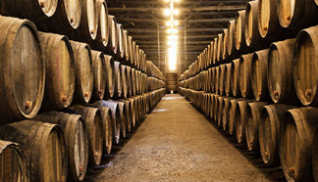
Hispatec is committed with innovation
Some leading R&D projects where we participate:
IOF2020 – IoT applied to Agro sector. Involvement in Fruit and Vegetables trials. H2020 project: 35 MM€, 70 organisations, 22 conutries. Leading European project
H2020 European project. Digital Innovation Hub in Agro. Hispatec focus in fertigation efficiency
Globalviti
Leading Spanish wine technology project. 8 organisations. 3 years. Relevant cellars involved
Corporate– Hispatec

Slide 11
Adapting each solution to different business needs
Turnkey global solution
Take advantage of a wide range of expertise gathered during 30 years dealing with the Agribusiness.
Adapting to your needs
Tell us what you need and we’ll provide you with a customized solution that meets your needs.
Develop your own software modules
ERPagro is not just an application but a platform which enables you to develop your own modules and solutions.
Corporate– Hispatec

Slide 12
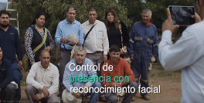
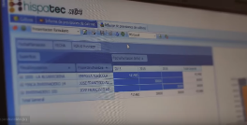
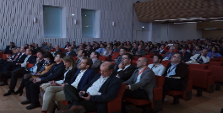
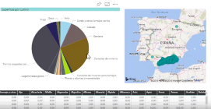
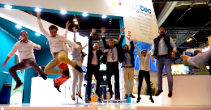
Real Impact: some examples
Frutasol
Hispatec
DatAgri
Hispatec: cada día cuenta
Soltir
Previsiones Junta de Andalucía
Fruit Attraction
Corporate– Hispatec

Slide 13
Hispatec: the Software and Data partner in Agrifood
Focus in Agrifood, specialization and niche software products.
Relevant continuous R&D investment. Participation in some of the most innovative Agrotech projects in Europe.
Sound experience in the field and reliability.
Proven solutions, with high impact business case in many companies.
Strong customer base and operations in different countries.
Solution approach, with the customer business needs always being the main focus.
Customer service and continuous monitoring of solutions.
Corporate– Hispatec

Slide 14
Let’s work for a better Agrifood sector

