Slide 1


Slide 2
High Tech Farming
Fabio Boscaleri Els van de Velde
Tuscany Region
IDEA Consult

Slide 3






Your partnership's progress since 2019 Spring AF Working Committee Meeting
Main accomplishment since March 2019
Further consolidation of the Pilot Business Cases under DG REGIO support (Financial Expert assigned since end of November)
New collaborations with European Initiatives/Projects:
  KIC FOOD (Meeting in September)
  ERANET ICT-AGRI-FOOD (Exchanges with the coordinator and participation to the Tech Meeting in Malaga)
  H2020 AGROBOFOOD Project
  H2020 SMART AGRI HUBs
Interregional Agreements signed at the level of Pilot Projects (FRESHFRUIT and PODUR)

Slide 4
Progress towards business and investment projects
Two Interregional Business Pilots – FRESHFRUIT and PODUR - active and well alive (both submitted under first TAF cut-off: rejected)
One more Pilot under development and other many ideas in the pipeline.
Established methodology to initiate new interregional business cases dealing with the farming sector.
Business model under finalization for the FreshFruit Pilot
Discussion to adopt a business model at the level of S3 HTF Partnership (Interregional Service Platform).

Slide 5
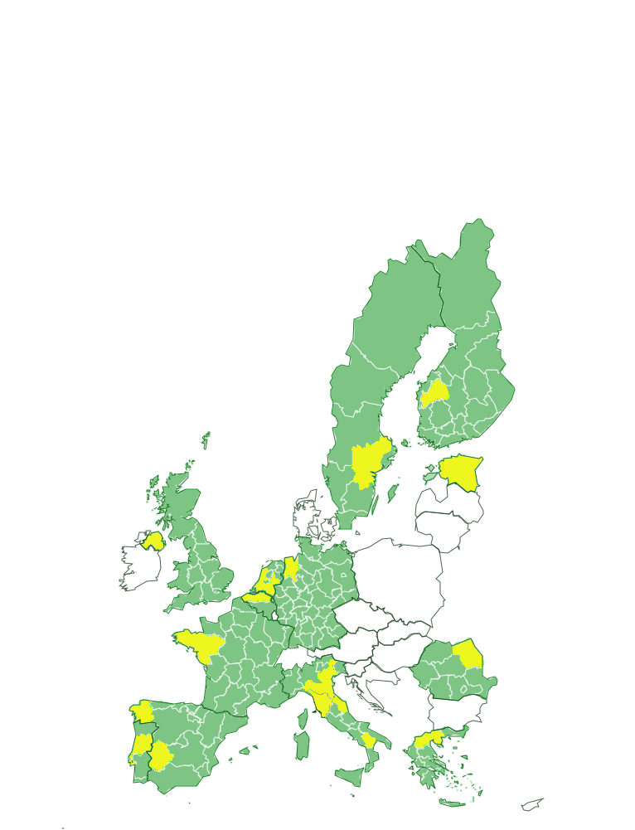
Progress towards business and investment projects
Towards a cross-regional interface of platforms
Regional Platforms should involve:
Demo farms (to run test/experiments) with standardised Farm Management Systems (to adopt the same procedures)
Regional Geographic Info Systems (mapping + data)
Political commitment (Regional funds)
Other actors a Region need to involve
Cross-regional Interface
Regional Platform 1
Regional Platform 2
Partnership Agreement
Farms/End users
Cross-regional Interface
Service oriented
Public-Public / Public-Private
Access to relevant data (but not personal/sensitive ones)
Fee based services
Business accelerator/incubator???
Each Platform acting as service node/hub
Regional Platform 3
Regional Platform n
Project
Data & Solution Providers
Identifying interregional projects (already running or potential) to define and test the actual role of the cross-regional interface
Project
Project

Slide 6
Progress towards business and investment projects
Regional versus interregional perspective of High Tech Farming partnership
Regional
International
Farmer
Product delivery
Retailer
Demand for higher quality
Translation
Implementation
International
Regional
Innovation intermediary
Deployment requirement
International
Determine the choice of technology to be implemented
Regional
Technology provider
Technology infrastructure

Slide 7
Digital services and technologies
FreshFruit Pilot project is aimed at deploying a new service for managing farming practices devoted to grape production (fruit and wine). The service built upon several digital technologies and services which are tested in the pilot:
  Farm Management software (deployment);
  Data transmission and management (deployment, exploration and exploitation);
  Sensors and mechanization (exploration and exploitation).

Slide 8



The Fresh Fruit case in Central Macedonia
  For 2019: 72.000€
  For 2020: ~150.000€
A.B. Vassilopoulos: 160.000€
Jupiter: 18.000€ (2019), 36.000€ (2020)
850.000€ (2019)
3.000.000€ (2020)
Pangeon Vineyards farmers’ group
Macedonian Vineyards farmers’ group
SPEKO cooperative
Fresh fruit delivery
A.B. Vassilopoulos (GR) &
Jupiter (UK): entering into pur-
chase agreements that offers
farmers a premium price
Demand for higher quality
Translation
Transadriatic Gas Pipeline: 70.000€
Stavros Niarchos Foundation: 260.000€
Regional Authority of Central Macedonia : 27.000€
Implementation
H2020
National and regional R&D budget
Determine requirement
Unified LoRa telecommunications infrastructure across Northern Greece
o Region of Central Macedonia;
o Stavros Niarchos Foundation;
o Bodosakis Foundations;
o Transadriatic Gas Pipeline
IFAC-CNR (IT): Smart-Grape
Instituto Pedro Nunes (PT): I9KIWI
CG Wireless (FR): ALAMO
Greenfield Technologies (ES)
Determine the choice of technology to be implemented

Slide 9
The Fresh Fruit case in Tuscany
DIGIVIT (EIP AGRI Operational Group) – about 300.000€ EARDF till 2022
Estimated cost reduction of min. 20%
No Direct investments – Premium price (%)
Better management + Prediction of yield and quality
Wine Cooperatives
Direct sell
Farmers in Tuscany:
3 Important Winemakers
Premium price
Integration of solutions & extension to new productions
Farm Management System
Agreement
TRT-ABACO
Written agreements among ARTEA - Leonardo
ARTEA - ABACO
Leonardo – Tuscany Region
Implementation
Terre Regionali Toscane (Demo Farms):
Wine
H2020
National and regional R&D budget
Determine requirement
Determine the choice of technology to be implemented
Building a Public-Private datasharing system by integrating:
Paying Agency Data (ARTEA);
Earth Observation maps (Leonardo Company)
Digital Platforms (ABACO / Oenosmart)
Land Management (Tuscany Region)
Technologies/Services
IBE-CNR (IT): Agriefesto + Agriduino
IFAC-CNR (IT): Smart-Grape
CG Wireless (FR): ALAMO
Greenfield Technologies (ES)
Dronebee (IT)

Slide 10
Digital services and technologies
PODUR Pilot project is aimed at deploying a new service for reducing dust production in poultry production sites. The service built upon several digital technologies which are tested in the pilot:
  Data transmission and management (deployment, exploration and exploitation);
  Sensors and mechanization (exploration and exploitation).

Slide 11
The PODUR case in East Netherlands
Increase of €0.007 per egg X a total of 10 billion eggs per year= €70 million
Farmers in East Netherlands
Egg delivery
Retailer
Demand for higher quality
Government
Demand for healthy environment
Poultry farmer: 25% risk of lung problems (compared to ~4%)
Translation
Implementation
Determine the choice of technology to be implemented
Poultry Expertise Centre
Determine requirement
Producers of fine dust reducing systems:
FreshLightAgri
Serutech
StaticAir
SmitsAgro
Producers of monitoring equipment:
Stalmeesters (NL)
Faromatics (ES)
Copeeks (FR)
~€6 million with 25% of poultry producers (€0,5 investment cost per hen)

Slide 12
Digital services and technologies
Added value of the Partnership
  Expanding the original pilots to new technologies
  Extending the pilots to new geographical areas
  Defining a space and methodology to operate interregionally

Slide 13
Future plans
Continuing the development of existing pilots and establishing new ones.
Supporting the collaboration of pilots with relevant cascading funding initiatives.
Setting up a legally based governance for the Partnership.

Slide 14
Future plans
What support is needed and is currently lacking?
  Finding the most appropriate partnership governance operational model
  Tailored support mechanisms under European Programmes and Funds (eg. push and pull in Cohesion Funds; priority areas under Horizon Europe)
  Soft supporting tools (eg. skills, programme design, shared/joint management)
  Better engagement of businesses (political and procedural talks push them away…)

Slide 15
Thank you!
fabio.boscaleri@regione.toscana.it
els.vandevelde@ideaconsult.be

