Slide 1
Digital transformation of farms and food producers through DIH AGRIFOOD
Digital Innovation Hub AGRIFOOD
Daniel Copot
Malaga, 04.12.2019

Slide 2
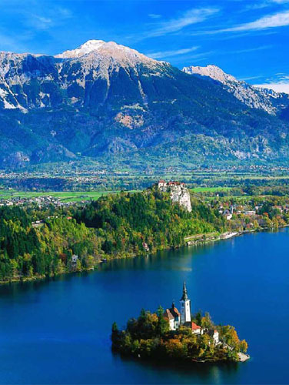
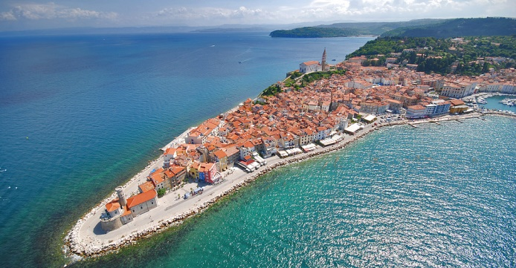
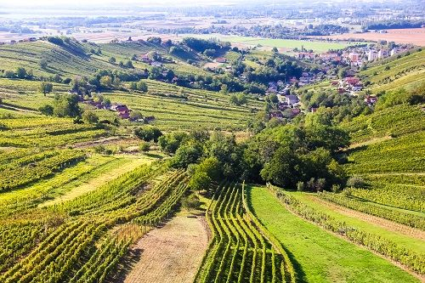
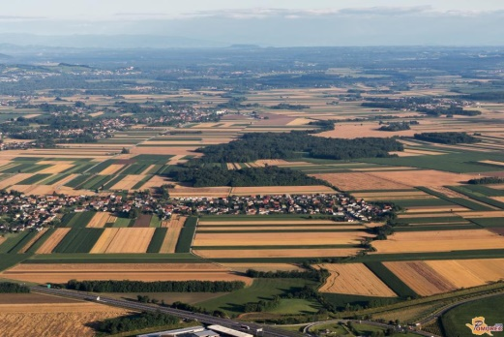
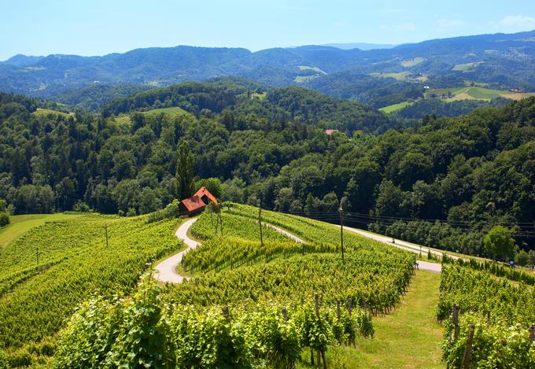
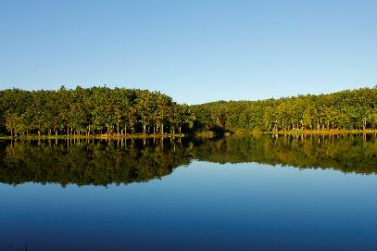
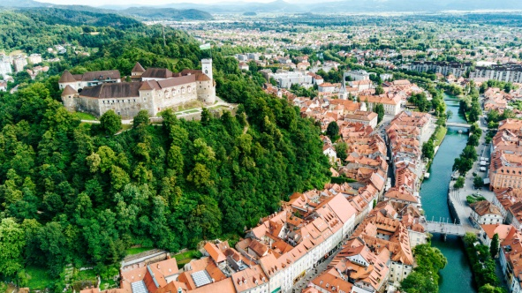
ITC - Innovation Technology Cluster
ITC Cluster aims at fostering cross-sectoral innovation, based upon novel technologies and ICT, while bringing together SMEs and other institutions from different sectors and turn them into being ‘’Smart’’.
Technology Transfer office
The Technology Transfer skills and principles are the key for ITC cluster operation.

Slide 3
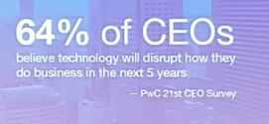
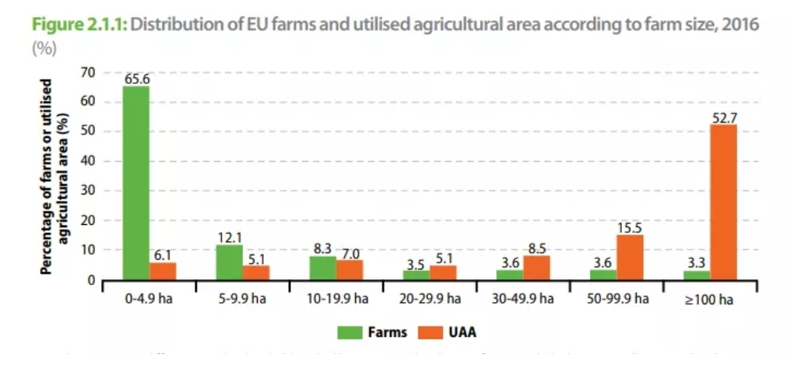
We needed to support farmers differently!
WHY? We need to produce more food with less resources and the way to achieve this is through digital transformation
Technologies: IoT, IoE, Industry 4.0, Agriculture 4.0
Trends in EU (Common EU Agricultural Policy, EIP-AGRI)
Farmers should be put in the centre!
The importance of ‘‘Technology transfer‘‘
Living lab approach
Complexity, lack of skills, lack of finances, …
‘‘The biggest winners of the transformational process will be the ones to control platforms for managing business ecosystems!‘‘
M.E.Porter, J.E.Heppelmann: How Smart, Connected Products Are Transforming Competition, November 2014

Slide 4
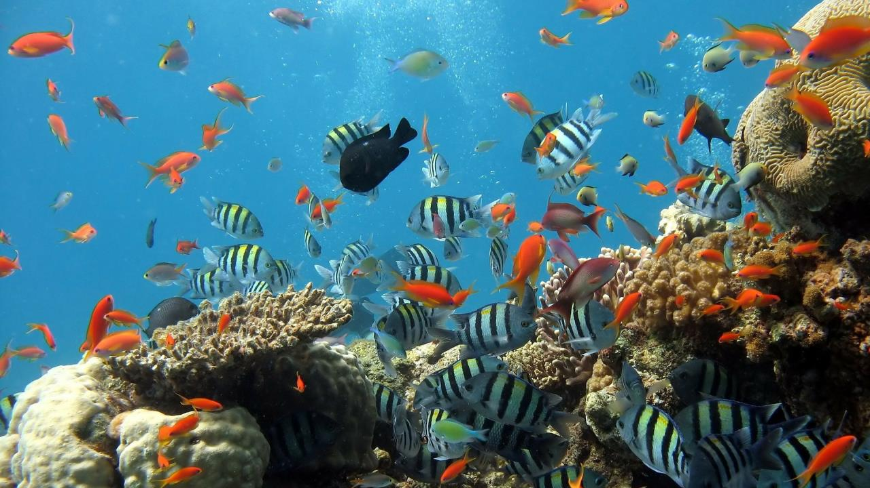
Digital Innovation Hub for Agriculture and Food Production – DIH Agrifood
The organization should represent a One-Stop-Shop providing services to target groups (farmers and food producers) through a multi-partner cooperation
The DIH ecosystem can be seen as a coral reef where there are big and small fish, hunters and prey, but overall everyone performs better compared to isolation.”
— Grigorios Chatzikostas, EIP-AGRI Seminar
Digital Innovation Hubs for Agriculture

Slide 5
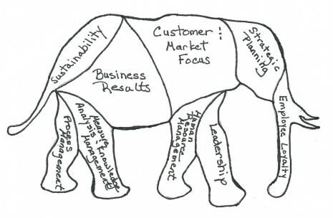
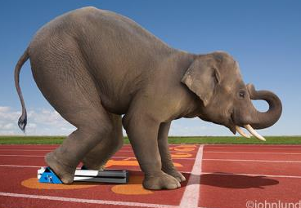
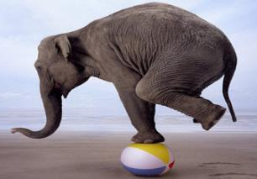
Our approach!
STEP
by
STEP
TRUST
SPEED
AGILITY/simplicity

Slide 6
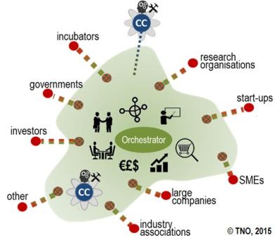
Our approach!
Multi-Actor Approach (MAA) based
Non-formal structure – network, no membership
No need to have complex rules and legal procedures since all parties can have advantages as long as the DIH AGRIFOOD concept is in the forefront and respected
Every participant is able TO TAKE ‘‘the common asset‘‘, however they should also be able to CONTRIBUTE to ‘‘the common asset‘‘
DIH AGRIFOOD shall become the synonym for Digital transformation of farmers and food producers
KISS (Keep it Simple and Smart)

Slide 7
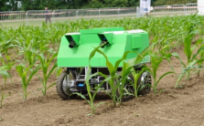
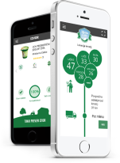
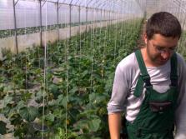
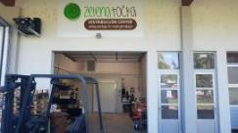
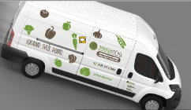
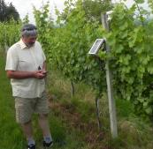
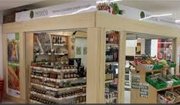
DIH AGRIFOOD
Topics
Short supply chains
Digital transformation
Gastronomy

Slide 8
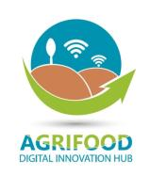
Farm manager
Cooperation platform
e-learning platform
DIH AGRIFOOD service portfolio
Living lab
Awareness creation
Mentoring and training
Innovation scouting and Technology Transfer
Develop strategies and business models
Cooperation with other DIHs
Financing / funding

Slide 9
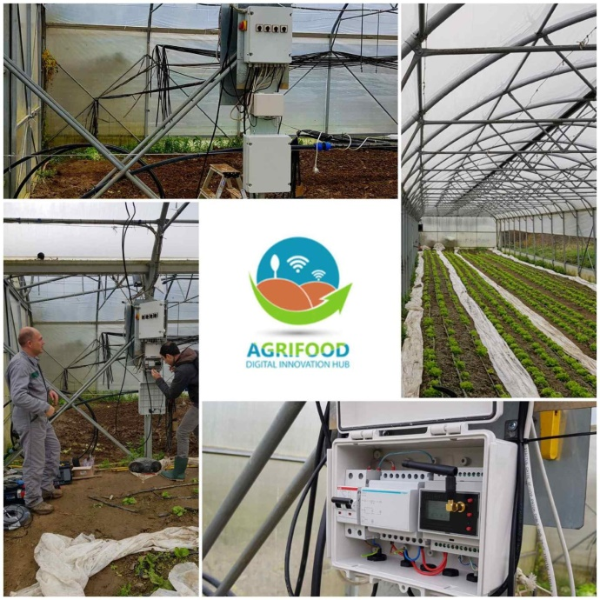
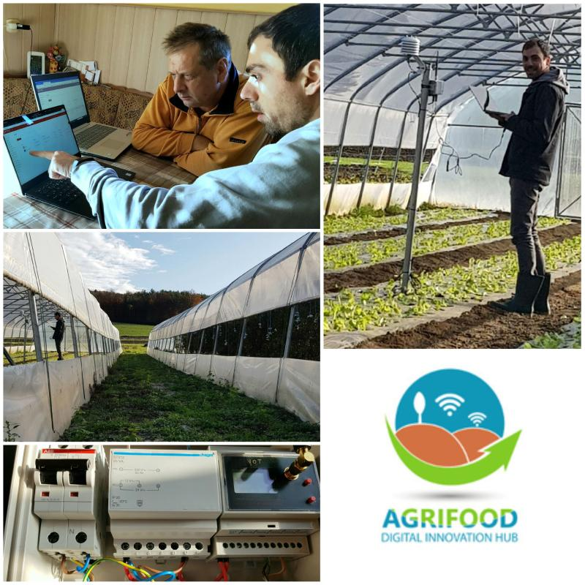
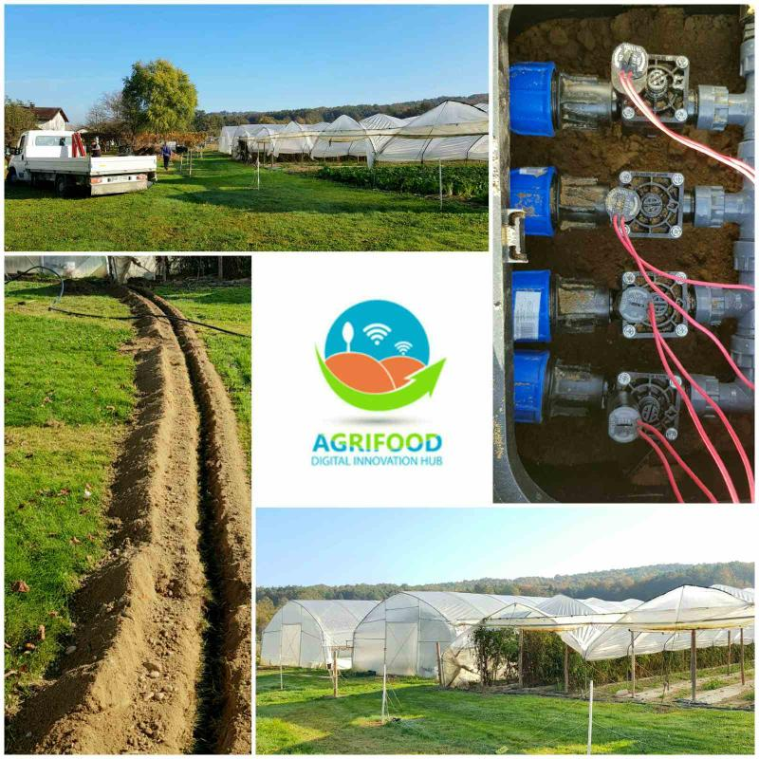
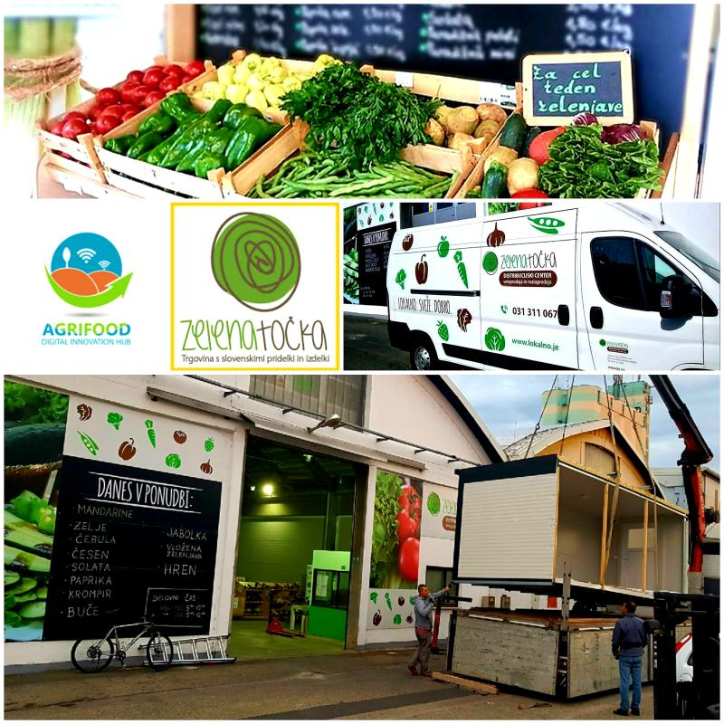
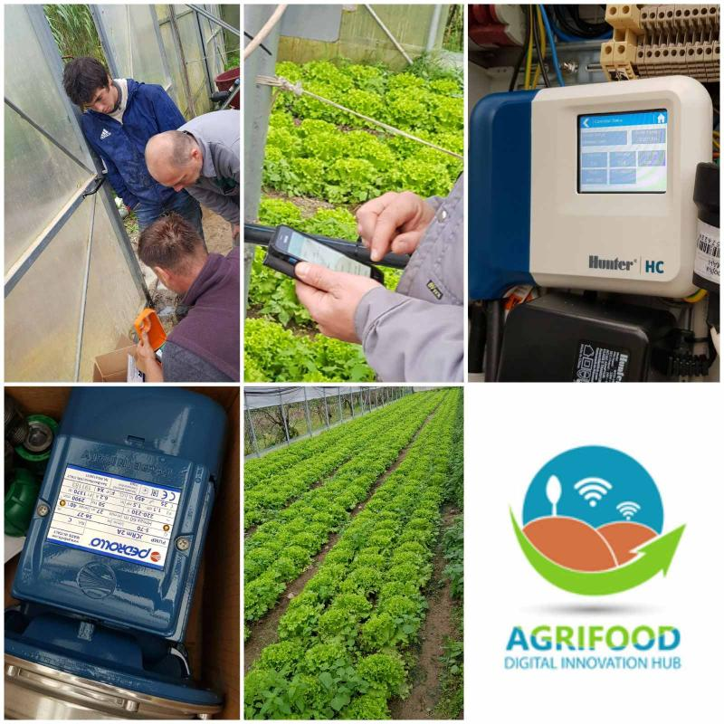
CYSLOP
12 farms and 3 supply chains equipped with IoT technologies (sensors, irrigation control, fertilization control, pest management, traceability)

Slide 10
DEMETER is focused in implementing concrete technological solutions that will foster digitalizing the sector across Europe
ITC (through DIH AGRIFOOD) will implement digital IoT technologies in three areas: poultry, orchards and vineyards
DIH AGRIFOOD is having direct access to key technologies in Agriculture

Slide 11
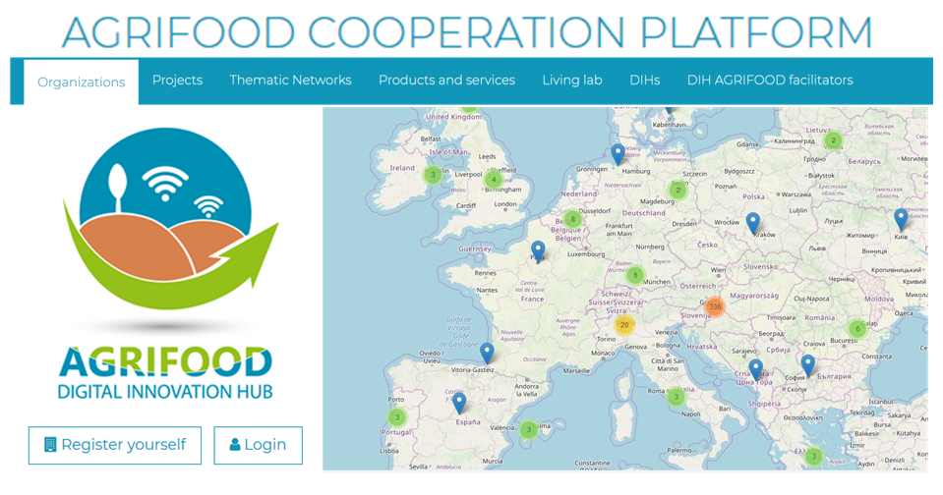
DIH AGRIFOOD Cooperation platform
http://mapping.itc-cluster.com/
The COLLABORATION and NETWORKING platform, based on FACILITATION, hosting:
Organizations
Projects
Thematic Networks
Products and services
Living lab
DIHs
Facilitators
WELCOME TO REGISTER!

Slide 12
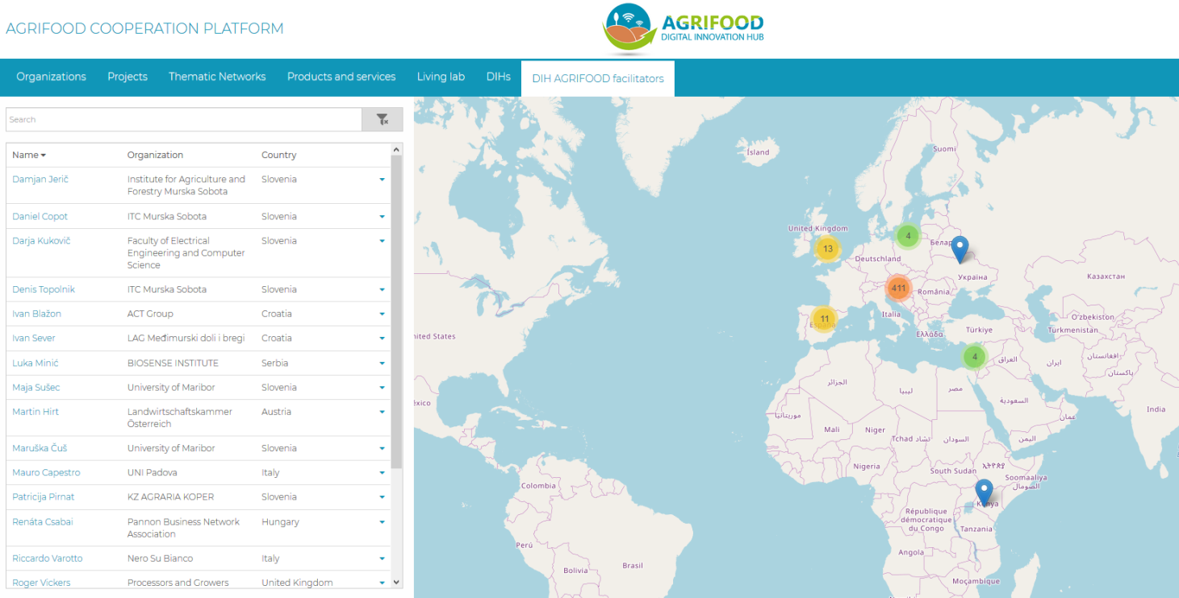
DIH AGRIFOOD Cooperation platform
http://mapping.itc-cluster.com/
The importance of facilitation!
Understanding farmer‘s needs
Connecting Supply and Demand
Skilled in Technology transfer process
Being able to facilitate the digital transformation process
Being able to get financial support
Excellent Demonstrators, Promotors
WELCOME TO REGISTER!

Slide 13
Contact and more information
THANK YOU FOR YOUR ATTENTION!
Daniel. Copot@itc-cluster.com
Follow us
Plese 9a, SI-9000 Murska Sobota
www.itc-cluster.com

