Slide 1
Declaration of cooperation on ‘A smart and sustainable digital future for European agriculture and rural areas’
Magdalena Szwochertowska
Policy & Programme Officer
Robotics & Artificial Intelligence
DG CNECT - EC

Slide 2
Agriculture is one of the key areas for future investment
…investments in projects in key application areas such as health, connected and automated driving, agriculture, manufacturing, energy, next generation internet technologies, security and public administrations
…a first series of testing and experimentation infrastructures for AI products and services will be set up in the areas of healthcare, transport, infrastructure inspection and maintenance, agrifood and agile production
…development of platforms and large-scale pilots integrating AI elements in areas such as energy, healthcare, manufacturing, geo-information and agriculture
…integrated earth observation and AI machine learning solutions in areas such as climate change, environmental protection, agriculture, urban development, disaster response, migration, infrastructure monitoring
Notes:
Agriculture is one of the key areas for future investment. The quotes are from the Communication on Artificial Intelligence for Europe and from the Coordinated Plan on AI.

Slide 3
Digital technologies have great potential for agriculture and rural areas
…potential to increase farm efficiency while improving economic and environmental sustainability.
…can transform all types of farming and enable better decision making.
…positive impact on the quality of life for farm workers, and may attract a younger generation to farming and rural business start-ups.
…help tackle the economic, social, climate and environmental challenges facing the EU's agri-food sector and rural areas.
Notes:
The focus on agriculture is due to the fact that agriculture is one of the areas with the highest potential for digitalisation. The quotes are from the new Declaration on ‘A smart and sustainable digital future for European agriculture and rural areas’ signed on Digital Day 2019 on 9 April.

Slide 4
Low use of digital technologies in agriculture and rural areas
…lack of information about existing technologies, the lack of digital skills
…limited availability of reliable cost/benefit analyses of the new technologies
…research and innovation still required to develop new solutions
…missing basic infrastructure, such as broadband or access to other high-speed internet connections
Notes:
At the same time the use of digital technologies in agriculture and rural areas is low, on average. The quotes are from the new Declaration on ‘A smart and sustainable digital future for European agriculture and rural areas’ signed on Digital Day 2019 on 9 April.

Slide 5
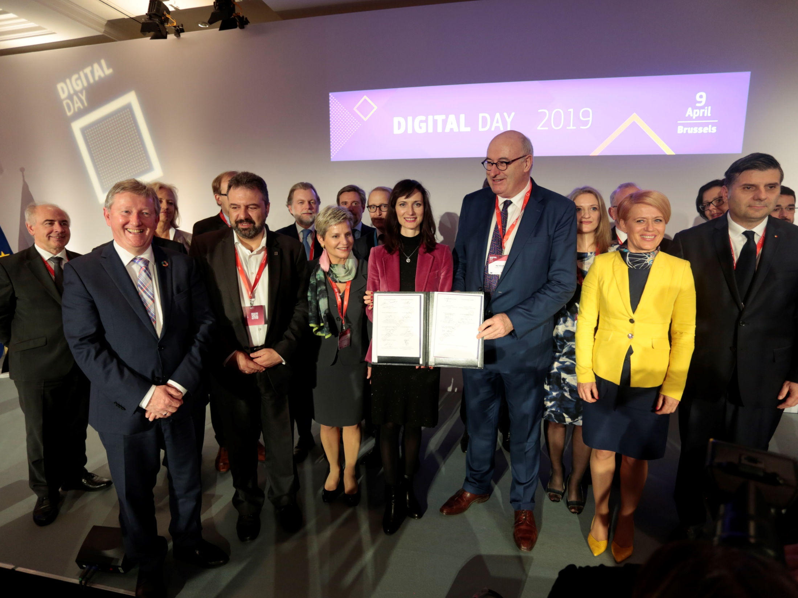
Notes:
The 2019 edition of Digital Day, on 9 April, also included a declaration and a panel discussion on digitalisation in agriculture and rural areas. By the end of the event, the declaration had been signed by 24 Member States. Bulgaria and Croatia will sign soon. Denmark is still considering. Malta declined.

Slide 6
Declaration of cooperation on ‘A smart and sustainable digital future for European agriculture and rural areas’
Research and innovation, especially in AI, but covering also socio-economic agronomic and environmental aspects
Adoption and deployment, including to support the CAP's transition towards a result-based policy and to build a strong smart agri-food sector
Pooling and sharing of agricultural data between farmers and throughout the food chain
Notes:
The new Declaration on ‘A smart and sustainable digital future for European agriculture and rural areas’ contains commitments to take action in three main areas: strengthening support for research, establishing an innovation infrastructure, and creating a European dataspace for smart agri-food applications.

Slide 7
Main priorities
SUPPORT FOR RESEARCH
resource efficiency, productivity, environment, bioeconomy
service delivery, quality of life, business opportunities, innovation capacities in rural areas
AI for agriculture
priority to solutions for family farm models
INNOVATION INFRASTRUCTURE
experimentation and testing facilities, AI4EU platform for AI on demand
agriculture in at least one DIH per MS, network agri-food DIHs and link them to general DIHs
up-skilling of farmers and rural populations
IoT (large-scale pilots, but also LPWAN), broadband
EIP-Agri (area of digital innovation), Smart Villages
COMMON AGRI-FOOD DATASPACE
cross-border pooling and sharing of agricultural data
identify and open up high value datasets, for common databases and AI-powered precision farming solutions
full use of European space programmes (EGNOS and Galileo) and the Earth observation programme
Notes:
The new Declaration is in line with and builds on the vision outlined in the Commission Communication on the Future of Food and Farming and on the actions and commitments laid down in the Commission Communication on Artificial Intelligence for Europe and in the EU Coordinated Plan on Artificial Intelligence.

Slide 8
Support for research
Investments in research and innovation in digital technologies
keep Europe at the forefront of progress in smart farming, by increasing investments at European and national levels in research and innovation in digital technologies, but covering also socio-economic agronomic and environmental aspects, and giving priority to artificial intelligence for agriculture and actions aimed at achieving improved food traceability through the use of blockchain technologies
Notes:
Under the pillar on establishing an innovation infrastructure, in the new Declaration the Member States have committed to helping the Commission to identify five large-scale reference experimentation and testing facilities for agri-food, in line also with the commitments made in the Coordinated Plan on AI.

Slide 9
Establishing an innovation infrastructure
Identifying five large-scale reference experimentation and testing facilities for agri-food
help the European Commission to identify at least five large-scale reference experimentation and testing facilities across Europe, in line with the actions we have agreed on in the Coordinated Plan on Artificial Intelligence, to serve as a common resource for all European stakeholders to validate new smart solutions in real settings and networking these reference sites with existing experimentation and testing facilities
Notes:
Under the pillar on establishing an innovation infrastructure, in the new Declaration the Member States have committed to helping the Commission to identify five large-scale reference experimentation and testing facilities for agri-food, in line also with the commitments made in the Coordinated Plan on AI.

Slide 10
Creating a Common European Data Space for smart agri-food applications
Facilitating the cross-border pooling and sharing of agricultural data between farmers and throughout the value chain
facilitate the cross-border pooling and sharing of agricultural data between farmers and throughout the value chain by promoting relevant platforms and databases
Identifying and opening up high value datasets for agriculture
identify, in collaboration with the Commission, and open up high value datasets in categories such as geospatial, environmental/climate/Earth observation and meteorological [...], in order to help develop common databases and to promote AI-powered precision farming solutions
Using the European space programmes and the Earth observation programme for agriculture
make full use of European space programmes (EGNOS and Galileo) and the Earth observation programme (Copernicus) for the accurate and efficient operation of unmanned aerial vehicles and autonomous agricultural machinery, and for data-driven decisions relating to agricultural operations
Notes:
Under the pillar on creating a Common European Data Space for smart agri-food applications, the signatory Member States have committed to creating a common European data space that would also cover smart agri-food applications, which is in line also with the commitments made in the Coordinated Plan on AI.

Slide 11
World class reference sites for experimentation and testing in real setting focusing on the applications of AI
Magdalena Szwochertowska
Policy & Programme Officer
Robotics & Artificial Intelligence
DG CNECT - EC

Slide 12
Definition (Coordinated Plan)
A Reference Testing and Experimentation Facility is a technology infrastructure that has specific expertise and experience of testing mature technology in a given sector, under real or close to real conditions (e.g. smart hospital, smart city, experimental farm, corridor for connected and automated driving, etc.).

Slide 13
AI & Digital Europe Programme (DEP): Capacity building & Deployment
CAPACITY: Technology infrastructure (DATA/ALGO/HW)
INDUST DATA
PSI
PERSO DATA
HEALTTH DATA
IOT
MACHINE LEARNING
NEUROMORPHIC
EXPLAINABLE AI
AI - EDGE
DATA ANALYTICS
CPS
NLP
ROBOTICS (lab2)
HMI
ROBOTICS(lab3)
COMPUTER VISION
ROBOTICS (lab1)
PERCEPTION
LARGE SCALE AI REF. TESTING*
FACILITIES
SMART CITY (city2)
SMART HOSPITAL (country1)
AGRI (country2)
SMART CITY (city3)
SMART HOSPITAL (country3)
SMART CITY (city1)
AGRI (country3)
SMART HOSPITAL (country2)
AGRI (country1)
* Only some examples, others include manufacturing, security, finance, etc
DEPLOY: DISTRIBUTION CHANNEL
DIH
DIH
DIH
DIH
DIH
DIH
DIH
DIH
DIH
DIH

Slide 14
Concepts
World-class Testing and Experimentation Facilities
Limited number per sector
Common resource available to all European stakeholders to validate new AI-based solutions in real settings.
Validate all the aspects: technical, socio-economic, legal
Results available to all throughout Europe (directly, or via the channel of Digital Innovation Hubs).

Slide 15
Concepts (details / examples)
No one size fits all
Adapted to the sector needs
Optimise efficiency and impact
Number & Localisation:
Economies of scale vs. easy access throughout Europe.
Criteria
Agriculture: representativity / accessibility
Healthcare: access to data, HPC, variability of social security systems
Regulatory environment

Slide 16
Digital Europe Programme Legal text
Co-investment with Member States in world class reference sites for experimentation and testing in real setting focusing on the applications of AI in essential sectors such as health, mobility, security, manufacturing or finance. The sites should be open to all actors across Europe and connected to the Network of Digital Innovation Hubs. They should be equipped with large computing and data handling facilities as well as latest AI technologies including emerging areas such as neuromorphic computing, deep learning and robotics.

Slide 17
Workshop on TEF in Agri-Food sector
Discussion on validation or proposals for use cases in the area of AI applications for Agri-Food:
When and where:
9th of January 2020 in Brussels
Participants:
Member States (AI working group)
MS experts from Agricultural/Digitalisation ministries
external experts, EC, potentially other EU bodies

Slide 18
Digital Innovation Hubs - AGROBOFOOD 39 partners, led by Wageningen University & Research Objectives: accelerate the digital transformation of the European agri-food sector through the adoption of robotic technologies establish sustainable network of DIHs involving all relevant European players. https://agrobofood.eu/

