Slide 1
Pan-European collaboration
Creating a European network of Digital Innovation Hubs
Digitalisation and New Technologies in AGRI-FOOD
Exploring synergies between Digital Innovation Hubs and Agri-food Partnerships
Potential synergies between networked DIHs and AF partnerships
Málaga, 04 Dec 2019

Slide 2
DIHNET.EU is about collaboration
“Creating a sustainable European network of DIHs, by developing a set of tools and boosting the collaboration of the different DIH networks, DIHs and other key DIH stakeholders in Europe”

Slide 3
How do we boost collaboration among DIHs in DIHNET?

Slide 4
1. Starting from the DIHs JRC Catalogue
Catalogue
Reinforcing Specialisation (WP4)
Activate collaboration and Communication (WP1)
DIH Maturity Assessment leading to inspiring cases
Active Collaboration/
Communication
Working Groups to make the EU DIH Community active and dynamic
To initiate the actual upgrade of the Catalogue in cooperation with DIHs.

Slide 5
How can you be part of the Catalogue?
1- Be part of a regional, national or European policy initiative to digitise industry.
2- Be a non-profit organisation.
3- Have a physical presence in the region and present an updated website
4- Have at least 3 examples of how the DIH has helped a company with its digital transformation referring to publicly available information.
A repository of DIHs- the Yellow pages
Fact-sheets with profile, contact data, service examples for regional, national, and EU-supported DIHs
Map-based search tool by country, evolutionary stage, technical competences, services provided, TRL, market sector
http://s3platform.jrc.ec.europa.eu/digital-innovation-hubs-tool

Slide 6
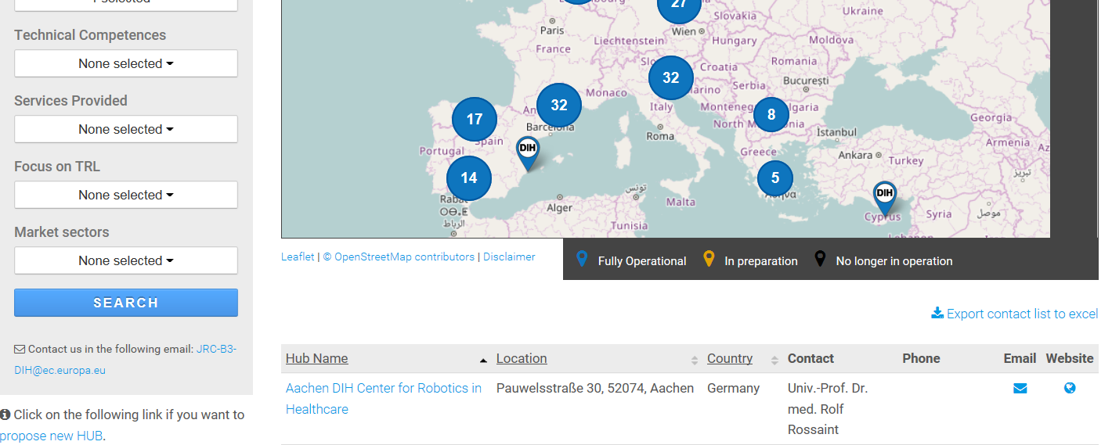
DIHs in the Catalogue & agrifood focused DIHs
Today: 523 published
(310 FO; 213 IP)
Register to the DIHNET.EU Community, the interactive community of the JRC DIH catalogue to find more information and to connect with other DIHs.
Last update 28th November 2019

Slide 7
2. Connecting on the DIHNET.EU Community
The DIHs Catalogue
DIHNET.EU Community
DIHNET Community is the facilitator (https://dihnet.eu/)

Slide 8
DIHNET.EU Community
DIHs can meet, exchange, cooperate, discuss, learn, get trained, informed, identify which of their missing expertise can be found in other DIHs across the EU, etc.
It has now 370 members (38/11/ 2019) and growing…
Joined by four key initiatives supporting DIHs: SmartAgrihubs, AIOTI DIH Network, DIH2, I4MS
3 agrifood focused DIHs already in our community & SmartAgrihubs
140 DIHs, 9 regionla clusters, 5 sectors, 28 flagship projects
https://smartagrihubs.eu

Slide 9
DIHNET.EU Community: a central information point for DIHs
Dynamic community of the JRC Catalogue
Get information;
Share your views;
Learn from others;
Facilitate alignment and synchronisation;
Offer common resources;
Select best practices;
Training activities;
Foster collaboration among Hubs.
Notes:
Dynamic community of the JRC catalogue: static information vs. information shared by DIHs for the DIHs.
Get information: about European Initiatives working in the field of Hubs, Networks of DIHs, events, trainings…Also about how to fill in the JRC catalogue application form correctly.
Share your views: we will be launching questions to be further discussed. For instance about the criteria to become a Fully Operational DIHs, it is easy to achieve? Are you missing something? Do you think a KPIs assessment tool for DIHs would be of interest? Offer feedback to EC activities.
Learn from others: by sharing your experiences. Asking for support, share your challenges.
Facilitate alignment and synchronisation: offering tools to the different stakeholders involved in the smart specialisations strategies…..
Offer common resources: templates for a coordinated communication approach that facilitates information sharing….
Select best practices: offer inspirational practical examples.
Training activities: community building
Foster collaboration among Hubs
In order to maximise the impact of the community and create a sustainable ecosystem that is active, and capable to share information, benefit from it and takes profit from all the available resources, FundingBox will organise different webinars in order to facilitate the use of the platform.

Slide 10
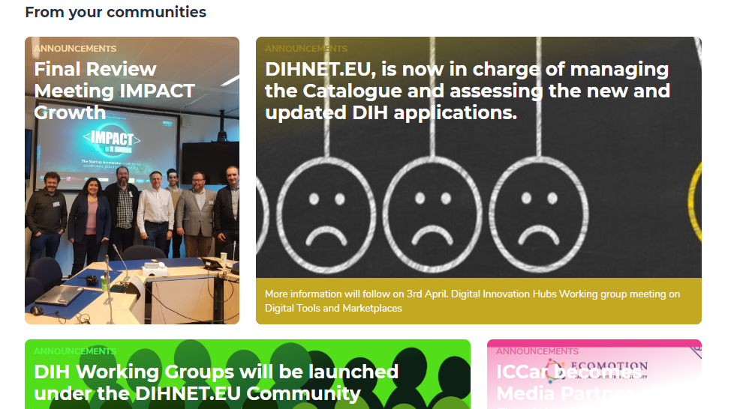
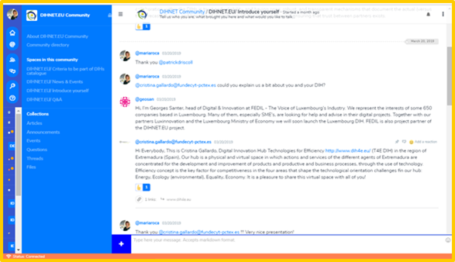
DIHNET.EU Community: how can we interact?
Join
4. Connect
5. Don’t miss anything!
2. Profile
3. Introduce yourself

Slide 11
DIHNET Community also offers
Private & public spaces. Each DIH can create a private space (subcommunity)
Check the Collections:
Know your ecosystem
DIHs related initiatives and projects
"DIHs Academy" focused on training and learning materials.
Targeted Working Groups: for interested DIHs in in-depth collaboration.

Slide 12
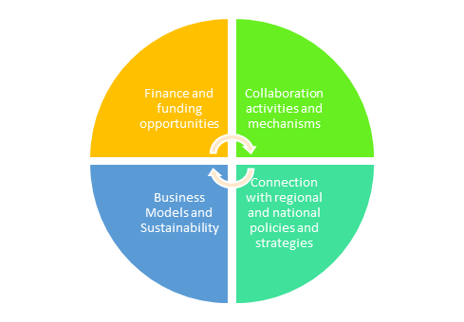
3. Taking part in the DIHNET Working Groups
To make the EU DIH Community active and dynamic; to foster continuous exchange of experiences and networking amongst DIHs and support cooperation with a unique focus, approach and common understanding.
Working Groups are providers of strategic information and evidence on needs, expectations, obstacles, gaps as well as inputs for policy making.

Slide 13
How can we create better impact and synergies between the AF partnerships and DIHNET?

Slide 14
Potential benefits
Agrifood Thematic Platform
DIHNET
The Agri-Food smart specialisation (S3) thematic platform provides an interactive and participatory environment to support interregional cooperation in this field in the context of S3.
These platforms intend to establish European ecosystems for transnational and interregional collaboration in regions and countries with similar or complementary S3 priorities.
The thematic platforms offer a structure to exploit synergies across partnerships and across sectors.
The investment opportunities generated by the S3P Agri-Food contribute to a more competitive and sustainable EU food supply chain, more resilient food systems, and to a more effective targeting of the EU regional funds.
Better alignment with DIHNET, which focuses on connecting DIHs and networks and the TP; e.g. through Working Group on Policies and strategies
Creating a Working Group on Agri-food under DIHNET Community with interested DIHs to better connect and take advantages from DIHNET
Support better cross-border cooperation for DIHs in the field (e.g. among regions that focus the same S3 priorities)
Better coordination and focus of funding (regional/national/EU/DIH ). DIHNET Working Group on Funding Opportunities.

Slide 15
Thank you!
We look forward to meet you under DIHNET.EU Community JOIN! www.dihnet.eu
Website: https://dihnet.eu/
E-mail: begona.sanchez@tecnalia.com

