Slide 1
UNESCO-UNEVOC
Skills for Innovation Hubs

Slide 2
Skills for Innovation Hubs – Project Context
UNEVOC Global Forum 2018, May 2018
Partner’s Previous Experiences Jun – Nov 2018
Trends Mapping on Innovation, Jun - Dec 2018
The Project – Skill for Innovation Hubs, Jan 2019

Slide 3
Skills for Innovation Hubs – Project Outline
Overall Objective
TVET institutions mainstream innovation in their strategic planning through a Innovation Framework
Specific Objectives
Co-develop and test the i-hubs innovation framework
Compile Innovative Practices
Design interventions to improve the i-hubs innovation capacity
Thematic Areas
Entrepreneurship, Digitalization and Greening
Timeframe
January 2019 – March 2020

Slide 4
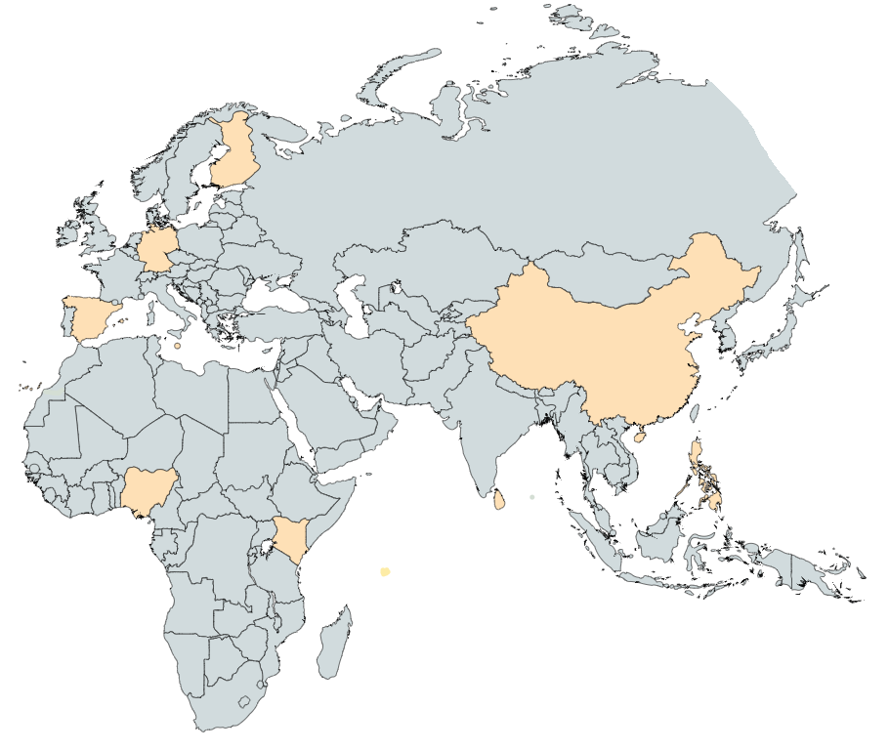
Skills for Innovation Hubs – i-hubs Project Partners
Europe
Asia – Pacific
Africa

Slide 5
Skills for Innovation Hubs – The Innovation Framework
Innovation
Substantial change in the way TVET is practiced by an institution, making it progressively more relevant to its economic, social and environmental context.
Innovation Leverage Potential
Organizational Practices
Teaching and Learning Processes
Products and Services
Skills and Innovation Ecosystem
Commitment to Skills Development
Dimensions
Leadership and Organisational Practices: strategy and planning, internal processes, human and financial resources, communication.
Teaching and Learning Processes: open and distance learning, ICT technologies, apprenticeship.
Products and Services: applied research, technological development, prototyping.
Skills and Innovation Ecosystem: Advocacy and external monitoring; networking; external engagement; internationalization.

Slide 6
Skills for Innovation Hubs – The Innovation Framework
Guided Self-Assessment
Outputs
Innovative Practice
Innovation Action Plan
Balanced Scorecard
Skills and Innovation Ecosystem Map
Recommendations to the i-hubs Innovation Framework
Peer Review
i-hub Peer Reviewer
Periodic Review
Notes:
Analysis/OECD SME Policy Index – Balanced Scorecard
Tools for Policy Impact – Skills and Ecosystem

Slide 7
Skills for Innovation Hubs – i-hubs + CoVEs
A network of TVET institutions pursuing the path of innovation;
A solid methodology for data collection on innovation in different settings/dimensions;
A comprehensive tool to map the TVET institutions’ skills and innovation ecosystem;
Innovative practices with a concrete set of “transferable” features and respective enabling conditions.
Provision of non-traditional services (TRL 4 – 7);
Multi-stakeholder coordination platform.

Slide 8
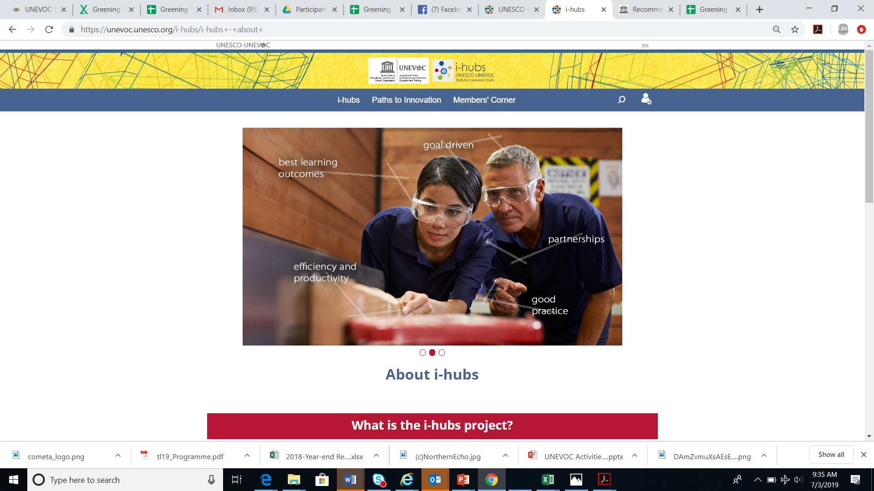
Skills for Innovation Hubs – Resources
i-hubs Innovation Framework - working draft
i-hubs Brochure
UNEVOC Trends Mapping Study of – Innovation in TVET
Project website
https://unevoc.unesco.org/i-hubs
Innovative Practices at a Glance
The i-hubs Team @ UNEVOC in collaboration with the i-hubs Project Partners
Wilson Lima Junior and Kenneth Barrientos
unevoc.i-hubs@unesco.org

