Slide 1
Vocational excellence and smart specialisation: support by ERDF Laurent de Mercey Unit G1 - Smart and Sustainable Growth DG Regional and Urban Policy

Slide 2
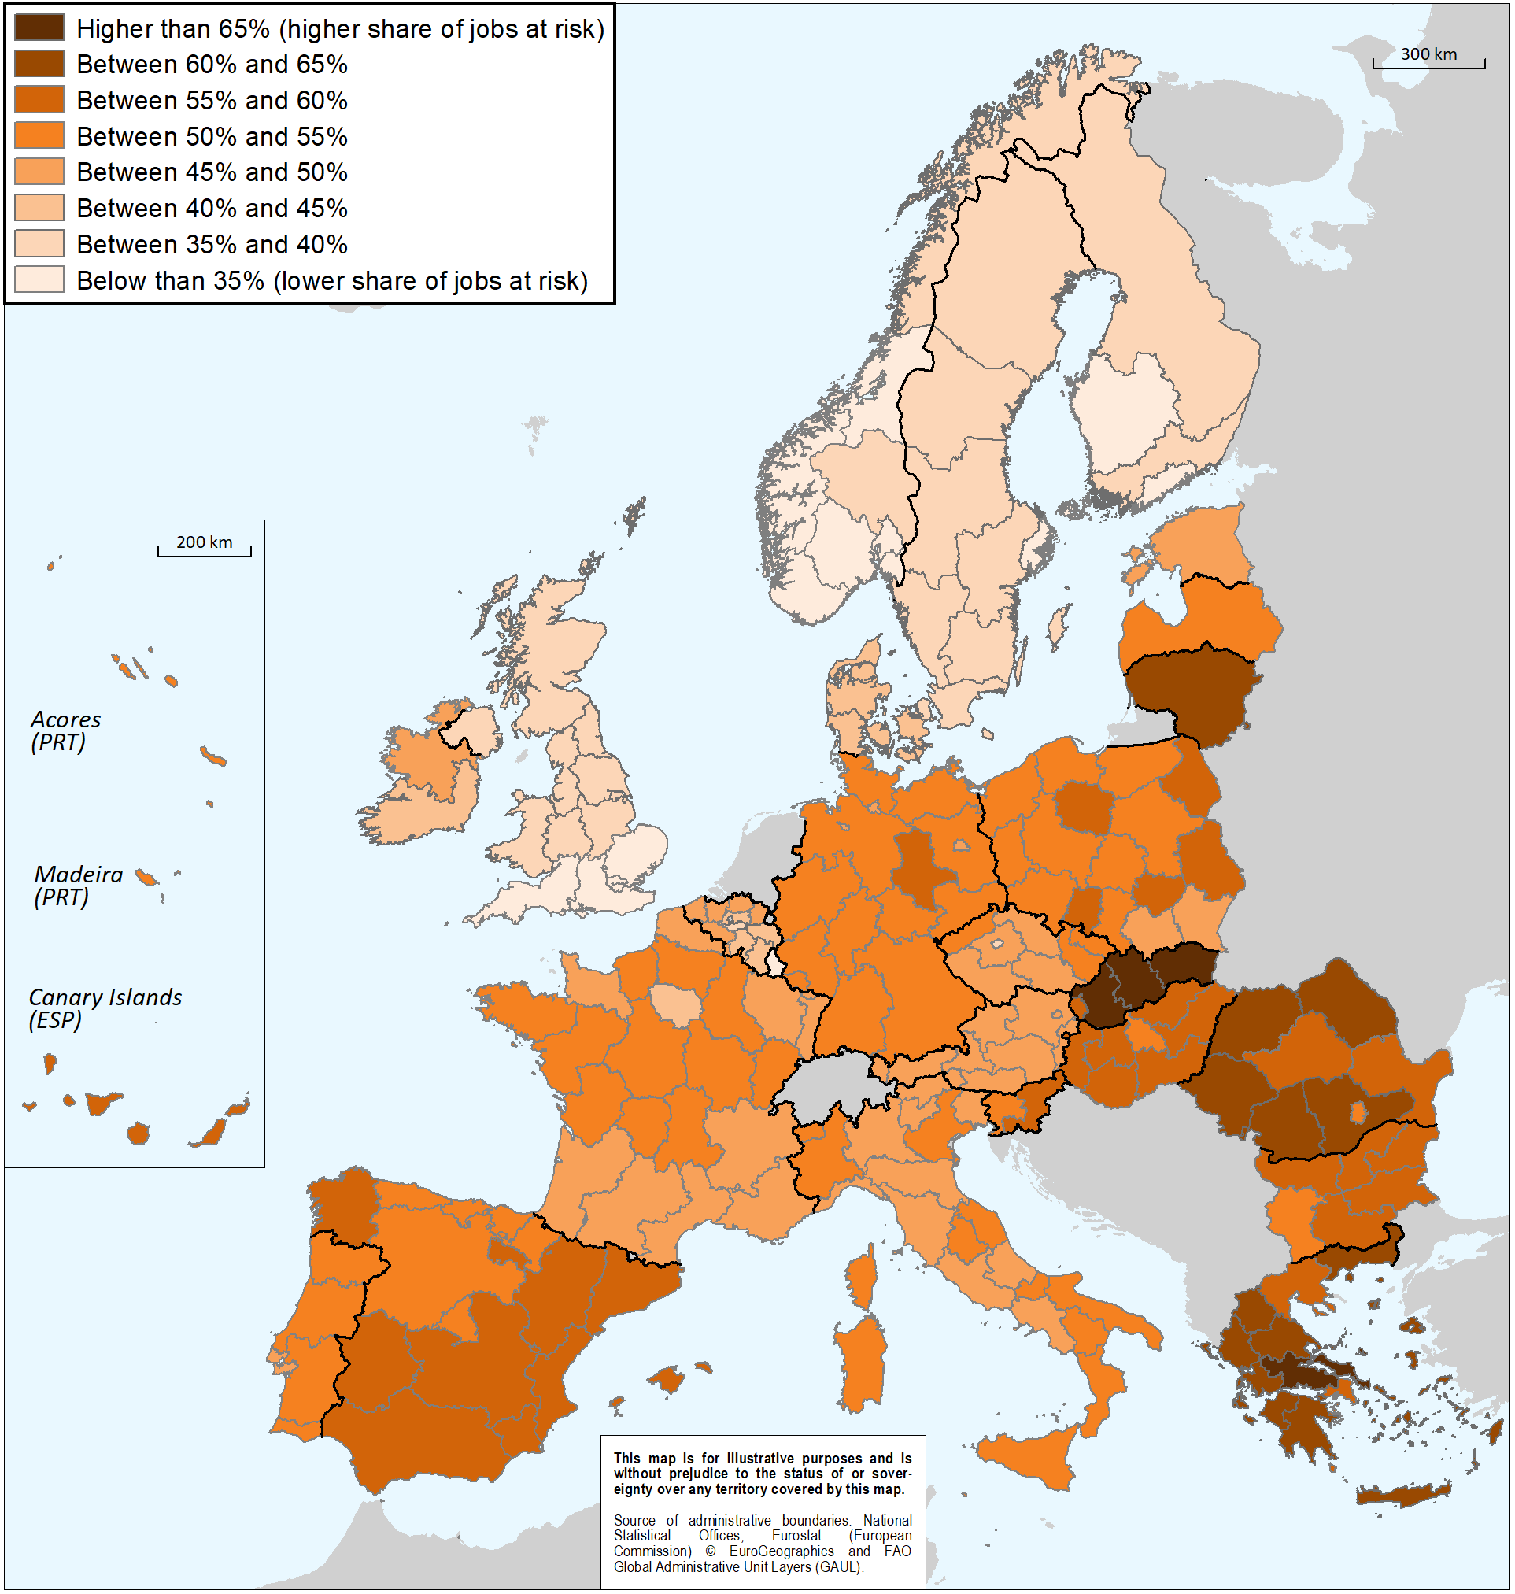
Key issues for regional skills ecosystems
The supply of high skills needs to match the specific needs of EU territories.
For the development of skills which will enable the diffusion of innovation and industrial transformation, closer cooperation between education, business and wider society is crucial.
Skill development should be considered as integral part of developing and implementing national or regional smart specialisation strategies.

Slide 3
2021-27 Cohesion Policy Objective 1: A smarter Europe 4 specific objectives supported by ERDF, 1 enabling condition
Smart Specialisation Strategies
Enhancing R&I capacities + uptake of advanced technologies
(SO 1)
Digitisation for citizens, companies and governments
(SO 2)
Developing skills for smart specialisation, industrial transition and entrepreneurship
(SO 4)
Growth and competitiveness of SMEs
(SO 3)
Interregional cooperation in value chains

Slide 4
Scope of support from ERDF
The ERDF shall support (Art. 4 of ERDF Regulation proposal):
investments in infrastructure;
investments in access to services;
productive investments in SMEs;
equipment, software and intangible assets;
information, communication, studies, networking, cooperation, exchange of experience and activities involving clusters;
technical assistance.
In addition, the ERDF shall support:
productive investments in enterprises other than SMEs when they involve cooperation with SMEs in research and innovation activities supported under PO1 – SO1
training, life-long learning and education activities in order to contribute to PO1 – SO4 (development of skills for S3, industrial transition and entrepreneurship)
Notes:
Not eligible:
Operating costs (except in the outermost regions)
Funding undertakings in difficulty
Checks for selection of projects include (Art. 67(3) CPR):
verify that the beneficiary has the necessary financial resources and mechanisms to cover operation and maintenance costs;
consistent with the corresponding strategies and planning documents established for the fulfilment of enabling conditions

Slide 5
Investment priorities
ERDF investments under PO1-SO4 (development of skills…) should focus on the smart specialisation priority areas identified in the process of entrepreneurial discovery.
The following types of actions can be supported:
Innovation management in SMEs
Skills for (training, re/upskilling) within firms
Integration of education and training institutions in technology diffusion ecosystems
Skills for higher education to increase commercial viability
The following should not, except under specific conditions, be a priority for ERDF investment:
- training for horizontal skills which are not an integral part of the regional or national smart specialisation strategy;
- activities falling within ESF+ remit (in policy areas of employment, education, social inclusion and health)

Slide 6
Integration of education and training institutions in technology diffusion ecosystems
Strengthening the integration of education and training institutions including high education and centers of vocational excellence within national and regional innovation, technology diffusion and skills development ecosystems.

Slide 7
Example: Region Värmland (SE) Academy for Smart Specialisation
Värmland is faced with low innovation capacity among SMEs (skills gap)
The Academy will help the Region to implement its S3, by improving the links between the education and business sectors in the various areas of regional specialisation.
Knowledge from research will be fed into training courses.
A new multidisciplinary competence centre on Industry 4.0 called “Smart Adaptive Factory” is about to be launched.

Slide 8
Thank you!

