Slide 2
200+

Slide 4
35 COMPANIES
400-600 STUDENTS
50 TEACHERS

Slide 5
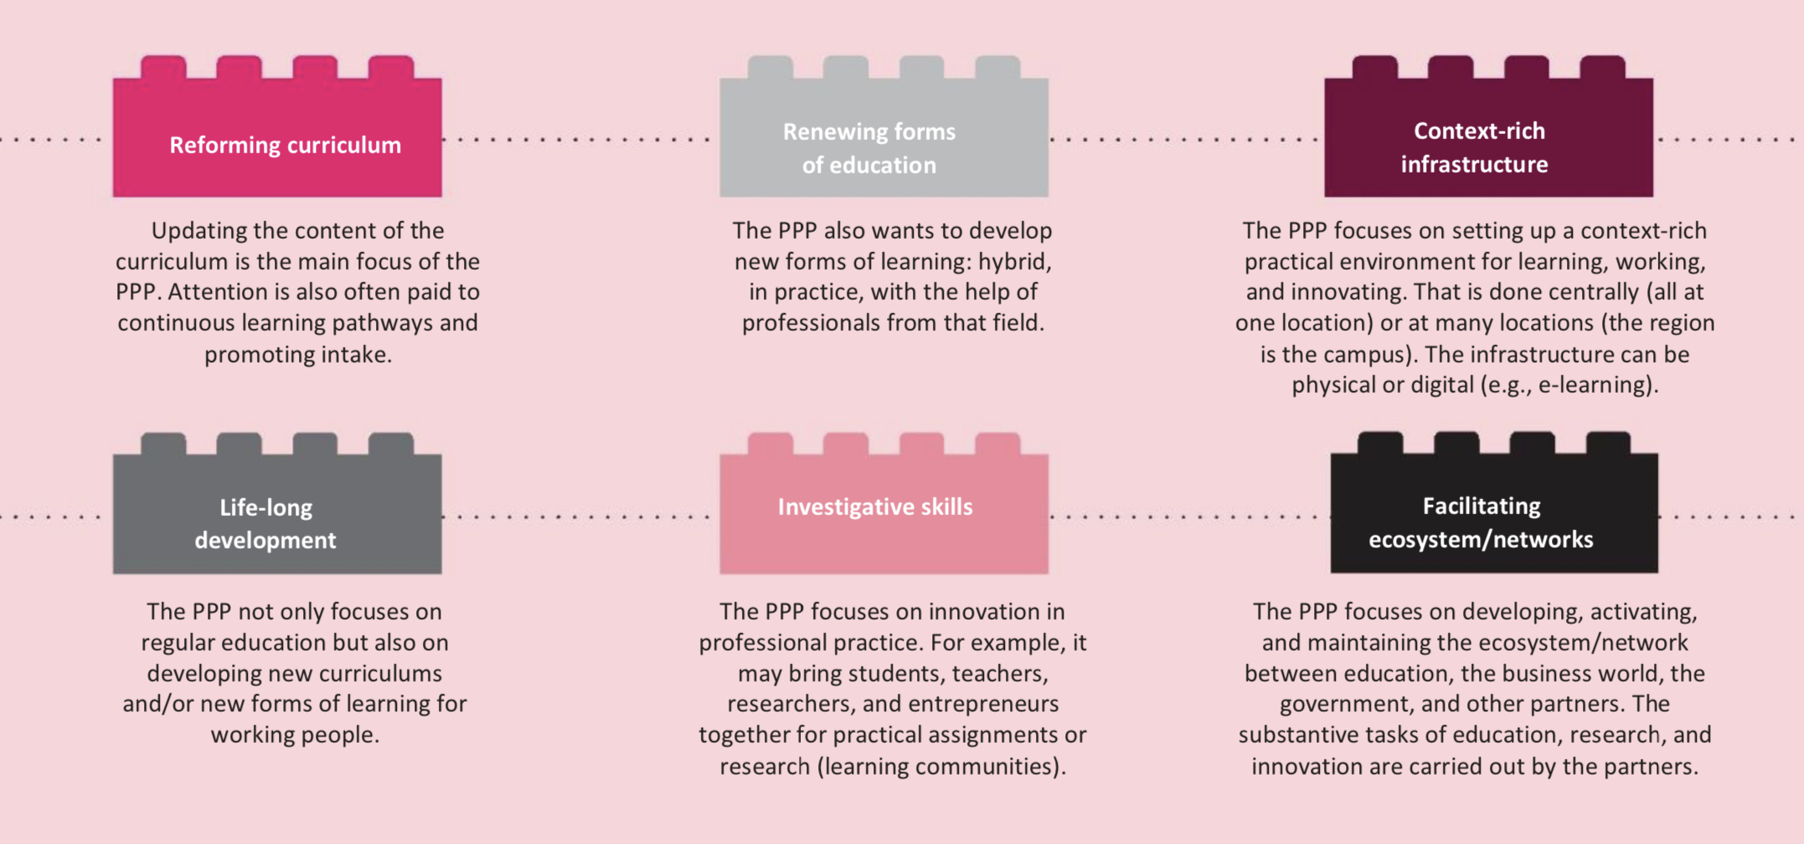

Slide 6
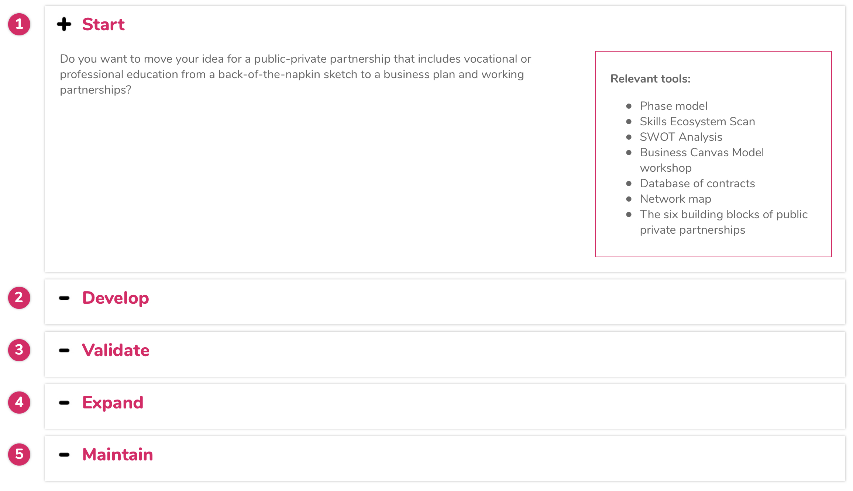

Slide 8
WE ARE ON THE MOVE
DO YOU move with us?
WeareKatapult.eu
hallo@WIJZIJNKATAPULT.NL

