Slide 1
Workshop on Vocational Excellence and Smart Specialisation
Brussels, 30 January 2020
By Georgios Zisimos

Slide 2
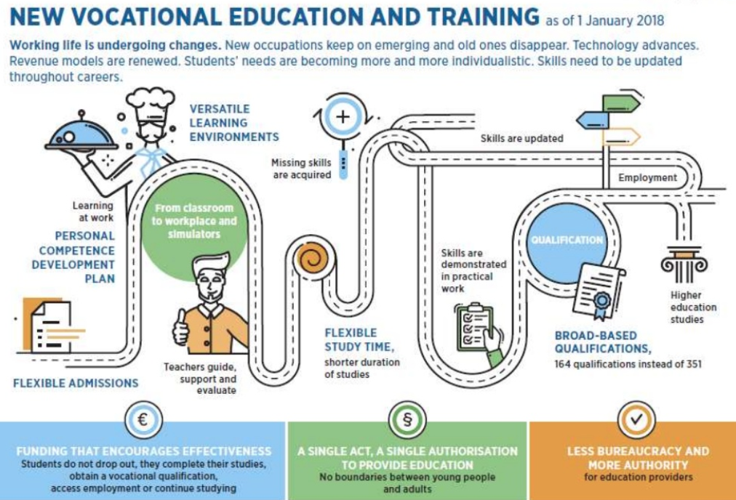
Centres of vocational excellence as engines for VET development

Slide 3
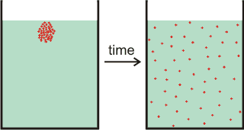
Diffusion of excellence
CoVEs (or regional vocational centres, or whatever term is used) can play a part in wider systemic VET reform, whether regional, national or transnational.

Slide 4
Overcoming isolation
Our analysis shows that most CoVEs are not connected with other CoVEs outside their region or country.

Slide 5
Different rationales behind CoVEs
Our analysis confirms that different countries are using CoVEs to pursue different strategies and it can help policy-makers to consider some of the choices and trade-offs they must confront.

Slide 7
ETF has selected 17 partner countries to invite them to join its international Network (ENE)
Israel
Turkey
Russia
Kazakhstan
Algeria
Morocco
Jordan
Ukraine
Belarus
Moldova
Armenia
Azerbaijan
Georgia
Serbia
Montenegro
Albania
N. Macedonia

Slide 8
Building Up a Registry of CoVEs
The 17 countries will be invited to provide information about CoVEs that function in their countries and they fulfil certain criteria.

Slide 9
Selecting CoVes for ENE
We shall apply 3 criteria for selection:
Endorsement by the country
What and How
Commitment

Slide 10
What are the expected outputs from ENE
Partnerships
Peer learning
Tools

Slide 11
Deliverables for 2020 – Looking for areas of interaction
Set up and launch the Network (ENE)
Make partnerships happen
Produce research and publications
Create a Registry of CoVEs
Develop Research Instruments

Slide 12
Focus on partnerships – what actions do we foresee
Design an action plan, with objectives, activities, responsibilities and time schedule to be carried out by the partnership members throughout 2020.
Investigate opportunities for peer learning activities (PLA) among members.
investigate the production of some kind of tool i.e. a training module, a planning tool or some instructional materials.
Identify and propose relevant opportunities to make applications for EU and other national and international Programmes and schemes, such as Erasmus+, E-Twinning, TAIEX calls.
Explore opportunities linked to Mobility/Learning agreements offered by the EU (and beyond).
Partnerships, “groups of CoVEs sharing common interests” are central to efforts of CoVEs to achieve excellence.
Typically, CoVEs build and engage in partnerships in order to use resources efficiently, to attract high quality teachers and trainers and to produce tools and innovative curricula in niche economic areas.

Slide 13
What and How? How partnerships happen …
The EU provides funds for the establishment and development of transnational platforms of CoVEs.
Platforms are formed by CoVEs, which :
share a common interest in specific sectors or trades (aeronautics, e-mobility, healthcare, tourism, etc.) or
develop together innovative approaches to tackle societal, technological and economic challenges (climate change, digitalisation, artificial intelligence, sustainable development goals, integration of migrants, upskilling people with low qualification levels, etc.)
The ETF Network will support partnerships in the following areas:
Adult education and training
Digitalisation
Smart specialisation
Green skills to achieve the 2030 SDGs
Employers engagement
Autonomy

Slide 14
Example: Looking into Autonomy – research module (work in progress)
 | Entirely a matter for the CoVE to decide | CoVE has great influence but formally may require approval from external bodies | Decision is largely made by external body but CoVE may have some influence | CoVE has no influence upon the decision
Autonomy in terms of staffing
Recruitment of permanent teachers and instructors for initial VET programmes.
Recruitment of fixed term contract teachers and instructors and administrators
Recruitment of part-time teachers/staff for continuing/adult VET programmes.
Promotion of staff.
Moving and dismissal of staff.
Academic autonomy
Recruitment of students for initial VET programmes.
Recruitment of students for continuing/adult VET programmes.
Development and introduction of own VET programmes.
Adjustment of centrally developed VET programmes (e.g. pedagogy/content/structure/timing to local needs/special industry needs).
Delivery approach (mix of work-based and school-based learning for VET programmes).
Financial autonomy
Use of budget for infrastructure (e.g. buildings).
Use of budget for equipment and materials (e.g. computers, textbooks).
Procurement procedures for most of the materials and equipment.
Salaries of staff.
Setting fees for VET programmes.
Generation of own funds (e.g. through production units).
Use of internally generated funds.
Planning and organisation
Annual or multi-annual objectives.
Annual or multi-annual work programme.
Internal quality management system (e.g. self-evaluation).
Organisational structure of the CoVE.

Slide 15
Thank you for your attention
Visit our page in:
https://openspace.etf.europa.eu

