Slide 1





Slide 2











Students and learners
Fund personal development
EIF
European Investment Fund
Enterprises investing in skills
Funding gap
Invest in their workforce upskilling
We support SMEs and key policy objectives of the EU by facilitating access to finance
Organisations supplying education and training
Fund their business needs,
expand their business
Notes:
Animation: first EC, GAPS, eif

Slide 3


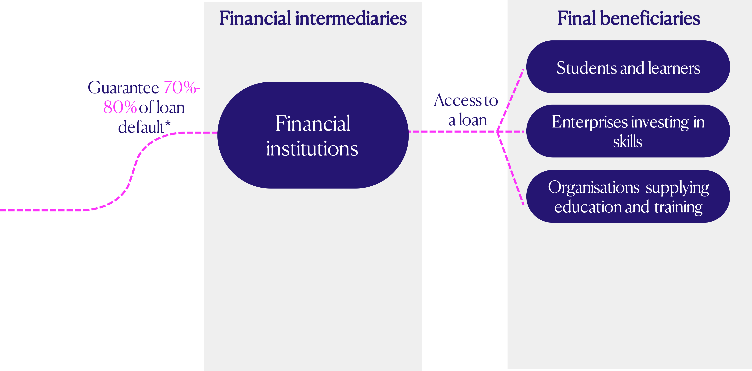




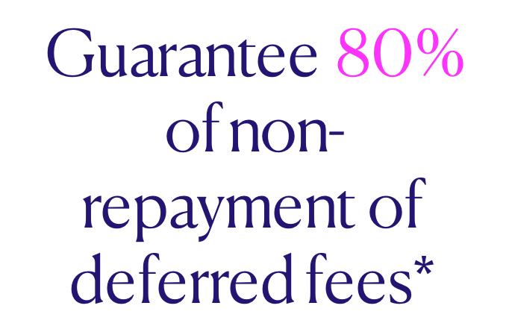


Financial intermediaries
Final beneficiaries
Students and learners
Guarantee 70%-80% of loan default*
Access to
a loan
Financial
institutions
Enterprises investing in skills
EIF
European Investment Fund
Organisations supplying education and training
Organisations supplying education and training
Guarantee 80% of non-repayment of deferred fees*
Access to deferred payment of fees
Students and learners
We share risks with our partners to incentivise lending
* Capped up to 25% of the portfolio
Notes:
SBM Comment: Please check if a CoVE is a Vocational Tranning Centre- CoVE (centre for Vocational Excellence) was the terminology I found online
LN: see comments in previous slide
Notes:
=> Overall benefit of this mechanism greater availability of financing => greater access to finace

Slide 4


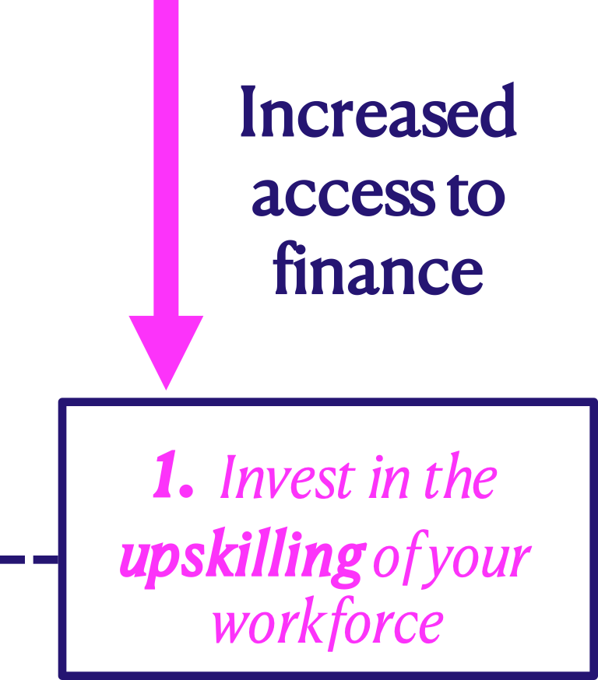









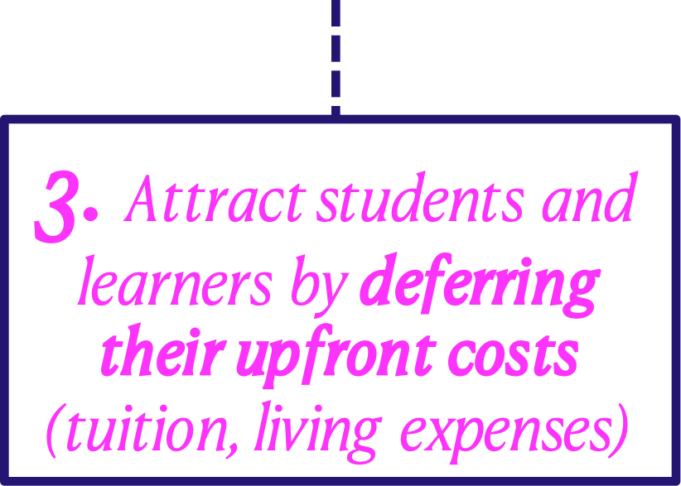
Increased access to finance
1. Invest in the upskilling of your workforce
2. Finance your business’ needs, expand your business or finance an educational project
3. Attract students and learners by deferring their upfront costs (tuition, living expenses)
Notes:
SBM Comment: Please check if a CoVE is a Vocational Tranning Centre- CoVE (centre for Vocational Excellence) was the terminology I found online
LN: see comments in previous slide
Notes:
=> Overall benefit of this mechanism greater availability of financing => greater access to finace

Slide 5


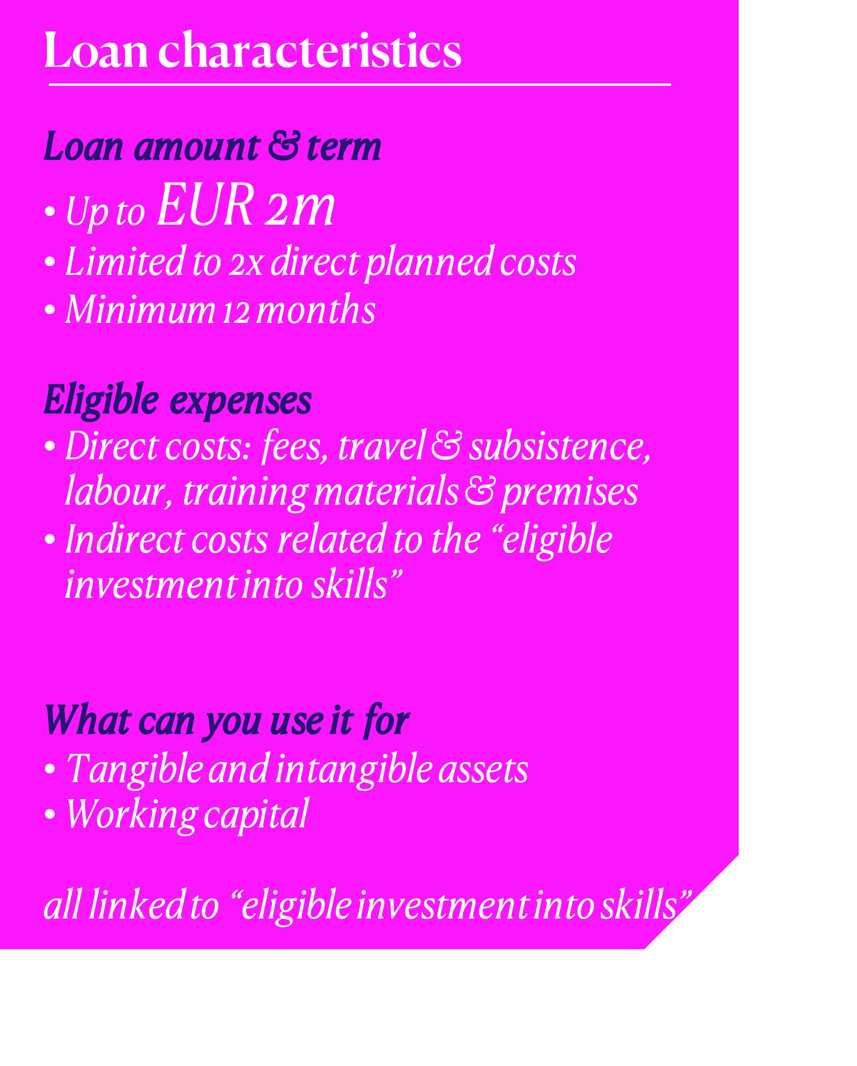
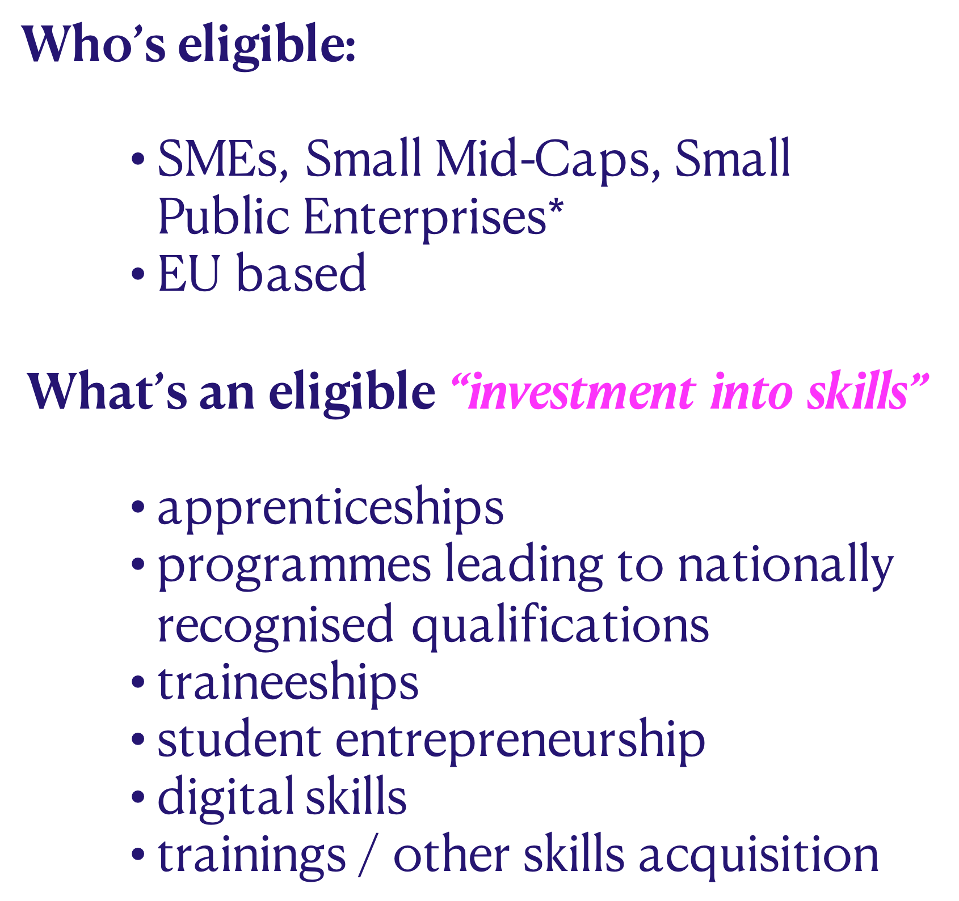


Notes:
Karen, overall note: in these 3 slides I didn’t highlight too much certain information as most of it is cumulative (so all should be highlighted) and the slides are already fairly texty. Instead I tried to simplify the text, increase font size and spacing. See what you think.

Slide 6



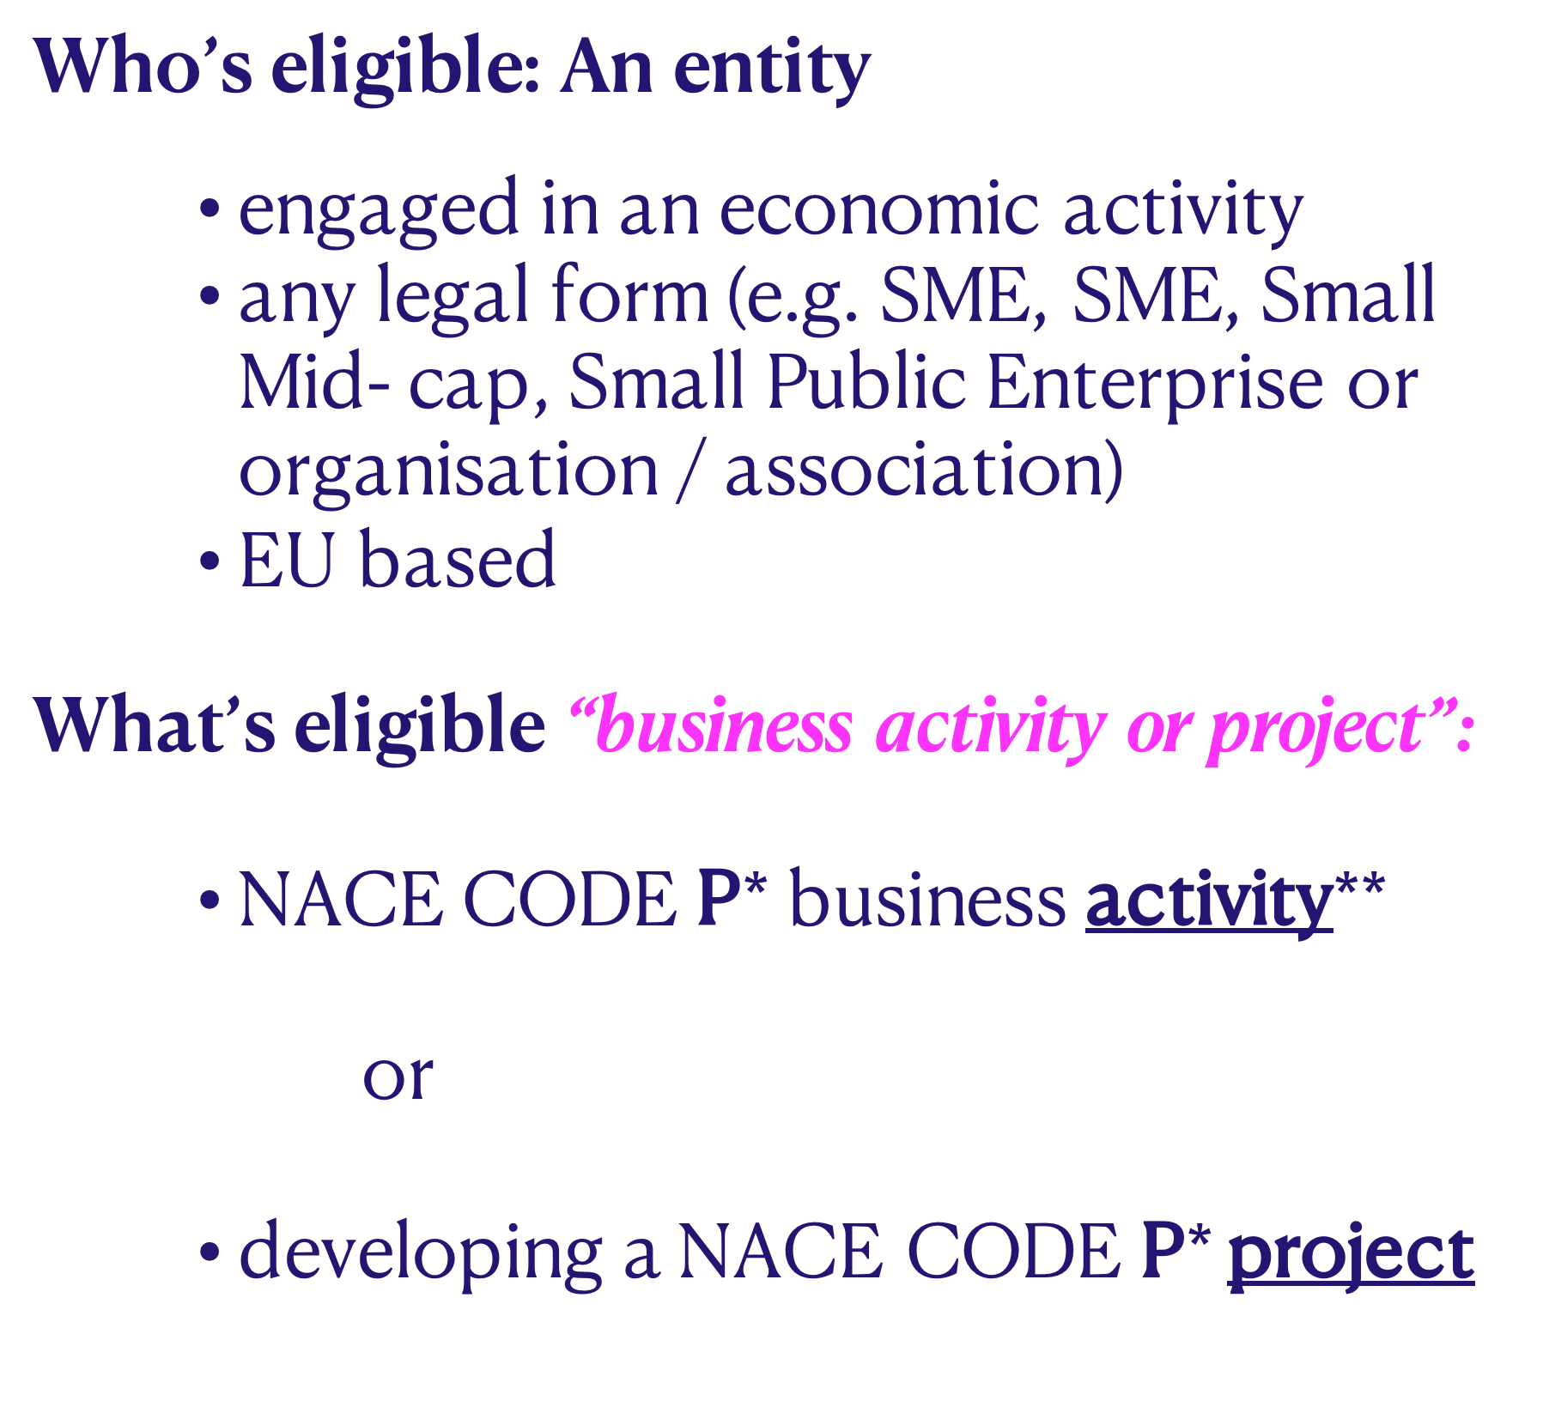
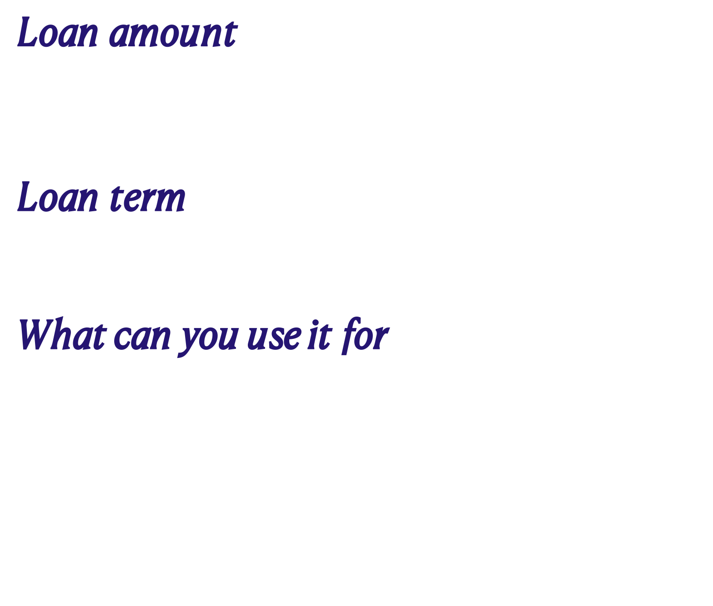

Slide 7




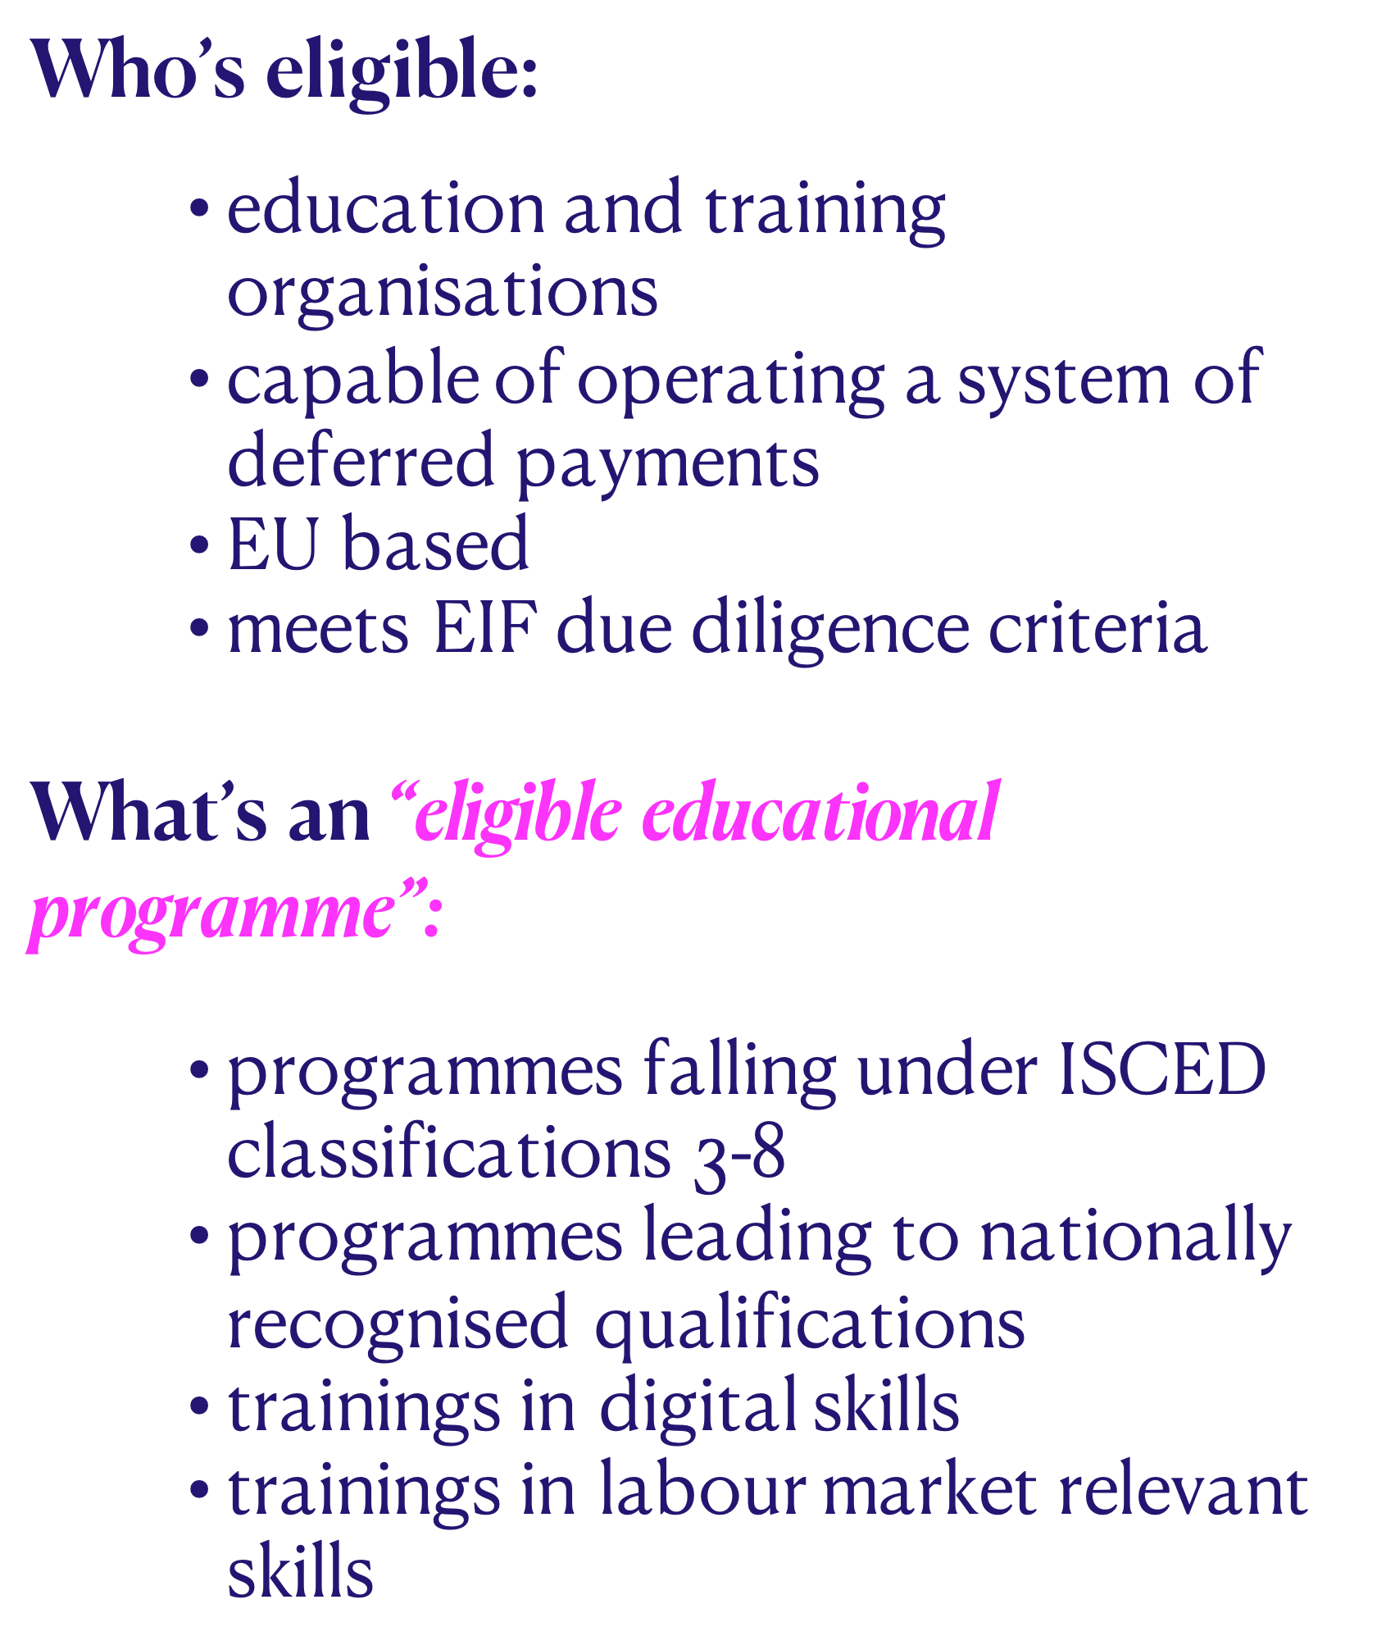
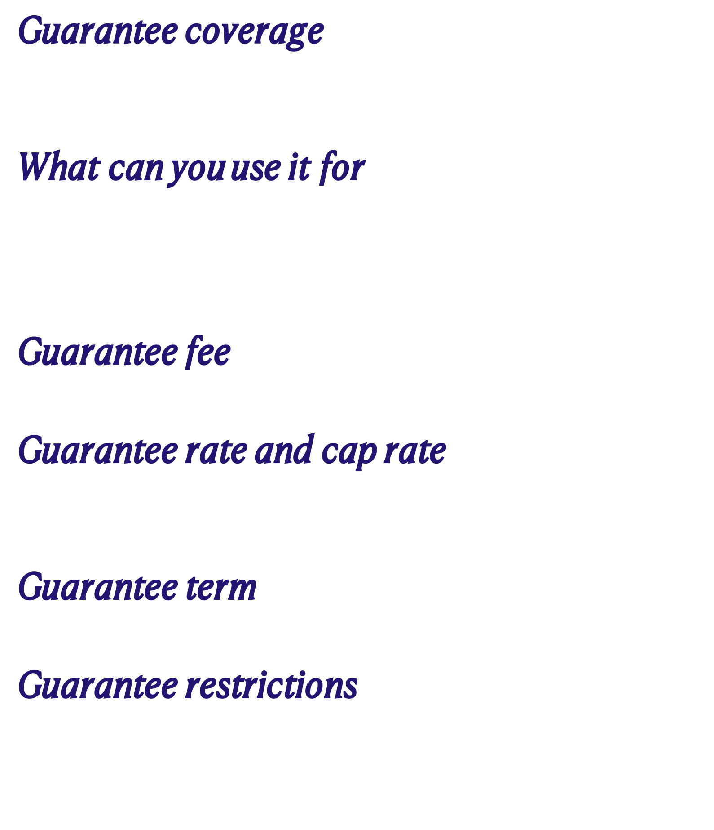
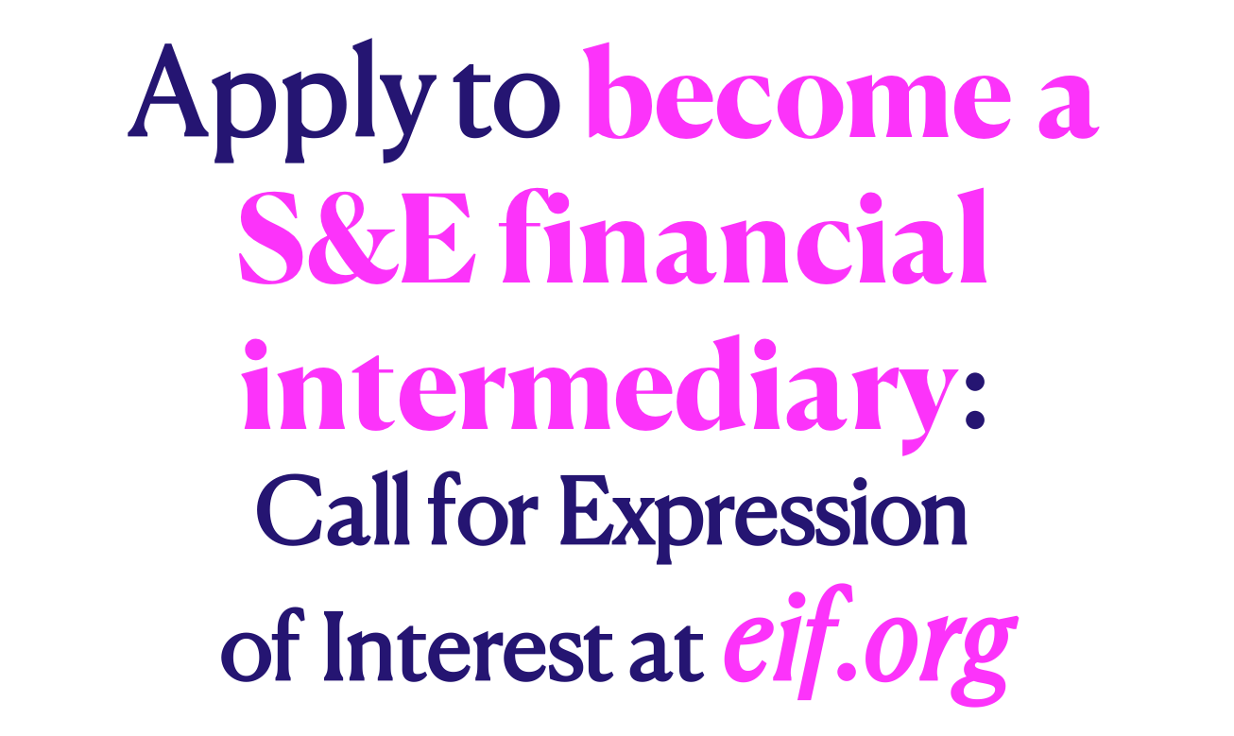
Notes:
Karen, overall note: in these 3 slides I didn’t highlight too much certain information as most of it is cumulative (so all should be highlighted) and the slides are already fairly texty. Instead I tried to simplify the text, increase font size and spacing. See what you think.

Slide 8








