Slide 1
Industrial Transitions
Workshop on Vocational Excellence and Smart Specialisation
Jonathan Barr
Head of Unit
OECD Centre for Entrepreneurship, SMEs, Regions, and Cities
30 January 2020
Twitter: @Jonathan_Local

Slide 2










OECD Centre for Entrepreneurship, SMEs, Regions and Cities @ a Glance
Regional Development Policy Committee + 3 WPs
Statistics
(regional, metropolitan, well-being)
Working Party on SMEs and Entrepreneurship
Multi-Stakeholder Engagement
(political and technical)
Tourism Committee + 1 Working Party
Local Economic and Employment Development (LEED) Programme
LEED Forum for Local Development Practitioners, Entrepreneurs & Social Innovators
Champion Mayors for Inclusive Growth
Roundtable of Mayors and Ministers
Thematic work
(culture, global events, entrepreneurship, social innovation)
Trento Centre
(spatial productivity, capacity building)
Thematic work
(megatrends, investment, sustainability, value chains, trade, transport, skills, digitalisation)
SME financing
(Scoreboard, OECD/G20 High Level Principles)
Thematic work
(digitalization, women entrepreneurship, productivity, GVCs, business transfers)
Thematic work
(subnational finance, multi-level governance, land use, green growth, migration)
Country and local reviews
(national, urban, rural, metro, MLG, etc. )
Country reviews
(Local Job Creation, HEInnovate, social ent., social inclusion)
Statistics
(Global Forum on Tourism Statistics, Tourism Satellite Account, trade)
National & local tourism reviews
SME and entrepren. country reviews
Water Governance Initiative
Venice Office
(culture, creative sectors)
SME Strategy
Monitoring tourism trends and policies

Slide 3
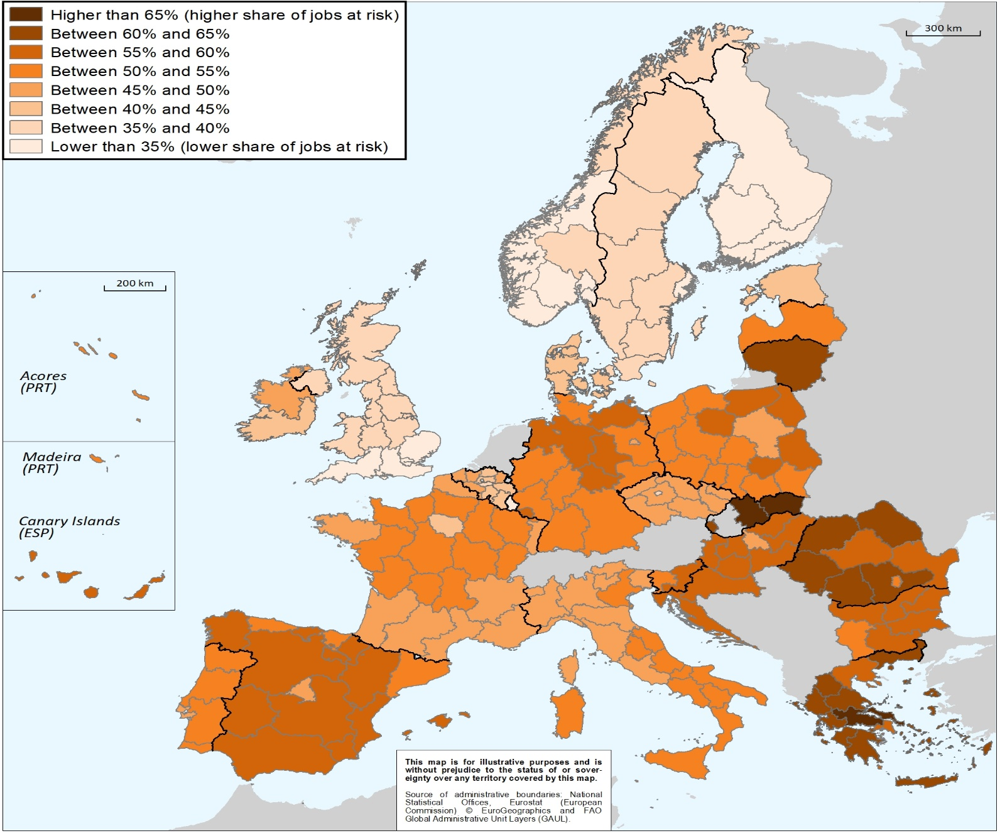
Some regions are more at risk of automation

Slide 4
Industrial transitions may come with increased job polarisation: Example of Sweden, 2000-17
Source: OECD Calculations based on EU Labour Force Survey
Notes:
High Middle Low
Småland with Islands 21 64.9664 -29.215 18.39899
South Sweden 22 147.2915 -22.8547 37.3463
East Middle Sweden 12 109.9468 -33.8949 32.2491
North Middle Sweden 31 39.1125 -23.9196 12.91454
West Sweden 23 142.2118 -15.0718 68.1851
Sweden 1 772.2221 -147.243 262.5008
Central Norrland 32 23.28107 -7.14689 0.90649
Stockholm 11 214.1299 -10.3442 84.8853
Upper Norrland 33 31.28212 -4.79575 7.61496

Slide 5
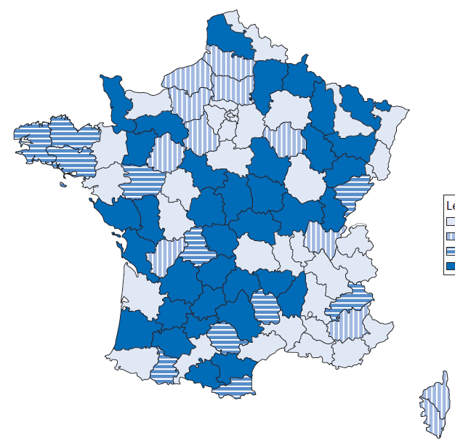
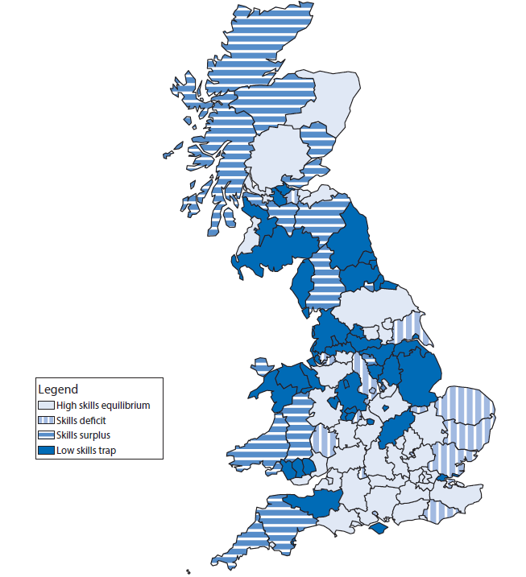
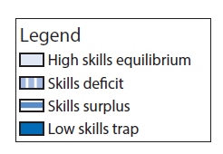
These trends could amplify place-based skills mismatches
France
United Kingdom
Notes:
The challenge with much of the data and information that is available to policy makers on whether skills are being put to good use is that it is focused on the individual worker.
Much of the data available focuses on whether an individual is well-placed within their job or company.
It does not tell policy makers much on overall local and regional performance, nor does it provide sufficient information on the perspective of employers.
While more will need to be done to develop information on the employer perspective, the OECD has developed a typology to understand whether skills are being put to good use at the level of local economies. This analysis assesses the supply of and demand for skills at the local level

Slide 6
What can policy do to support a successful transition?
Supply the right skills for new and emerging activities
  Better anticipating skills needs
  Engaging local firms to understand their needs
Supporting workers in transition
  Support vulnerable individuals (e.g. mid-career workers)
  Integrating disadvantaged groups
Investing in new sources of growth and employment
  Providing supports to firms to become more innovative
  Encouraging knowledge-exchange and cooperation
Creating adequate coordination and financing mechanisms
  Fostering good partnerships on the ground
  Ensuring adequate carrots and sticks

Slide 7

For more information
To discuss OECD’s work on local employment and skills:
Jonathan.barr@oecd.org
To learn more about the OECD’s Centre for Entrepreneurship, SMEs, Regions and Cities: http://www.oecd.org/cfe/
Twitter: @oecd_local, #OECDlocal
42

