Slide 1
EIT Manufacturing and TVET
P.Fantini & R. Pittschellis / EIT Manufacturing

Slide 2
EIT Manufacturing and TVET
EIT Strategy is aiming clearly towards academic education:
Master / PhD Schools
Entrepreneurial thinking to students
Innovation in the knowledge triangle Industry – Research – Education (=Universities)
However, manufacturing takes place in factories, and most of the people working there have a vocational background!
To master the 4. industrial revolution we have to train the existing and future workforce on the shopfloor, too!

Slide 3
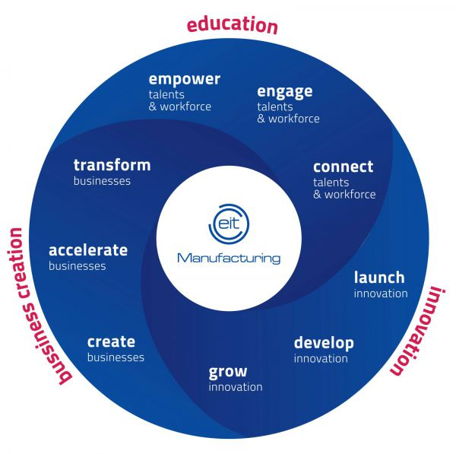
Our Strategic Objectives
30% of budget
STRATEGIC OBJECTIVES
Excellent manufacturing skills and talents
Efficient manufacturing innovation ecosystems
Full digitalisation of manufacturing
Customer-driven manufacturing
Socially sustainable manufacturing
Environmentally sustainable manufacturing
30% of budget
40% of budget

Slide 4
Education Pillar of EIT Manufacturing
Education Strategy rests on three pillars
Empower Program
Bachelor/Master/PhD programmes
Professional trainings at workplace
Professional training around workplace
Connect program
Guided Learning Platform
Create Nuggets
Interact with Learning / Teaching Factories
Engage Program
Engage Society
Engage Pupils
Cross-Industry Engagement

Slide 5
Example: Guided Learning Platform
Short digital learning units, delivered online free of charge (nuggets)
Courses consists of several nuggets
Nuggets made by the partners
Modular approach allows easy adaptation to different target groups
Supports workforce (academic and TVET!) at the workplace!
Supports professional trainings, too

Slide 6
Example: Learning and Teaching Factories
Learning Factory:
Model of a real factory line to perform realistic training in a school
Learning Factories are used in academia and vocational schools (sometimes the very same installations)
will be integral part of our professional training program
Teaching Factory:
students solve real problems from factories by means of web conferencing (no need to be in the factory)
Teaching Factories bring practice into schools, can be adapted to TVET
Teaching Factories bring more theoretical knowledge to workers on the shopfloor.

Slide 7
Example: Learning Factories I 4.0 in Baden Württemberg
Baden Württemberg wants to ensure competitiveness of ist industry
Investments in Learning Factories I4.0 in 30 vocational schools!
Schools had to prepare a concept including:
Support for local SME
Professional training
Education of apprentices

Slide 8
Thank you

