Slide 1
Broad-based Innovation
Dimitrios PONTIKAKIS
JRC.B3 Territorial Development
dimitrios.pontikakis@ec.europa.eu
Brussels, 30 January 2020
* VIEWS ARE PERSONAL *

Slide 2
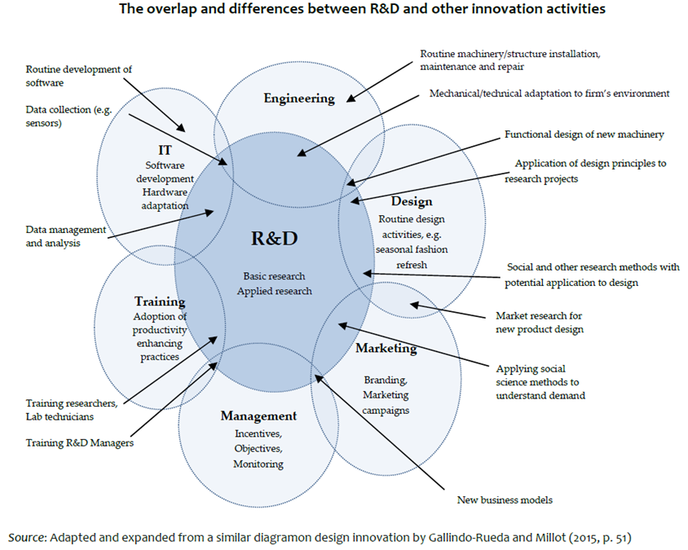
Broad-based innovation: R&D and non-R&D innovation activities
Source: Pontikakis, D. (work in progress ), Business Innovation: What it is, how to measure it and how to get more of it.
Notes:
Non-R&D innovation are especially important for firms in services sectors and for firms engaging in new-to-the-firm and new-to-the-market innovation
Non-R&D innovation activities tend to be assumed away in much contemporary literature, they are not costless nor fully responsive to changes in market prices
Empirical studies find that non-R&D innovation activities produce spillovers, correlate with the economic value of innovation and that they are complementary to R&D.

Slide 3
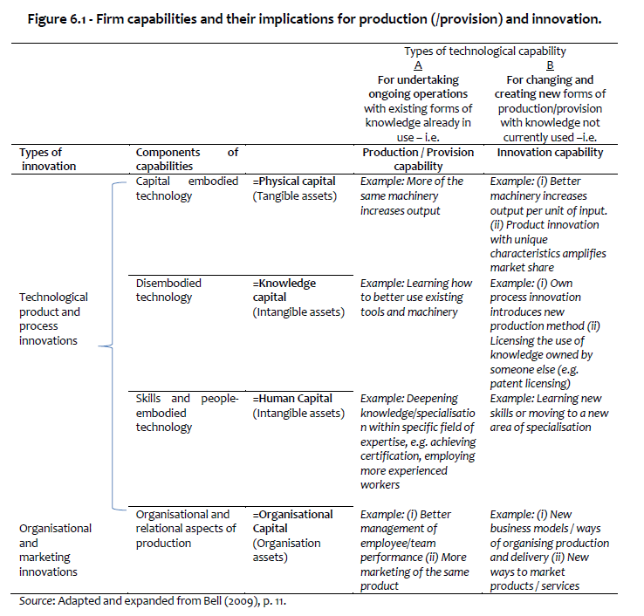
Broad-based innovation: R&D and non-R&D innovation capabilities

Slide 4
Non-R&D innovation is valuable in its own right
Notes:
This is of course self-evident. Globally-leading firms and even entire industries thrive on innovation that is non-R&D. More commonly however, economically useful innovation consists of bundles of R&D and non-R&D innovation.

Slide 5
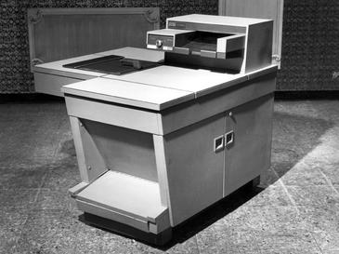
Non-R&D innovation is complementary to R&D
Photocopiers - Invented: Xerox, Popularised by: Mostly others (Henderson and Clark, 1990)
Graphical User Interfaces (GUIs) – Invented: Xerox, Popularised by: Apple/Microsoft
Notes:
The invention of the photocopier can be traced directly back to the R&D efforts of Xerox, first commercialised in 1959. However other companies reaped comparatively greater gains, by offering smaller and more reliable photocopiers.
It took Xerox several years, and significant losses in market share, before they could offer similarly competitive products (Henderson and Clark, 1990).
Xerox never benefitted from its invention of the GUI.
Benefits accrued to those who performed the complementary design, marketing and organisational innovations that permitted economic exploitation.

Slide 6
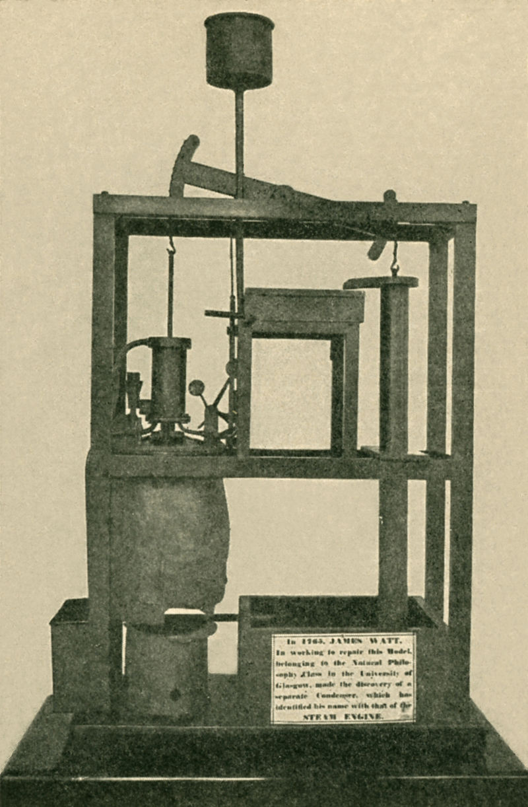
The invention of the Steam Engine
In the 1760s an instrument maker and repairman at the University of Glasgow was asked to repair a model of the Newcomen Pump.
Newcomen Pump was then in limited use for over 6 decades. Piston was expected to be both cold and hot at the same time, which it did poorly.
James Watt the repairman - not the university professor or professional researcher – identified this as a key inefficiency and introduced a separate condenser.
With Matthew Boulton's financing, the Boulton and Watt steam engine would literally power the Industrial Revolution that followed.
Burke, J. (1978), “Connections: An Alternative View of Change”, BBC documentary series, https://archive.org/search.php?query=subject%3A%22connections%22%20creator%3A%22james%20burke%22
Notes:
Not all non-R&D engineers are James Watts. And to paraphrase Louis Pasteur, fortune favours the prepared mind. But among equally capable and dedicated minds, there's no telling who's going to come up with the next breakthrough.

Slide 7
Evidence on the value of non-R&D innovation activities
Micro-level studies
Arundel et al. (2008, p. 30-31) find no statistically discernible differences in the revenue performance of R&D-performing versus non-R&D-performing innovating firms, suggesting that the contribution of the two modes are comparable.
The most valuable individual examples of innovations reported by firms can often be non-R&D innovations (O'Brien, 2016; CIS analysis)
Design expenditures alone contribute to new-to-the-firm/-market innovation by as much 30% as R&D (Ciriaci, 2011; CIS analysis; elasticities).
Elasticity of sales of new products with respect to marketing innovation expenditure about twice as strong as that of R&D (Garcia, 2011; CIS analysis).
Economic value from innovation comes from bundles of R&D and non-R&D innovation (Polder et al. , 2010; Evangelista and Vezzani, 2010; and Hervas-Oliver et al., 2015)
References
Arundel, A., Bordoy, C., Kanerva, M. (2008), “Neglected innovators: How do innovative firms that do not perform R&D innovate?”, INNO-Metrics Thematic Paper, MERIT, March 31
O'Brien, K. (2016) “Is newest always best? Firm-level evidence to challenge a focus on high-capability technological (product or process) innovation”, Economics of Innovation and New Technology, 25:8, pp. 747-768
Garcia, A. (2011), “The relevance of marketing in the success of innovations”, IPTS Working Paper on Corporate R&D and Innovation, No. 09/2011, doi: 10.2791/75736
Ciriaci, D. (2011), “Design and European firms’ innovative performance: A less costly innovation activity for European SMEs?”, IPTS Working Paper on Corporate R&D and Innovation, No. 08/2011, doi:10.2791/72880
Notes:
Individual examples of extremely successful innovations, whether products or services, tell rich stories of creative combinations of R&D, design, marketing and organisational novelties, not necessarily in this order.
The runaway success of Apple’s mass-market products can be traced at the intersection of cutting edge technology, product design, ergonomics and social-positioning marketing.
Other notable recent innovators combined technology with novel business models in ways that presented bold challenges to legal and regulatory frameworks (Netflix and Airbnb/Uber with regard to intellectual property rights and industry regulation), or to established frameworks and platforms for identification and communication (e.g. PayPal, WhatsApp using email in lieu of banking information, and phone number in lieu of email respectively).

Slide 8
Broad-based innovation
In-house innovation capabilities develop slowly (if at all), as a function of the sophistication of production capabilities
Important activities and capabilities: R&D and also design; marketing; management; training; information technologies and non-R&D engineering
Complementarities suggest that non-R&D innovation can be a stepstone to more, more systematic and more valuable R&D.
How: Subsidise human resources within firms (e.g. a first-engineer, first-programmer) and on-the-job learning
High quality education and training play a crucial role

Slide 9
Skills for business innovation
Jones and Grimshaw (2012): Lit. review training and innovation:
It is the making rather than the buying of skills that matters for innovation
Both formal and informal training good predictors of business innovation
Enormous variance in skills required by different types of firms, contingent on myriads of factors
Contingency suggests that education alignment most profitable at the lowest possible territorial/administrative level.
Place-based innovation policies can probably play an important role, with a focus on training, education, and professional development, primarily within (and with) firms.
Jones, B. and Grimshaw, D. (2012), “The Effects of Policies for Training and Skills on Improving Innovation Capabilities in Firms”, Compendium on Evidence on the Effectiveness of Innovation Policy Intervention, Manchester Institute of Innovation Research, http://www.innovation-policy.org.uk/compendium/section/Default.aspx?topicid=17

