Slide 1



Platforms of
Centres of Vocational Excellence
“Skills ecosystems” for innovation, regional development, and smart specialisation
DGEMPL/Joint Research Centre Workshop
Brussels, 30 January 2020
#EUVocationalSkills
#EUVocationalExcellence
Joao SANTOS
Deputy Head of Unit
European Commission,
Directorate General for Employment, Social Affairs and Inclusion
Unit E3 - Vocational training, Apprenticeships and Adult learning
joao.santos@ec.europa.eu linkedin.com/in/JoaoSantosEU @JoaoSantosEU
Notes:
The combined effects of rapid technological change, digitalization, climate change, circular economy, and new forms of work, call for innovative ideas to ensure that Vocational training not only adapts to change, but is also at the forefront of mastering and driving this change. These developments are not only disrupting every aspect of work and life, but also creating opportunities for innovation and employment creation across all sectors. The capacity to innovate is increasingly becoming the key factor driving economic and social development.
VET policy makers are confronted with new challenges in anticipating and responding in due time to the fast changing skill needs of the labour market, and to the expectations of individuals. The "shelf-life" of skills is becoming increasingly short. To address this challenge, VET institutions must become much more flexible and responsive to the need for renewing their offer, companies have to become an active partner in designing and providing opportunities for work-based learning, and individuals have to embrace lifelong learning to maintain their employability, active citizenship and quality of life. The way we teach and learn has to be in tune with these new opportunities and challenges.
In the past, developments in the VET system have been mainly of a gradual and incremental nature, and in most cases driven top-down. Business-as-usual may not be a viable option for the future. The speed and scale of change calls for innovative approaches where VET institutions are increasingly empowered to understand, engage and be an active partner in co-creating solutions for local social and economic development. A bottom-up approach to excellence where VET institutions are capable of rapidly adapting skills provision to evolving local needs, is essential to raise the attractiveness, relevance and quality in VET.
The new paradigm for VET institutions is local in its nature, while the challenges they are facing is increasingly complex and global.

Slide 2
The timeline to
“Vocational Excellence”
Communication on
Rethinking Education
…align VET policies with regional/local economic development strategies
namely for smart specialisation
EC proposal for the Erasmus programme
2021-2027
… support for Platforms of “Centres of Vocational Excellence”
Communication on
Building a
stronger Europe
…proposes to support the establishment of
Centres of Vocational Excellence
2012
2018
2004 2006 2008 2010
2017
ACVT Opinion on the future of VET
“VET excellence should be encouraged, supported, promoted and rewarded”
2019
Communication on
Strengthening Innovation in Europe's Regions
…link VET to innovation systems, as part of smart specialisation strategies at regional level
First Erasmus+ call for proposals
For Pilot projects on Centres of Vocational Excellence
VET Communiqués
call for action on
Innovation
and Excellence
Notes:
How and when has this initiative been prepared? Which stakeholders have been involved in the preparatory phase of this initiative?
The policy concept of Vocational excellence is not new. An initiative to promote Vocational excellence has been called for since 2004 when the parties to the Copenhagen process, i.e. the member states, the social partners, the candidate countries and the EFTA countries, set the overall priorities for the EU VET modernisation agenda in the following Communiqués:
2004 Maastricht Communiqué: “…achieve high levels of quality and innovation in VET”
2006 Helsinki Communiqué : “…developing and highlighting excellence in VET skills…”
2008 Bordeaux Communiqué: “… promote excellence and guarantee equal opportunities.”
2010 Bruges Communiqué, calls for “…vocational excellence for smart and sustainable growth.”, and “VET providers to collaborate with enterprises, design centres, cultural sector, and HE forming "knowledge partnerships".
2015 Riga Conclusions, calls for “increase cooperation to promote innovation and excellence in VET”
2018 ACVT Opinion on the future of VET calls for VET excellence should be encouraged, supported, promoted and rewarded
The 2012 Communication on Rethinking Education, proposed that excellence be pursued by aligning VET policies with regional/local economic development strategies namely for smart specialisation.
Together with the 2012 Communication, a Staff Working Document gave further details on how the concept of Vocational excellence could be developed and achieved. The recent 2017 Communication on "Strengthening Innovation in Europe's Regions" makes a specific reference to "linking vocational education and training to innovation systems", as part of smart specialisation strategies at regional level.
In the 2018 Communication on Building a stronger Europe: the role of youth, education and culture policies, in which the Commission proposes to support the establishment of Vocational Education and Training Centres of Excellence:
These centres should connect reference vocational education and training providers across Member States, foster cooperation, including with stakeholders, and strive to develop high quality curricula and qualifications focused on sectoral skills needs. They should act as drivers of excellence and innovation and promote a proactive role for vocational education and training in local and regional economic development, including by acting as entrepreneurial incubators and catalysts for investment. It also proposes that the Centres will build synergies with universities, thus jointly contributing to the provision of the range of skills needed to support innovation and competitiveness.
On 30 May, the Commission adopted its proposal for the next Erasmus programme 2021-2027. In addition to doubling the funding for Erasmus to €30 billion, the Commission also proposes that under the title Partnerships for Excellence, funding be provided for Centres of vocational excellence:
This initiative will support the development of trans-national platforms of centres of vocational excellence closely integrated in local and regional strategies for growth, innovation and competitiveness, while supporting overall structural changes and economic policies in the European Union. These platforms will embed partnerships of vocational education and training providers with the relevant stakeholders responsible for economic development, innovation and competitiveness policies in a given economic context.
These can include economic development agencies, regional authorities responsible for economic development, innovation clusters, employment services, skills observatories, business support services, business innovation centres, technology transfer agencies, incubators, as well as key companies, social partners and economic sector representatives. The Centres of vocational excellence will act as drivers of quality vocational skills in a context of national, regional/local, and sectorial challenges, while supporting overall structural changes and socio-economic policies in the European Union. They will develop and offer high quality transnational joint vocational programmes and qualifications focused on meeting current and emerging sectoral skills needs with a strong element of work-based learning, digital content and mobility experience abroad.

Slide 3
CoVE’s fostering local/regional
“Skills ecosystems”
Companies
See comparative
advantage to address
skill development and
business performance
for generating
innovation and growth
Bringing together:
Policy makers
Companies
Chambers
Trade unions
VET institutions
Universities of applied science
Research centres
Employment services/agencies
Regional development agencies
Professional or sector associations
Vocational Education and Training
Responsive delivery at all levels, that is valued by individuals and employers
Skills
eco-system
Policy setting
VET, employment and economic development policies support high skills strategy
Individuals
Invest in skills because
of rewarding jobs
and career
opportunities
Inspired on concept of “Skills ecosystems” proposed by David Finegold (1999) ‘Creating self-sustaining, high-skill ecosystems’, Oxford Review of Economics
Notes:
Inspired on concept of “Skills ecosystems”, as proposed by David Finegold (1999)
‘Creating self-sustaining, high-skill ecosystems’, Oxford Review of Economics

Slide 4

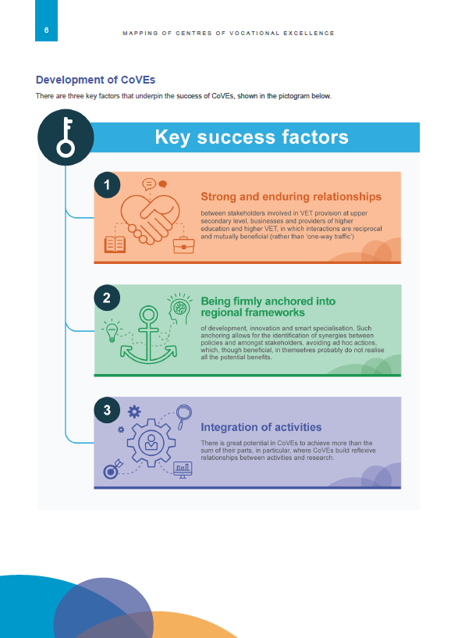
https://ec.europa.eu/social/main.jsp?catId=738&langId=en&pubId=8250&furtherPubs=yes
Notes:
Final report delivered by ECORYS in September 2019.
The over-arching aim of the mapping in all EU 28 Member States, EFTA and candidate countries is:
To identify examples of excellence in VET linked to wider strategies related to innovation and economic and social development
By the end of the exercise we also aim to have built an informed perspective on:
What is understood by VET Excellence in the context of the practice of regional social and economic development, innovation strategies, smart specialisation etc.; and
How Excellence in VET in this context is being pursued throughout Europe.
Geographical coverage:
EU Member States, EFTA, candidate countries, and other ETF partner countries

Slide 5
Centres of Vocational Excellence
Overview of 2019 selected projects
Title | Talentjourney | Excellent Advanced Manufacturing 4.0 | Digital Innovation Hub for Cloud Based Services | Open Design School | Platform of Vocational Excellence Water
Sector | IoT in Smart manufacturing | Advanced Manufacturing | Cloud computing | Cultural and creative industries | Water sector
Countries | 5 | 4 | 5 | 9 | 6
EU Grant | 953.550 € | 799.332 € | 999.882 € | 874.093 € | 998.022 €
Coordinator | Šolski center Nova Gorica (SI) | Tknika (ES) | Helsinki Business college (FI) | Basilicata Foundation (IT) | Friesland college (NL)
Partners | 13 | 8 | 10 | 9 | 11
5 projects selected. Duration 2 years. Total grants: €4.624.879
Notes:
To bring you up to date with the developments regarding the first call for pilot projects on the initiative on “Centres of Vocational Excellence”:
In 2019, we could not launch a specific call for the CoVE initiative, and therefore we modified the regular Sector Skills Alliance call to include a Lot for the launch of a small set of pilot projects that closely resemble the concept we are developing for the CoVE.
This was not the ideal way of supporting the comprehensive approach we want for the CoVE's, which include both a sectoral dimension (supported by SSA), as well as a thematic dimension (not possible under SSA).
However, we were very positively encouraged by the demand for this first limited call, which was initially designed to support only 4 projects with a total budget of €4 million, but attracted 15 applications (almost 4 times more than expected) with a budget of €13 million.
Applications came from 11 countries, and included partners from all EU countries (except HU and LU), and also from one candidate country. In total, we have 177 organizations involved in these applications, with an average of 12 partners per project.
Partners are mostly VET centres (both upper secondary, as well as tertiary level Universities of applied sciences), Centres for adult training, regional development agencies, SMEs, Chambers and Social partners.
The analysis of these applications will be very useful for finalising the concept of the initiative and designing future calls.
For the AWP2020, we plan to have a dedicated KA3 call for the CoVE, which will support the full concept as outlined in the concept note that we are currently finalising with the close involvement of VET stakeholders. Discussions have taken place within the DGVT, ACVT as well as meetings with VET providers and Chambers.

Slide 6
Centres of Vocational Excellence
E+ KA3 - The 2020 Pilot projects
https://eacea.ec.europa.eu/erasmus-plus/funding/ka3-centers-of-vocational-excellence_en
KA3 Specific call
Support for “Platforms of Centres of Vocational Excellence (CoVE)”
Support for 5 Pilot projects running for 4 years, based on innovative cooperation methods, for the establishment of Platforms of CoVE’s
Strategic approach to development of skills-ecosystems at local level and in line with local growth and innovation strategies
At least 4 programme countries, at least 8 full partners, with at least 1 company or industry representative, and 1 VET provider in each country
Can be focused on any EQF level but must also include levels 3, 4 or 5
Budget €20.000.000, with maximum EU grant €4,000,000 per project
Published 15 October 2019. Deadline for applications February 2020.

Slide 7
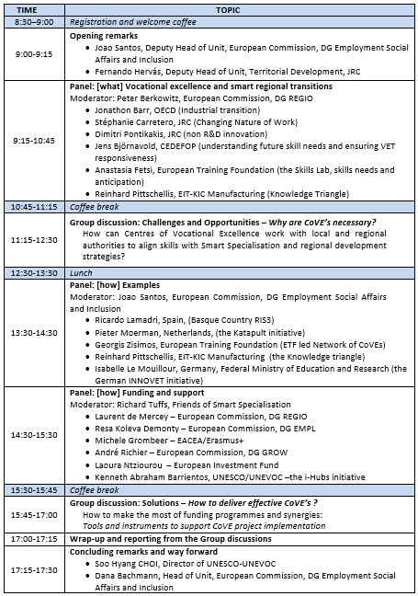
Coming up next…
30 January 2020
JRC/EMPL Workshop on Vocational Excellence and Smart Specialisation
31 January 2020
EACEA kick-off meeting for the 5 projects selected in the 2019 CoVE call
20 February 2020
Deadline for submission of project proposals for the 2020 Cove call
October 2020 (depending on MFF negotiations)
Erasmus call under the new MFF

Slide 8
Resources on CoVE’s
European Commission mapping study on approaches to Centres of Vocational Excellence
https://ec.europa.eu/social/main.jsp?catId=738&langId=en&pubId=8250&furtherPubs=yes
European Training Foundation: Centres of vocational excellence – an engine for VET development? - An international analysis https://www.etf.europa.eu/en/document-attachments/centres-vocational-excellence-engine-vet-development
Joint Research Centre: The role of VETin Smart Specialisation Strategies
https://s3platform.jrc.ec.europa.eu/-/skills-and-smart-specialisation-the-role-of-vocational-education-and-training-in-smart-specialisation-strategies
Cedefop Briefing note Innovation and training: partners in change
https://www.cedefop.europa.eu/en/publications-and-resources/publications/9103
UNESCO-UNEVOC study on Innovation in technical and vocational education and training (TVET)
https://unevoc.unesco.org/go.php?q=UNEVOC+Publications&lang=en&null=&null=&akt=id&st=&qs=6273
OECD Report on Regions in Industrial Transition, Policies for People and Places
http://www.oecd.org/publications/regions-in-industrial-transition-c76ec2a1-en.htm
Industry 2030 High Level Industrial Roundtable report “A vision for the European Industry until 2030”
https://ec.europa.eu/docsroom/documents/36468
Report on High-Tech Skills: Scaling up best practices and re-focusing funding programmes and incentives
http://skills4industry.eu/sites/default/files/2019-11/EA-01-19-571-EN-N_incl-exec-sum.pdf and
http://skills4industry.eu/sites/default/files/2019-10/EA-01-19-639-EN-N.pdf
Increasing EU’s talent pool and promoting the highest quality standards in support of digital transformation
https://skills4industry.eu/sites/default/files/2019-06/Brochure_Digiframe_final20190617.pdf
Skills for Industry - Skills for Smart Industrial Specialisation and Digital Transformation
http://skills4industry.eu/sites/default/files/2019-11/EA0419517ENN -Skills for Smart Industrial Specialisation and Digital Transformation - Brochure.pdf
Skills for industry - Online training : promoting opportunities for the workforce in Europe
https://op.europa.eu/en/publication-detail/-/publication/1b81c203-f553-11e9-8c1f-01aa75ed71a1/language-en
Skills for Industry - Curriculum Guidelines 4.0 (to be released in Feb. 2020)
Skills for SMEs: Big Data, Internet of Things and Cybersecurity (to be released in Feb. 2020)
Article in the CECIMO Magazine on Platforms of Centres of Vocational Excellence https://www.cecimo.eu/newsroom/magazine/
The Erasmus+ call for pilot projects on CoVE’s, published on 15 October 2019
https://eacea.ec.europa.eu/erasmus-plus/funding/ka3-centers-of-vocational-excellence_en

Slide 9


