Slide 1
SELFIE: supporting VET schools with digital age learning
Ralph Hippe
European Commission, JRC
S3 & CoVE | 30 January 2020
#SELFIE_EU

Slide 2
How can each VET school make the most of technology for teaching and learning?
Notes:
Schools in Poland and across Europe are facing the challenge
of how best to embed technology into their teaching and learning.
And how to prepare students for an increasingly digital world.

Slide 3
Available for primary, secondary (general and VET) and post-secondary non-tertiary institutions
37 languages
free
https://ec.europa.eu/education/schools-go-digital
Notes:
Pan
Add SELFIE
Self-reflection on Effective Learning by Fostering
Innovation through Educational Technology

Slide 4
A tool that brings together perspectives of school leaders, teachers and students
Reality
Notes:
PAN
Other tools were misssing the student voice f the 15 we looked at hardly any had the student voice

Slide 5
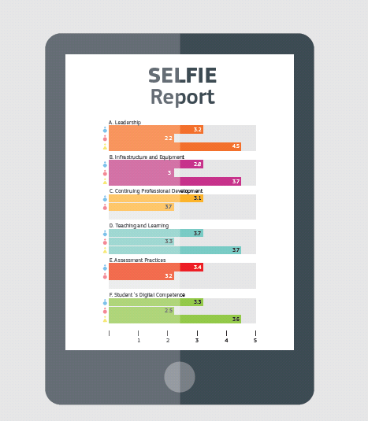
SELFIE School Report
It highlights what’s working well, where improvement is needed and what the priorities should be
Notes:
Based on this input, the tool generates a report – a snapshot (‘SELFIE’ :-)) of a school‘s strengths and weaknesses in their use of digital technologies for teaching and learning. The more people in the school taking part, the more accurate the SELFIE of their school will be.
On completing SELFIE, each school receives a tailor-made, interactive report which provides both in-depth data and quick insights into strengths and weaknesses.

Slide 6
SELFIE allows a VET school to know where it stands in digital education and take action
Supports innovation and modernisation of the VET system
Involvement of learners
Bottom-up approach
In the future: collection of good practices in using SELFIE and digital education
Learn from examples from another country or region
SELFIE
Notes:
Support digital readiness of schools… by making the SELFIE self-assessment tool reach one million teachers, trainers and learners by end of 2019

Slide 7
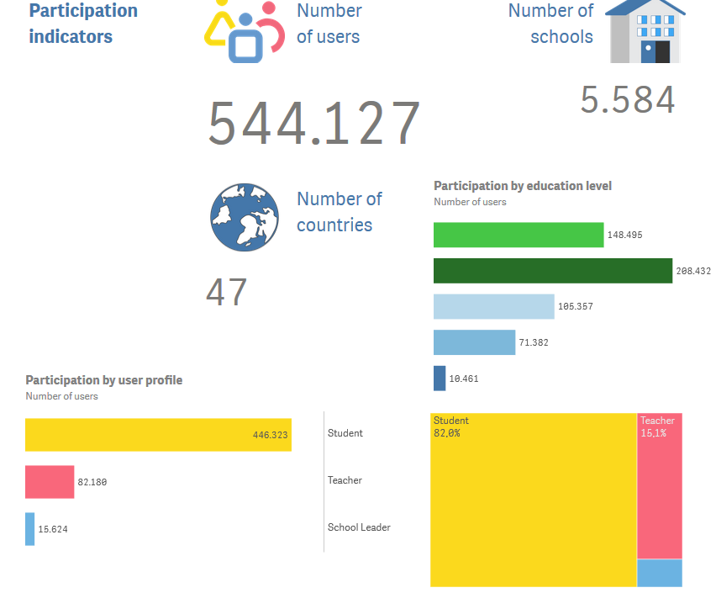
SELFIE participation
- all education levels
(Oct. 2018 – Jan. 2020)
Notes:
DEE

Slide 8
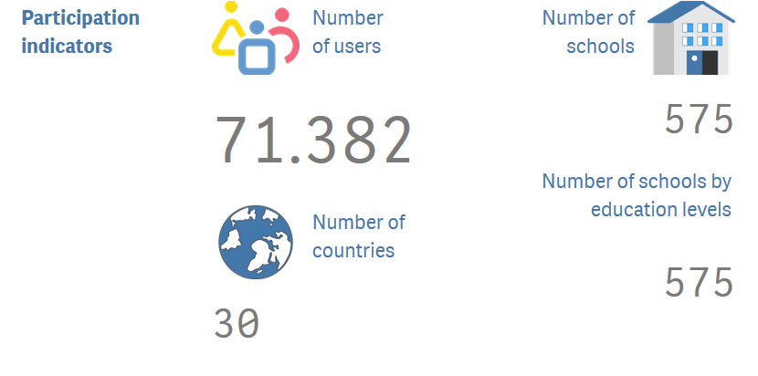
SELFIE participation
- upper-secondary VET
(Oct. 2018 –
Jan. 2020)
Notes:
Latest figures – but probably not country breakdown?? They will be curious but I don’t want to make it league table…
[410,424 users from October 2018 until 1st September 2019]

Slide 9
SELFIE is also being developed for work-based learning:
(Dual) apprenticeships
Traineeships, internships
Training-on-the-job
Expert workshop on 9 March 2020, Brussels
Pilots between May and October 2020
SELFIE for work-based learning
Notes:
Support digital readiness of schools… by making the SELFIE self-assessment tool reach one million teachers, trainers and learners by end of 2019

Slide 10
Support local VET schools and companies in making the best use of digital technologies for teaching and learning
Participation of in-company trainers
New questions on cooperation issues
SELFIE for WBL can connect local actors better to each other
Improvement of local cooperation
SELFIE for work-based learning
Notes:
Support digital readiness of schools… by making the SELFIE self-assessment tool reach one million teachers, trainers and learners by end of 2019

Slide 11
Stay in touch!
Contact us
ralph.hippe@ec.europa.eu
JRC-EAC-selfie-tool@ec.europa.eu
Check out the SELFIE webpage
https://ec.europa.eu/education/schools-go-digital
Latest news on Twitter
#SELFIE_EU
@ralphhippe

Slide 12
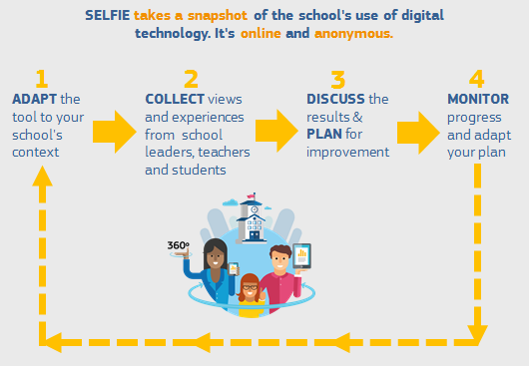
SELFIE in a nutshell

