Slide 1

Innovations for Sustainability: Smart Specialisation and Environmental Commons.
2020 Smarter Conference
Smart Specialisation for SDGs
Nebojsa Nakicenovic
Executive Director, TWI2050
Former Deputy Director General, IIASA
Former Tenured Professor, TU Wien

Slide 2
Despite the major immediate threat of the COVID-19, the climate crisis is here and also injustice, inequity, and ever-increasing pressure on Earth systems and global commons.
Source: TOLES © The Washington Post. Reprinted with permission of ANDREWS MCMEEL SYNDICATION. All rights reserved.

Slide 3

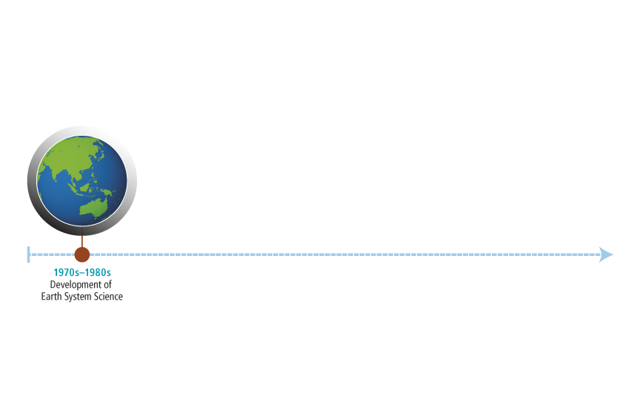

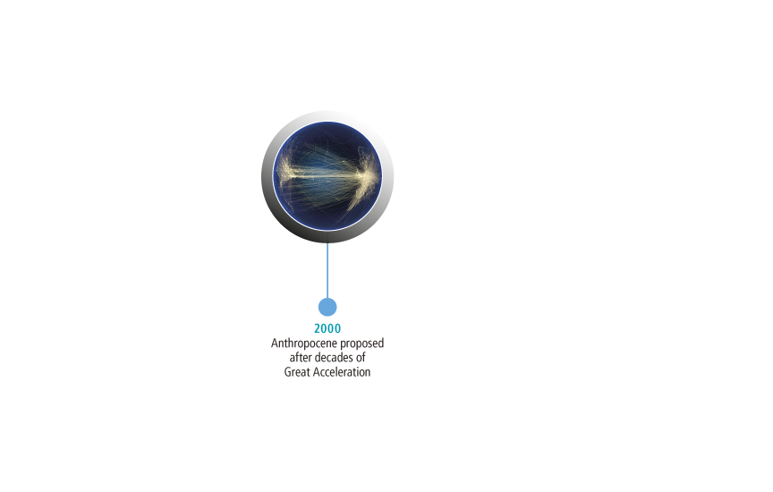
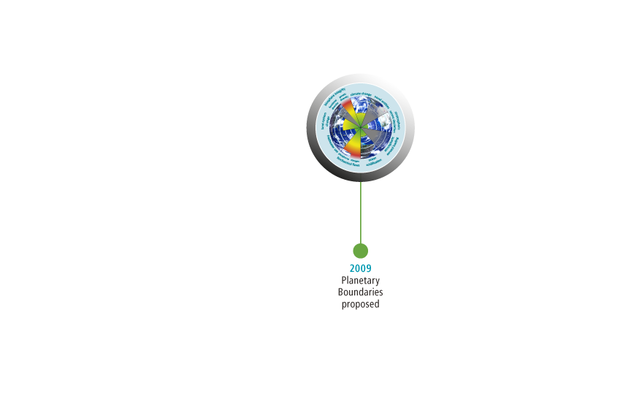



Beyond Global Commons
toward safe and just future

Slide 4
The World is at “Crossroads”
Explosive development transgressing planetary boundaries but many left behind
Global economy increased 100 fold, energy 50 fold and CO₂ 30 fold
Temperature increase over 1ºC, about 8 million die due to indoor and regional air pollution
Achievement of 2030 Agenda would bring multiple co-benefits for people and the planet

Slide 5
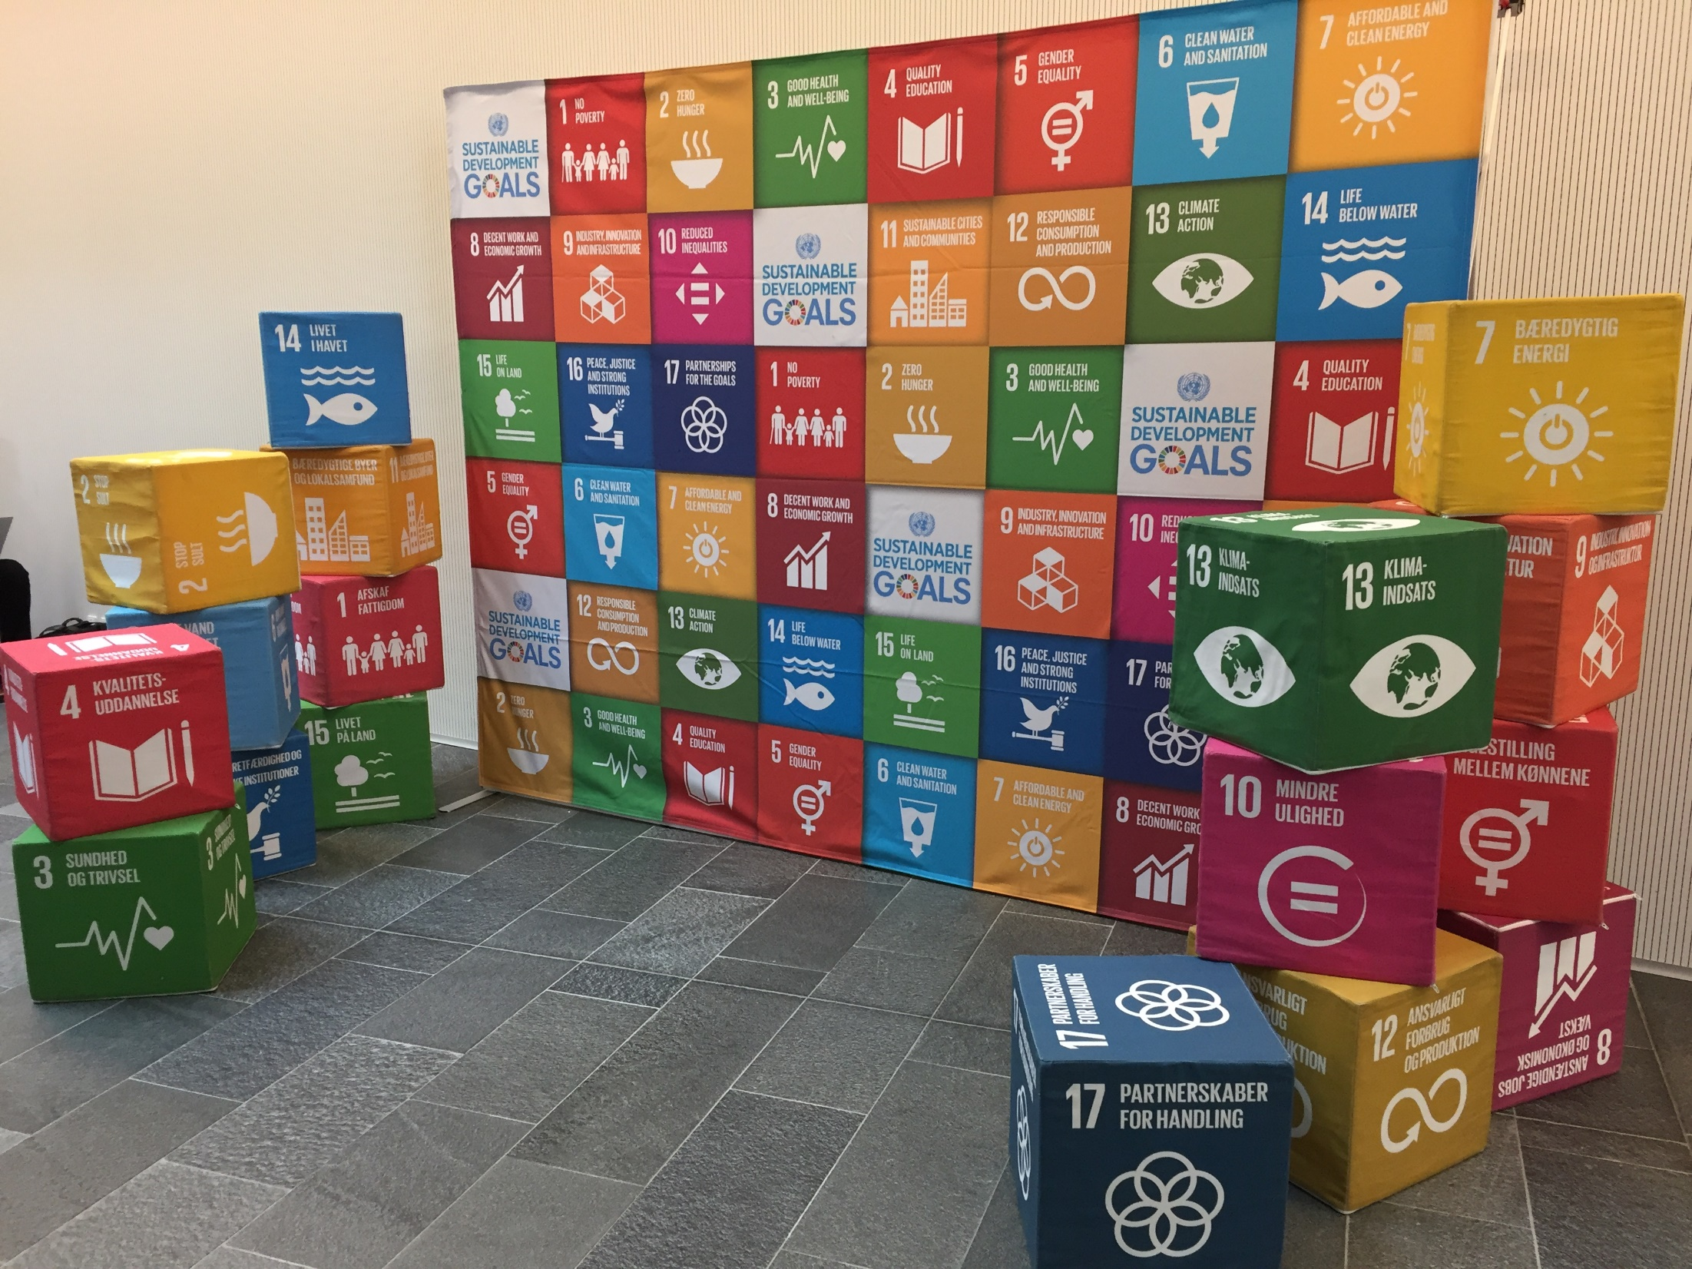
UN DESA and UNFCCC conference on synergies between the SDGs and the Paris Agreement – 1-3 April 2019 Copenhagen.

Slide 6
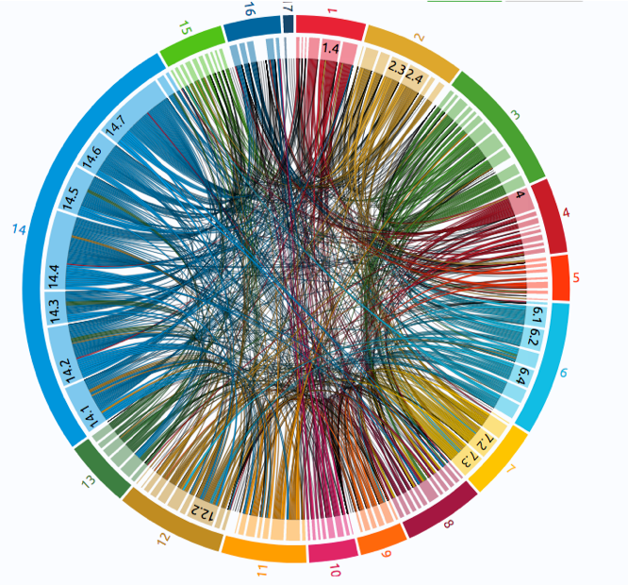
Interlinkages among the SDGs
interlinkages among goals and targets
Using knowledge on interlinkages to exploit synergies and minimize trade-offs in the policy process can contribute to overall policy coherence
Survey of existing publications
A tool to visualize the cumulated interlinkages from a set of publications
Meta analysis of the main studies on interlinkages
Source: Miola, 2019

Slide 7
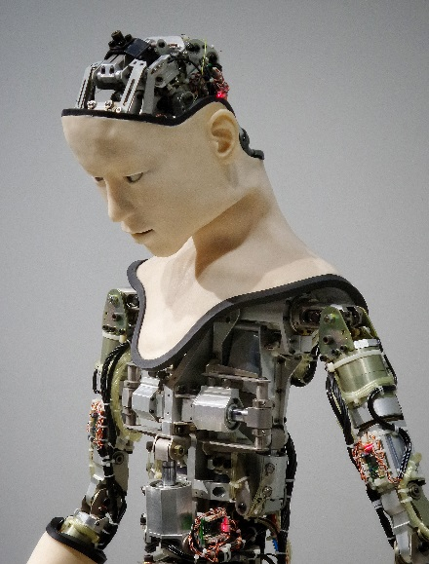
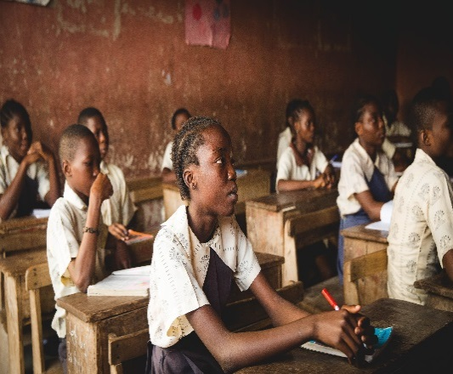
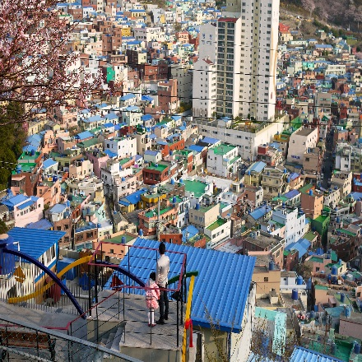
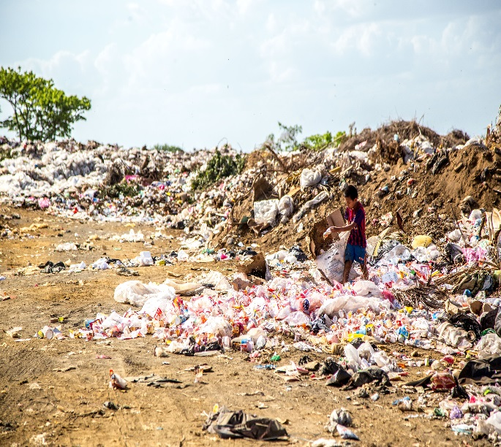
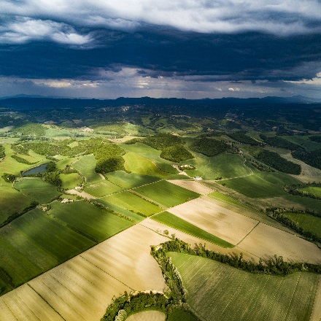
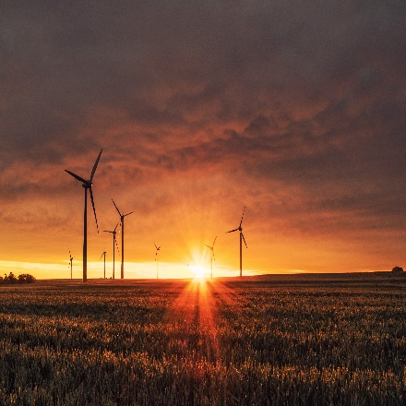
Six Major Transformations (TWI2050.org)
Digital
Revolution
Human capacity
Demography & Health
Smart Cities & Mobility
Consumption
& Production
SDGs:
Prosperity
Social Inclusion
Sustainability
Food, Biosphere
& Water
Decarbonization
& Energy
Notes:
Figure 2. TWI2030 focuses on six transformations that capture much of the global, regional, and local dynamics and encompass major drivers of future changes: i) Human capacity and demography; ii) Consumption and production; iii) Decarbonization and energy; iv) Food, biosphere and water; v) Smart cities; and vi) Digital revolution. Together they give peoples-centered perspective: building local, national and global societies and economies which secure wealth creation, poverty reduction, fair distribution and inclusiveness necessary for human prosperity. They are necessary and potentially sufficient to achieve the SDGs if addressed holistically in unison. Source: TWI2050.

Slide 8


Slide 9
The World in 2050 (TWI2050, 2018; Sachs et al., 2019) | Science for Sustainable Development (GSDR, 2019) | The European Green Deal (EC, 2019)
1. Human capacity and health | 1. Human well-being and capabilities | 1. A zero pollution ambition for a toxic-free environment
2. Consumption and production | 2. Sustainable and just economies | 2. Preserving and restoring ecosystems and biodiversity
3. Decarbonisation and energy | 3. Food systems and nutrition patterns | 3. From ‘Farm to Fork’: a fair, healthy and environmentally friendly food system
4. Food, biosphere and water | 4. Energy decarbonisation and universal access | 4. Accelerating the shift to sustainable and smart mobility
5. Smart cities | 5. Urban and peri-urban development | 5. Building and renovating in anenergy and resource efficient wayLeave
6. Digital revolution | 6. Global environmental commons | 6. Mobilising industryfor a clean and circular economy
 |  | 7. Supplying clean, affordableand secure energy
 |  | 8. Increasing the EU’s Climate ambition for 2030 and 2050
Transformations to achieve sustainable, equitable and just future for all and the planet;
mobilizing STI, financing, and leaving no one behind

Slide 10
Basic needs, Decent living & Sufficiency
  → 2050: Sustainability transformation
service provision
(consumption)
Overconsumption
(obesity)
Sufficiency
Decent Living Standards
Sufficiency corridor
Basic
access
  → New values and norms; new morality and ethics
wellbeing

Slide 11
Smart Specialization Strategy (S3)
S3 is an important driver of development and prosperity and includes:
Entrepreneurial discovery (STI)
Entry and agglomeration (convergence)
Structural change (“creative destruction”)
Aspirational vision (roadmaps, action plans)
But not:
“Horizontal” support of all sectors and domains
“Central planning” by decision makers (public or private)
Source: After Foray, 2012

Slide 12
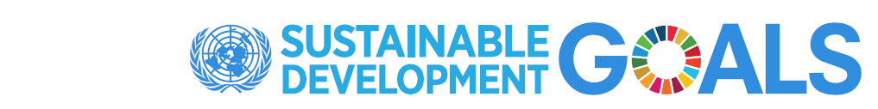
“Doughnut” Perspective on Sustainable Development and Planetary Boundaries

Slide 13
THANK YOU
www.TWI2050.org
naki@iiasa.ac.at

