Slide 1
Smart Specialisation for the SDGs: Are theoretical and conceptual foundations of Smart Specialisation fit for the SDGs?
SMARTER 2020 Conference
Smart Specialisation for the Sustainable Development Goals
10 November 2020
Michał Miedziński
UCL Institute for Sustainable Resources
Notes:
New context and new challenges for (regional) innovation policy
Theoretical perspectives and insights emerging from the literature review
Smart Specialisation and the SDGs: Towards a synergy?

Slide 2
New context and challenges for (regional) innovation policy

Slide 3
SYSTEMIC CHALLENGE
+
Notes:
SDGs are a transformative agenda – it asks for an overhaul of production and consumption systems. These require deep structural changes of socio-technical systems.

Slide 4
Source: UN (2019) Global Sustainable Development Report 2019
Notes:
Transformation is systemic and complex: cuts across borders, many levels, many actors, has risks and uncertainties

Slide 5
Source: EUROSTAT (2020) Sustainable development in the European Union Monitoring report on progress towards the SDGs in an EU context 2020 edition

Slide 6
Notes:
The ambition of the EGD is transformative.The EU documents started using the language of transition.

Slide 7
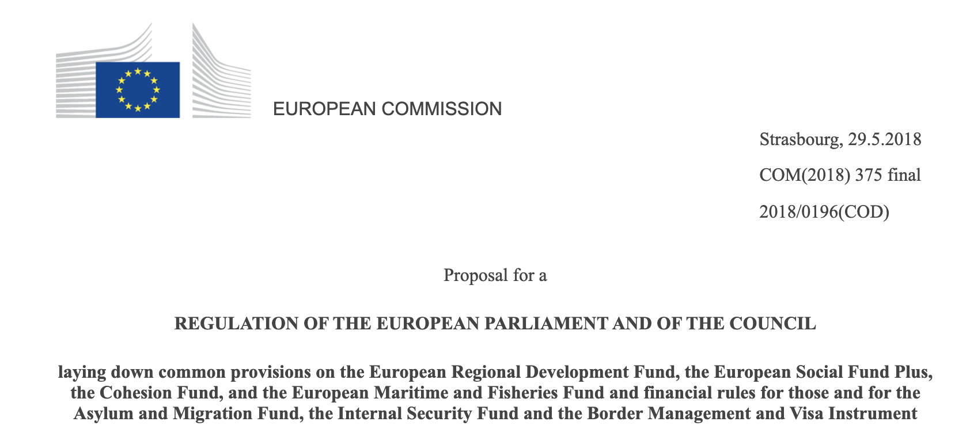
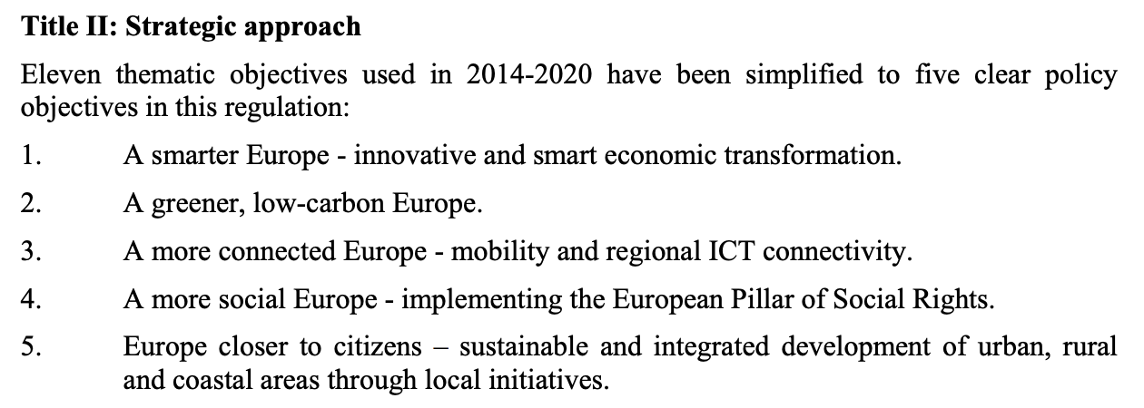
New expectations towards EU Cohesion Policy
Source: COM (2018) 375: Proposal for a REGULATION OF THE EUROPEAN PARLIAMENT AND OF THE COUNCIL laying down common provisions on the European Regional Development Fund, the European Social Fund Plus, the Cohesion Fund, and the European Maritime and Fisheries Fund and financial rules for those and for the Asylum and Migration Fund, the Internal Security Fund and the Border Management and Visa Instrument
Notes:
Expectations towards EU programmes and funds to contribute to this transitions. Now combined with the recovery from Covid-19.

Slide 8
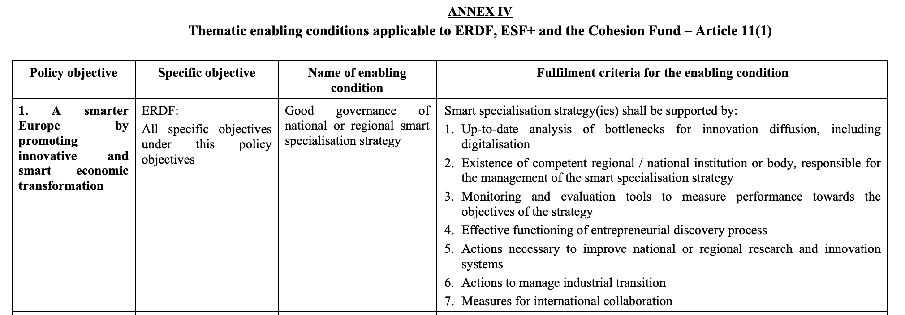
New expectations towards Smart Specialisation
S3 to promote “innovative and smart economic transformation” and “industrial transition”
Source: COM (2018) 375: Proposal for a REGULATION OF THE EUROPEAN PARLIAMENT AND OF THE COUNCIL laying down common provisions on the European Regional Development Fund, the European Social Fund Plus, the Cohesion Fund, and the European Maritime and Fisheries Fund and financial rules for those and for the Asylum and Migration Fund, the Internal Security Fund and the Border Management and Visa Instrument
Notes:
Action to support industrial transition include transition to low carbon economy
Major differences with SDGs
Political ambition and context
Underpinning normative rationale
Governance, implementation and incentive regimes

Slide 9
Theoretical perspectives and insights from the literature review

Slide 10
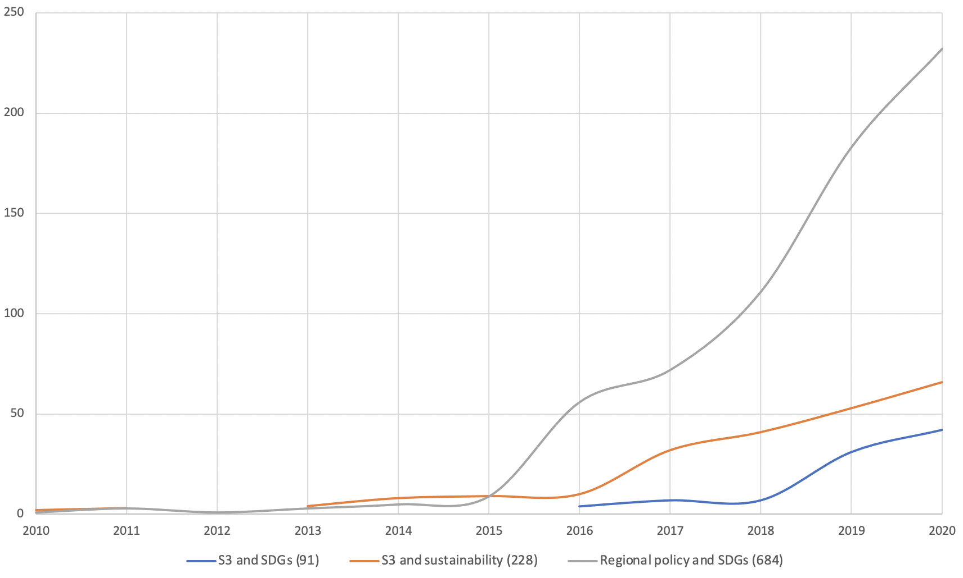
A glance at the publication trends on regional innovation and the SDGs
Scopus queries conducted on 30 October 2020 (documents published 2010-2020): S3 and SDGs: ALL("smart speciali*ation" OR "regional innovation strategy” OR “regional innovation policy”) AND ("sustainable development goals” OR SDGs) S3 and sustainability: ALL("smart speciali*ation" OR "regional innovation strategy” OR “regional innovation policy”) AND (sustainable OR sustainability) Regional policy and SDGs: TITLE-ABS-KEY(regional OR spatial OR local) AND (strategy OR policy) AND ("sustainable development goals” OR SDGs) Note additional filters were applied to the searches (e.g. results are shown for journal articles and reviews in selected subject areas).
Notes:
To revisit S3 we must learn from the current experience. Here the focus is on academic research, including theoretical but also empirical research

Slide 11
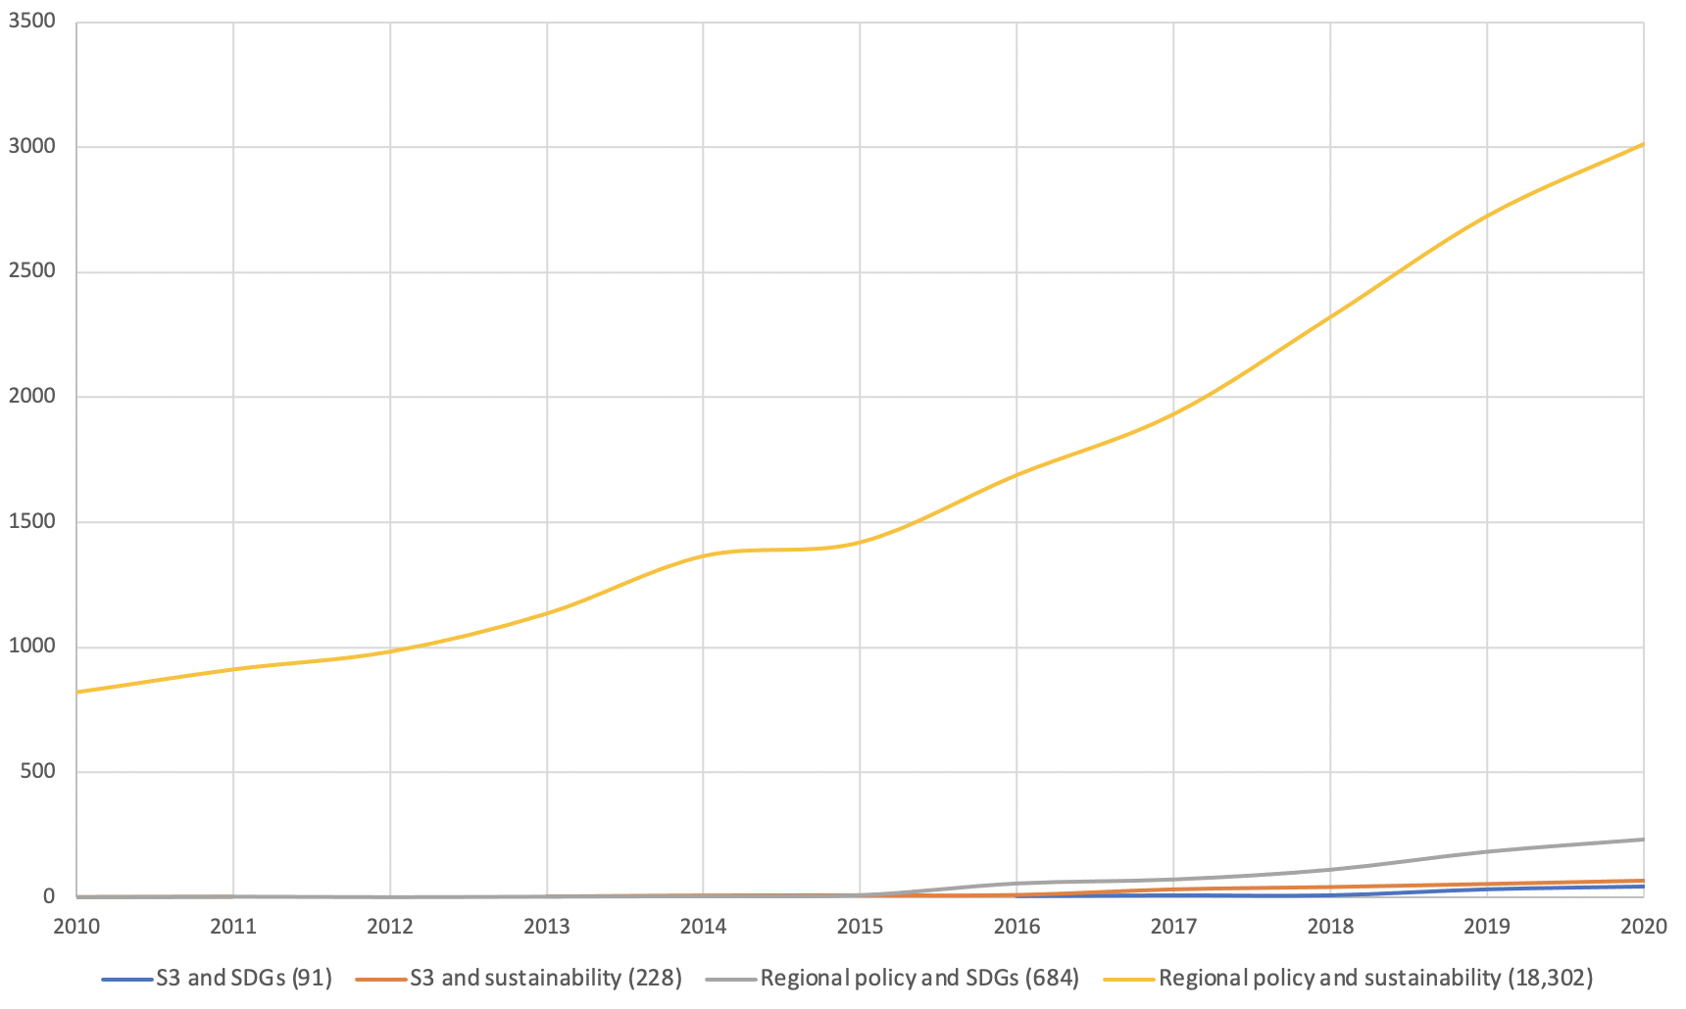
To put in a perspective…
Scopus queries conducted on 30 October 2020 (documents published 2010-2020): S3 and SDGs, S3 and sustainability, Regional policy and SDGs (ibid) Regional policy and sustainability: TITLE-ABS-KEY((regional OR spatial OR local) AND (strategy OR policy) AND (sustainable OR sustainability)) Note additional filters were applied to the searches.

Slide 12
Theories and concepts connecting regional innovation policy with sustainability
Diversity of theoretical perspectives and insights from across various disciplines and research traditions
Economic geography, especially evolutionary and institutional lenses
Innovation policy studies, notably work on challenge-driven innovation policy (e.g. transformative innovation policy, mission-oriented policy)
Sustainability transitions, notably multi-level perspective, transitions management, strategic niche management
Policy studies, including policy mix literature in the context of transitions
Governance, notably multi-level/multi-scalar governance
Political ecology
Spatial planning
Resilience theory
Climate adaptation
Social learning
Notes:
Elmqu

Slide 13
academic critique and debate on the future of Smart specialisation (1)
Sustainability orientation
How to introduce and localise strategic orientation towards SDGs in S3 and in innovation policy across regions and at different governance levels?
How to reconcile regional competitiveness with global sustainability goals?
Transformative potential
How relevant is S3 as a concept and as an instrument for the structural transformation needed to achieve the SDGs?
Has S3 been focusing on spatial scales and instruments appropriate to foster structural transformation needed for the SDGs?
What are transformative outcomes one can realistically expect from the current S3, especially in institutionally weaker regions?
Innovation
How to shift the focus from conventional, R&D-driven technological innovation to stronger embrace other forms of innovation relevant for sustainability (e.g. eco-innovation, social innovation)?
How to foster system innovation in S3, especially in weaker regions?
For the recent academic critique and debate see e.g. Hassink and Gong (2019), Benner (2020) and Foray (2019, 2020) for responses
Notes:
To revisit S3 we must listen and engage with critique especially that it is relevant for the the question on how S3 be applied to foster sustainability transition. Also to learn about the limits of the approach.
Six questions from Hassink and Gong (2019)
Lack of conceptual clarity (specialisation versus diversiﬁcation)
Overly focused on a conventional science and technology (S&T)
Often too close in substance to cluster policies
Limited transformative potential of EDP
Limited benefits for structurally weaker regions (“regional innovation paradox”)
Insufficient measurement of smart specialization.
Additional six questions from Benner (2020)
The narrow focus on R&D
Problems with addressing the appropriate spatial scale
The one-size-fits-all methodological approach
Insufficient focus on the process, especially implementation
Realistic expectations and not overloading it with new asks (e.g. SDGs)
Need for simplification of regional innovation policy.

Slide 14
academic critique and debate on the future of Smart specialisation (2)
Governance and self-discovery
Can self-discovery process become a challenge-led process exploring alternative innovation pathways towards sustainability goals? What would be key features of such a process and its environment?
Policy coherence
How to ensure a better “policy reach” and coherence between S3 with broader innovation policy horizontally within regions and across governance levels?
To what extent can the logic and process of S3 be applied at different levels of governance?
How to strengthen regional institutional capacity to address the SDGs?
Policy learning and evidence base
How to consolidate open access evidence base to inform robust diagnosis of global and local sustainability challenges?
How to strengthen EU’s and regional capacity to continuously monitor, evaluate and reflect about possible and actual (beneficial and adverse!) effects of innovation on sustainability transitions and the SDGs?
Notes:
To revisit S3 we must listen and engage with critique especially that it is relevant for the the question on how S3 be applied to foster sustainability transition. Also to learn about the limits of the approach.

Slide 15
S3 and the SDGs: Towards a synergy?

Slide 16
Aligning S3 with the SDGs: towards a framework
Key issues | Re-orienting S3 towards the SDGs | Advantages of S3 | Limitations of the current S3
Sustainability orientation | - Introduce sustainability goals in the prioritisation in line with the broader policy targets (EGD and SDGs) and scientific evidence - Embed and localise sustainability goals using self-discovery process | - Focus on selecting strategic priorities in the planning phase (intentional) - Emerging examples of regions focusing on sustainability challenges | - Tension between the focus on economic competitiveness and the fundamental principles of the Agenda 2030 (e.g. indivisibility of the SDGs and the ‘leave no one behind’ principle)
Transformative potential | - Introduce longer-term planning horizons - Refocus on transforming socio-technical systems rather than economic sectors - To be effective, reflect on the scale and level of action adequate to the challenge addressed (subsidiarity) - EU and national innovation policy must support regions in prioritizing relevant challenges for the transition and, when needed, foster innovation collaboration across borders and governance levels. | - Intended focus on structural transformation and societal challenges - Cross-sectoral approach - Central role of innovation as a driver of transformation | - Limited capacity to foster structural transformation - Unclear scalability of - Focus on economic sectors as subject of transformation - S3 is not a universal approach (whereas the Agenda 2030 is!)
Types of innovation | - Broaden the definition of innovation to harness wider socio-economic and environmental benefits of innovation (e.g. social and green innovation) - Focus on experimentation and demonstration of system innovation - Support challenge-driven collaboration - Invest in innovation capabilities and skills relevant for challenges | - Predominant focus on R&D and technological innovation - Limited attention to system innovation | - Focus on innovation as a driver of structural transformation

Slide 17
Aligning S3 with the SDGs: towards a framework
Key issues | Re-orienting S3 towards the SDGs | Advantages of S3 | Limitations of the current S3
Governance and self-discovery | - Consider self-discovery as a challenge-led learning and co-creation process to address sustainability challenges - Self-discovery process can be applied beyond single regions (e.g. trans-regional networks) | - Multi-stakeholder process (quadruple helix) - Bottom-up entrepreneurial discovery (self-discovery) process - Open to experimentation of alternative solutions | - Predominant focus on actors from knowledge-intensive high-tech sectors and limited participation of civil society
Policy coherence | - Strive for horizontal (between S3 and regional policies) and vertical policy coherence (local-regional, national, EU) - Design instrument portfolios to support S3 (not only within OPs) - Create concrete incentives for actors to engage in aspirational innovation projects (e.g. missions) - Invest in public sector capabilities to address sustainability challenges | - Intention to embed S3 in a wider innovation policy mix | - Insufficient link with regional and national policy mix - Insufficient governance mechanisms to act on the appropriate spatial scales - Weak design and implementation capacity in some regions and countries
Policy learning and evidence base | - Policy monitoring and evaluation as reflexive and participatory system - Diagnosis based on scientific evidence on global and local sustainability challenges in the region (key role of EU and international organisations) | - Insufficient development of monitoring and evaluation in S3 | - Diagnostic tools, monitoring and evaluation as an integral part of S3

Slide 18
Are theoretical and conceptual foundations of Smart Specialisation fit for the SDGs?
The current approach to Smart Specialisation givens regions and countries flexibility to decide whether and how to align their strategies with the SDGs.
S3 has a lot to offer to challenge-driven regional innovation policies:
Combining planning with self-discovery to localise and embed the SDGs
Experience in running multi-stakeholder and cross-sectoral processes
Growing experience in supporting eco-innovation and low-carbon transition
Openness to experimentation
Strong focus on evidence-based process and learning.
But the approach needs to be adapted to contribute to the SDGs:
System transformation towards sustainability as an overarching goal of S3
Stronger alignment of S3 priorities with the EGD and the SDGs
Use self-discovery as a challenge-led learning and co-creation process
Support system innovation to foster local transitions (e.g. energy, mobility, food)
Subsidiarity as a key principle for challenge-led S3: adjust the scale and level of response to orchestrate most effective response to the nature of the SDGs.

Slide 19
Thank you for your attention!
Michał Miedziński
UCL Institute for Sustainable Resources
m.miedzinski@ucl.ac.uk
@miezzinski

