Slide 1
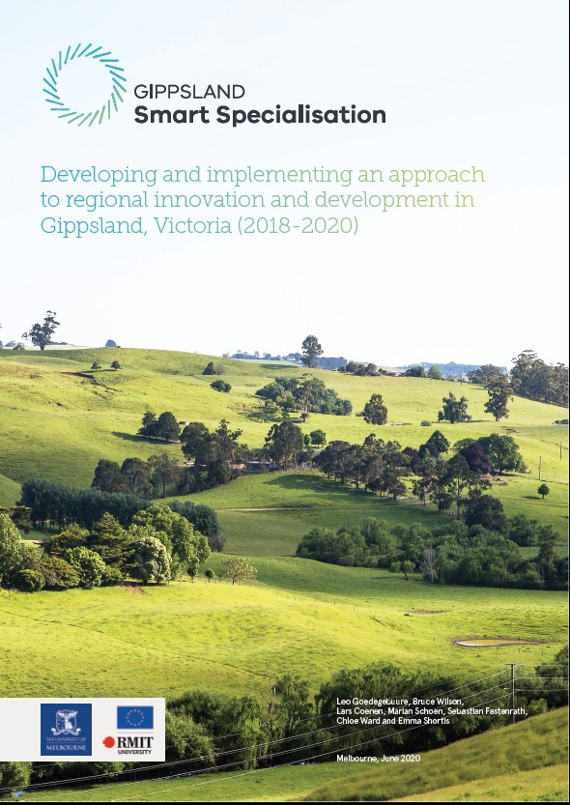

Smart specialisation, policy experimentation and place-based sustainability transitions: insights from Gippsland, Australia
Lars Coenen
Mohn Centre for Innovation and Regional Development
Honorary Prof. University of Melbourne
lars_coenen
SMARTER 2020 Conference - 3d webinar - Smart Specialisation for Sustainable Development Goals
10/11/2020

Slide 2
Objective of this talk
What? To reflect on the possibilities for Smart Specialisation to shift gear towards transformative Agenda 2030 policy
How? Applying S3 on the renewal of the regional economy of an iconic Australian coal region experiencing the transformative local impact of an unfolding global low-carbon transition in its full force.
Development by design or by delivery?
S3 and its heroic assumptions (Marques and Morgan, 2018)

Slide 3
Smart Specialisation in Australia: Latrobe Valley and Gippsland S3
March 2017: Closure of coal mine triggered policy response
Latrobe Valley Authority: Triage, Recovery, Reconstruction
Low levels of confidence, the resentment of Melbourne decision-makers and the vested interests and tensions in the existing arrangements of local government and industry politics across the region
Adoption of S3 marked a sharp departure from the typical Australian response of relying on infrastructure investment and grants programs and a hyper hightech-centric view on innovation

Slide 4
What made GS3 experimental & sustainable?
Integrated, long-term policy framework based on four platforms for regional diversification: food & fibre, new energy, visitor economy, health and well-being
Inclusive governance based on cross-sector deliberation & partnerships through entrepreneurial discovery
Innovation beyond a silver bullit: economic, social & environmental impact
The role of science & scientists
Direct engagement with citizens (quadruple helix)
Re-installing (state) capability for implementation

Slide 5
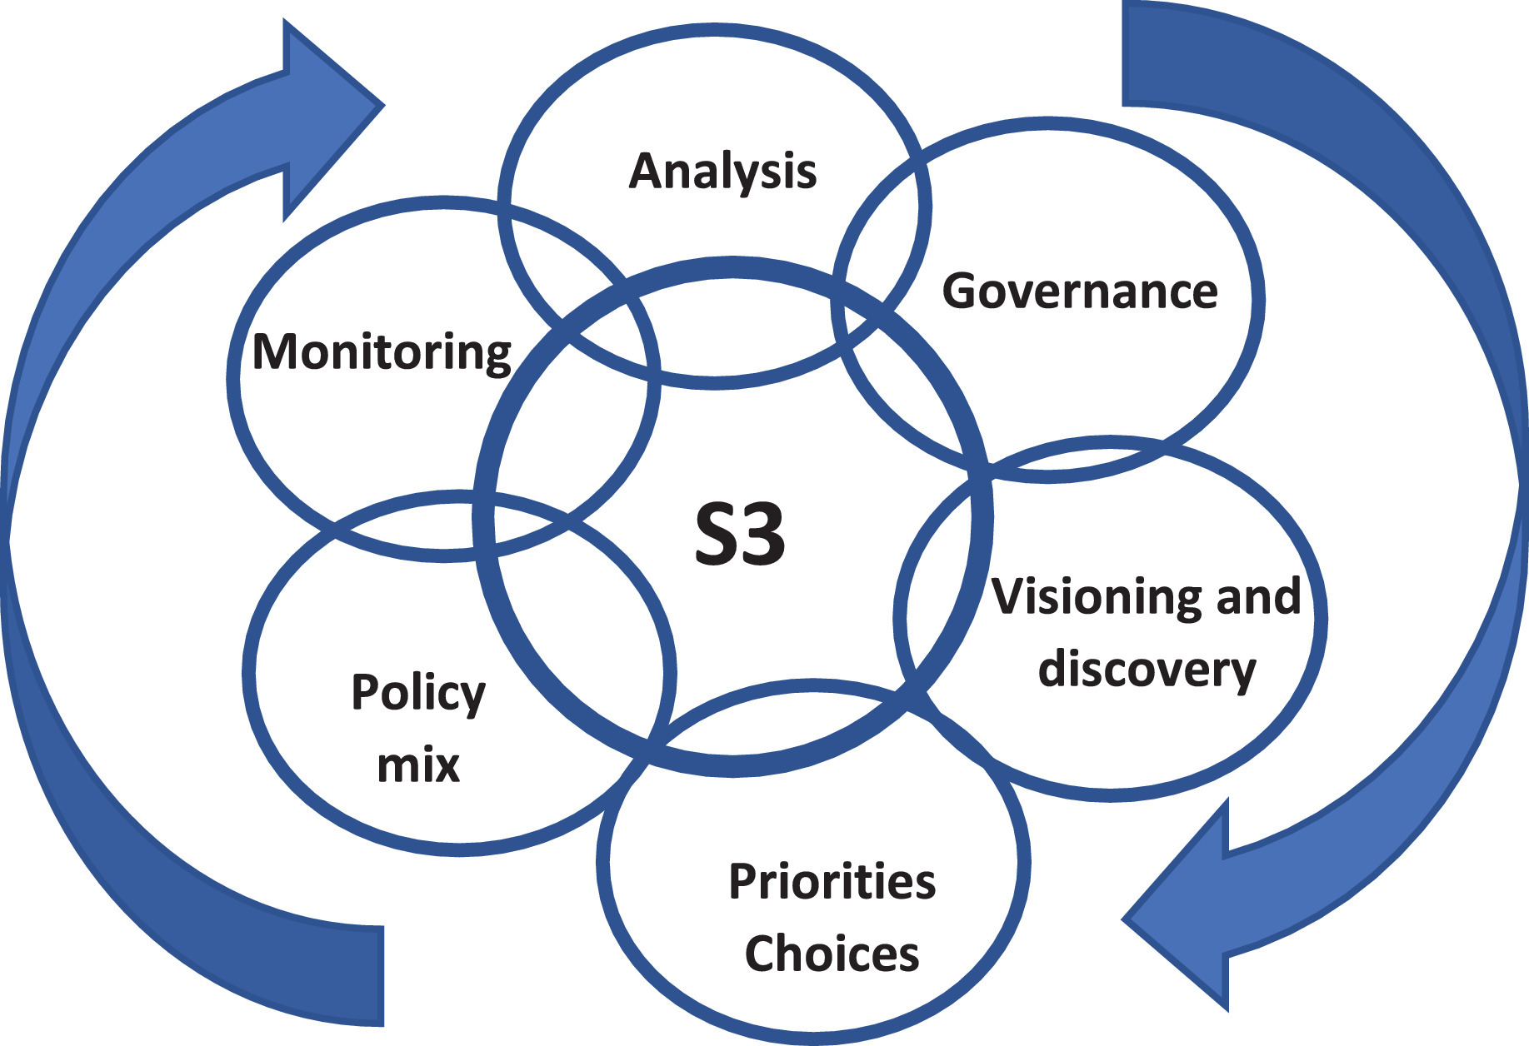
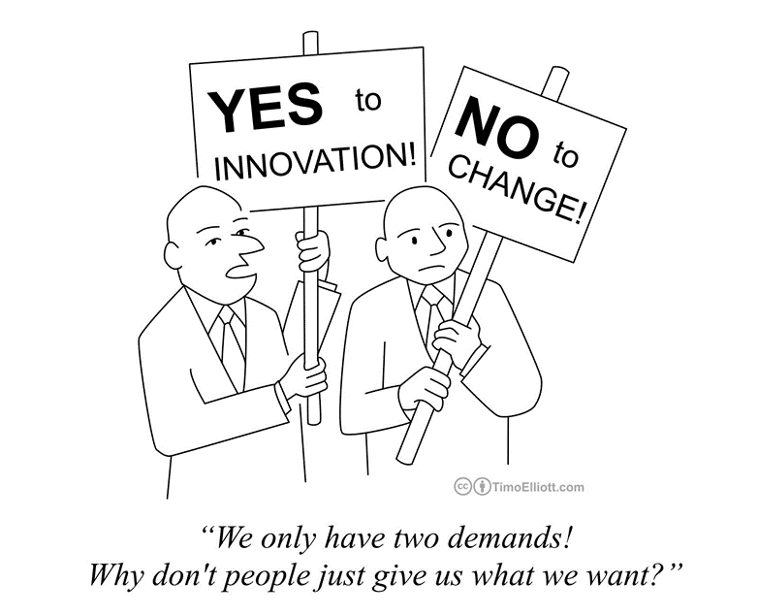
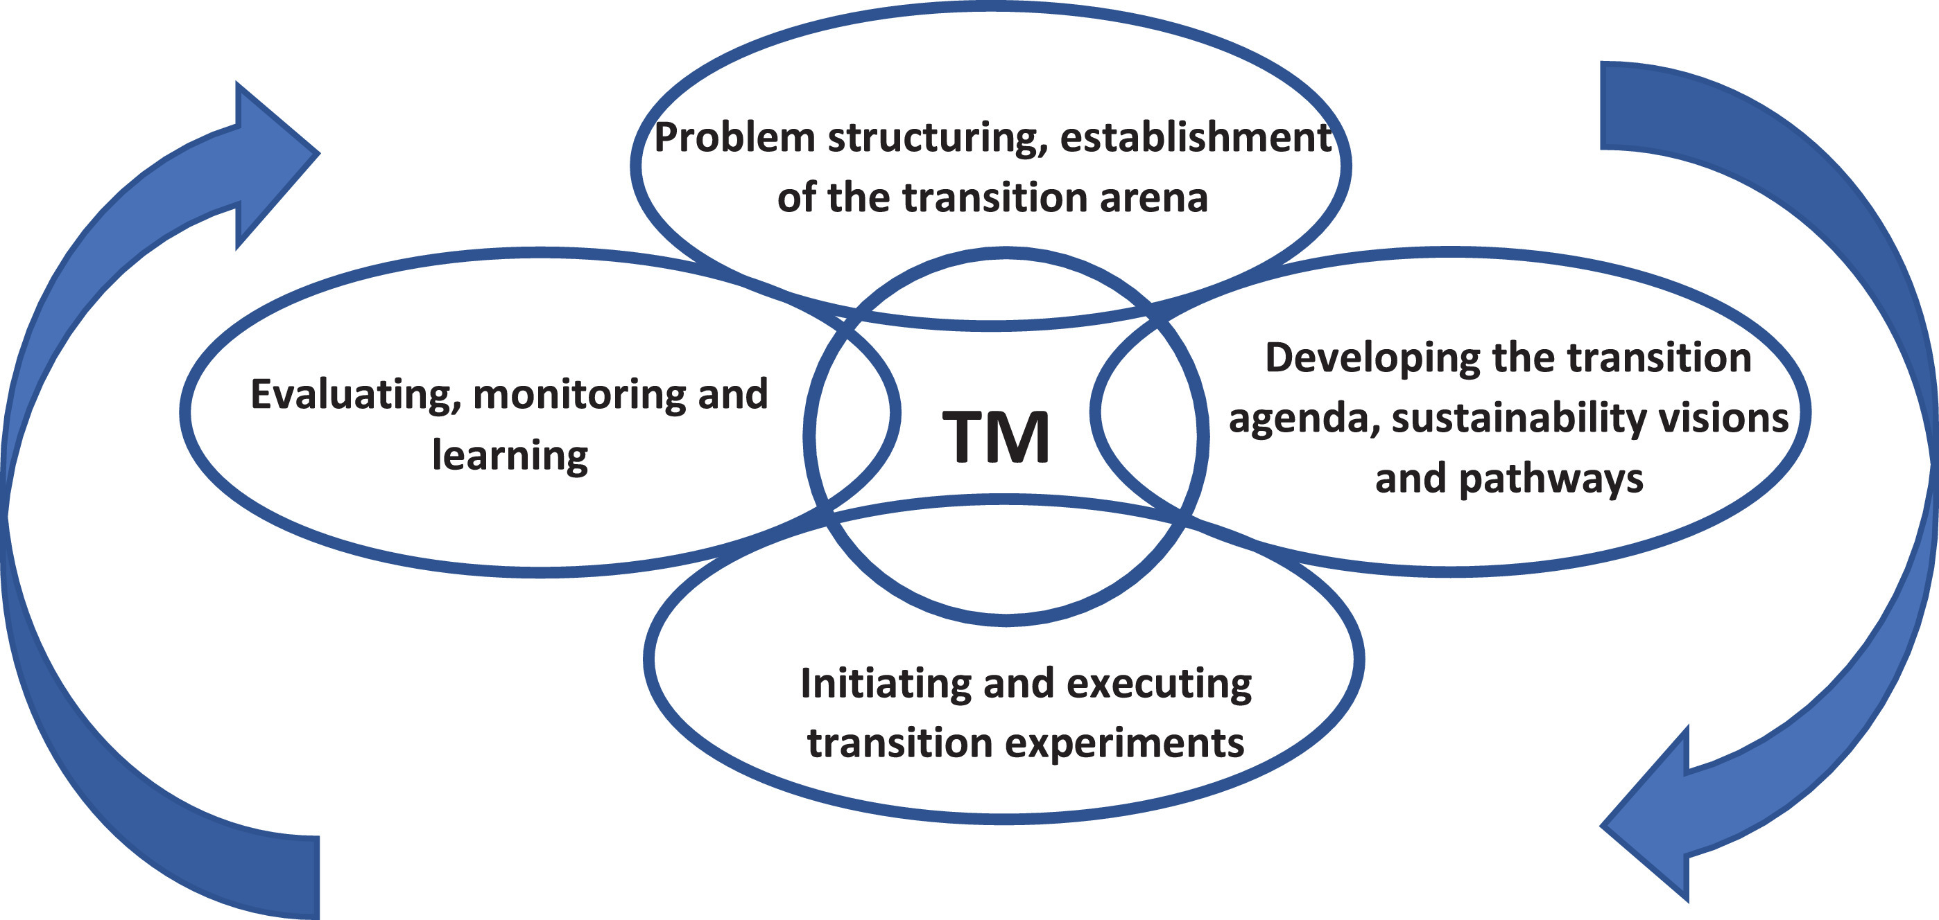
Smart specialisation strategies as part of wider sustainability transitions: From S3 to S4?

Slide 6
Local embedding of sustainable smart specialisation
Point of departure: regional capabilities enable (related & unrelated) diversification (Balland et al., 2019) and place-based transition (Hansen and Coenen, 2015).
Greater attention required for agentic and conflictual aspects of ‘establishing inclusive, collaborative governance arrangements’ in S3 (Boschma et al., 2017)
Power dynamics and conflicts stemming from contradictory interests among stakeholders (and SDGs)
The role of institutional entrepreneurship (Grillitsch & Sotarauta, 2020)
Taking place-based institutions (more) seriously (Gertler, 2018)
S3 as ‘empowering and leverage niche experimentation’: ‘fit and conform’ or ‘stretch and transform’ (Smith and Raven, 2012; Bugge et al., 2017)
Questioning the purpose of innovation in S3
Beyond growth poles & alternative rationales for economic development (e.g. foundational economy)
Greater appreciation of socio-ecological models of innovation (Healy and Morgan, 2012)
Responsible innovation in an age of growing polarisation (Fitjar et al., 2019)
New geographies of innovation (Coenen & Morgan, 2020)?

Slide 7
Conclusions
S3: the development challenge is largely framed as a ‘technical problem’ that can be ‘solved with greater knowledge
S4: the development challenge becomes wicked
Sustainable smart specialisation strategies as governance experiments orchestrated by an (locally) embedded state and delivered through local pop-up innovation systems emerging around a particular articulation of a broader sustainability challenge (Wanzenböck and Frenken, 2020)
Institutional design principles from ‘robust action’ (Ferraro et al., 2015; Fastenrath and Coenen, 2020)
S4 has ‘prescriptive’ dimensions that nonetheless offer interpretative flexibility around boundary objects (entrepreneurial discovery, SDGs) to promote coordination without requiring explicit consensus.
S4 is contingent on participatory / associative institutional architecture and thus local qualities of institutions & government (Rodriguez Pose & Di Cataldo, 2015)
Can one identify institutional conditions that enable a culture of experimentation?

Slide 8
Thank you

