Slide 1
Human capital, S3 and EU funding opportunities
Marie Lalanne and Jayne Woolford (JRC)

Slide 2
HESS WP4
Understand how investment in skills and human capital can support competitiveness and growth, how HEIs can act as drivers for innovation and regional development; general difficulties in integrating human capital in S3 approaches.
Development of skills in line with S3 and S3 domains and workforce transition in the light of the twin transitions – recognised as an integral part of the S3 process in the 2021-2027 ESIF regulations.
Analyse ERDF investments in human capital and skills in the 2021-2027 programming period - the level of financing, type of initiative funded and potential beneficiaries. Broadened to include 2014-2020 ERDF and ESF investments and 2021-2027 RRF investment.
Notes:
CPR 2021-2027:
Policy Objective 1, Specific objective 4 Developing skills for smart specialisation, industrial transition and entrepreneurship.
Intervention code 023: Skills development for smart specialisation, industrial transition, entrepreneurship, and adaptability of enterprises to change.

Slide 3
ERDF and ESF investment 2014-2020
Over 45,000 projects (c.8% of the total) funded under ERDF representing 24.0 bn € (11.3%) of the total ERDF commitment could be identified as skills-related activity relevant to smart specialisation (S3). The corresponding figures for ESF are 71,385 projects (8.4% of the total) representing 14.9 bn € (17.3%) of the total ESF commitment.
HEIs lead 11,759 (16,574) projects overall representing 6% (4.6%) of total ERDF (ESF) funding and 9.1% (9.3%) of total lead beneficiaries.
But only 1.1% (3.6%) of all ERDF (ESF) projects i.e. around 6,130 (2,580) represented S3 Skills projects led by a HEI.
Notes:
HEI projects seem to focus on smart specialisation objectives more widely but not necessarily with a human capital dimension

Slide 4
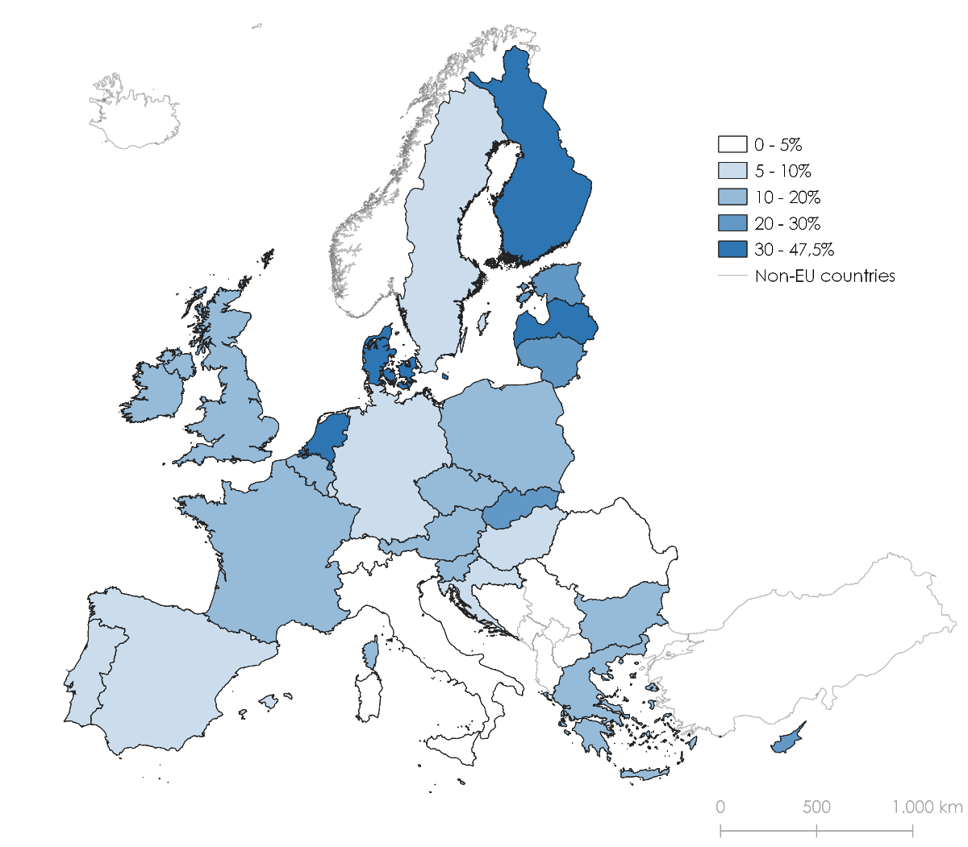
Share of ERDF allocated to Skills for S3 projects identified by country, as % of total ERDF co-funding amount (2014-2020)
Notes:
Hungary has a mere 2.3% of all ERDF-funded projects identified as relevant compared to Denmark with a significant 55.6% of all ERDF projects related to Skills for S3
Geographical distribution of Skills for S3 funding varies significantly across the EU territory:
- different funding processes, programmes (national, regional, INTERREG) and reporting schemes
- differences in country size and levels of regional development (affecting ERDF eligibility and funding received)
- socio-institutional diversity

Slide 5
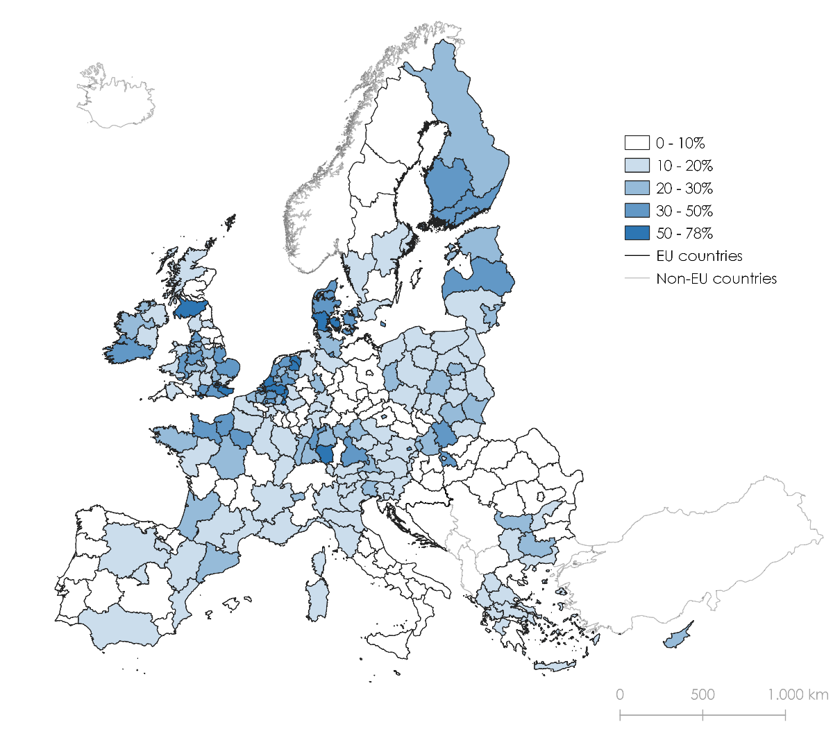
Share of ERDF co-funding amounts for Skills for S3 projects identified by NUTS-2 region, in % of total ERDF co-funding amount (2014-2020)
Notes:
- several countries such as Austria, the Czech Republic, France or Poland, demonstrate larger shares of ERDF funding for Skills for S3 projects in capital city regions
- in Sweden or Italy for example, Skills for S3 projects appears to be linked to a higher regional economic development status, the presence of a relatively large manufacturing sector or industrial clusters

Slide 6
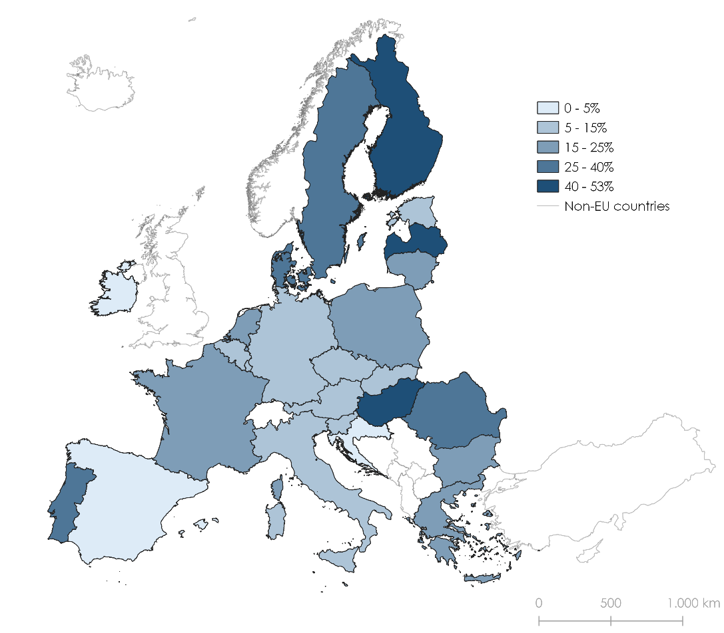
Share of ESF co-funding for Skills for S3 projects by country (% of total ESF (maximum) co-funding amount)

Slide 7
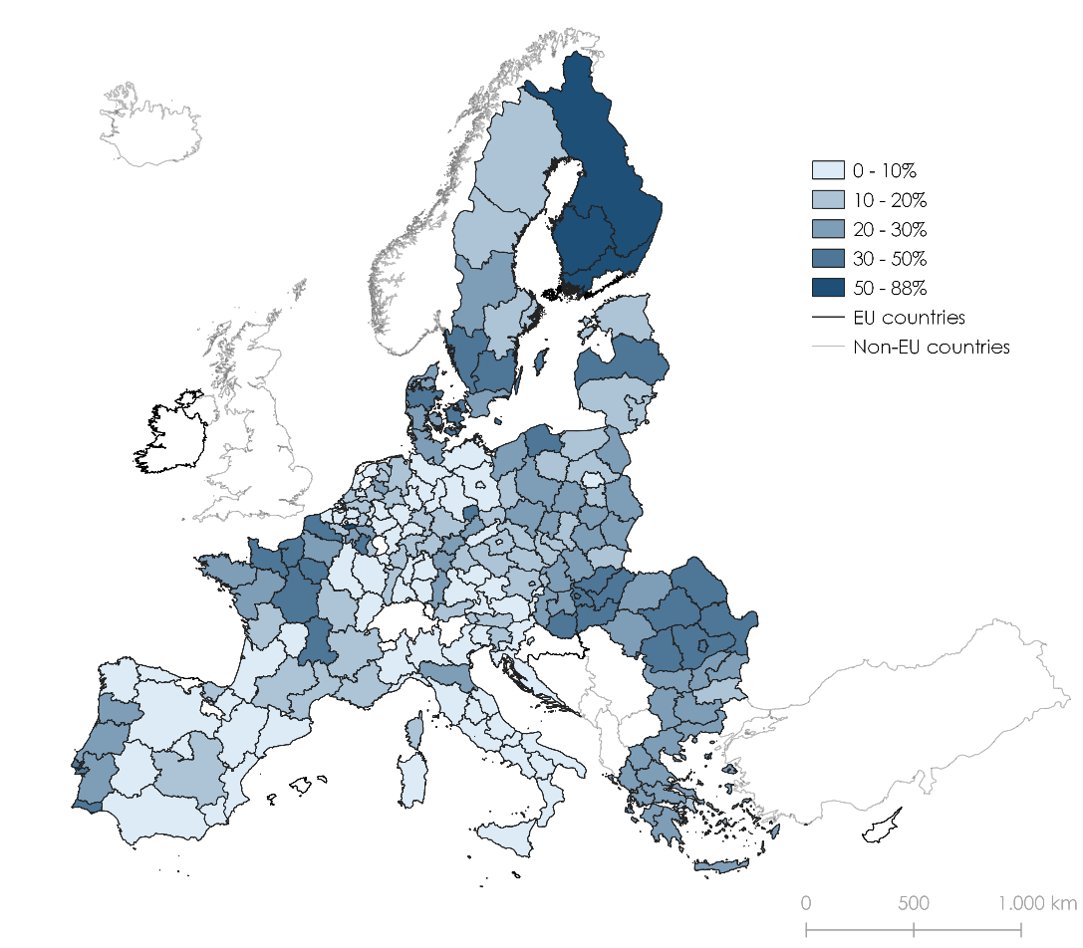
Share of ESF co-funding for Skills for S3 projects at NUTS-2 level , % of total ESF co-funding

Slide 8
Investment in HESS case study regions 2014-2020
(NB: quantitative and qualitative analysis for ERDF)
Case studies: significant variations from the overall EU figure of 11.3% (15.8%) of the total ERDF (ESF) co-funding
In half of the case study regions, ERDF amounts are larger than the 11.3% figure. Most significant result: In Groningen (NL11) and Drenthe (NL13) (more than 60% of the total co-funding amount)
Lower than the ERDF 11.3% figure: PT regions, Navarra, Nord-Est and Puglia. Seeming North/South divide, but low % also for Germany (7.3%) and Sweden (7.7%). The lowest share is found for Italy (4.7%).
Puglia has the lowest share of Skills for S3 funding across both funding streams (ERDF 1.3%, ESF 3%). Nord-Est and Algarve displayed significant differences between ERDF and ESF funding shares (2.4% vs 36.4% and 5.7% vs 34.4%).
Notes:
Whilst the majority of case study regions (14 out of 20) display a higher percentage share of Skills for S3 funding in the ESF analysis, the three Dutch regions (NL11, NL12, NL13), Navarra (ES22) and Lower Austria (AT12), as well as one of the Lithuanian regions (LT01) showed a higher share of Skills for S3 investment under ERDF.

Slide 9
Investment in HESS case study regions 2014-2020
Share of ERDF Skills for S3 projects run by a HEI: from 1% in Puglia (ITF4) to 38% in the Algarve region (PT15). Average of 14%.
The unequal distribution of HEI-led Skills for S3 projects reflects geographical aspects such as the degree of urbanization and presence of top-ranking universities.
Clear distinction in terms of the typology and types of projects funded. Variations across different regions in types of activity funded seems to reflect levels of regional economic development and HEI capacity rather than need. (i.e. more innovative developed regions are investing more than lagging regions)

Slide 10
Typology of HEI projects developed from qualitative analysis of a sample from HESS case study regions (ERDF)
Type of HEI Skills for S3 ERDF funded project 2014-2020 | Description
Type A - Enhancing HEIs excellence through investing in research infrastructure and capacity | Projects with a focus on HEI needs – investment projects in research infrastructure, IT tools and research projects but without clearly defined market potential or commercial interest.
Type B - HEI engagement with and embedding in innovation ecosystem | Projects of a systemic nature - targeted on the needs of public administration, institutions, and other non-business stakeholders. Aim to develop tools, databases, research, platforms, policy dialogue, and capacity build.
Type C - Promoting business innovation and competitiveness | Projects have a clear focus on the market / business needs, through the development of links between HEIs and enterprises and technology/knowledge transfer projects or through skills development.
Notes:
HEI-implemented Skills for S3 projects funded under mainstream national / regional Operational Programmes tended to concentrate on improving research infrastructure and capacity, reflecting the needs of the individual institutions (78% of the selected sample). Over focus on supply-side measures (investment in R&I capacity), rather than on supporting emerging sectors and innovation.
Conversely, INTERREG-funded Skills for S3 projects, were more likely to focus upon institutional capacity building and internationalization, to include an explicit focus upon human capital development and incorporate a broader set of actors

Slide 11
ERDF allocations 2021-2027
Of the 190 ERDF programmes, 68 of them (36%) include a financial allocation for RSO1.4 and 94 of them (49%) for CoE23.
  Policy Objective 1, Specific objective 4 Developing skills for smart specialisation, industrial transition and entrepreneurship.
Intervention code 023: Skills development for smart specialisation, industrial transition, entrepreneurship, and adaptability of enterprises to change.
Of the total ERDF allocation, 0.73% goes to SO1.4, 0.94% to CoE23 and 0.67% to both SO1.4 and CoE23, i.e. the total percentage is 1.01% (corresponding to 2.1 bn €).
Tendency for national/multi-regional programme to spend a greater percentage amount on RSO1.4/CoE23 than regional programmes.

Slide 12
ERDF allocations 2021-2027
5 MSs with no funding allocated to SO1.4 or CoE23: AT, CY, DK, IE, LU
IT: 17 of its 21 regional programmes allocated funding to SO1.4
RO and SE: all of their 8 regional programmes have funding allocated to both SO1.4 and CoE23

Slide 15
ERDF indicators 2021-2027
Indicators most used for SO1.4:
Code | Number of programmes | Definition
RCO01 | 30 | Enterprises supported
RCO101 | 53 | SMEs investing in skills for smart specialisation, for industrial transition and entrepreneurship
RCO16 | 32 | Participations of institutional stakeholders in entrepreneurial discovery process
RCR98 | 52 | SMEs staff completing training for skills for smart specialisation, for industrial transition and entrepreneurship

Slide 16
ERDF indicators and activity 2021-2027
MSs tend to use similar indicators across their different programmes
RCO101 (SMEs investing in skills for S3) and RCR98 (SMEs staff completing training for skills for S3), by far the two most widely used common indicators for RSO1.4, are almost always used in combination with each other
SO1.4 covers two main types of activity:
  1/ supporting enterprises with training for skills for S3 (36 out of 68 programmes)
  2/ supporting EDP (8 out of 68 programmes)
  3/ both (23 out of 68 programmes)

Slide 17
RRF allocations 2021-2027
Quantitative analysis of all RRF measures across EU27 from 2 sources
Seven case studies: EL, ES, FI, FR, HU, IT, LT, also more qualitative approach
Shared elements: inclusion of investments related to the green and digital transitions
The case study countries exemplified national innovation ecosystems at different levels of development (different priorities and extent of funding needs). However, countries with both a strong innovation ecosystem and tradition of university-business collaboration (FI) and those with innovation ecosystems in earlier stages of development (HU) included investments in strengthening R&D&I ecosystems.
Notes:
Here explain Bruegel and Fenix – two pieces of work to validate the approach/figures. Caution around the fact that the plans have already been modified significantly …

Slide 18
RRF allocations 2021-2027
Best practice examples:
  allocations explicitly referred to national-level S3 strategies, with most of these consisting of funding for R&D projects focused on S3 priority topics or reform of the educational system to provide students with skills most relevant for strategic economic sectors or areas defined by the country’s national S3 strategy
  allocations that explicitly mentioned the need to redefine the missions of HEIs and strengthen their contribution to regional development, including reforms and investments to bring together industry and public research players, redesign university curricula and operation to ensure alignment with local societal and economic needs, and promote employment and skills development based on local specificities

Slide 19
RRF allocations 2021-2027
FENIX database 494 measures
(versus 242 Bruegel)
corresponding to 57.78 EUR billion
(versus 60.17 EUR billion Bruegel)
of a total of 505.86 EUR billion i.e.
11.42% (versus 491.51 EUR billion
and 12.24% Bruegel)
Notes:
This table shows the figures of the graphs next slide so maybe drop this slide?
Marie- I would put the amounts and % at 2 decimal places and highlight the extremes at either end. I took out the graph in the next slide as it was too small to see a clear picture, so I would talk to this slide instead

Slide 20
Notes:
Skills for S3 measures selected (by Jayne and Marie) from the FENIX initial plans database (only green measures)

Slide 21
With thanks to our experts for their collaboration
WIFO, Austria (particularly Julia Bachtrögler-Unger and Anna Burton)
Krzysztof Gulda
T33, Italy
Blomeyer & Sanz, Spain

Slide 22

Thank you
© European Union 2020
Unless otherwise noted the reuse of this presentation is authorised under the CC BY 4.0 license. For any use or reproduction of elements that are not owned by the EU, permission may need to be sought directly from the respective right holders.
Slide xx: element concerned, source: e.g. Fotolia.com; Slide xx: element concerned, source: e.g. iStock.com
Notes:
Update/add/delete parts of the copy right notice where appropriate.
More information: https://myintracomm.ec.europa.eu/corp/intellectual-property/Documents/2019_Reuse-guidelines%28CC-BY%29.pdf

