Slide 1
Higher Education and Partnerships for Regional Innovation
Ellen Hazelkorn, Henning Kroll, Alessio Cavicchi
Seville, 14th December 2023
Notes:
The research will identify, analyse and map different approaches and articulations of the role and functions of HE within the pilot PRI approaches, and identify emerging best practice not only in the regions taking part to the pilot phase.. The analysis will consider the extent to which experiences reflect variations across HEIs and their territorial and socio-economic/cultural contexts, including the specific interaction and engagement of stakeholders, the types of outcomes sought, and the extent to which they promote skills relevance and resilience.
In the first section, Ellen Hazelkorn provided a policy framework for the System of Education in PRIs.
In the second section, Henning Kroll analysed challenges and functions of Universities
In the third section, I’ve analysed regional authorities challenges and fucntions in multi-sector, multi-level and multi-funding partnerships

Slide 2
Policy Framework - 1
Regional vitality depends on dynamic tertiary institutions
Policy and academic literature on Smart Specialisation Strategies (S3) has focused on the role played by universities and university-based research as a key driver of innovation and regional development. However, in the future, sustainable social and economic development requires human capital in the broadest sense: graduates from all levels of education who are capable of creativity and critical thinking, initiative and independent action.
Along with primary and secondary schools – and looked at spatially – they collectively create a dynamic multi-faceted education eco-system which has the capacity to produce a pipeline of talent, support innovation by raising the overall productive capacity in high-tech as well as low-tech industries, drive competitiveness and growth policies for the digital and green agenda and support social cohesion
To sum up: Widening the lens of PRI
Notes:
While new jobs will be in high-skilled industries, almost 45% of employment (according to Cedefop) will require middle skills. Failure to recognise this is leading to most EU countries experiencing huge skills gaps. Lagging regions experience uneven access to basic services, infrastructure and education, and struggle with underdeveloped innovation systems, low productivity and educational attainment and employment compared with other regions. They experience brain drain of tertiary students and highly educated professionals. ﻿
Policy across EU, OECD, UNESCO – and countries moving towards tertiary.
The term tertiary education is used as a reference for the whole post-secondary sector, covering all types of higher education institutions, including, in accordance with national law or practice, research universities, university colleges, universities of applied sciences (UaS), higher vocational education and training institutions (TVET), and higher arts institutions. This is equivalent to ISCED and EQF Level 5-8.

Slide 3
Policy Framework - 2
2. Increasing awareness of all forms of innovation
Historically, there was a tendency to see skills and knowledge as distinct bodies of “activity” ascribed to institutions according to whether they provided vocational, professional or academic learning. However, today, there is a deeper appreciation that skills and knowledge are interdependent and iterative elements of a dynamic innovation system; a knowledge base underpins all skills formation.
By taking a wider approach and linking skills with innovation and regional policy, it is clear innovation occurs across all types of economic activity, from low to medium and high tech.
This is not always or only associated with “high-skill research scientists, R&D staff, knowledge experts and senior organisational and production managers” etc. The key point is that innovation is more diffuse than something being handed down by research universities and company R&D departments.
To sum up: By putting so much focus on research universities and start-ups, we miss the key point. It is people – our graduates –, who catalyse knowledge, contribute to a shared pool of ideas throughout society and drive/lead innovation.
Notes:
Accordingly, engagement with/between universities as well as UaS and TVET is vital – without which it will be impossible, as the OECD says, to move employment into the high skills quadrant and close the regional disparity gap.
By putting so much focus on research universities and start-ups, we miss the key point. It is people – our graduates –, who catalyse knowledge, contribute to a shared pool of ideas throughout society and drive/lead innovation.

Slide 4
Policy Framework - 3
3. Initiatives with PRI opportunities
Understanding the breadth of the education system and what can be achieved by creating collaborative regional partnerships.
Regional Partnerships have the potential to make a concrete, systemic and sustainable contribution to regional regeneration and growth. Successful strategies involve research universities, polytechnics/universities of applied sciences and TVET schools working in intensive and genuine partnerships with other regional actors.
The objective is to reject atomised strategies/activities, petty rivalries and competition in favour of “maximising capacity beyond individual capabilities ”.
More structured engagement on the skills agenda leads to better outcomes for learners and enterprise development. Governance arrangements are key.
Developing study programmes, in curriculum development, in work-related experiences and in quality assurance reviews.
To sum up: PRI criteria should require alliance across the tertiary landscape
Notes:
TVET institutions can affect curriculum and pedagogical practices given their discipline specific expertise, in other words bringing practice directly into their teaching. For example, the teacher of apprentices can bring insights from engineering directly into shaping the changing work of electrical trades' apprentices. Similarly, teachers of aged care workers can consider integrating new health research (e.g. Alzheimers) into the career preparation of care workers. Finally, the digital transformation could be included horizontally in all VET programmes, given the impact it can have on productivity. Compared to university academics, VET teachers are often better placed to integrate practice into teaching because they are more likely to have had the practical experience themselves. It is also one of the key reasons why VET teachers need higher education qualifications that include emphasis on the scholarship of teaching and

Slide 5
Functions and challenges of HEIs
they provide higher education to the local population
they span global and regional knowledge networks
they can serve as neutral, solution-oriented brokers in strategy processes
Challenges
loosely-coupled entities in which leadership has limited power
very safe employment contracts, great freedom to decide individually at working level
individual researches are facing conflicting demands from all three missions (research, teaching, transfer) at once and can typically not address all at the same time – hard in particular for young ones who have to publish
disciplinary fragmentation as a cultural problem - in particular where interdisciplinary solutions are required

Slide 6
Fundamental questions for HEIs
Fundamental question for mid-term, mid budget policy initiatives like the PRI:
“how to make universities' contribution to the twin transitions
more strategic, more coordinated and more targeted”
how can existing commitment be activated ?
how can existing activities can be better coordinated and complemented?
first “key”, lies in activating university researchers individual interest in contributing to change
Second, in establishing fora and creating occasions where individual impulses transform into collective agency
Notes:
enable an internal flow of knowledge and to establish fora within universities by means of which creativity can be leveraged and relevant competences combined
interfaces have to be improved between the university and its external environment, to make university actors more aware of the external problems that they could tackle
prompt cross-disciplinary discussions about new, additional efforts relating to twin transition related challenges in university's primary domains of research and teaching
leverage the PRI as an opportunity to intensify existing discourses with firms, local public authorities and NGOs in order to identify feasible and useful contributions that the university can make to its local environment.
existing organisational structures offer themselves readily as the platform for such activities. Many universities have rather competent technology transfer offices
the more ambitious idea of creating new structures for purpose should not be out of consideration.
If, in a particular situation, available structural funding e.g. permits the set-up of a new university-industry campus, new satellite units close to relevant stakeholder or the creation of actual posts for researchers

Slide 7
Fundamental questions for HEIs
PRI process dimension of engaging regional actors.
      build the institutional capacity to identify researchers having information and networks with change agents in the region
PRI process dimension of envisioning future challenges.
      strategically plan curricula on the basis of assumptions regarding the development of skills needs in the (regional) workplace
      connect their regional environment to the most recent global discussions in the field of the twin transitions
PRI process dimension of orchestration
      introduce new, soft institutions like additional platforms, working groups or discussion circles
      reallocate resources in/to the technology transfer office or around the vice-president for university-industry relations
      align the PRI activities with more momentous opportunities provided at national or European level
level of the design of support measures and policy actions
      have experienced researchers provide information on suitable funding modalities
      university management can commit to make administrative provisions so that funding can effectively processed
      internal working groups to establish where there is a demand for additional support and, if so, of which type
Engagement in policy learning at both the technical and the strategic level
Notes:
enable an internal flow of knowledge and to establish fora within universities by means of which creativity can be leveraged and relevant competences combined
interfaces have to be improved between the university and its external environment, to make university actors more aware of the external problems that they could tackle
prompt cross-disciplinary discussions about new, additional efforts relating to twin transition related challenges in university's primary domains of research and teaching
leverage the PRI as an opportunity to intensify existing discourses with firms, local public authorities and NGOs in order to identify feasible and useful contributions that the university can make to its local environment.
existing organisational structures offer themselves readily as the platform for such activities. Many universities have rather competent technology transfer offices
the more ambitious idea of creating new structures for purpose should not be out of consideration.
If, in a particular situation, available structural funding e.g. permits the set-up of a new university-industry campus, new satellite units close to relevant stakeholder or the creation of actual posts for researchers

Slide 8
Regional authorities engaging in multi-sector, multi-level and multi-funding partnerships, activities, and learning pathways: rationale, projects and tools
Alessio Cavicchi
Seville, 14th December 2023
Notes:
The research will identify, analyse and map different approaches and articulations of the role and functions of HE within the pilot PRI approaches, and identify emerging best practice. The analysis will consider the extent to which experiences reflect variations across HEIs and their territorial and socio-economic/cultural contexts, including the specific interaction and engagement of stakeholders, the types of outcomes sought, andthe extent to which they promote skills relevance and resilience

Slide 9




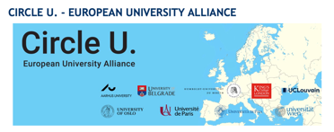

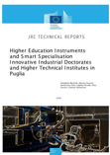

Personal experience on HESS and related EU initiatives: TWL, FoodBiz, MOOC on Agrifood in the Med, Heinnovate, EIT-HEI initiative, European Universities
High Schools and ITS
HEIs
Entrepreneurs and Local Communities
Notes:
make working together entrepreneurs and students on common perceived problems, through workshops and learning events;
favour the creation of new business ideas, jointly generated by entrepreneurs and students in the frame of entrepreneurial discovery process events;
stimulate the establishment of professional links within the sector in the region, to promote knowledge exchange and co-creation.
Regional communities building (the Wine Hubs),
place-specific, multi-stakeholder and being able to solve real-world issues
Mobility of students in wine companies
Wine Living Labs – workshops, hackathons, seminars, transnational learning weeks, to make researchers, students and wine makers working together
Learning materials and short courses, where winemakers, professionals and students learn together

Slide 10
Definitions
Multi-Level Projects for regional authorities means being involved in collaborative initiatives that require multiple levels of governance, often including local, regional, and national government bodies, working together to address a shared issue or pursue a common goal (i.e. Innovative industrial PhD in Italy within the framework of Regional and National S3)
Multi-Sector Projects see the involvement of different industries, sectors, or domains within a specific region, facilitated and coordinated by regional government bodies. The goal is to foster cross-sectoral partnerships to tackle complex challenges that require a holistic approach, bringing together expertise from diverse fields to create innovative solutions and promote sustainable development (i.e. High Tech Farming)
Thanks to Multi-Funding Projects, regional authorities can get financial support from multiple sources, often including local, regional, national, and international (European) funding streams. In this context, regional authorities play a key role in promoting and/or coordinating and/or managing the various funding sources to ensure projects’ successful implementation (i.e. regional incubators funded by various sources)
Notes:
Multi-Level Projects for regional authorities means being involved in collaborative initiatives that require multiple levels of governance, often including local, regional, and national government bodies, working together to address a shared issue or pursue a common goal. This type of project acknowledges the interdependence and interconnectedness of various administrative levels, aiming to leverage their combined resources, expertise, and decision-making capacities to achieve more effective and comprehensive outcomes.
Multi-Sector Projects sees the involvement of different industries, sectors, or domains within a specific region, facilitated and coordinated by regional government bodies. The goal is to foster cross-sectoral partnerships to tackle complex challenges that require a holistic approach, bringing together expertise from diverse fields to create innovative solutions and promote sustainable development.
Thanks to Multi-Funding Projects, regional authorities can get financial support from multiple sources, often including local, regional, national, and international (European) funding streams. In this context, regional authorities play a key role in promoting and/or coordinating and/or managing the various funding sources to ensure projects’ successful implementation. This approach diversifies the project's financial base, reduces risks associated with single-source funding, and enhances the project's potential impact. Specifically, in the context of European innovation ecosystem, this means a continuous search for synergies between direct and indirect (cohesion policy) funds available for research and development projects.

Slide 11
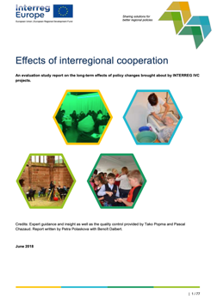
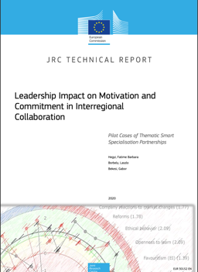
Background context: success factors in policy reports
For leaders:
- feedback culture
- setting clear objectives,
- developing conflict management competences
- improving culture of control, involvement and delegation techniques and general communication skills.
For partners:
- development of team spirit and
- strengthening the perception of usefulness of work and of partnership vision as well as the definition of clear responsibilities and the work on individual opportunities.
- having the decision makers ready to carry out the desired policy change
- the exchange of experience”
- putting in practice solidarity which is at the heart of the Cohesion policy
- capacity building
- involvement of local stakeholders groups thanks to international mobility and experiential learning,
- better use of structural funds
ss
Notes:
As it has been stated by Hegyi et al. (2020) these recommendations can enhance leadership and partner collaboration, ideally through the development of leadership competency and ACTION LEARNING rather than through conventional leadership skill trainings. Action learning, described by Mintzberg et al. (1998), is a dynamic and complex collaborative process where issues from real-world projects are resolved.
The use of context-specific action-based approaches in interregional partnerships would provide a way to look for pathways to improve an organization's performance from a shared task. The collaborations can be seen as a learning system where each partner can obtain solutions to its own problems. HEIs can facilitate this process to Regions by providing methods and talents to perform such learning pathways.

Slide 12
Challenges: personal investigation in dealing with S3
Internal staff turnover and lack of appropriate scientific knowledge: ensuring continuity of work, getting access to knowledge and updated information as well as profiting from existing professional networks is crucial for trans-regional cooperation in smart specialisation.
The necessity of a dialogue between regional officers at the local level and regional delegates in Brussels: good multi-level governance requires better dialogue between regional administrative staff and their colleagues delegated at the EU level in Brussels Regions’ headquarters.
Going beyond routine: for many regional officers involved in multi-level/funding projects, the time to be devoted to international collaboration has to be managed together with the office work routine. This work is often made of writing calls, setting up evaluation procedures, R&D contract agreements, relationships with beneficiaries of funding calls, etc
ss
Notes:
Internal staff turnover and lack of appropriate scientific knowledge: ensuring continuity of work, getting access to knowledge and updated information as well as profiting from existing professional networks is crucial for trans-regional cooperation in smart specialisation. Clearly, different thematic topics and priorities. i.e. industrial modernisation, agri-food, etc., require specific technical and sector-specific knowledge as well as a continuity of both information flows and staff involved in this process
The necessity of a dialogue between regional officers at the local level and regional delegates in Brussels: good multi-level governance requires better dialogue between regional administrative staff and their colleagues delegated at the EU level in Brussels Regions’ headquarters. In fact, a limited number of officers in Brussels often deal with several different projects and cannot be the only cockpit for these initiatives. Thus, a strong coordination between different administrative offices (local and at the EU level) is necessary.
Going beyond routine: for many regional officers involved in multi-level/funding projects, the time to be devoted to international collaboration has to be managed together with the office work routine. This work is often made of writing calls, setting up evaluation procedures, R&D contract agreements, relationships with beneficiaries of funding calls, etc… On one side, the participation in international projects can be a way to escape work routine and increase motivation among involved officers; on the other side, finding the right time to carry on something that is not “compulsory” for the Regional Authority, requires extra organisational effort as well as clear and shared objectives.

Slide 13
Challenges: personal investigation in dealing with S3
Importance of working on problem-solving / real challenges: there is a difference between pilot projects driven by a challenge felt by the industry and those driven by technology.
Lack of committed regional stakeholders: since in many countries and regions there is not yet a strong connection between public authorities and academia and that for several regions the S3 process is still limited to the duty of ex-ante conditionality, it is important to collaborate with stakeholders with a certain continuity in order to harmonise policy efforts with real usefulness.
ss
Notes:
Importance of working on problem-solving / real challenges: there is a difference between pilot projects driven by a challenge felt by the industry and those driven by technology. The latter are more complex to achieve and to bring to market, because, if on one side the technology could be really innovative, on the other side it may not meet specific needs and thus could result in completely useless suggestions and/or prototypes. The point is to work on problem-solving. Ideas have to be linked to high TRL.
Lack of committed regional stakeholders: since in many countries and regions there is not yet a strong connection between public authorities and academia and that for several regions the S3 process is still limited to the duty of ex-ante conditionality, it is important to collaborate with stakeholders with a certain continuity in order to harmonise policy efforts with real usefulness. Entrepreneurs and their associations are indeed called upon to support the Entrepreneurial/Open Discovery Process at the beginning of the programming period, and it happens that they don’t feel themselves as active stakeholders, neither in local activities nor in international partnerships. Thus, regions can make the most of local universities to facilitate this process.

Slide 14
Behavioural Additionality applied to PRIs
Typologies of Behavioural Additionality | Definition
Project additionality | Whether a PRI has resulted in an R&D or innovation project that would not have been conducted in the absence of a subsidy/support.
Acceleration additionality | Whether the participation in a PRI has an impact on the dimensions and the speed of the R&D innovation projects and initiatives
Scale & scope additionality | Scale: if PRI enables the institution (regional authority) to conduct a project on a larger scale than previously intended Scope: if PRI enables the institution (region) to expand a project to a wider range than without the initiative.
Challenge additionality | Whether PRIs encourage the Institution (Region) to conduct more risky and challenging projects.
Network additionality | Whether increased cooperation and networking resulted from PRI
Management additionality | Whether PRI initiatives have improved management practices and routines as a result of the regions’ participation
Follow-up additionality | Whether spin-off (follow up) projects are created because of the PRI initiatives.
Source: authors’ elaboration based on Lohmann (2014).
ss
Notes:
The term behavioural additionality is related to a multidimensional concept linked to the ability of institutions such as companies, public bodies, clusters, etc. to absorb new knowledge. The focus is on the building of innovation capabilities and competence-building in general, as well as on the organisations’ ability to make use of new technologies and R&D procedures elsewhere.
This idea of organisational learning suggests that the incentives for changes in institutional behaviours are linked in a direct (formal) or more indirect (informal) way with a learning process within the organisation. Huber (1991) argues that "an entity or organization learns if, through its processing of information, the range of its potential behaviours is changed". For this reason, Buisseret (1995) asserts that “companies and institutions undertaking publicly sponsored projects are rarely left unchanged by the experience” and thus, he defines the concept as “the change in a company’s way of undertaking R&D that can be attributed to policy actions”.

Slide 15





Cases: a) RE-ACT «Erasmus Forward Looking Project»
 | Participation in the project enabled PBS to engage with other HEIs to co-create solutions for divers, especially RIS3 related challenges. It also leveraged the connection with public actors, in line with PBSs strategic objective. Future opportunities also open for regional projects in areas such as health and tourism, new, emerging areas in Norte RIS3.
 | The team widened the HEI’s connections with other HEIs and the organisation responsible for RIS3. The project also strengthened the HEI’s presence in its regional campus, providing with further contribution to the development of CUB’s entrepreneurial profile.
 | The team supported the HEI for the attraction of funds through new projects, that will contribute to further strengthening entrepreneurial/civic university profile. Strengthened cooperation with RIS3 responsible organization and other stakeholders at regional level.
 | The Results of the project were reflected in the design of the Košice Self-Governing Region’s RIS3. The timing of the project activities and the development of the new RIS was an advantage. HEInnovate for RIS3 was also used in the preparation of a project in the Ulyseuss University Alliance.
 | The team supported Marche Region (Italy) official stakeholder engagement activities on RIS3 revision. UNIMC moderated the discussion among regional innovation eco-system’s stakeholders from each RIS3 priority area, by also investigating the civic/entrepreneurial role of HEIs in this context, based on RE-ACT’s framework.
ss
Notes:
The goal of Forward Looking projects funded by Erasmus+ is to find, create, test, and/or evaluate novel policy approaches that have the potential to become widely adopted, thereby enhancing educational and training systems. They support innovative concepts that address important European priorities and have the potential to be adopted. They also contribute to the improvement of education, training, and youth systems and have a significant innovative impact on all forms of learning and active participation environments for the social cohesion of Europe.
The objective is to aid in the implementation of international cooperation initiatives that involve a collection of sectoral or cross-sectoral activities that either:
a) foster innovation in terms of scope, ground-breaking methods and practices, and/or
b) ensure a transfer of innovation (across countries, policy sectors or target groups), thus ensuring at European level a sustainable exploitation of innovative project results and/or transferability into different contexts and audiences.
In 2019, 4 projects were funded. They were characterized by a high level of complementarity.

Slide 16
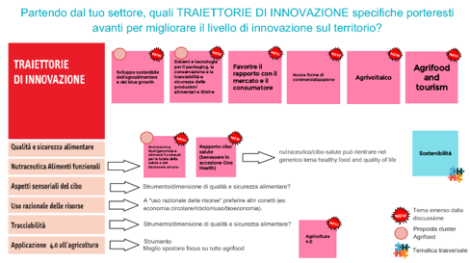
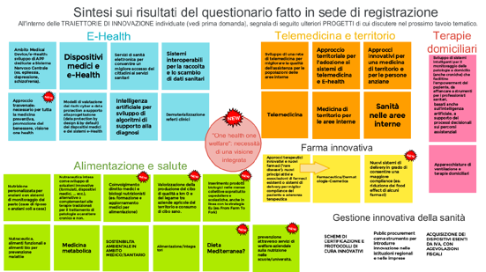
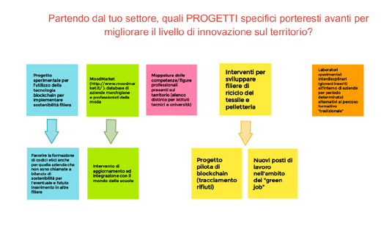
METHODOLOGY
FOR EACH TABLE:
Online meetings (TEAMS), use of Jamboard and Sli.do;
Sharing and discussing the results of the questionnaire (from the registration form) about proposals for actions on identified innovation trajectories;
Discussion on proposals for new innovation trajectories and re-organization of the existing ones (keeping/removing trajectories/identifying transversal ones)
Discussion about LEARNING NEEDS and related ACTIONS/PROJECTS

Slide 17
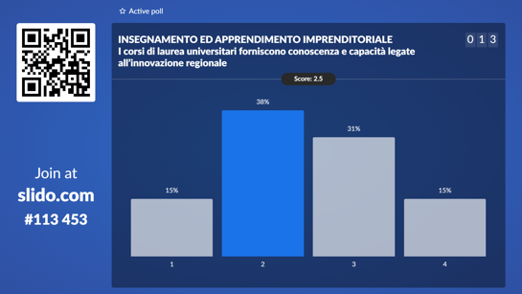
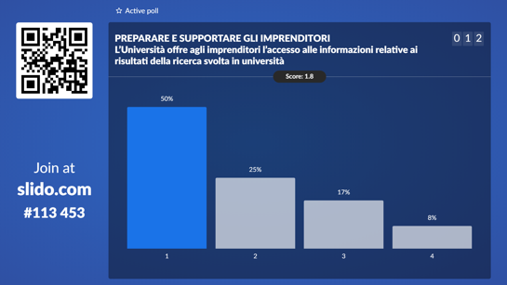
METHODOLOGY (2)
RE-ACT’s application to the context:
Presentation of the RE-ACT project during the meetings: objectives and activities;
Use of live polls on slido.com;
Testing and validating statements for the new “HEInnovate for RIS3” tool with participants from the meetings;
Selection of statements from the most feasible HEInnovate dimension/area applied to the context (e.g. Entrepreneurial Teaching and Learning; Supporting Entrepreneurs; Digital Transformation and Capability…)
Sharing and discussing the results of the live polls: proposals of actions for HEI’s improvement

Slide 18
Transversal topics emerged in all focus groups
Business/research cooperation
- importance of industrial doctorates;
- mapping of:
- competences on the territory in the specific fields
- training needs of companies;
- services provided by universities that are useful for companies;
- skills in programmes taught in HEIs;
- research areas developed at university level for the creation of databases aimed at sharing research results in relation to company needs and to avoid training overlaps between universities but also to facilitate transdisciplinarity;
- Companies/universities clusters. Hub of competences to draw upon in order to innovate > a continuous meeting point. Innovation brokers able to intercept the needs of the companies themselves;
- Digital innovation hubs (Marche Innovation Hub) and competence centres as tools to raise awareness in the area and support local businesses in launching innovative projects.

Slide 19
Transversal topics emerged in all focus groups
Innovation in training
already delivered vocational training courses to be aligned with regional innovation trajectories and to be considered for possible follow-up (avoiding overlapping with new training proposals);
importance of training new professional figures able to apply digital technologies at various company levels - process/production/organisation (e.g.: digital marketing, artificial intelligence, remote management, interaction design, etc.);
need for vocational training of craftsmen and technical professionals in combination with the use of technologies (also in ITS or IFTS courses);
training for the development of digital skills in companies and in the operators of public bodies;
training for the induction of young people engaged in design/training in the legal field
Innovation in processes
concept of One Health (in relation to Health, Food, Agrifood and enhancement of excellence);
importance of product/process certifications linked to sustainability (link with blockchain);
use of open data for R&D;
importance of investment in supply chains (various areas);
focus on blockchain in various areas;
centralised high-tech platforms that support businesses in various areas;
circular economy/reduction of waste and sustainable use of resources;
strengthening of existing technology centres.

Slide 20
WIN-WIN STRATEGY
From the methodology proposed by UNIMC, Marche Region gained support for the revision of the RIS3 (2021-2027) by making use of reports and insights from the meetings for the design of the new strategy;
UNIMC and the RE-ACT consortium gained further insights for the implementation of the “HEInnovate for RIS3” tool and for the next steps of the project and, moreover, for the contribution HEIs could give to the regional innovation ecosystem.
TRANSVERSAL RESULTS FROM PARTICIPATORY APPROACHES
Training and Education (of PhD students as a bridge between firms and university – R&D; new professional figures with digital skills; technical/artisanal professional figures; new professional figures trained for project design and management and legal issues)
Mapping competences, services, learning needs and research interests (to increase University-Business collaboration)
Investments on Open data/Supply-Value chain and traceability (e.g.: blockchain)

Slide 21
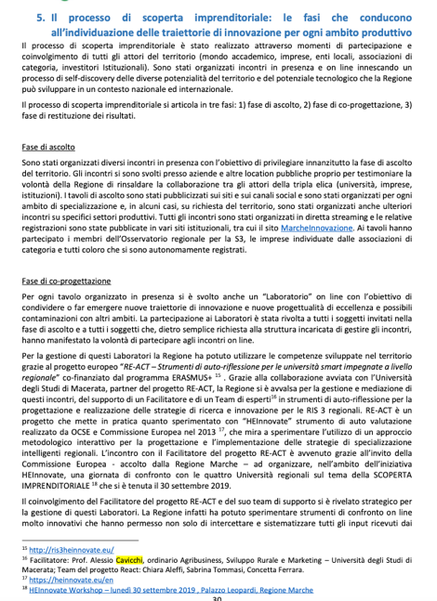
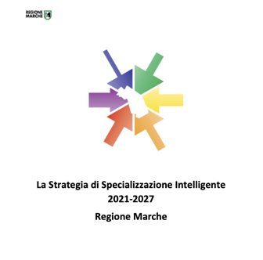
THE APPROACH INCLUDED IN REGIONAL S3
«The involvement of the RE-ACT project Facilitator and its support team proved to be strategic for the management of these Workshops. In fact, the Region has been able to experiment very innovative online reflection tools that have allowed not only to intercept and systematise all the inputs received from the participants in the meetings, but also to receive further feedbacks thanks to the use of online consultation tools, on issues such as education and training, always with reference to the entrepreneurial discovery process.
Results feedback phase
Thanks to the support of the RE-ACT project, it was possible to share with all participants the outcomes of the meetings through synthetic reports of the inputs that emerged and their translation into trajectories of innovation with reference to each specific area of specialisation dealt with. In addition, the results of the various surveys conducted during the workshops were published. All the documents are available on the MarcheInnovazione website»

Slide 22
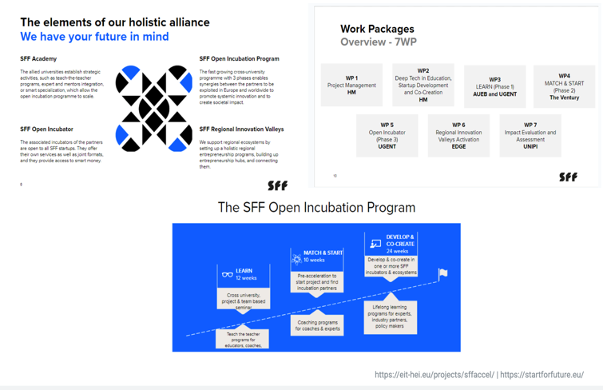
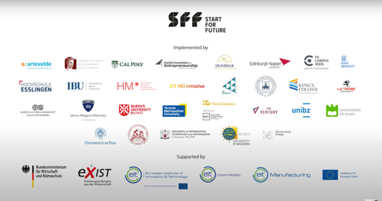
Cases: b) EIT-HEI (Startforfuture.eu)
ss

Slide 23


Other projects and cases to be considered for the Playbook
The Interreg Policy learning Platform
The Platform is a space where the European policy-making community can tap into the know-how of regional policy experts and peers https://www.interregeurope.eu/policy-learning-platform
THE URBACT Programme
Cases of multi-level governance and collaboration between Cities, Regions and HEIs. Importance of URBACT toolkit https://urbact.eu
The new HEINNOVATE > Action Cards
Actioncards based on HEInnovate revision
- Greater focus on global and societal challenges,
entrepreneurial ecosystems and networks and impact of the entrepreneurial HEI https://www.heinnovate.eu
The RIPEET project
The RIPEET project supports Responsible Research and Innovation (RRI) policy experimentations for energy transition in three European territories - in Extremadura (ES), Highlands and Islands of Scotland (UK) and Ostrobothnia (FI).
https://ripeet.eu/
The case of Smart Specialisation Academy – Varmland
Since 2010, Karlstad University and Region Värmland have worked in a formal partnership on research and innovation activities linked to regional development. In 2015, this partnership led to the creation of the Academy for Smart Specialisation.
https://www.kau.se/en/external-relations/research-and-innovation-collaboration/research-collaboration/academy-smart
ss

Slide 24
For further information and suggestions
@: alessio.cavicchi@unipi.it
Skype: alessio.cavicchi
Grazie!

