Slide 1
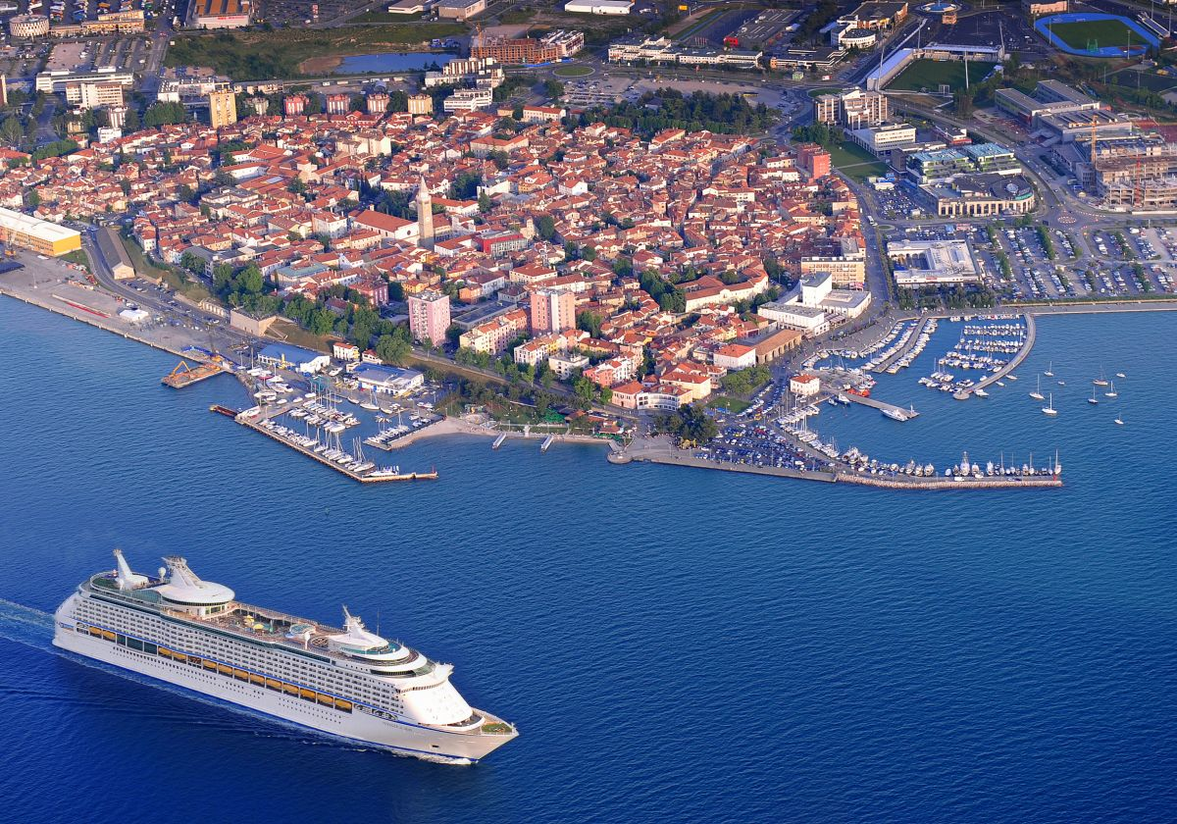
Seville, 3. 12. 2015
University of primorska – innorenew centre of excellence and sustainable construction
Funding: H2020 Widespread 2014–1 Teaming
Michael Burnard
University of Primorska, Slovenia
Andrej Marušič Institute, Department of Technology
Faculty of Mathematics, Natural Science, and Information Technology
http://innorenew.eu/en

Slide 2
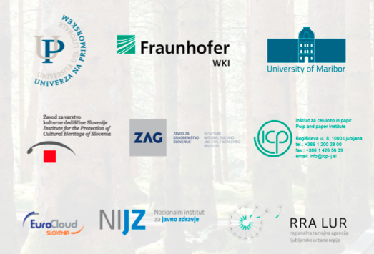
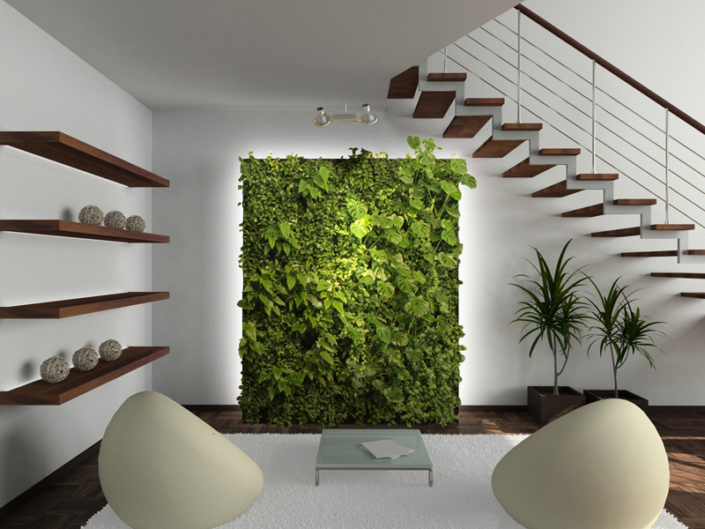
Renewable materials and healthy living environments research and innovation centre of excellence (InnoRenew CoE)
Restorative Environmental & Ergonomic Design (REED)
Expanded sustainable design
REED attempts to create positive impacts
RIS3 - Slovenia:
Integration of the wood value chain into the design of homes and working environments
Sustainable biomass transformation, new bio-based materials and technologies for use of secondary and raw materials, and reuse of waste

Slide 3

Collaboration/opportunities
RIS3 of Junta de Andalucía
Promotion of Renewable Energies and Energy Efficiency:
  energy efficiency in building and restoration
  new materials and processes for sustainable building
Fostering the public health and welfare system
  Fostering biotechnology companies in cooperation with the public health service as the driving force for innovation.

Slide 4
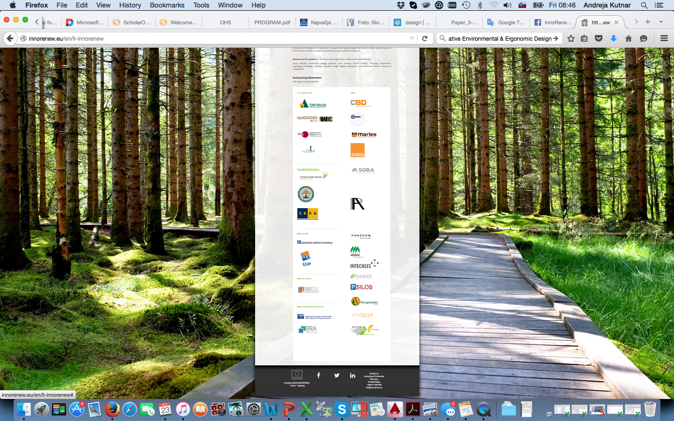





HOW – join our LL InnoRenew
18 SMEs; 4 National organizations
8 International organizations
2 RRA; 2 Ministries
http://innorenew.eu/en/ll-innorenew

Slide 5



To learn more about us check out our projects
  H2020 Teaming: Renewable materials and healthy living environments research and innovation centre of excellence (InnoRenew CoE) www.innorenew.eu
ERA-net+ WoodWisdom-Net:
  Cascading Recovered Wood (CaReWood) www.carewood.eu
  What We Wood Believe? Societal perceptions of the forest-based sector and its products towards a sustainable society (W3B Wood Believe) www.wood-w3b.eu
Erasmus+: Novel learning approach for ERGOnomic principles for deSIGNers working in the upholstery and sleep sectors by using Virtual Reality.
FP1407: Understanding wood modification through an integrated scientific and environmental impact approach costfp1407.iam.upr.si
Thank you!

