Slide 1
COST as a network instrument:
Actions in Sustainable Construction and Energy Efficient Buildings
S3 Platform on smart specialisation
Workshop “Towards a Model of Sustainable Construction and Energy Efficient Buildings”
Session 3: “Financing energy rehabilitation of buildings and its implementation”
Dr. Mickael Pero
Science Officer
COST Association
Notes:
Aim of the presentation: Provide insight on how COST can contribute to energy rehabilitation of buildings and its implementation.
Outline of this short presentation: What is COST? What is a COST Action? Example of COST Actions in sustainable construction and energy efficient buildings? Andalucía and Spain within COST networks?
Ref:
This session aims at discussing which financing instruments are available and how to better spend these funds.
Presenting and discussing the available EU programmes and instruments (and their synergies) that can help cities and regions in the field of sustainable construction.
Implementing European Cohesion Funds in the field of sustainable construction (In particular, thematic objectives 1 and 4).
In the 2014-2020 programming period, the European Structural and Investment Funds, in particular the European Regional Development Fund (ERDF), the European Social Fund (ESF) and the Cohesion Fund, will support 11 investment priorities, also known as thematic objectives:
1. Strengthening research, technological development and innovation
2. Enhancing access to, and use and quality of information and communication technologies (ICT)
3. Enhancing the competitiveness of small and medium-sized enterprises (SMEs)
4. Supporting the shift towards a low-carbon economy in all sectors
5. Promoting climate change adaptation, risk prevention and management
6. Preserving and protecting the environment and promoting resource efficiency
7. Promoting sustainable transport and removing bottlenecks in key network infrastructures
8. Promoting sustainable and quality employment and supporting labour mobility
9. Promoting social inclusion, combating poverty and any discrimination
10. Investing in education, training and vocational training for skills and lifelong learning
11. Enhancing institutional capacity of public authorities and stakeholders and efficient public administration

Slide 2
What is COST?
COST (CO-operation in Science and Technology) is a pan-European intergovernmental framework dedicated to networking activities for European researchers, enabling them to jointly develop their own ideas and new initiatives across all scientific disciplines through trans-European coordination of nationally funded research activities.
Notes:
COST Added Value
Value from connection, exchange, sharing
Know what others are doing on a given topic
Exchange knowledge and know-how
Compare geographical areas / legal backgrounds / national practices
Build a common understanding / opinion on a topic
Create a platform / reach a critical mass
Standardise practices / elaborate common guidelines
and more…

Slide 3
What is COST?
Founded in 1971, COST is the oldest and widest European intergovernmental framework for transnational Cooperation in Science and Technology.
COST has been supporting networking of research activities across the 37 COST countries and beyond for more than 40 years (19 COST countries in 1971).
One instrument: the COST Action (network of researchers). Only a few Actions at the beginning to more than 300 Actions running today.
Promotion of excellence, inclusiveness and openness across networks.
Notes:
COST is the oldest and widest European….. COST has been founded in 1971 by ministerial conference of 19 European States in Brussels as a framework for coordinating nationally funded research activities in Europe.
Founded in 1971, COST is the oldest and widest European intergovernmental framework for transnational Cooperation in Science and Technology. For 40 years COST has supported networking of research activities across all its Member countries (36 today+1 cooperating state) and beyond. COST is open to all disciplines, to all novel and ground-breaking S&T ideas, to all categories of partners, to the world where mutual benefit is real.

Slide 4
What is a COST Action?
The COST pan-European networking instrument that allows researchers, engineers or scholars from COST Member Countries and Cooperating State to jointly develop their own ideas and new initiatives in a field or topic of common interest.

Slide 5
COST Actions characteristics
Answering to the COST Open Call for proposals
Based on a joint work programme of participating COST countries for 4 years
Implemented through networking activities: Meetings, Working Group meetings, Conferences, Workshops, Short Term Scientific Missions, Training Schools and Dissemination Activities
Average Annual COST Budget EUR 130 000
COST DOES NOT FUND RESEARCH
Notes:
Next: examples of ongoing COST Actions relevant for the topic

Slide 6
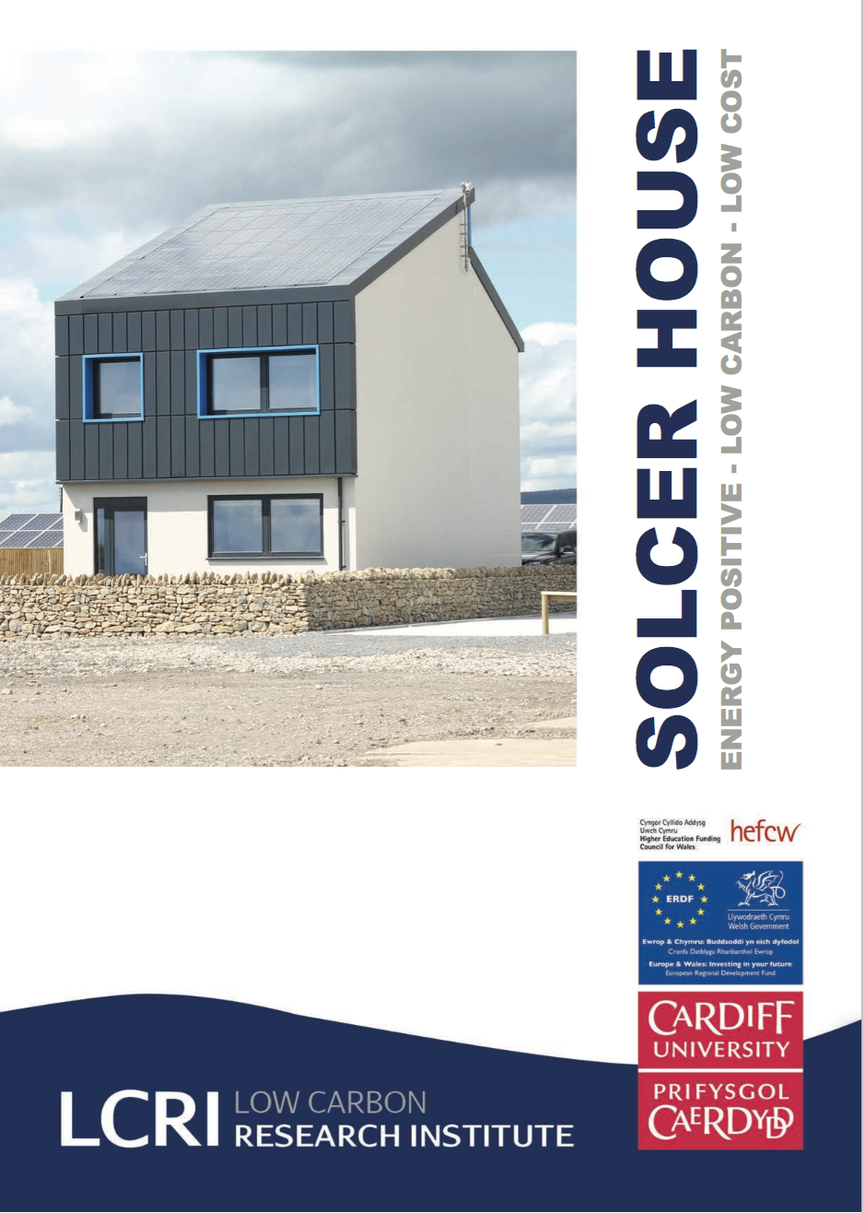
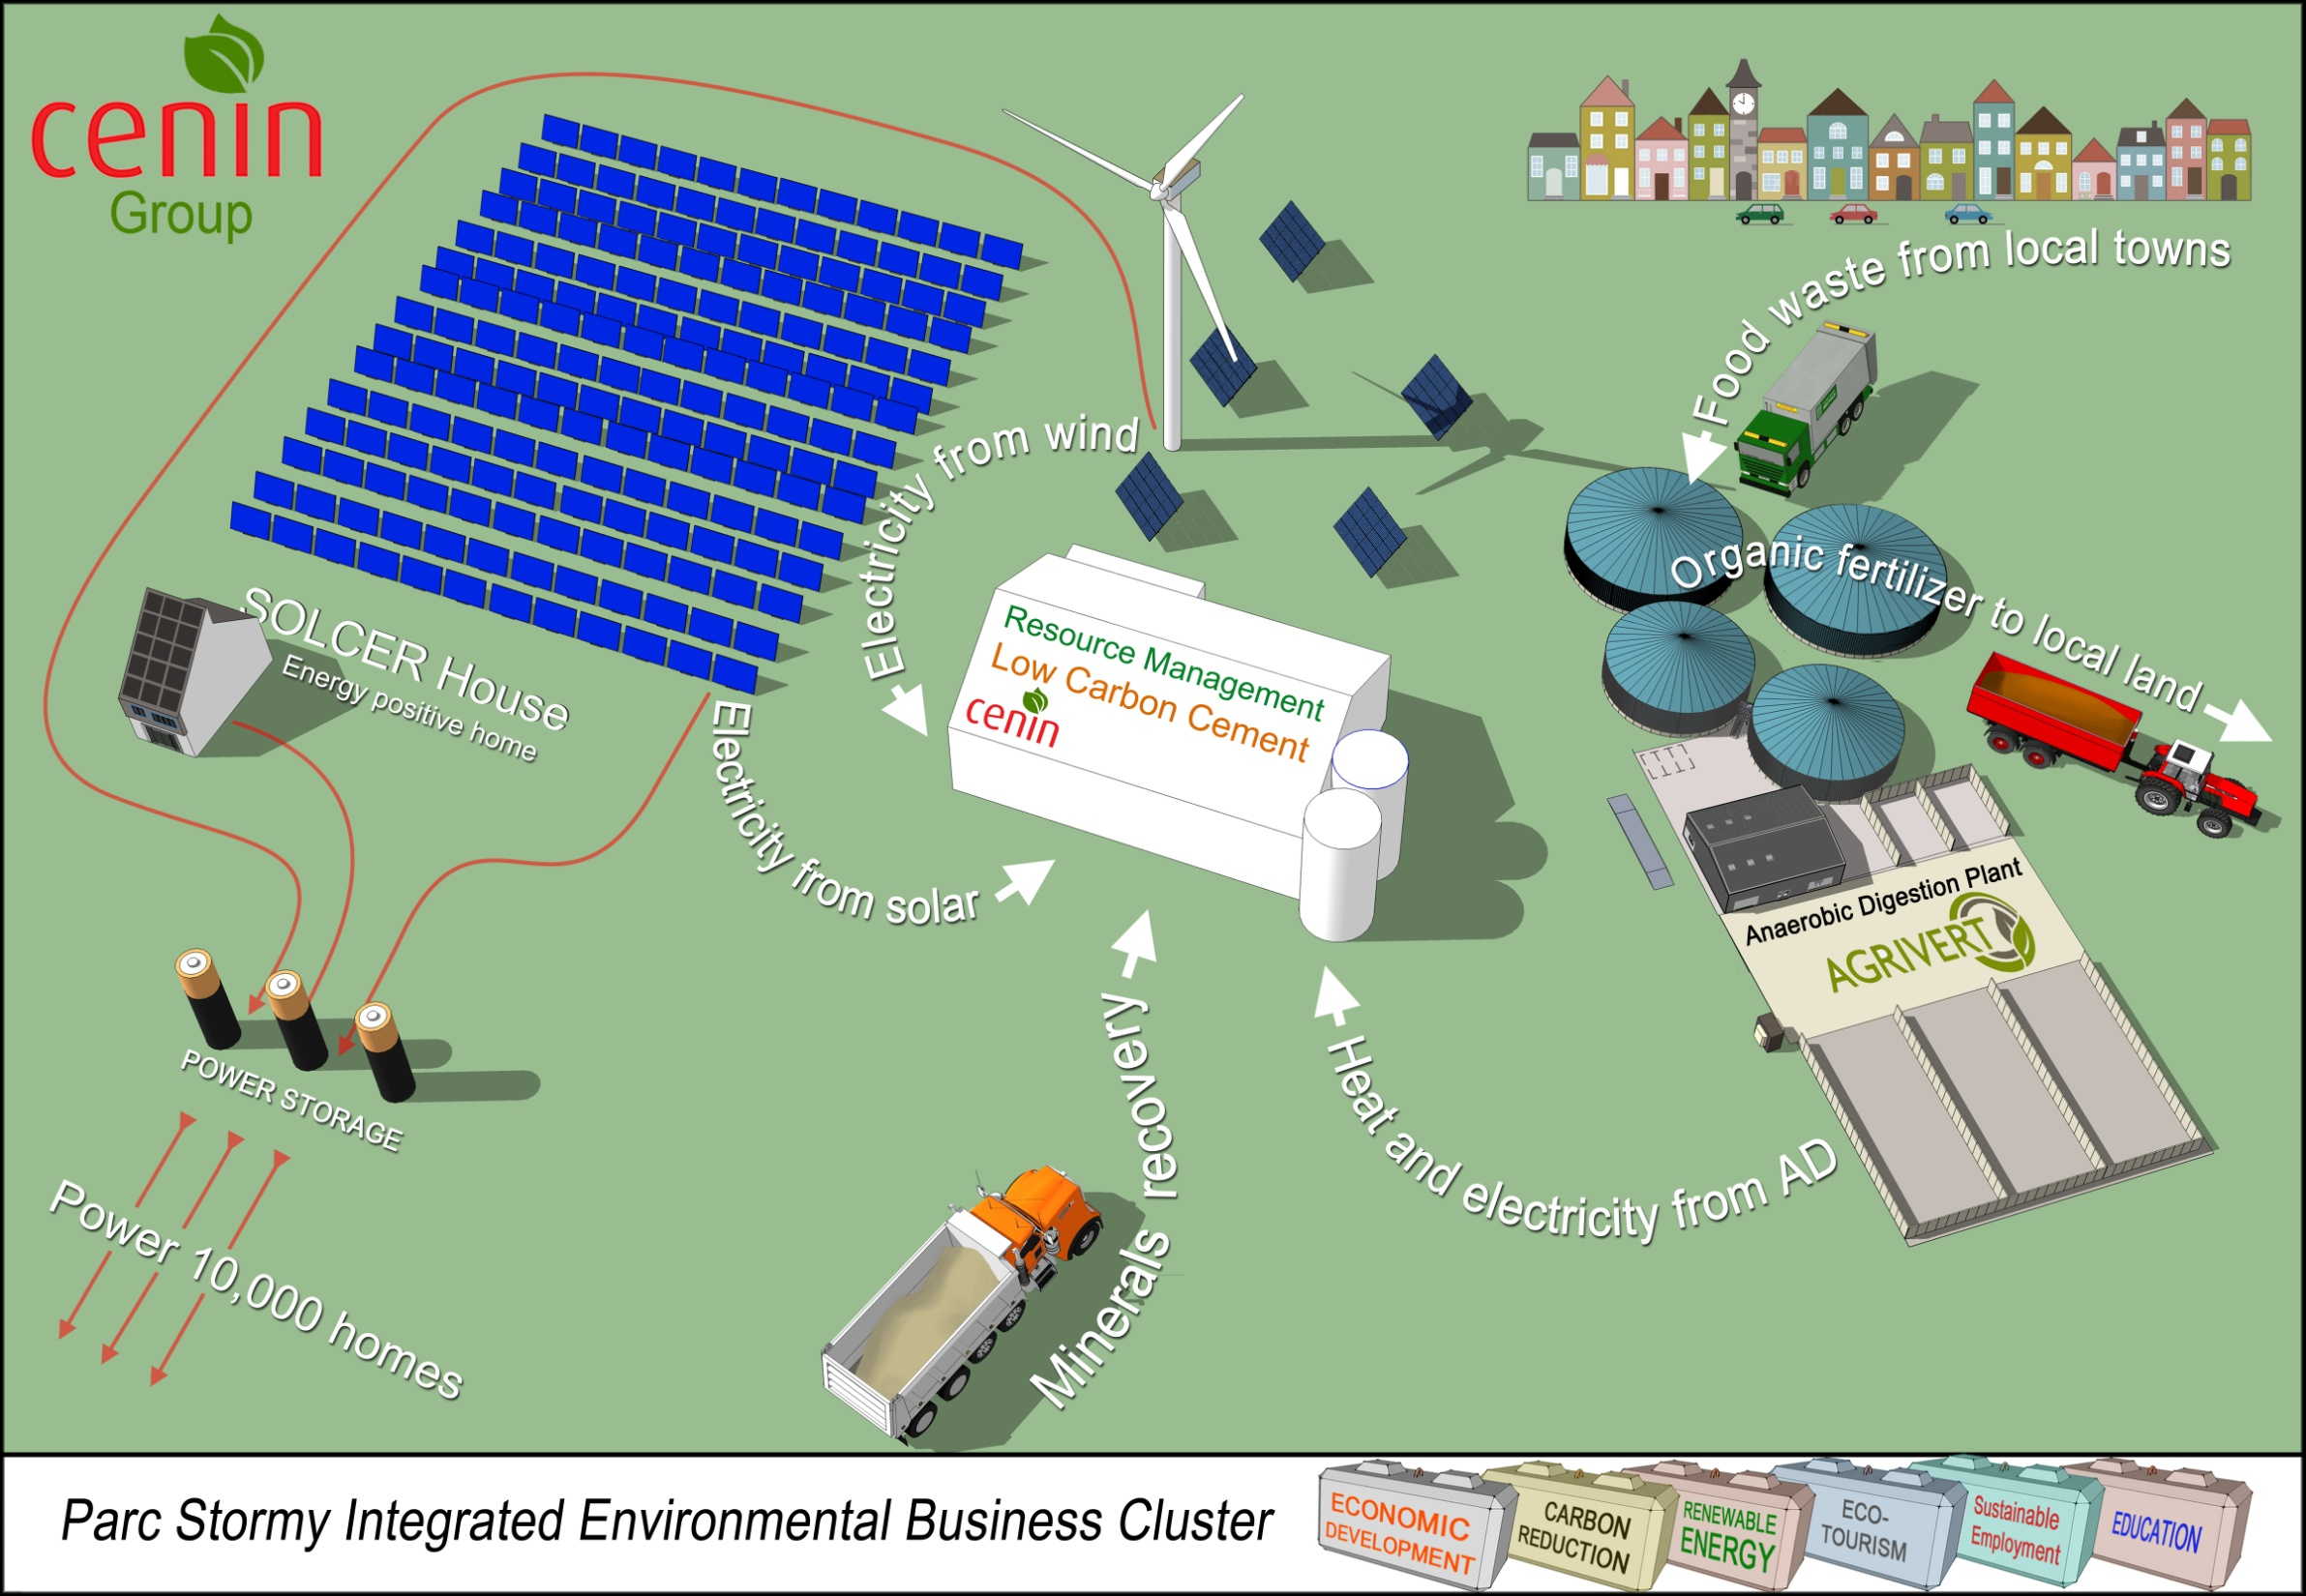
Smart Energy Regions (TU1104)
Background
Speed up the transition of low carbon design and technology into practice to meet Policy related carbon emission reduction targets, for achieving a low energy built environment.
Objectives
Attract and support new innovative industries into the market, driven from ‘bottom-up’ solutions, providing local benefits - jobs and wealth creation.
Develop Bottom-up Systems Approach: A systems approach integrates across supply, storage and demand, linking technology with design and socio-economic factors, to yield multiple benefits, including performance, replicability and affordability. (technology → design → policy)
Contact: Prof. Phillip Jones from Cardiff University (Spain represented)
Low carbon energy positive buildings
AIR COLLECTOR
Energy clusters

Slide 7
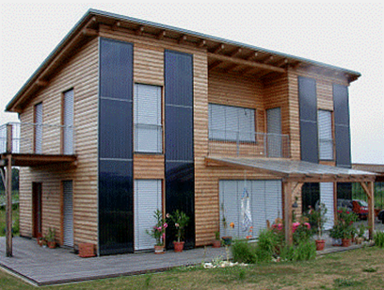
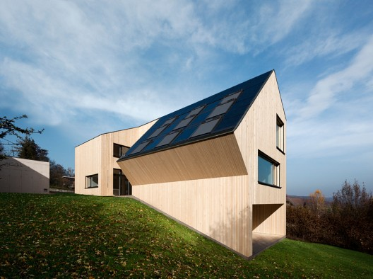
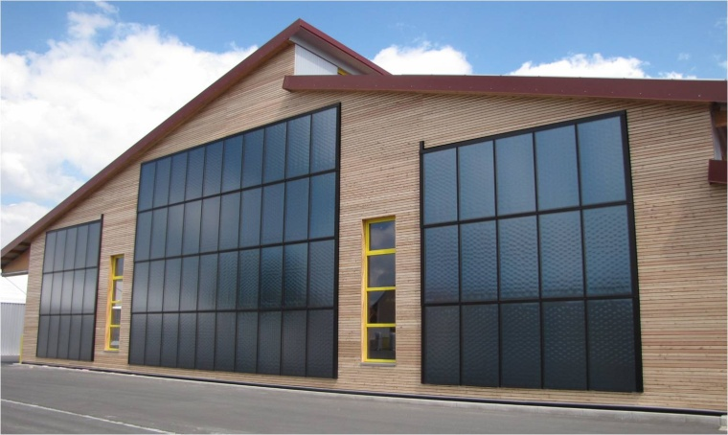
Building Integration of Solar Thermal Systems (TU1205)
Background
Energy use in buildings represents 40% of the total primary energy used in the EU and therefore developing effective energy alternatives is imperative. Solar thermal systems (STS) will have a main role to play as they contribute directly to the heating and cooling of buildings and the provision of domestic hot water
Objectives
The Action will foster and accelerate long-term development in STS through critical review, experimentation, simulation and demonstration of viable systems for full incorporation and integration into the traditional building envelope.
Contact: Prof. Soteris Kalogirou from Cyprus University (Spain represented)

Slide 8
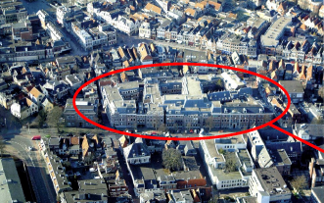
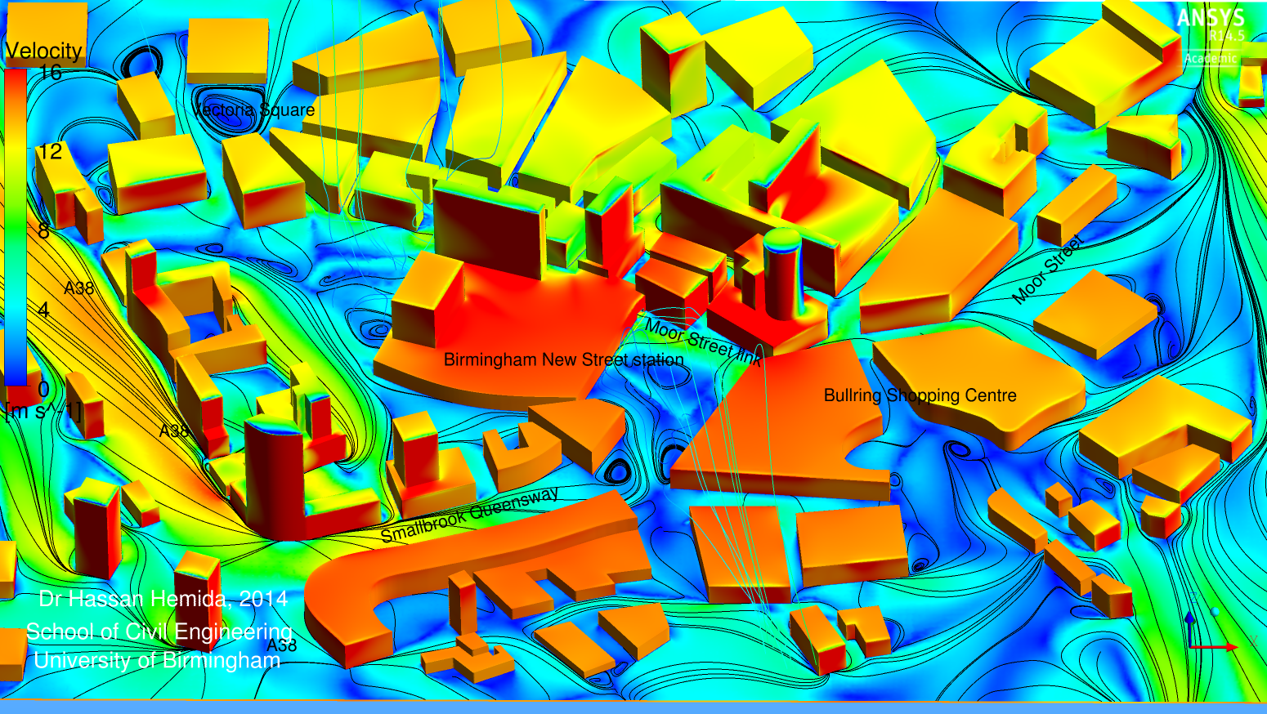
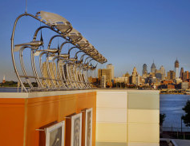
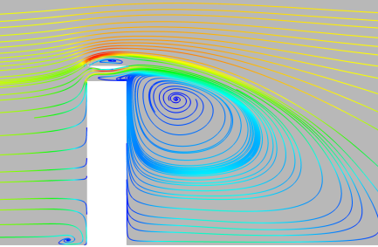
Wind Energy Technology Reconsideration to Enhance the Concept of Smart Cities (TU1304)
Background
Study the theoretical and implementation of wind energy potential in an urban and suburban environment, thus contributing to the design of future intelligent cities
Objectives
Collect expertise and study the Built environment Wind Energy Technology (BWT) – wind flow in urban and building scale, wind tunnel modeling, wind computational fluid dynamics, wind sensitive structures’ structural dynamics, electricity networks.
Study the BWT societal acceptance (noise, aesthetics, economics)
Contact: Prof. Charalampos Baniotopoulos from Birmingham University (Spain and Granada represented)
Urban scale studies
Building scale studies

Slide 9
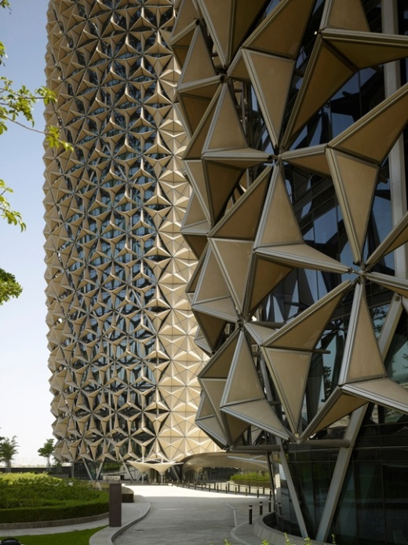
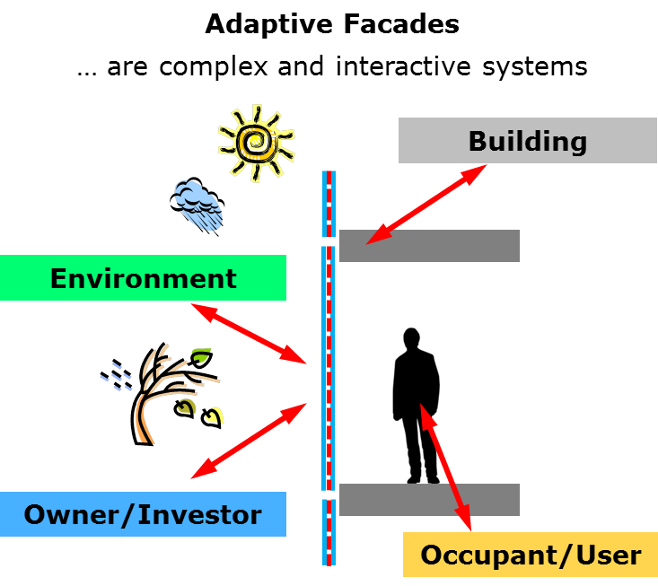
Adaptive Facades Network (TU1403)
Background
Building envelopes play a key role achieving the EU climate and energy targets: energy demand may be reduced by up to 71% (by 2050) by improving existing and future building envelopes
Objectives
Harmonize and share European research and knowledge between industry and academia and foster their collaboration by developing novel concepts, technologies and products
Foster development of more holistic approaches, metrics and tools to evaluate the performance of adaptive Facades
Promote the integration of adaptive facades into buildings
Contact: Dr. Andreas Luible from Lucerne University (Spain represented)
Notes:
- Novel structural skins (TU1303)

Slide 10
Representation of Spain and Andalucía within COST networks
Spanish participation in COST Actions management committees (at country level)
Spanish Regional participation in COST Actions management committees (at NUTS 2 level)

