Slide 1
Towards a Model of Sustainable Construction and Energy Efficient Buildings
Financing energy rehabilitation of buildings and its implementation
Peter Virtič, Borut Žalik, Gorazd Štumberger, Andrej Predin, Franjo Pranjić, Peter Mrak, Franci Rihl, Niko Lukač, Miroslav Premrov, Vesna Žegarac Leskovar, Maja Žigart, Klara Mihalič

Slide 2
Contractual provision of energy saving in buildings of the University of Maribor
Planning of renovations by the University of Maribor
  Elaboration of extended energy audits for 28 buildings and determining the reference quantities and costs for the base year of 2008.
  Lack of funding for the renovation.
  The decision to carry out a renovation in the form of public-private partnership with the model of contractual provision of savings and contractual energy supply. The public tender was carried out according to the rules of public procurement.
Preparation of ESCO (Energy Service Companies) project by the University of Maribor
Campus
University of Maribor Library and Faculty of Economics and Business

Slide 3
Contractual provision of energy saving in buildings of the University of Maribor
  Financing and implementation of all emergency measures:
  The construction of a hot water pipeline network in the campus and technical faculties;
  Replacement of heating stations;
  The change of the way of sanitary hot water preparation and lighting renovation in 5 buildings;
  Investment in buildings envelopes with insulation cofinanced (up to 25%) by EU funds;
  Implementation of the remote management and control for all buildings with implemented investment measures
Effects of ESCO project 2008-2014 and experiences of the University of Maribor
  Between the years 2010 and 2014, the private ESCO partner invested in the reconstruction of the energy infrastructure of the University of Maribor 4,6 million EUR excluding VAT and took over the supply of all the electric and heat energy.
  The project now includes all 33 buildings of the University of Maribor and for the first 28 buildings the University of Maribor has 400.000 EUR lower energy costs than in 2008, with the contractual participation of the public partner for guaranteed savings of only 2%.
AFTER INVESTMENT
Campus
University of Maribor Library and Faculty of Economics and Business

Slide 4
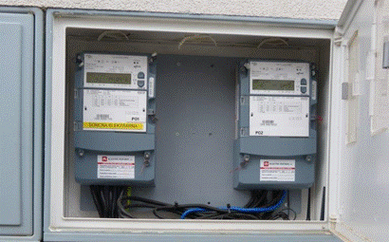
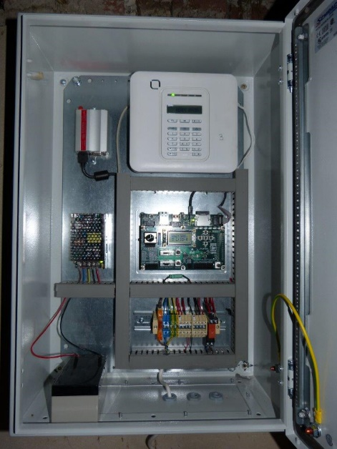
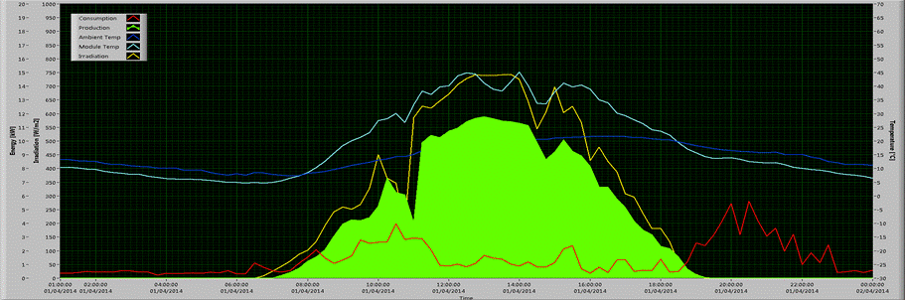
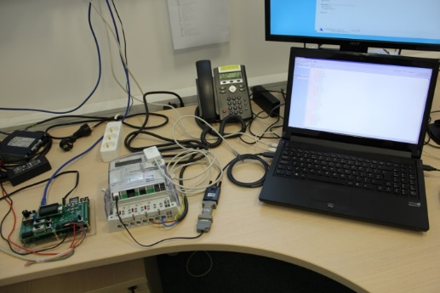

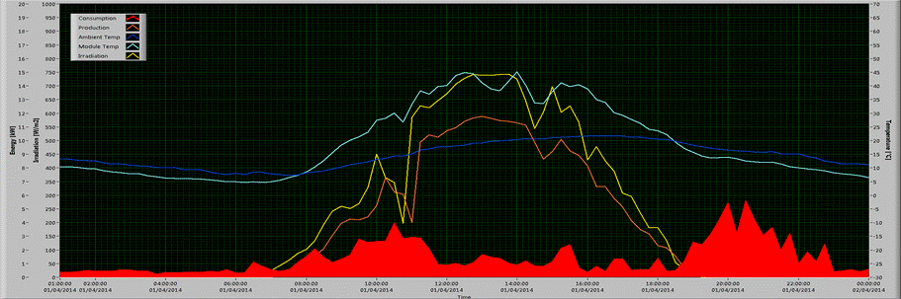
Project: PV-NET – Net metering (MED Programme)
Motivation:
  Feed-in-tarrif has (FIT) been adopted to the majority of the EU countries as cost effective measure to increase the RES at the time when the technology was not competitive.
  Today, the FIT offers lower incentives (RES technologies are more competitive).
  Smart net metering can be a very good solution offering the possibility of measuring and managing the electrical energy consumed in buildings by subtracting the energy produced with the installed RES (increased energy efficiency and use of RES).

Slide 5
RDI projects financed by EU programmes
EN-DIFF: Energy2B - Inteligent Energy Europe Programme (2009-2012)
  Project Energy2B is an innovation stimulating initiative that targets university students and encourages them to turn energy innovation ideas into reality via new business start-ups.
ENERSCAPES: Territory, landscape and renewable energy source - MED Programme (2010-2013)
  This project investigated and evaluated the impacts that a non-regulated diffusion of RES could cause on Mediterranean territories and landscapes.
  By connecting energy and territorial planning, partners identified suitable strategies for considering ecological, landscape and heritage aspects while setting up RES promotion policies.
MANERGY: Paving the way for self-sufficient regional energy supply based on sustainable energy concepts and renewable energy sources - Central Europe Programme (2011-2014)
TREND: Training for Renewable Energy Network Development - Erasmus+ Programme (2014-2016)
  TREND is a regional initiative to support the development potential of energy efficiency and renewable energy sources in the Drava river in the Croatian-Hungarian-Slovenian border region with the idea to train local small and medium-sized enterprises, non-governmental organizations, heads of municipalities and students.
E-RESPLAN: Innovative Educational Tools for Energy Planning - Erasmus+ Programme (2015-2017)
  E-RESPLAN is a Strategic Partnership for Higher Education, aiming at providing young professional and experts with innovative tools in order to reinforce their interdisciplinar skills in the field of energy planning, RES development and spatial planning.

Slide 6
RDI projects financed by EU
CO-EFFICIENT-MED Programme (2013-2015)
  CO-EFFICIENT is aiming to advance innovation and already available technologies for energy efficiency and use of renewable resources in operations and production processes of Mediterranean SMEs.
LBTGC: Load Bearing Timber-Glass Composites - ERA-NET WoodWisdom-Net Research Programme (27 partners from 7 countries) (2011-2014)
  Wood based construction for multi-storey buildings.
  The potential of adhesives bounded timber-glass composites as load bearing beams, columns, stiffening panels
Open Information Environment for Knowledge-based Collaborative Processes throughout the Lifecycle of a Building - FP6
Structural Glass - Novel design methods and next generation products - COST Action
Smart Energy Regions - COST Action
Integrating and Harmonizing Sound Insulation Aspects in Sustainable Urban Housing Constructions - COST Action
Improving the Quality of Suburban Building Stocks - COST Action
EFENIS: Efficient Energy Integrated Solutions for Manufacturing Industries http://efenis.uni-pannon.hu/ - FP7

Slide 7

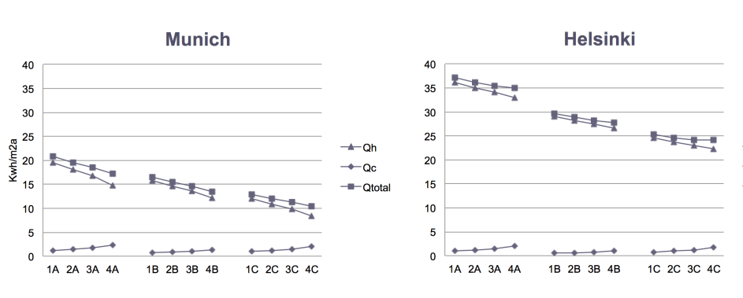
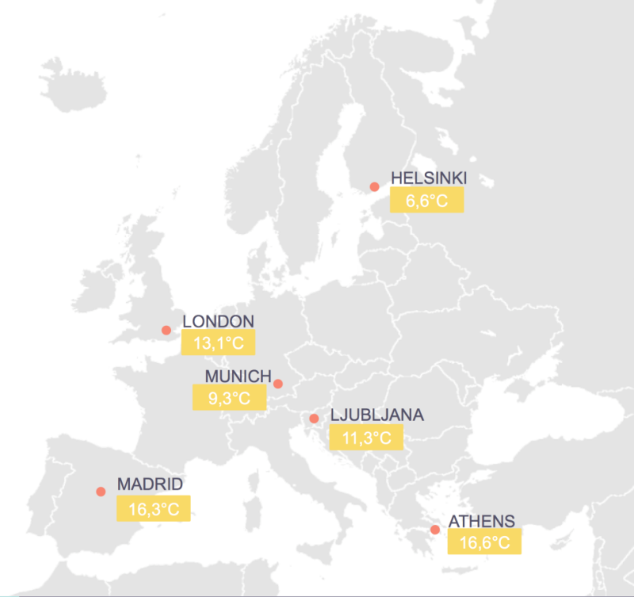
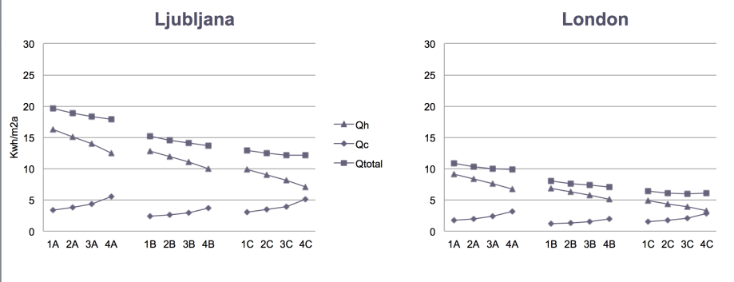
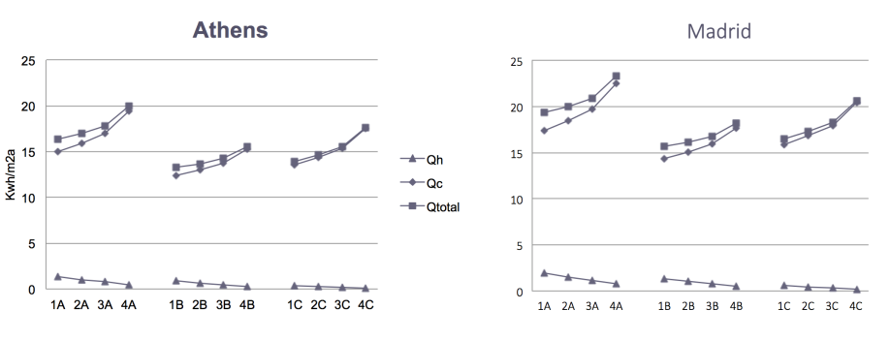

SUSTAINEBLE TIMBER-GLASS BUILDINGS
Influence of Building Geometry on Energy Demand of Timber-Glass Buildings for different Climatic Regions
Qh – energy used for heating of the building
Qc – energy used for cooling of the building
Q – total energy
1A
2A
3A
4A
1B
2B
3B
4B
1C
2C
3C
4C

Slide 8
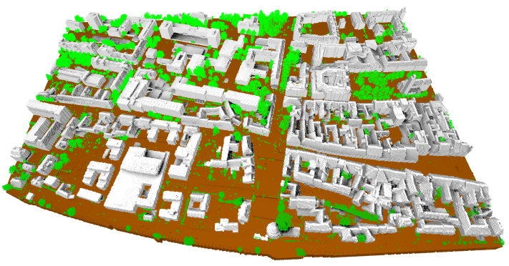
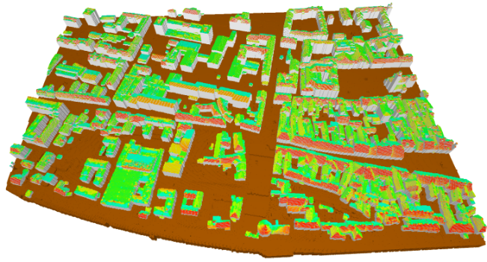
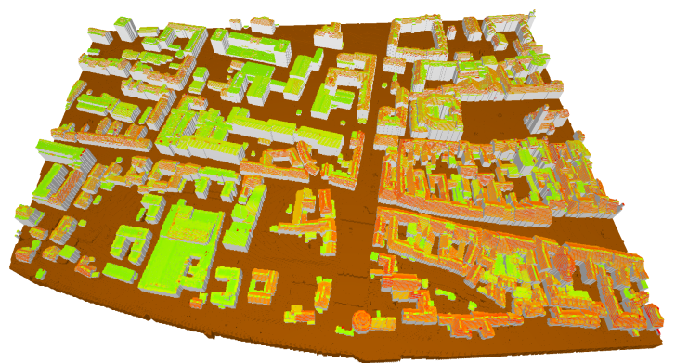
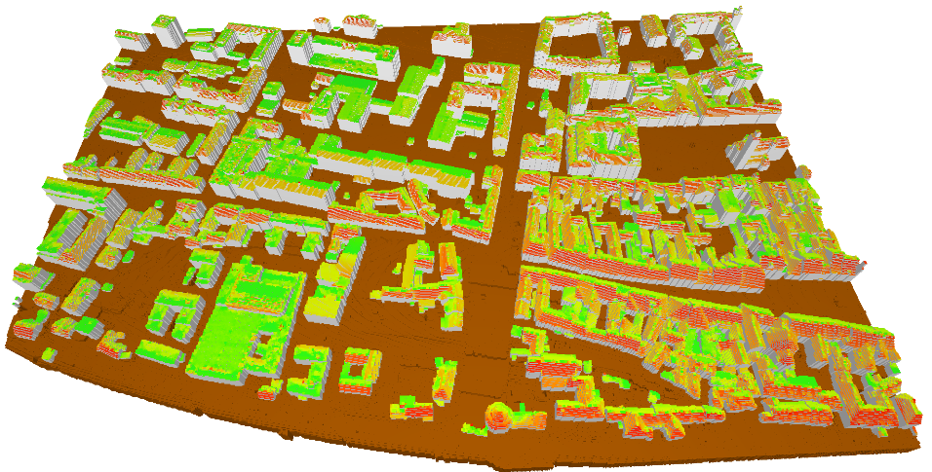
Buildings` solar potential estimation by using
LiDAR (Light Detection and Ranging) data
Shadowing
Direct irradiance
Diffuse irradiance

Slide 9
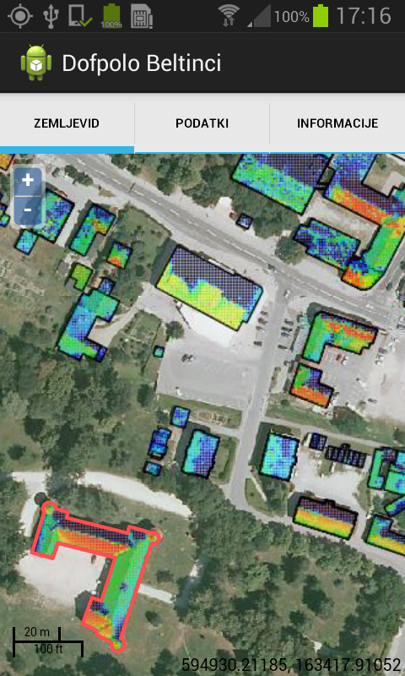
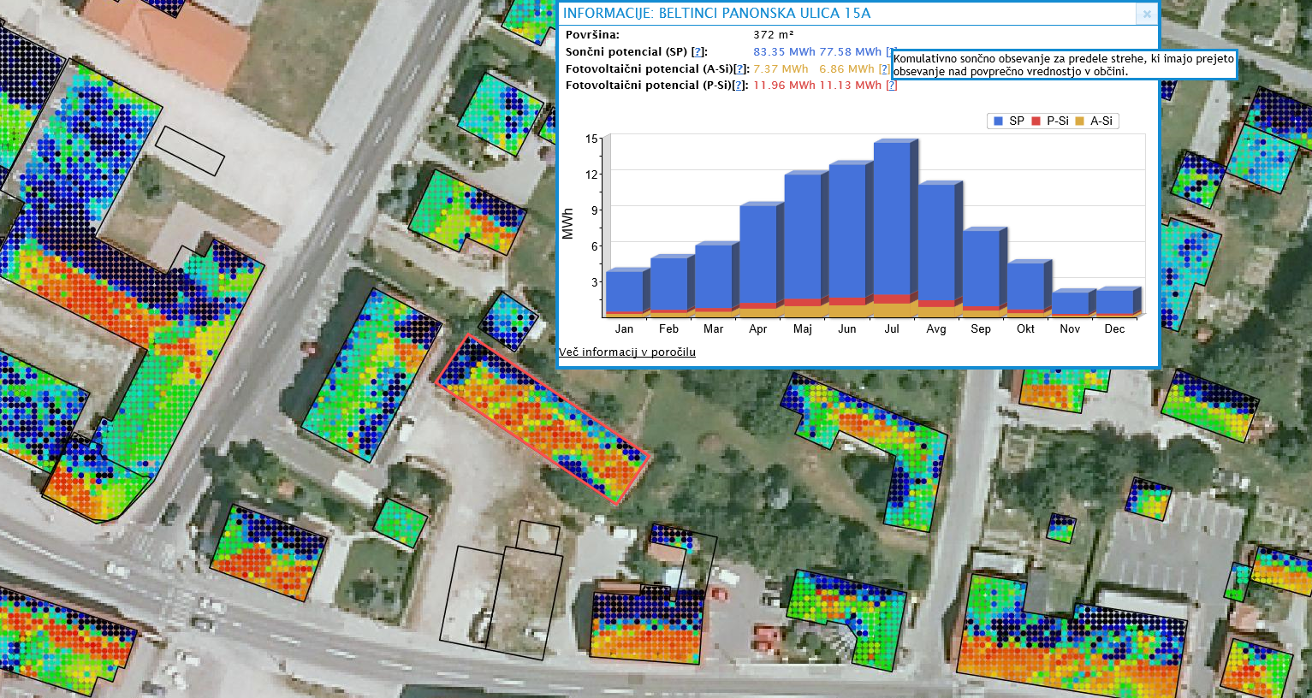
PV potential application using Geographic Information System (GIS)
Calculation of PV potential for ~5600
buildings (ERDF project – Ministry of science)
http://solarenergo.beltinci.si

Slide 10
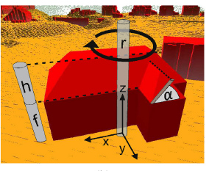
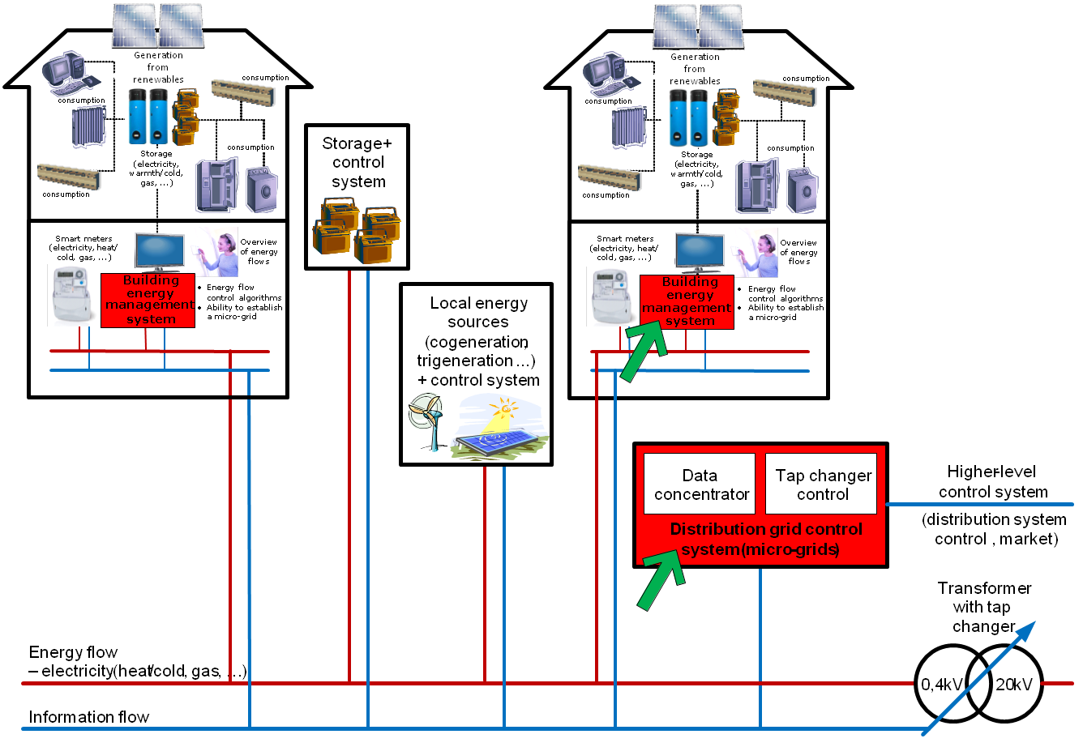
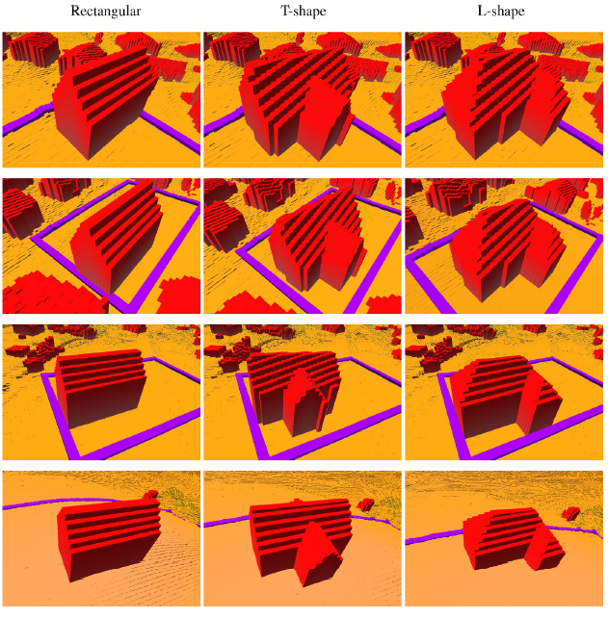
Optimisation of buildings construction regarding solar potential
Optimisation of building`s model geometry in order
to maximize the solar potential
Inclusion within LiDAR data
Integration in local smart grid control

Slide 11
Thank you for attention!
Assoc. Prof. Peter Virtič, Ph.D. E.E.
peter.virtic@um.si

