Slide 1
Towards a Model of Sustainable Construction
and
Energy Efficient Buildings
Session 4
Innovative approaches to sustainable construction
for urban development
Introduction:
Martina Pertoldi Institute for Prospective Technological Studies - Joint Research Centre, European Commission
Panelists:
Judith Borsboom Netherlands Organisation for Applied Scientific Research TNO, The Netherlands
Casper Mikkelsen CLEAN, Denmark
François Dewez Bruxelles-Environment (BE), Belgium
Seville, 3 December 2015

Slide 2
Rationale –why?
Cities as crucial actors to achieve EU 2020 and 2030 climate
and energy targets
Local responsibility in built environment (policy, projects, regulations and incentives)
Cities can mobilise citizens within the city but also mobilise cities in similar issues
e.g. the over 6,300 signatories of the Covenant of Mayors all voluntarily committed to an average 28% emission reduction target by 2020 (JRC, 2015)
Sustainable construction is an opportunity for cities
The recognition of the role of cities in the EU as
a. drivers of economic development,
b. key players in climate action,
c. front-line managers of social cohesion and inclusion and
d. strategic leaders for integrated and sustainable urban development (Eurocities, 2014)
Strategic upgrading of material infrastructures for
better quality of life
Building (also) on existing instruments and platform as
e.g. Integrated Sustainable Urban Development Strategies
Urban Innovation Initiatives (among the selection criteria is Partnership)
EIP on Smart Cities and Communities

Slide 3
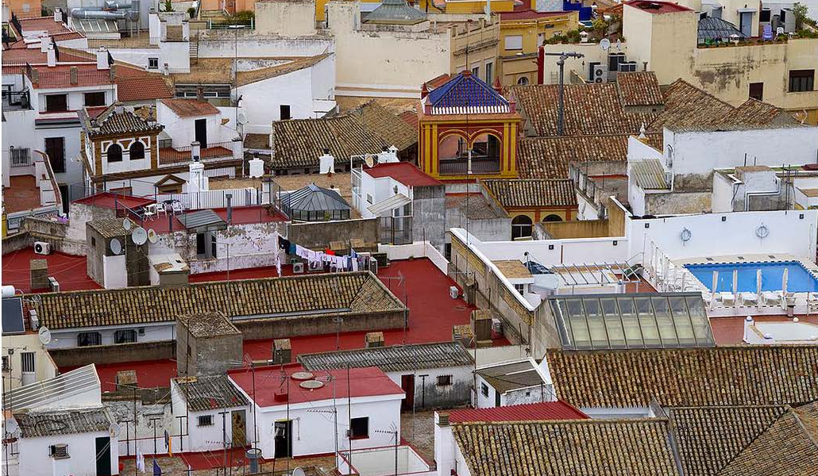

Slide 4
What does Smart Specialisation (S3) bring in?
S3/RIS3 (Regional/National R&I Strategies for Smart Specialisation)
A favourable policy framework to bridge R&I policy and urban development policy
Key concepts:
Place-based - Bottom-up approach and top-down
Economic structural change – addressing regional development;
Broad understanding of innovation;
Societal challenges - vision and sense of directionality;
Entrepreneurial Discovery Process. Process of discovery – entrepreneurial search – involves experimentalism
Actors/Entrepreneurs – firms, universities, inventors, independent innovators, citizens
Multi-level governance
Defining the relation between the "power to decide" (e.g. power to design policies) and the "power to transform" (e.g. power to deliver)
Kevin Morgan, 2004
Cities as living lab for both entrepreneurial discovery process and implementation

Slide 5
Some (main) challenges
Moving from the building scale to the city scale
Being aware the scale and extent of the radical changes that are required to put into practice the knowledge developed in different sectors - not yet generally appreciated as they should.
Moving from a sectoral to an integrated approach
Sustainable construction, energy planning and urban planning
Many competing values (e.g. energy saving-cultural heritage preservation)
How can we increase awareness and promote interventions in sustainable construction that include elements of value not only related to energy efficiency?
New collaborative models: Co-design and co-delivery
Ghent transition arenas, Dortmund Masterplan Energy Transition,
Amsterdam City-ZEN Test Living Lab (from energy saving meters to self-produced energy selling schemes)
Green jobs for social inclusion (Birmingham, Newcastle, Antwerp)
Energy Managers in Public Building (Lviv)
Are different stakeholders (universities, companies, city departments, citizens, etc.) sufficiently involved? What are the current challenges in making different actors actually work together?
How to move from involvement to effective engagement and collaboration?
Notes:
Energy is a key issue but not the only one for our cities. In some cases it could be perceived in contrast with other existing assets as, for instance, cultural heritage. On the contrary, we have plenty of innovative applications in retrofitting of historical building that provide win-win solutions and support new markets, as eco-renovation.

Slide 6
Towards a Model of Sustainable Construction
and
Energy Efficient Buildings
Session 4
Innovative approaches to sustainable construction
for urban development
Judith Borsboom Netherlands Organisation for Applied Scientific Research TNO, The Netherlands
Casper Mikkelsen CLEAN, Denmark
François Dewez Bruxelles-Environment (BE), Belgium
Seville, 3 December 2015

