Slide 1

“De- and Remanufacturing”
Pilot Network
Regions: Lombardy, Scotland, Saxony, Tampere, Flanders, Basque Country and Norte
Technical Coordinator: Marcello Colledani
Presenter: Marcello Colledani, Politecnico di Milano, Lombardy
AFIL: Intelligent Factory Lombardy Region Cluster
6th of December 2016 – Florence

Slide 2
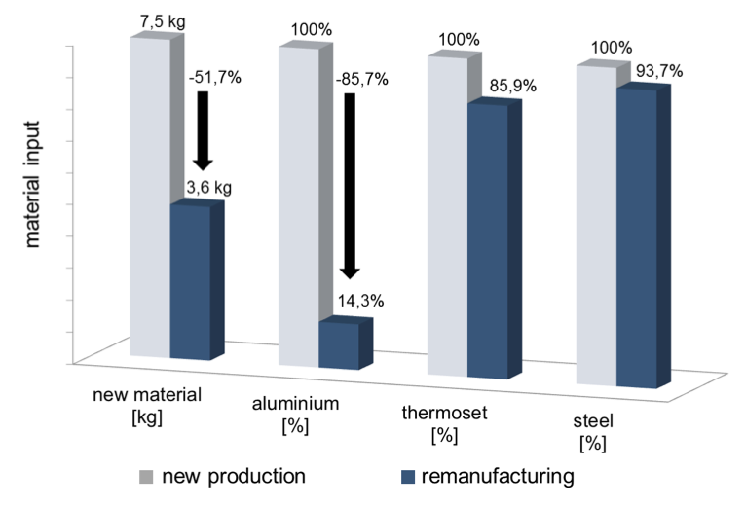
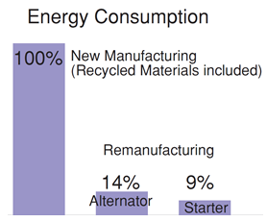
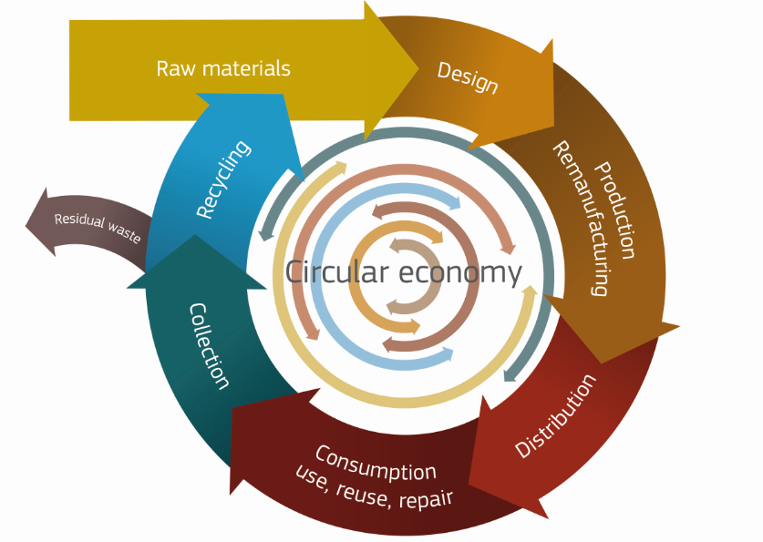
Pilot Idea: Concept
De- and Remanufacturing includes the set of technologies, tools and knowledge-based methods to recover, re-use and upgrade functions and materials from industrial waste and post-consumer high-tech products, under a new producer-centric Circular Economy perspective.
Example: Benefits of Remanufacturing in the automotive industry (Electronic Air Control unit).
[Source Kohler: D., Mechatronic Remanufacturing at Knorr-Bremse Commercial Vehicles Systems (CVS)].
EU – Towards a circular economy, a zero waste programme for Europe, COM (2014) 398 final

Slide 3
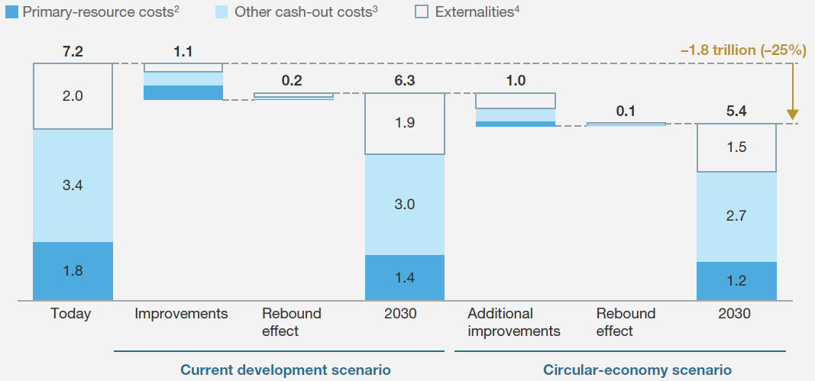
Economic Benefits of Circular Economy at large scale
Shifting toward a circular economy model would deliver better outcomes for the European economy and yield annual benefits of up to €1.8 trillion by 2030.
Annual total cost of producing and using primary resources, EU-27, euros trillion
Source: Europe’s circular-economy opportunity
McKinsey Center for Business and Environment September 2015

Slide 4





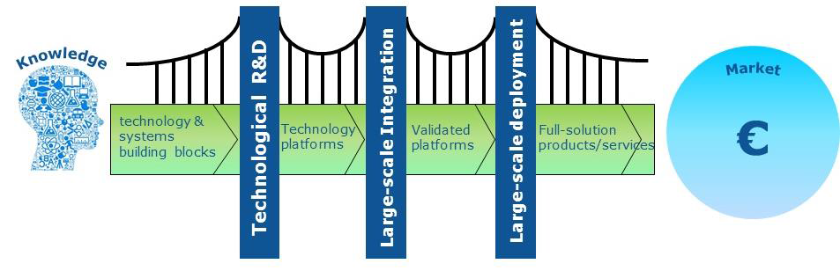

Strategy: demonstrating integrated innovative solutions and de-risking private investments in Circular Economy
G7 Summit Declaration June 2015: The G7 Alliance on Resource Efficiency promotes Circular Economy, Remanufacturing and Recycling as strategic actions.
At European level, the Commission has launched in December 2015 the strategic initiative “Closing the loop - An EU action plan for the Circular Economy”.
H2020 R&I projects under the Focus Area “Industry 2020 in the Circular Economy”, calls CIRC, Spire and FOF, at TRL 6-7.
Lack of infrastructures that can demonstrate to industry integrated circular economy solutions and business models, de-risking the private investment.
These Innovation Hubs should act as “technology gateways" that any business sector can use.
De-and Reman
pilot network
Applied Research - Techn. Validation - Demonstration - Ready to market

Slide 5
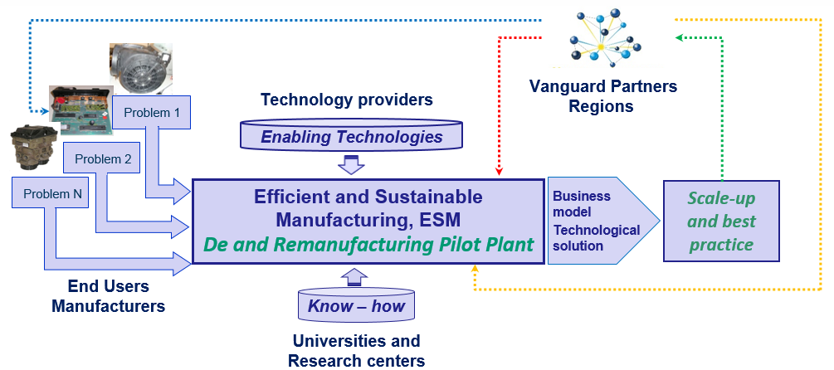
Pilot Idea: Application Domain
The main objective of the De-and Remanufacturing pilot network is to integrate a multidisciplinary set of advanced and innovative enabling technologies and digital innovations (TRL 7-8) and to exploit the regional Smart Specializations in synergic way to offer services to European end-users, mainly manufacturing companies, to solve specific sustainability-oriented problems related to their products.
The pilot network nodes will act as Innovation Hubs for Circular Economy, being a network of competence and technology centers and supporting future producer-driven replication at industrial scale (TRL 9).

Slide 6
Pilot Geographic Configuration and Regional Specialization
The network will be composed of:
New infrastructures, which will be designed, developed, and installed on purpose for this pilot network.
Existing infrastructures, which will be upgraded towards integrated pilot plants.
Key Issue: integrated pilot plant solutions, needed by industry to validate high-risk investments in circular economy businesses before the industrial implementation.
Scotland

Slide 7
Benefits of the multi-regional approach
Enabling technologies and processes
(collaborative disassembly by robotics, remanufacturing, inspection, demanufacturing, re-processing, coating and recovery)
Digital Innovation
(IoT, smart products, cloud-based platforms, Things Lifecycle Management, data analytics, process and system simulation)
Innovation in eco-products, processes and business models
Cross-regional Value-chain building
( new service-oriented business models, open innovation, product re-design, cross-sectorial industrial symbiosis, ecosystems)
Scotland
An effective transition to new circular economy businesses in Europe requires a systemic approach and cross-KETs innovations, in traditional and emerging sectors (SCREEN CIRC-3, FiberEUse CIRC-1 ).

Slide 8


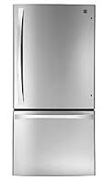
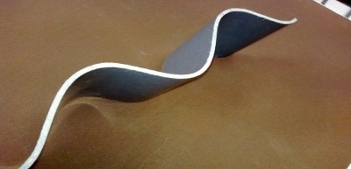
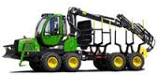
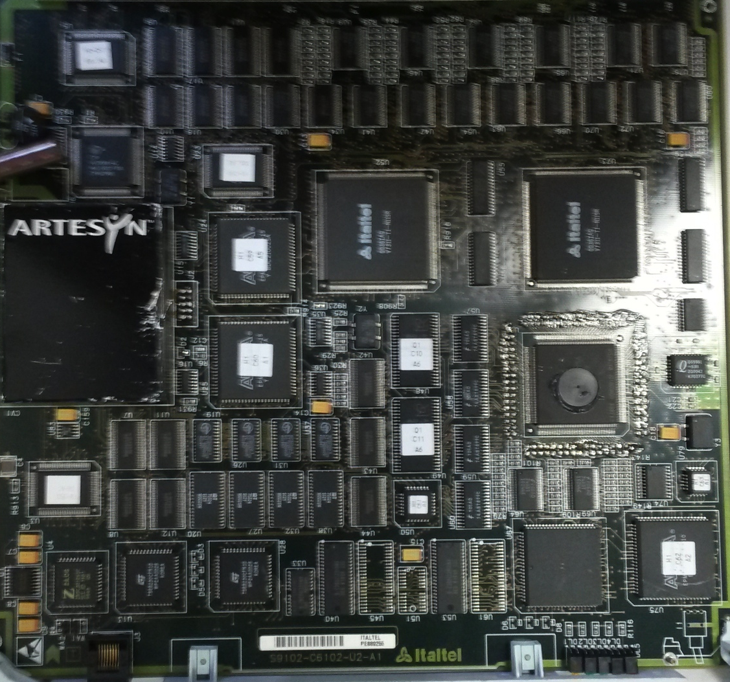
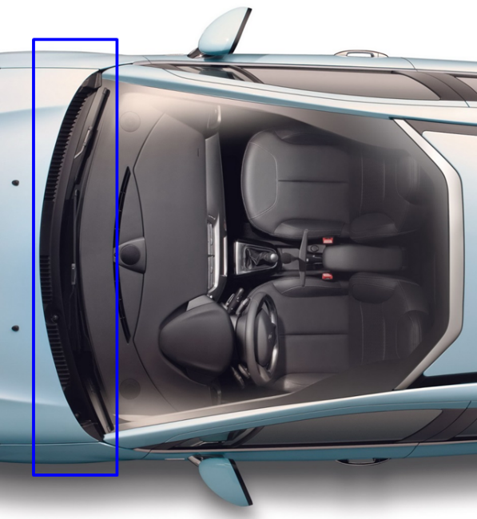
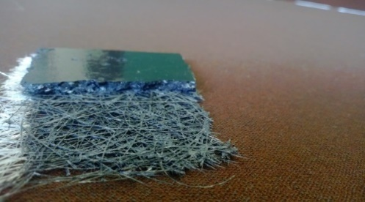
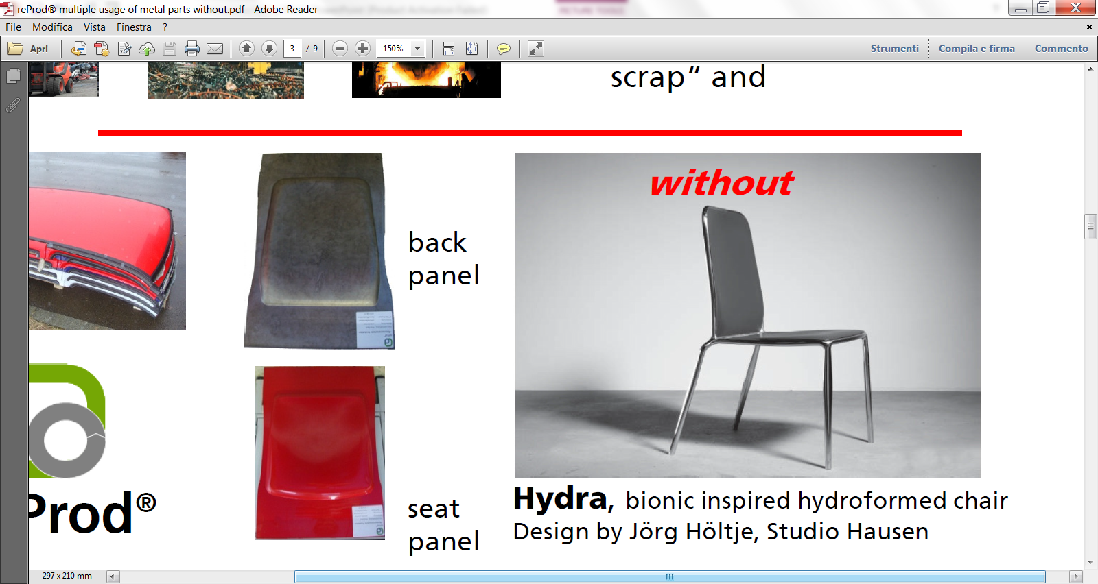
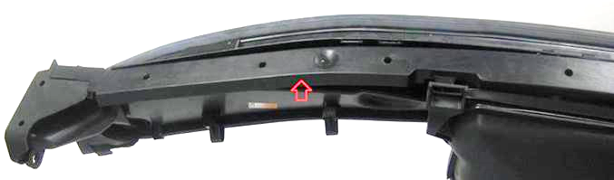
Industrial Participants and investors.
More than 60 European companies, with a cumulative turnover of 32 B€ and with some 175,000 employees, and 69 universities and RTOs distributed among the involved regions are involved.
Electorlux
Candy
RoldElectronics
TP Vision
Barco
Worldilne
Whirlpool
Cargotec Finland Oy
Sandvik Mining and Construction Oy
Metso Minerals Oy
Valmet Power Oy
John Deere Forestry Oy
Bronto Skylift Oy Ab
Avant Tecno Oy
Magneti Marelli
Cannon
Mercedes
Tenova
Maier
Indeva
Filartex Spa
Gafitex
Pass Maglia
Samatex
PTMT PANTER
Rivierasca
Brianza Plastica S.p.A.
Sintostamp S.r.l.
Magniplast S.p.A.
OCV Owenscorning
Covestro
Campine
Galloo Plastics
Kokkola LCC Oy
A2A Ambiente
Relight
Fincoat OY
Telatek Oy
Marzotto
Batz
Ki-lab
Gamesa
Xnext
Lot Quantum Design
MH Systems
Holonix
Idealtech
Cosberg
Giasini
AERNNOVA
ITP
Galloo
Van Gansewinkel
TKM TTT Finland Oy
IRIZAR
Meleghy Automotive
GKN
Enginsoft
Engineering
Cobat
The stakeholders have agreed to sign Letters of Intent to participate to the definition of this Pilot Network and, in the case of future end-users, to access the pilot network and to carry on industrial take-up, in case of positive evaluation of the developed solution.

Slide 9

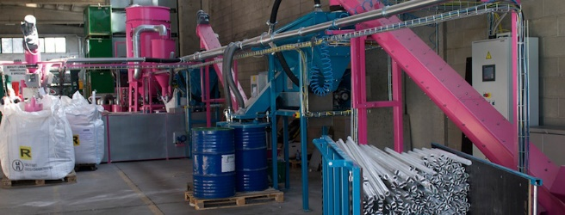

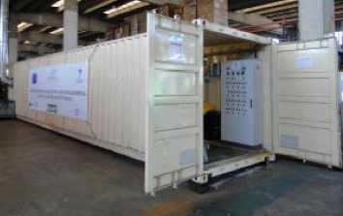
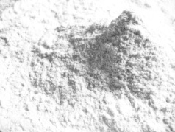
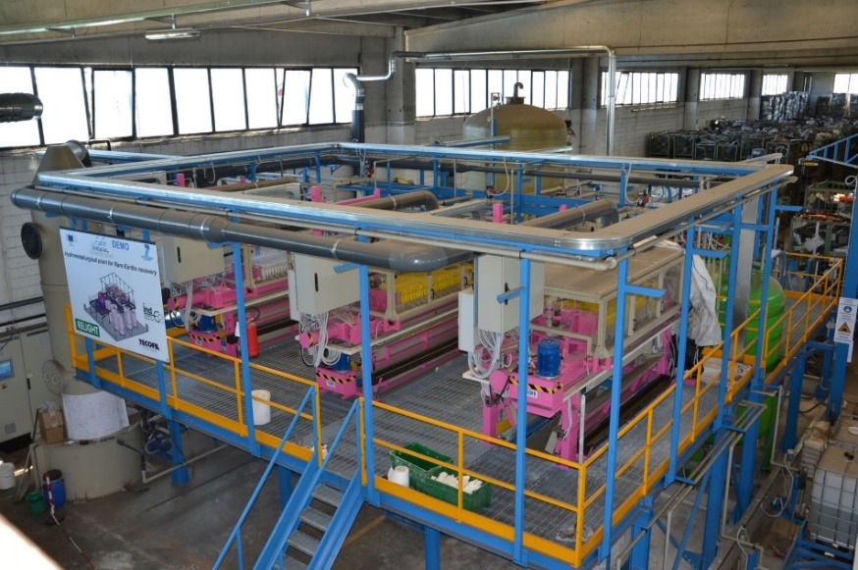
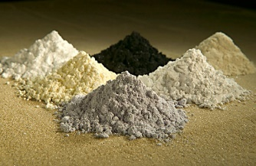
Role of technology providers: Relight s.r.l., Hydro WEEE.
Spent Lamps
Fluorescent lamps powder
“The Vanguard De-and Remanufacturing pilot network is a new way to share innovation.”
“Relight as a member of this pilot, aims at opening new markets by establishing a sustainable cooperation within the pilot to attract new industrial users of Relight technologies and to pave the way for new recycling services.”
Bibiana Ferrari, CEO of Relight s.r.l.
Rare earth oxalates

Slide 10
Role of technology providers: A Digital Platform for Circular Economy
The Vanguard De-and Remanufacturing pilot network will integrate a Digital Platform for Circular Economy that will encompass a FIWARE-based Open Platform for Industrial IoT support integrated with specific Circular Economy applications for Things Lifecycle Management.

Slide 11
Industry-led use cases and related business cases
A detailed analysis of identified sectorial Use Cases, with industrial partners associated, has been performed, where more regions are involved. For each Use Case, a business case has been detailed including a business plan for the industrial take-up of the solutions.
Regional/Cross-Regional Use Case | Involved Regions
Composite Recovery from Wind Energy System | Basque Countries, Saxony, Lombardy, Tampere
Heavy machinery components remanufacturing | Tampere, Basque Countries, Lombardy, Saxony
Automotive parts remanufacturing | Scotland, Lombardy, Saxony, Norte
High-value TLC systems and Electronics Recovery | Lombardy, Tampere
Metal components reprocessing | Saxony, Tampere, Lombardy
Remanufacturing of e-motors | Saxony, Lombardy, Norte
Plastics recycling from WEEE | Flanders, Lombardy
E- mobilty batteries remanufacturing for re-use | Lombardy, Saxony
Photovoltaic panels de-manufacturing | Flanders, Lombardy

Slide 12


Example of industrial use cases
Goal:
Recover and re-use composites from blades in other industrial sectors (automotive and construction).
Example 1:
Gamesa, producer of wind energy systems. By 2034, some 225000 tonnes of rotor blade materials will have to be treated annually worldwide. Wind energy market growth of 5% in EU.
Impact:
20M€ increase in revenues per year for the company.
Goal:
Re-use components.
Recover high-value materials.
Example 2:
Italtel, producer of products and solutions for Next-Generation Networks services (8 millions of hardware units, 24 millions of telephone lines installed worldwide).
Impact:
8M€ increase in revenues per year for the company.
Pay back time of the investment is 2 years.

Slide 13
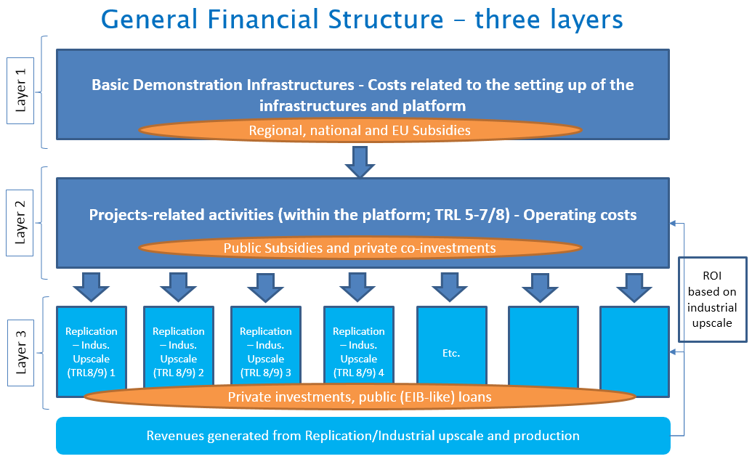
Operational and Business Model of the Pilot Network
Regional, national, EU, projects exploitable results and competences.
Industrial users (first group from use-cases)
Private investments for industrial take-up
New Circular Economy businesses in EU.
New jobs, social and environmental impact.

Slide 14
Business Model of the Pilot Network
This pilot network is designed to be a “generator” of new industrial plants for European circular economy solutions.
Pilot Network Revenues:
The User will pay a daily fee for each access.
The User will share with the pilot network a portion of the revenues obtained by selling the product/service demonstrated by the business case developed by the platform (IPR exploitation).
The core partners of the pilot (companies, universities and RTOs) will pay a yearly fee to be part of the pilot network and to access the generated knowledge and best practices.
Pilot Network Costs:
Each demonstration project will have a specific duration and will requires a group of full-time dedicated persons (hired and paid by the pilot network).
Maintenance and upgrade costs of the pilot network facilities will be covered yearly by the pilot.
A cost of customization of the platform for each new project will be incurred (paid by the pilot).

Slide 15
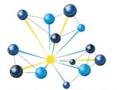
Business Model of the Pilot Network
 | Year after installation
 | 1 | 2 | 3 | 4 | 5
Accesses to the pilot network (n°) | 18 | 23 | 30 | 33 | 36
Pilot total revenues (mln €) | 2.281 | 3.414 | 4.916 | 5.963 | 7.565
Total costs (mln €) | 0.88 | 2.34 | 2.69 | 2.86 | 3.03
Installation & Launch costs co-funding (mln €) | 12 | / | / | / | /
Installation & Launch costs funding (mln €) | 28 | / | / | / | /
Annual margin (mln €) | -10.6 | 1.07 | 2.23 | 3.1 | 4.53
Cumulative margin (mln €) | -10.6 | -9.53 | -7.3 | -4.2 | 0.34
The installation and launch investments will be paid back in 5 years if 4 demonstration projects are attracted per year (on average) by each regional pilot.
Considering a successful industrial replication rate of the developed solutions of 25%, about 35 new industrial installations will be originated by the pilot network in these 5 years.
The cumulative revenue for the involved companies of about 215 million Euros.
The 35 new installations will mobilize private resources for 535 million Euros.
Leverage factor for the public investment of about 19 in five years from the pilot network installation.

Slide 16
Impacts: supporting re-industrialization of Europe and growth
Demonstrating new De-and Remanufacturing solutions for circular economy businesses will bring social benefits worldwide:
  New jobs coupled with technological and automation innovations, due to the increased competitiveness of companies through the ability of delivering products at lower cost (15000 new jobs for the considered access profile);
  New effective technologies to be exported also to emerging countries;
  Environmental, social and image advantages for global manufacturing enterprises (total savings of emissions of 60000 KTons CO2/year, of energy of 10 TWh/year and of materials, that otherwise would go to landfill, of 200 kTons/year for the considered access profile);
  Political benefits in terms of independency from fluctuations and turbulence in the primary material market (e.g. for rare earths).

Slide 17
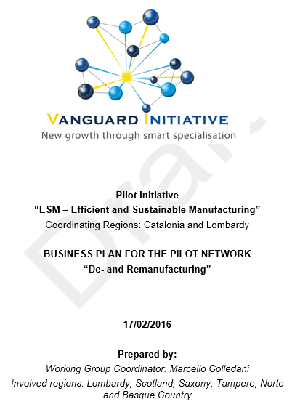
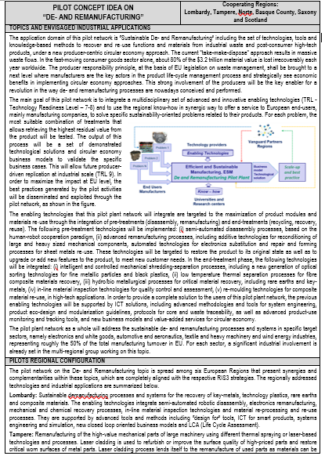
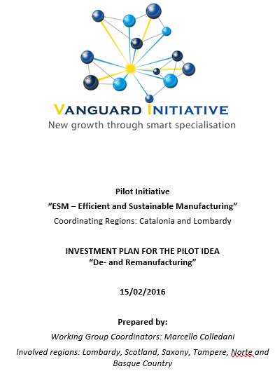
Business Model doc
Pilot Summary
Investment Plan
Thank you for attention
63 pages
4 pages
25 pages
“De- and Remanufacturing”
Pilot Network
Region | Technical contact | Organization | Email
Lombardy | Marcello Colledani | Politecnico di Milano | marcello.colledani@polimi.it
Tampere | Reijo Tuokko | Tampere University of Technology | reijo.tuokko@tut.fi
Norte | Luis Carneiro | INESC Porto / PRODUTECH Cluster | luis.carneiro@inescporto.pt
Scotland | Winifred Ijomah | Scottish Institute for Remanufacture - Strathclyde | w.l.ijomah@strath.ac.uk
Saxony | Katja Haferburg | Fraunhofer Institute for Machine Tools and Forming Technology | katja.haferburg@iwu.fraunhofer.de
Basque Country | Ane Irazustabarrena | Tecnalia | ane.irazustabarrena@tecnalia.com
Flanders | Joost Duflou | Ku Leuven | joost.duflou@kuleuven.be

Slide 18
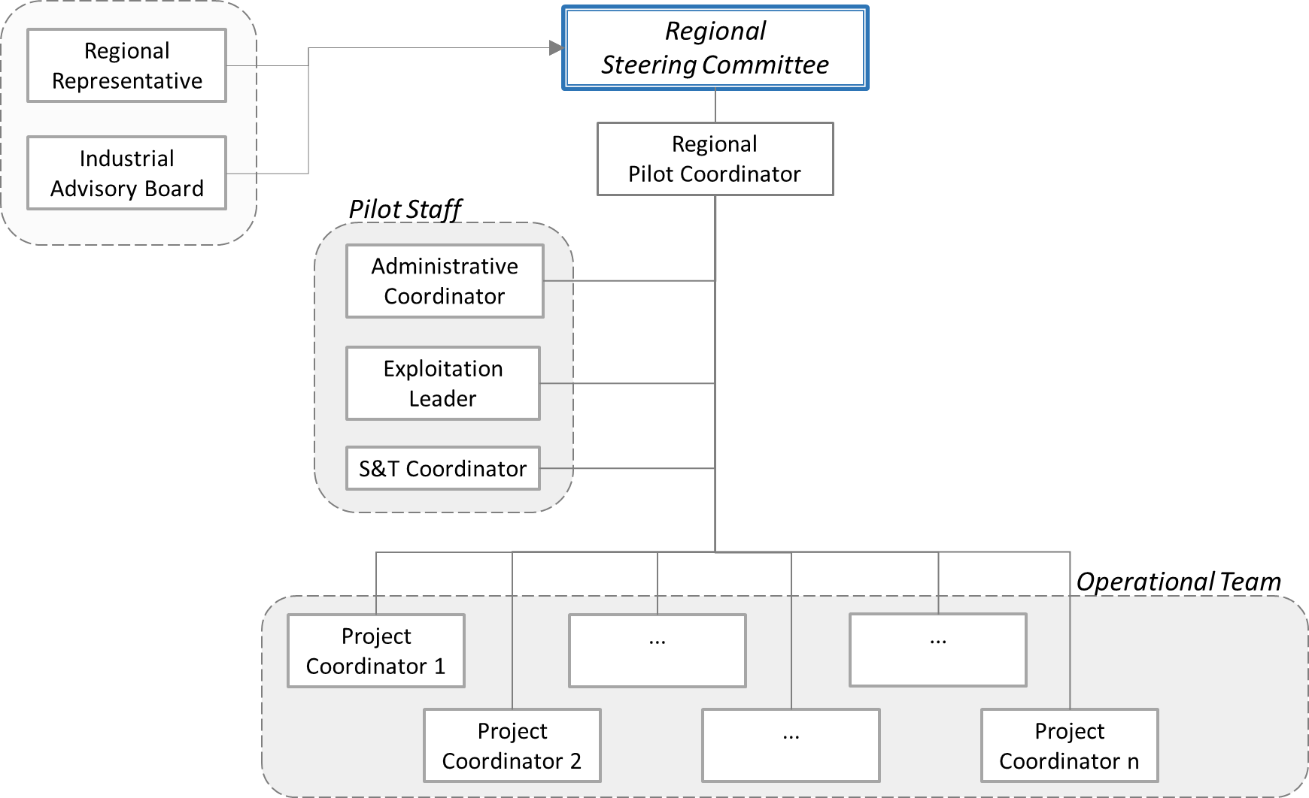
Pilot network organization

Slide 19
Pilot network organization
c
c
Regional Representative
European Pilot Network Board
Regional Pilot Coordinator
Elects
Elects
Elects
Industrial Advisory Board
Administrative Coordinator
Exploitation
Leader

Slide 20

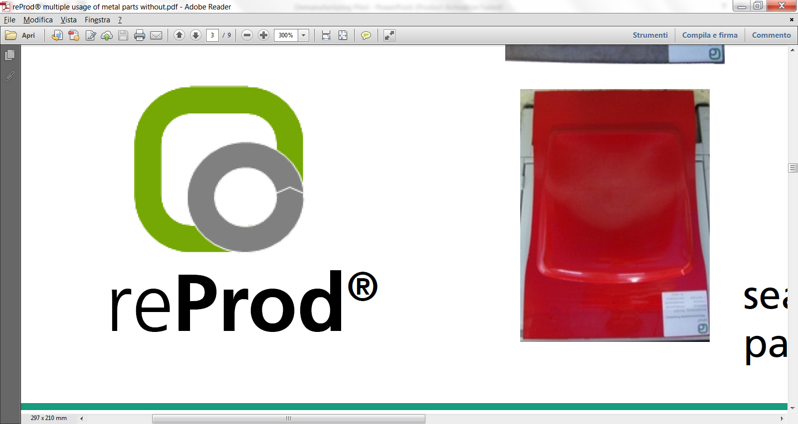




Pilot Idea: Application Domain
The main objective of the De-and Remanufacturing pilot network is to integrate a multidisciplinary set of advanced and innovative enabling technologies and digital innovations (TRL 7-8) and to exploit the regional Smart Specializations in synergic way to offer services to European end-users, mainly manufacturing companies, to solve specific sustainability-oriented problems related to their products.

Slide 21
Pilot network organization
Proposed Business Entity: Association.
Two-level governance:
European (Cross-regional level): European Pilot Network Board. Main Role: to coordinate the interregional cooperation activities with decision-making power at operational, monitoring and strategic levels.
  Approves the regional and cross-regional projects;
  Plans the future investments of the nodes;
  Exploits IPRs and best practices;
  Monitors the accessibility of the infrastructure to the SMEs and the coherence of the projects with the pilot network mission;
  Approval and acceptance of any change in the pilot network structure/organization, promoting the involvement of new regions, especially from strategic growth areas in Europe.
Local (Regional level): Regional Steering Committee, lead by the Regional Pilot Coordinator. Main Role: to locally attract and effectively delivery the services to the users.

Slide 22
IPR Management Guidelines
  IPR claim is justified when the activities made possible by the platform have led to de-risking private investment in industrial upscale and new market access.
Guidelines for management of IPR:
  The signature of a IPR Agreement between the user and the node of the network delivering the service is required before starting each project delivery.
  If a user intends to keep the full rights on the foreground knowledge, a specific fee shall be negotiated (function of the revenues).
  If the pilot keeps the IPR on the foreground knowledge, it will constitute the “best practices” knowledge base, at disposal of the whole network.

Slide 23
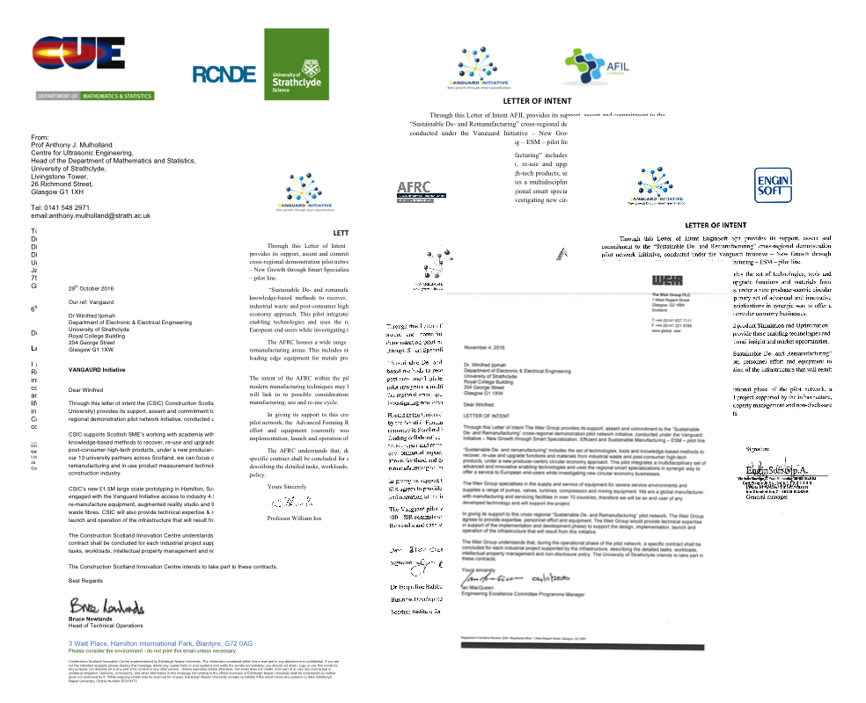
Industrial Participants and investors.
More than 60 European companies, with a cumulative turnover of 32 B€ and with some 175,000 employees, and 69 universities and RTOs distributed among the involved regions are involved.
Electorlux
Candy
RoldElectronics
TP Vision
Barco
Worldilne
Whirlpool
Cargotec Finland Oy
Sandvik Mining and Construction Oy
Metso Minerals Oy
Valmet Power Oy
John Deere Forestry Oy
Bronto Skylift Oy Ab
Avant Tecno Oy
Magneti Marelli
Cannon
Mercedes
Tenova
Maier
Indeva
Filartex Spa
Gafitex
Pass Maglia
Samatex
PTMT PANTER
Rivierasca
Brianza Plastica S.p.A.
Sintostamp S.r.l.
Magniplast S.p.A.
OCV Owenscorning
Covestro
Campine
Galloo Plastics
Kokkola LCC Oy
A2A Ambiente
Relight
Fincoat OY
Telatek Oy
Marzotto
Batz
Ki-lab
Gamesa
Xnext
Lot Quantum Design
MH Systems
Holonix
Idealtech
Cosberg
Giasini
AERNNOVA
ITP
Galloo
Van Gansewinkel
TKM TTT Finland Oy
IRIZAR
Meleghy Automotive
GKN
Enginsoft
Engineering
Cobat
The stakeholders have agreed to sign Letters of Intent to participate to the definition of this Pilot Network and, in the case of future end-users, to access the pilot network and to carry on industrial take-up, in case of positive evaluation of the developed solution.

Slide 24
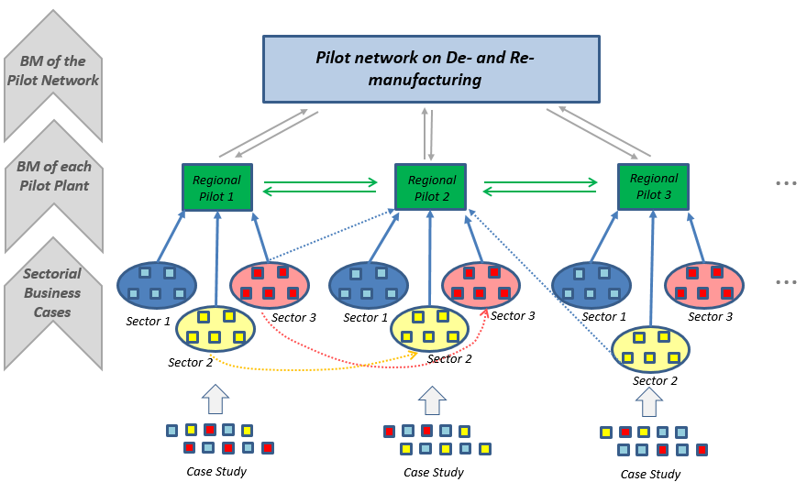
From Use Cases to the Business Model of the Pilot Network
Procedure for Business Model development

Slide 25
Partners & Role
60 Industrial partners (both large companies and SMEs): cumulative turnover of 32 B€; 175.000 employees
9 Industrial sectors: Electric and Electronic Equipment & White Goods, Automotive & Transport, Composite Manufacturing, Recycling Industry, Heavy Machinery, Metal Processing Industry, Textile Industry, Wind Energy Industry, Aeronautic.
  Manufacturers.
  Technology Providers.
  Recyclers and Remanufacturers.
69 Universities and RTOs
They will conduct specific research activities to bring the pilot technologies and methods to the required TRL level (7-8) and will support the long‐term sustainability of the pilot network through education (students) and training (professionals).
Public authorities, as well as Technology Clusters and industrial associations, at EU and local level.

Slide 26
Impacts
Example for Electric and Electronic Equipment and white goods industry
New jobs: 12000 (2020)
Value added: 2,5BEuro (2020)
CO² emissions: -15%
Energy consumption: -25%
Materials recovery: 70% recovery of critical raw materials (rare earth and valuable metals). 70% recovery of black plastics and 35% re-use of these plastics in high-tech sectors.
Natural resource consumption: -10% in water use

Slide 27

Pilot progress and ongoing activities
Pilot Idea: work done & next step
Call for Ideas - Pilot / demonstration projects
HORIZON 2020
NOW
Deadline: Call for Ideas - Pilot / demonstration projects
HORIZON 2020 - Climate Action, Environment,
Resource Efficiency and Raw Materials
OTHER EUROPEAN INITIATIVES
Steering Committee Announcement:
3 Categories
11 Topics
11 Working Groups
Bruxelles meeting for Pilot presentation and Delivery of an integrated version on Demanufacturing Pilot
H2020 Calls CIRC 01, CIRC 03
ESM Pilot Concept note Catalonia-Lombardy
Lombardy coordinator for Demanufacturing topic
Elaboration and delivery to SC of the Business Document for the Pilot Network
Scotland meeting
Vanguard ESM Steering Committee
Elaboration of a progress report for Demanufacturing Pilot
Updated version of the Business Document for the Pilot Network
VANGUARD LEVEL
Interaction with other European regions: Tampere, Norte, Basque Country, Scotland
Vanguard Brokerage Event in Brussels
Updated version of document on Demanufacturing Pilot
Meeting with Flanders, Scotland and South Netherlands
New regional partner: Flanders
Meeting AFIL among the affiliated companies
2° Meeting among lombardy companies to define the progress report
Elaboration of a report at regional level for the Call for Ideas
AFIL
meeting
Delivery of the first version for Lombardy (Excel+Word)
LOMBARDY REGIONAL LEVEL
AFIL meeting
4° and 5° Regional Lombardy Meeting
8° and 9° Regional Lombardy Meeting
12° and 13° Regional Lombardy Meeting
1° Meeting for partners interested in Demanufacturing Pilot
3° Regional Lombardy Meeting
6° and 7° Regional Lombardy Meeting
10° and 11° Regional Lombardy Meeting
14° , 15°and 16° Regional Lombardy Meeting
Nov/Dec
Jan/Feb
Mar/Apr
May/Jun
Jul/Ago
Sep/Oct
Nov/Dec
Jan/Feb
Mar/Apr
May/Jun
2014
2015
2016

Slide 28
Implementation Plan
Four Phases of implementation have been predicted
Phase 1 – Concept & Business Plan. The technical and business context related requirements for the large pilot technologies will be gathered, targeting the solution to the considered European sectors. In this phase, the barriers and opportunities for the proposed circular economy approach will also be identified (Required time: 12 months. Achivied in 2015 with co-funding).
Phase 2 – Detailed Design. The second phase will deal with the engineering of the pilot plant technological solutions. The control solutions to provide the plant the required level of flexibility enabling to treat different industrial problems in the same settings will be developed (Required time: 9 months).
Phase 3 – Installation & Commissioning. Installation and set‐up of the designed pilot plant in the designated areas (Required time: 15 months).
Phase 4 – Marketing & Launch. The activities will cover marketing, dissemination and exploitation of the generated best practices, in order to achieve the target impact of the pilot (Required time: 3 months).

Slide 29
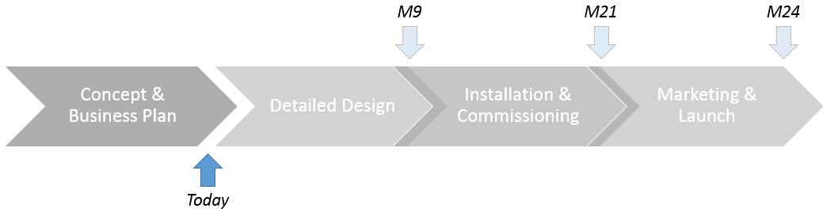
Phase 1: Implementation & Investment Plans
Integration of existing, new and upgraded facilities
Phase | 1 Concept & Business Plan | 2 Detailed Design | 3 Installation & Commissioning | 4 Marketing & Launch | Total
Funding | 0 | 3.15 | 24.5 | 0.35 | 28
Co-funding | 0.5 | 0.85 | 10.5 | 0.15 | 12
Total | 0.5 | 4 | 35 | 0.5 | 40
Schedule | Achieved 2015 | M1-M9 | M6-M21 | M18-M24

Slide 30
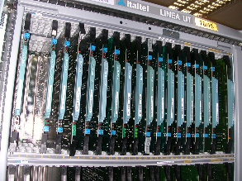
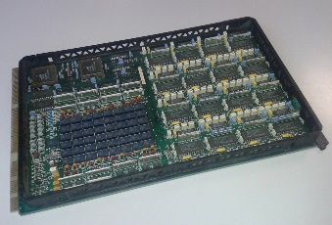
Example of Use Case
Problem statement
Key metals from TLC Printed Circuit Boards
Objective. The main interest of the company are:
To investigate innovative de- and re-manufacturing process-chain alternatives to recover functions and value from the their end-of-life product.
TLC systems and HW boards
Regional partners:
Manufacturers/Demanufacturers: Italtel, Rivierasca.
Technology Providers: Relight, A2A, Xnext, LOT Quantum Design, Holonix, PoliMI-DIG.
Universities/Research Centers: Polimi-MECC, Polimi-CHIM, ITIA-CNR, IREA-CNR, RSE.

Slide 31
Example of Use Case
Product. The UT100 (multiple layer PCB) has been taken into consideration as a reference product, with 8 millions of boards expected to be dismissed in the next years.
Results. Preliminary business plan for two investigated scenarios
Scenario 1. All the PCBs are treated with mechanical process to separate metal and non-metal fraction. Metals will be treated with hydrometallurgical processes, while non-metals will be used as secondary raw materials in construction industry.
Scenario 2. All the PCBs are tested: the working components are reused while the others are treated with the previous process-chain.
Data.
Technology installation costs: (source: participants, publications).
Operational costs (personnel, maintenance, floorspace, energy, and consumables): (source: participants, publications).
Material concentration in product (source:quantitative tests on samples)
Revenues: (source: secondary material market)
Product flows: (source: company estimates, based on installations).
Scenario 1
Scenario 2

Slide 32
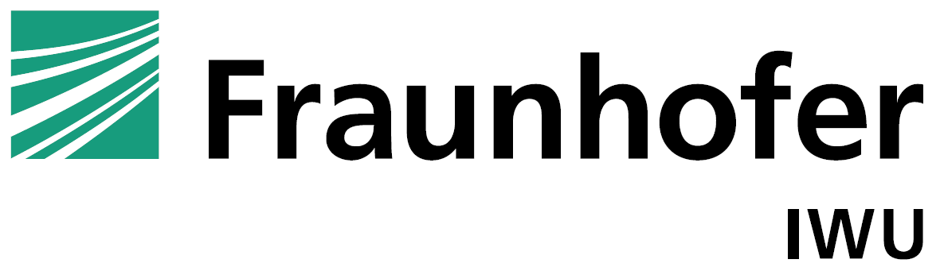
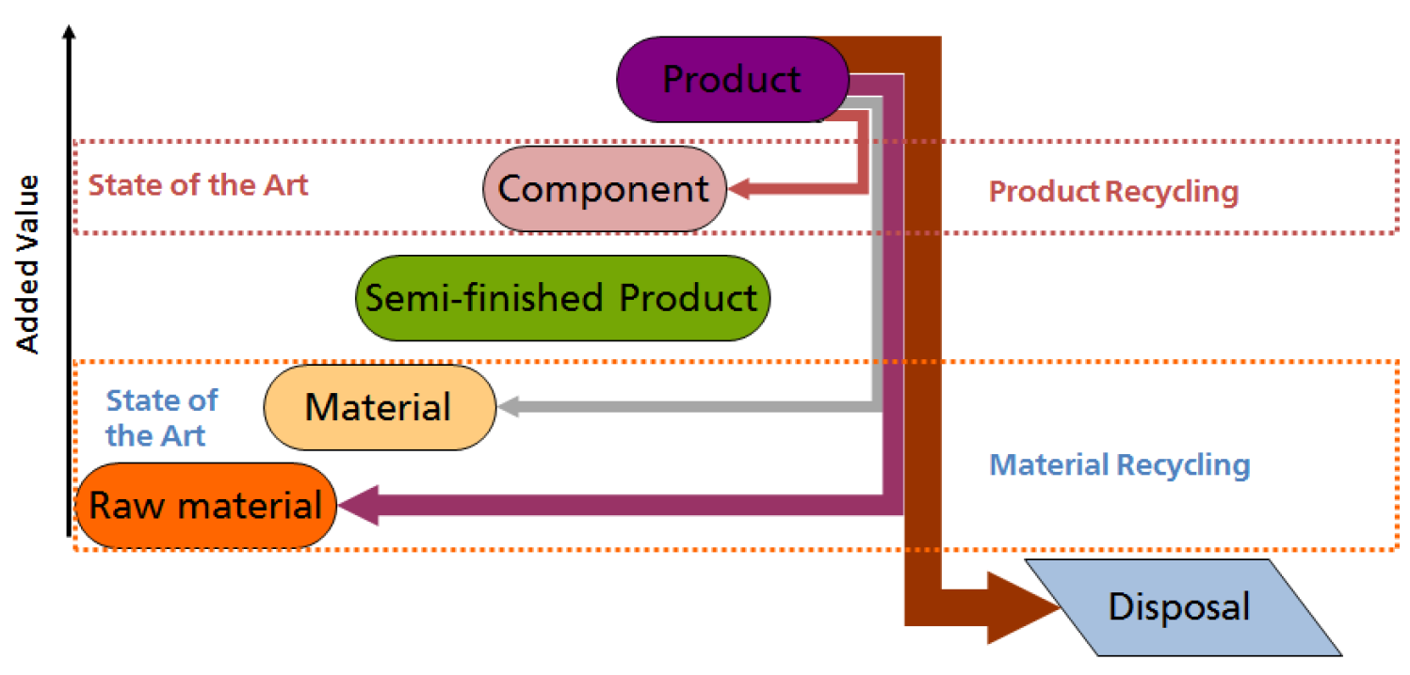
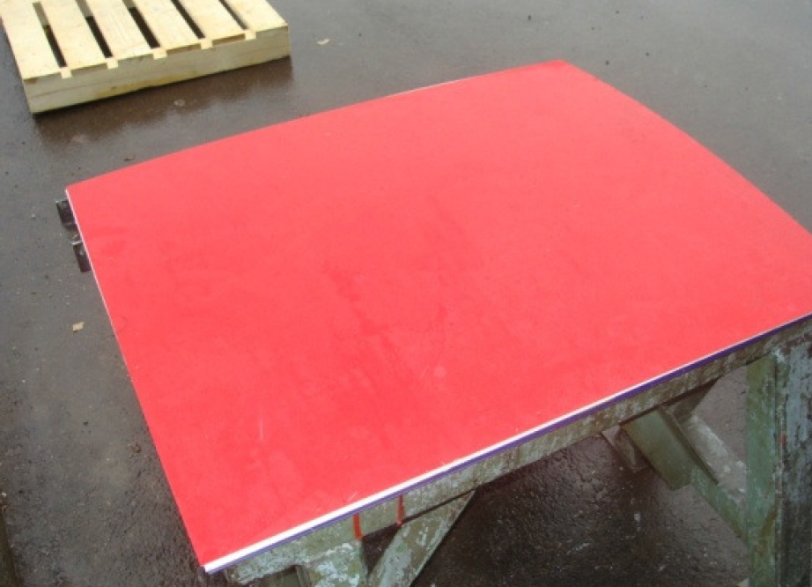
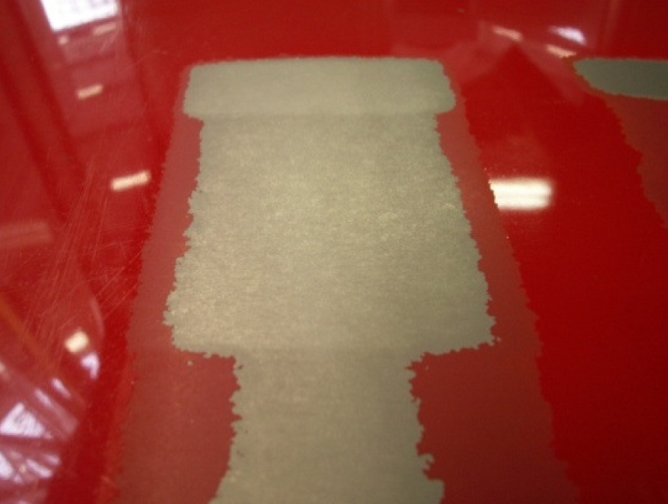
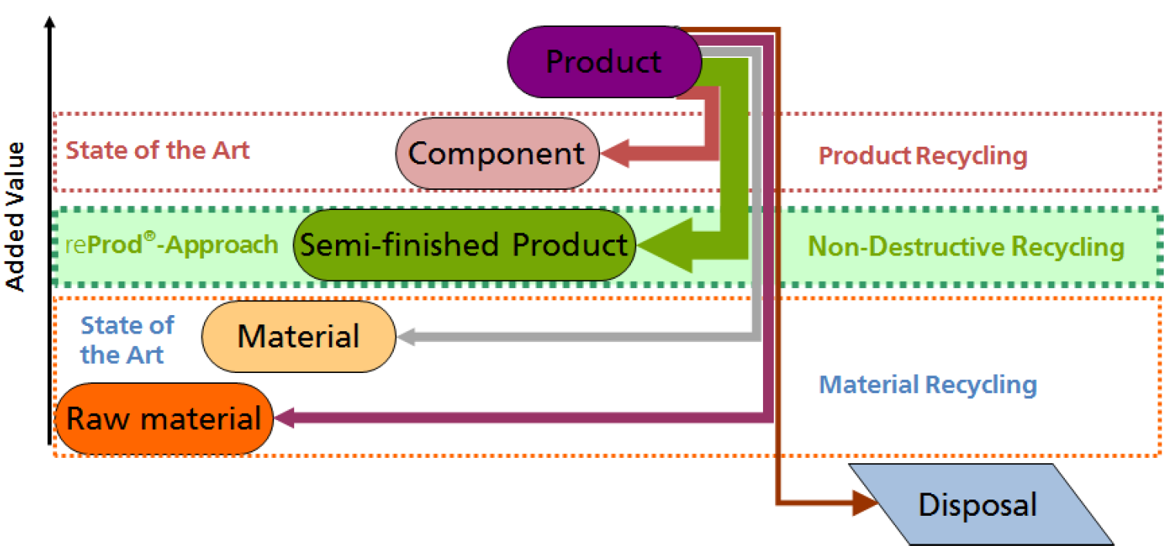
Example of competences: reProd® - Fraunhofer
Multiple usage of metal
Parts without the ‘detour of scrap’
Today
Tomorrow

Slide 33
Industrial Participants and investors.
More than 60 European companies, with a cumulative turnover of 32 B€ and with some 175,000 employees, and 69 universities and RTOs distributed among the involved regions are involved.
Electorlux
Candy
RoldElectronics
TP Vision
Barco
Worldilne
Whirlpool
Cargotec Finland Oy
Sandvik Mining and Construction Oy
Metso Minerals Oy
Valmet Power Oy
John Deere Forestry Oy
Bronto Skylift Oy Ab
Avant Tecno Oy
Magneti Marelli
Cannon
Mercedes
Tenova
Maier
Indeva
Filartex Spa
Gafitex
Pass Maglia
Samatex
PTMT PANTER
Rivierasca
Brianza Plastica S.p.A.
Sintostamp S.r.l.
Magniplast S.p.A.
OCV Owenscorning
Covestro
Campine
Galloo Plastics
Kokkola LCC Oy
A2A Ambiente
Relight
Fincoat OY
Telatek Oy
Marzotto
Batz
Ki-lab
Gamesa
Xnext
Lot Quantum Design
MH Systems
Holonix
Idealtech
Cosberg
Giasini
AERNNOVA
ITP
Galloo
Van Gansewinkel
TKM TTT Finland Oy
IRIZAR
Meleghy Automotive
GKN
Enginsoft
Engineering
Cobat
The stakeholders have agreed to sign Letters of Intent to participate to the definition of this Pilot Network and, in the case of future end-users, to access the pilot network and to carry on industrial take-up, in case of positive evaluation of the developed solution.

Slide 34
Industrial Participants and investors.
More than 60 European companies, with a cumulative turnover of 32 B€ and with some 175,000 employees, and 69 universities and RTOs distributed among the involved regions are involved.
Electorlux
Candy
RoldElectronics
TP Vision
Barco
Worldilne
Whirlpool
Cargotec Finland Oy
Sandvik Mining and Construction Oy
Metso Minerals Oy
Valmet Power Oy
John Deere Forestry Oy
Bronto Skylift Oy Ab
Avant Tecno Oy
Magneti Marelli
Cannon
Mercedes
Tenova
Maier
Indeva
Filartex Spa
Gafitex
Pass Maglia
Samatex
PTMT PANTER
Rivierasca
Brianza Plastica S.p.A.
Sintostamp S.r.l.
Magniplast S.p.A.
OCV Owenscorning
Covestro
Campine
Galloo Plastics
Kokkola LCC Oy
A2A Ambiente
Relight
Fincoat OY
Telatek Oy
Marzotto
Batz
Ki-lab
Gamesa
Xnext
Lot Quantum Design
MH Systems
Holonix
Idealtech
Cosberg
Giasini
AERNNOVA
ITP
Galloo
Van Gansewinkel
TKM TTT Finland Oy
IRIZAR
Meleghy Automotive
GKN
Enginsoft
Engineering
Cobat
The stakeholders have agreed to sign Letters of Intent to participate to the definition of this Pilot Network and, in the case of future end-users, to access the pilot network and to carry on industrial take-up, in case of positive evaluation of the developed solution.

