Slide 1
Florence, 6th of December Sophie Vogelaar – Randstad Region, Netherlands Filippo Martinelli – PNO Consultants
Notes:
This is Filipo Martinelli and my name is Sophie Vogelaar. We’re here today to represent the Vanguard Initiative, especially the Bioeconomy pilot.
I will tell you more about Vanguard itself and Filippo will tell you more about the content of the Bioeconomy pilot demo cases.
Later on Wim de Kinderen is going to enlighten you more on progress, successes and remaining challenges of the Vanguard Initiative.
Just to get an indication: Who of you is already familiar with the Vanguard Initiative?

Slide 2
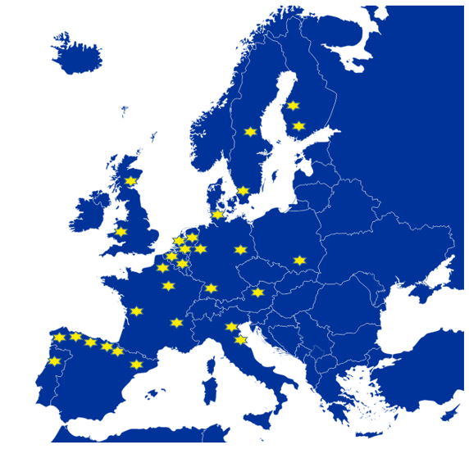
Asturias
Baden - Württemberg
Basque Country
Cantabria
Catalonia
Dalarna
East - Netherlands
Emilia - Romagna
Flanders
Galicia
Ile - de - France
Lombardy
Malopolska
Navarra
Nord - Pas de Calais
Norte
North Rhine - Westphalia
Pays de la loire
Ostrobothnia
Randstad Region
Auvergne - Rhône - Alpes
Saxony
Scotland
Skåne
South - Denmark
South - Netherlands
Tampere Region
Upper - Austria
Wales
Wallonia
Notes:
The VI is an alliance of 30 regions that wants to impact the European innovation and industrial policies for new growth.
It started at the end of 2013 with 10 members and slowly increased to 30

Slide 3
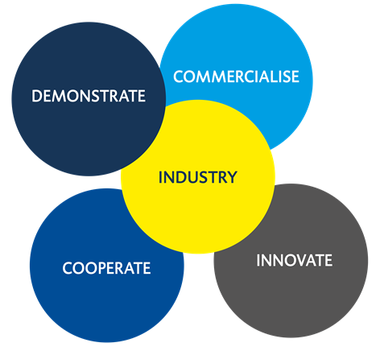
What is the Vanguard Initiative?
Network of 30 regions in Europe
striving for modernisation, stronger competitiveness and internationalisation of
Europe’s industry
Notes:
All of the 30 regions share the ambition to use smart specialisation strategies for supporting entrepreuneurship and innovation driven clusters to develop new industrial activities in the regions across Europe.
It’s special since it’s a bottom-up initiative, founded by the regions itself.

Slide 4
What is the Vanguard Initiative?
Interregional cooperation
To speed up the market uptake of new innovative technologies
Collaboration between regional authorities, clusters, business, knowledge institutes
Exploring and facilitating public-private investment and co-funding possibilities
Co-shape EU policy and agenda
Members with strong political commitment and ambition

Slide 5
What is the Vanguard Initiative?
Currently 5 thematic pilots: nano-enabled products, efficient and sustainable manufacturing, 3D-printing, energy related applications for harsh environments and bioeconomy
Strong EU orientation
Smart Specialisation Strategies are the core of the collaboration
Brussels based coordination of the network
European Institutions as strategic partners, EU policy influencing
Smart Specialisation Platform on Industry Modernisation

Slide 6
GENERAL ASSEMBLY
All member regions
Political Meeting
Annual meeting
Directors Meeting
Annual meeting
Brussels Network Meeting
6-8 times per year
BOARD/
COORDINATION GROUP
Lombardy& Randstad
Catalonia & Lombardy
Flanders Norte, South-Nether-lands
Basque Country, Scotland
Skåne, Tampere
BIO-ECONOMY Interregional cooperation on innovative use of non-food biomass
EFFICIENT AND SUSTAINABLE MANU-FACTURING
High performance production through 3D-PRINTING
Advanced manufacturing for ENERGY-RELATED APPLICATIONS in harsh environments
New NANO-ENABLED PRODUCTS
Biobased Aromatics
Lignocellulose Refiinery
Biogas Beyond Energy Production
Turning (waste) Gas into Value
Bio Aviation Fuel
Food and Feed from Agrofood Waste
Food and Feed Ingredients frrom Algae
Notes:
Right now there are 5 different pilot projects.
Each project consists of a number of demo cases.
The bioeconomy pilot has 7 different cases.

Slide 7
Vanguard Initiative approach
Launch of new ventures and start - ups
New value chains
TRL 9
UPSCALE
COMMERCIALISE
Networked demonstration
Pilot lines and first of a kind factories
TRL 6 – 7 – 8
DEMONSTRATE
Matching events for complementary partners
Developing demonstration cases
CONNECT
Developing a scoping paper
Mapping questionnaire
Identify lead regions and actors
LEARN
Notes:
The Vanguard Initiative has 4 different phases in the upscaling of the demonstration cases.

Slide 8
Demo Case | Objective
Biobased Aromatics | Interregional value chains and Joint Demonstration on Biomass Valorisation to Aromatics
Lignocellulose Refinery | Production of bulk and fine chemicals and fuels from lignocellulose biomass. Set-up of a European value chain from lignocellulose to end products using biotechnology (refinery)
Biogas Beyond Energy | Advancing the state of the art of biogas production towards more and higher value added outputs
(Waste) gas into Value | Turning C1 gas streams (from biogas production, biomass gasification or industrial emissions) into chemicals or fuels
Bio Aviation Fuel | Promoting larger scale aviation biofuel production
Food & Feed from Agrofood Waste | Extracting functional foods and feed from different waste streams, such as fish, domesticated animals, cereals, fruit, and vegetables.
Food and Feed ingredients from Algae | Extraction of high value products from microalgae for the food & feed sector.
Notes:
The bioeconomy pilot is interesting since it is a cross-sectoral pilot and it has a link with several DG’s of the European commission.
At first sight, the link between AgriFood and the cases would be strongest with the bottom cases (food & feed from agrofood waste and food and feed ingredients from algae), but there is a link with all of the demo cases of the pilot projects.

Slide 9
Bioeconomy Valentina Pinna and Bart Verschoor
Pilot active case groups
Demo Case | Leading region | Case leader
Biobased Aromatics | Flanders – VITO | Ludo Diels ludo.diels@vito.be
Lignocellulose Refinery | Randstad – Biobased Delta | Carolien Huisman Carolien.huisman@biobaseddeltazh.nl
Biogas Beyond Energy | Lombardy – Green Chemistry Association | Daniele Colombo, daniele.colombo@mi.camcom.it
(Waste) gas into Value | Flanders - Ghent Bio-energy Valley | Sofie Dobbelaere, Sofie.Dobbelaere@UGent.be
Bio Aviation Fuel | Värmland – Paper Province | Marcus Elmer m.elmer@paperprovince.com
Food & Feed from Agrofood Waste | Scotland – Scottish Enterprise | Mark Morrison Mark.morrison@optimat.co.uk
Food and Feed ingredients from Algae | Asturias | Contactperson: Julia Alvarez, alvarezjulia@uniovi.es

Slide 10
Contact details
Sophie Vogelaar – Randstad region
Sm.vogelaar@pzh.nl
Filippo Martinelli – PNO Consultants
filippo.martinelli@pnoconsultants.com
Notes:
We also participate in smart specialisation platform, so we watch which case fits best in which platform.

