Slide 1
RIS3 support in
Lagging Regions – Introducing Monitoring and Governance
Suceava, 26th October 2016
Project team: Mark Boden, Karel Haegeman, Elisabetta Marinelli, Patrice dos Santos, Susana Valero
www.jrc.ec.europa.eu
Serving society
Stimulating innovation
Supporting legislation

Slide 2
Aim of the presentation
Introduction to
The RIS3 Targeted Support project
Introduction to the participatory exercise – EDP in Agro-food

Slide 3
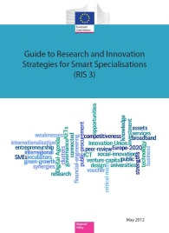
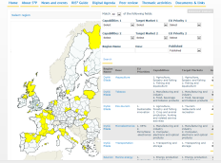
Activities of the S3 Platform
TARGETED SUPPORT
The RIS3
Guide & the Digital Agenda Toolbox; S3 policy briefs
Synergies ESIF-H2020
Eye@RIS3
Trans-national learning and Peer Review
Interactive web tools, S3 Newsletter and Website
Thematic focus on actors, process, common features and priorities
Value chains and alignment of innovation roadmaps
RIS3 assessment
and support to REGIO desks; ICT experts
Notes:
The role of the S3Platform as an interactive and highly participatory interface between up-down and bottom-up processes. This cannot be underestimated.

Slide 4
RIS3 in Lagging Regions: aims & background
Aims
To support the refinement and implementation of the RIS3 of selected EU regions
To generate lessons and a model for other regions
To serve as a test-bed for theories on Smart Specialisation – understanding of RIS3
Background
Extends successful activities on Eastern Macedonia and Thrace
Implements two European Parliament "Preparatory Actions"

Slide 5
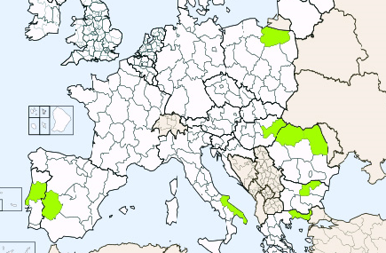
Focused on 9 regions in Eastern and Southern Europe: selection of regions
Support to RIS3 implementation in Lagging Regions
Warminsko Masurskie
Észak-Alföld
Nord-Vest
Nord-Est
Centro
Severen Tsentralen
Extremadura
Puglia
Eastern Macedonia
and Thrace

Slide 6
Implementation
Partnership
JRC, DG REGIO, other DGs, regional and national authorities
Flexibility
approach tailored to needs and problems identified by stakeholders
Transnational dimension
Identify and share common project-ideas and solutions
Synergies with other activities
S2E, Less Developed Regions initiative, Vanguard Initiative, S3P, etc.

Slide 7
Horizontal issues
Broader RIS3 implementation
Sustaining EDP
Instruments beyond the ROP
Outward-looking orientation – Transnational cooperation
Governance
Monitoring

Slide 8
Regional-specific issues
Co-defined activities
Specifically discussed with each region
Synergies with NOPs and ROPs in Apulia
EDP in NE, NW, Romania
Working groups on human resources/governance, in NE and NW Romania.
RIS3 instruments in Extremadura
Urban dimension of RIS3 in BU & HU

Slide 9
EDP in Agrofood
4 segments
Development of new products
i.e. genetics of the plants; augmented nutritional value; healthy food, etc.
New practices/processes
i.e. second harvest, third harvest, circular economy, etc.
New business models agriculture
i.e. traceability, linking producers to markets
Non-food use of agricultural products
i.e. bioenergy, building with natural materials

Slide 10
Participatory exercises – overview
4 working groups
1 secretary – provides support to participants & moderator
2 steps
1- identification of project-ideas and sub-groups
1 moderator – do what she/he says!
Outputs
2 - discussing ways to address the project-idea
List of project-ideas for regional development
Identification of interested actors

Slide 11
Participatory exercise step - 1
Split into thematic working groups
Individual identification of project-ideas
Presentation of project-ideas to the group
Formation of sub-groups

Slide 12
Participatory exercise step-1
Split into thematic working groups
Individual identification of project-ideas
Presentation of project-ideas to the working group
Formation of sub-groups

Slide 13
Participatory exercise step-1
Split into thematic working groups
Individual identification of project-ideas
Presentation of project-ideas to the working group
Formation of sub-groups
Individual project-idea fiche
Project title
Individual reflection
Few minutes
Bring your perspective
Project description and impact on the region

Slide 14
Participatory exercise step-1
Split into thematic working groups
Individual identification o
Presentation of project-ideas to the group
Formation of sub-groups
Roundtable of short, presentations
project-ideas can be discussed/reformulated in group
Follow the moderator

Slide 15
Participatory exercise step-1
Split into thematic working groups
Individual identification of project-ideas
Presentation of project-ideas to the group
Formation of sub-groups
project-ideas | Participants
C.1 | P1 | P2 | P4 | P3
C.2 | P2 | P4 | P3
C.3 | P3 | P1
C.4 | P4 | P1
4-6 triple helix participants
addressing one "Regional development project-idea"
Preference table
Sub-groups
Voting & Consensus building

Slide 16
Participatory exercise step-2
Split into sub-groups
Discuss and fill-in "Regional development Idea"
Internal reporting

Slide 17
Participatory exercise step-2
Split into sub-groups
Fill-in "Regional development Idea"
Internal reporting

Slide 18
Participatory exercise step-2
Split into sub-groups
Discuss and fill-in "Regional development Idea"
Internal reporting
Regional development fiche
Nominate
Writer
Rapporteur
Sub-group exercise
Core-of the exercise
Type in computer
Use images/links

Slide 19
Participatory exercise step-2
Split into sub-groups
Fill-in "Regional development Idea"
Internal reporting

Slide 20
Conclusions
Output
list of regional development ideas
Shared by 4-ple helix
Based on local strengths
Aware of local limitations
Outcome
4-ple Helix understanding of bio-tech opportunities
4-ple Helix understanding of EDP
Impact
Influence ROP funding
Develop RIS3 strategy

Slide 21
Project website
http://s3platform.jrc.ec.europa.eu
Thank you!

