Slide 1
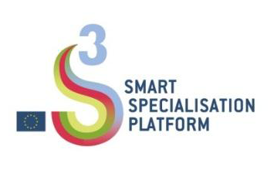
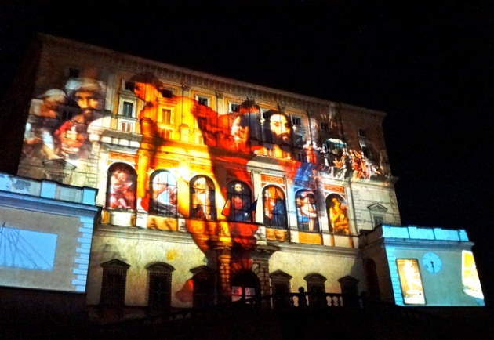
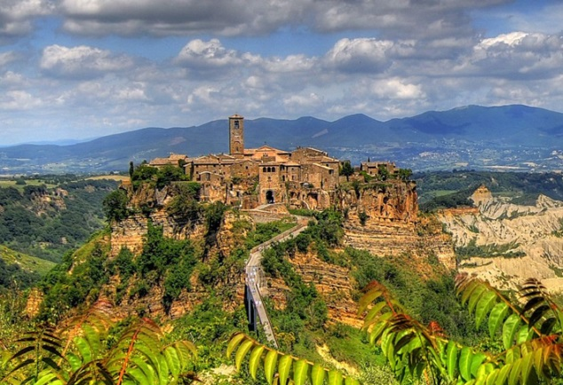
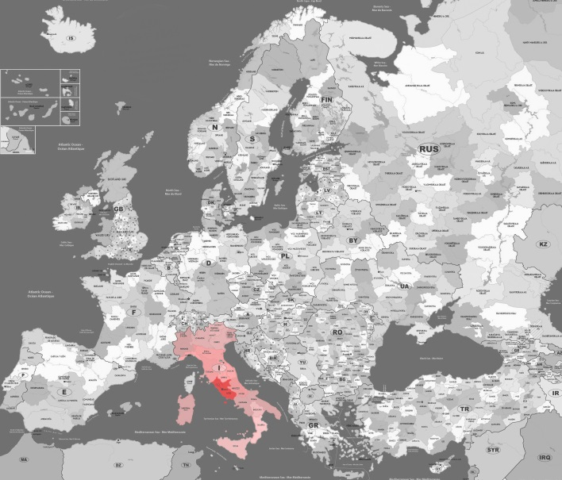


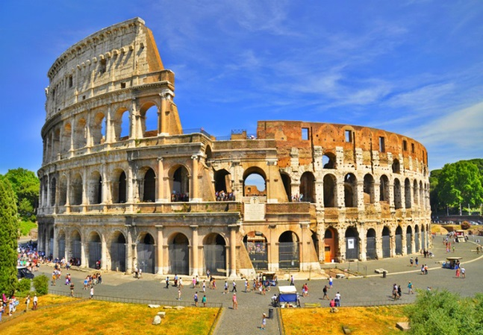
CULTURAL HERITAGE
An engine for innovation and growth – S3 Platform peer review
Rome, 25th November ²⁰¹⁶
Implementing Smart Specialisation Strategies: how do we address Cultural Heritage and what are the key issues in addressing Cultural Heritage?
REGION
of LAZIO

Slide 2
CULTURAL HERITAGE. An engine for innovation and growth – S3 Platform peer review
(Rome, 25th November 2016)
Tourism and cultural heritage - Our region by the numbers
Number of enterprises:
40,000
(14% of the national total)
Value added:
€14,700,000,000
(16% of the national total)
Source: Io sono cultura - 2016
Source: Io sono cultura - 2016
Number of employees:
202,000
(14% of the national total)
International tourism totals:
20,000,000 visitors
€6,300,000,000
(3.8% of the national total)
Source: Io sono cultura - 2016
Source: Banca d’Italia

Slide 3
CULTURAL HERITAGE. An engine for innovation and growth – S3 Platform peer review
(Rome, 25th November 2016)
Cultural heritage - Our region by the numbers
Museums and galleries:
259
Archaeological parks & areas:
28
Monuments:
29
UNESCO:
5
Source: Istat - 2011
Universities:
13
(5 public and 8 private)
Central institutions of the Ministry of Cultural Heritage and Activities and Tourism (MiBACT):
6
Source: MIUR 2015
Leading Research Organizations:
3 (ENEA, CNR, INFN)

Slide 4
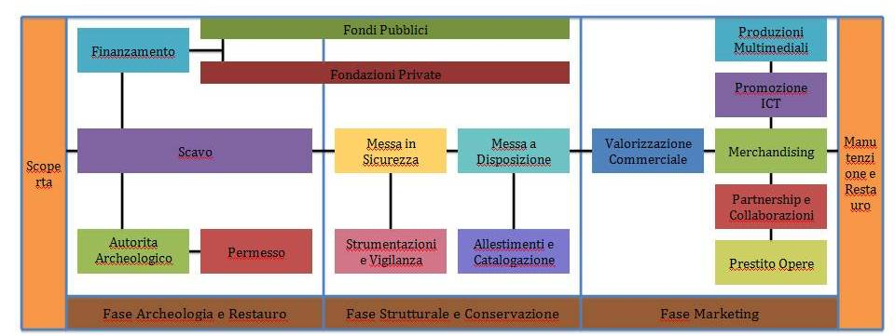
CULTURAL HERITAGE. An engine for innovation and growth – S3 Platform peer review
(Rome, 25th November 2016)
S3 elements relevant to the Cultural Heritage of the Region of Lazio
A first-rate industry, recognized worldwide, which includes all sectors connected with the development of knowledge, products and services related to the various links in the value chain:
Knowledge, diagnostics, conservation and restoration necessary to explore and preserve Cultural Heritage;
Development, use and management of Cultural Heritage assets to present them and make them accessible to the community.

Slide 5
CULTURAL HERITAGE. An engine for innovation and growth – S3 Platform peer review
(Rome, 25th November 2016)
S3 elements relevant to the Cultural Heritage of the Region of Lazio
1) Strong presence of public operators and market failure
2) Conditions for improving competitiveness:
the removal of institutional constraints and national laws that restrict the development of innovation, and tax incentives to facilitate private financing;
the implementation of new technologies for diagnosis, planning, restoration and safeguarding of cultural heritage assets, including imported from other sectors (cross fertilization), in particular from aerospace and ICT;
the use of technology and development of new technological products for the marketing and commercial exploitation phase (laser scans, 3D models, apps, etc.);
strengthening the way the territory markets museums, to make viewing them interactive and exciting for visitors, drawing inspiration from the most successful examples throughout Europe

Slide 6

CULTURAL HERITAGE. An engine for innovation and growth – S3 Platform peer review
(Rome, 25th November 2016)
Past actions
Consultation with stakeholders (listening and feedback):
New industry policy
"Value added Lazio"
Milestones
DRAFTING
OF THE NEW PUBLIC NOTICE
"Exploitation, use and conservation of cultural assets "
worth €10.6 million
Focus group
Call 4 Proposals
Overall State of the Industry
Guidance for the design and implementation of public notices
Focus group
16 December 2013
28 July 2015
24-26 February 2016
September
October 2016
2017
Timeline

Slide 7
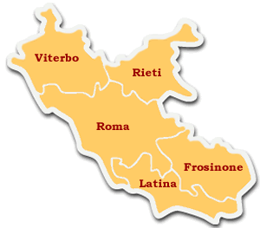
CULTURAL HERITAGE. An engine for innovation and growth – S3 Platform peer review
(Rome, 25th November 2016)
Past actions
Consultation with stakeholders (listening and feedback):
Call 4 Proposals
Area of ​​the actor making the proposal
Total Investments:
€256,695,000
Average investment: €9,507,222
Number of proposals
27
2
By residence of the actor making the proposal
Multi-sector
3
15
3
-
Regional level proposals: 2
Proposals not at the regional level: 2

Slide 8



CULTURAL HERITAGE. An engine for innovation and growth – S3 Platform peer review
(Rome, 25th November 2016)
Lessons learned
Consultation with stakeholders (listening and feedback):
Focus group
(16 December 2013) - Smart Specialization Strategy Lazio Focus Group Cultural Heritage:
Call for Proposals (published 28 July 2015):
High number and quality of consultations, and identification of seven S3 priority areas, including "Cultural Heritage and Technology for Culture"
Strengthening listening and feedback activities
Formalization of 8 Areas of interest for implementation of public notices relating to S3 areas of specialization for a total value of over €100 million (including the public notice "Exploitation, use and conservation of cultural assets" with a value of €10.6 million)
Limiting the duration of the process of drafting public notices (high number of proposals received)
Overall State of the Industry
(22-24 February 2016):
Active participation by numerous stakeholders: 12 focus groups with nearly 1,000 participants, including about 150 in the focus group on "Cultural heritage and technology for culture"
Strengthening and continuity in the dialogue with stakeholders

Slide 9
CULTURAL HERITAGE. An engine for innovation and growth – S3 Platform peer review
(Rome, 25th November 2016)
Past actions
Local actions for Cultural Heritage
The Technological District for Culture – DTC1 (2009-2014)
DTC1: the Technology District for cultural heritage and activities was created in May 2008 through a "Framework Programme Agreement" between the Region of Lazio, the Ministry of Economic Development, the Ministry of Education, Universities and Research and the Ministry of Cultural Heritage and Activities and Tourism, as a tool for economic and local development, to initiate a structured network of relationships and technical/scientific collaborations between public and private research and businesses.
The DTC's implementing measures made it possible to create an integrated system of 10 projects, beginning in 2009 and concluding in 2014, through 5 regional public notices worth a total of 13 million euro, for the purpose of enhancing Lazio's cultural heritage and to consolidate and stimulate innovation on the part of sector stakeholders.

Slide 10


CULTURAL HERITAGE. An engine for innovation and growth – S3 Platform peer review
(Rome, 25th November 2016)
Lessons learned
Local financial actions exclusively for Cultural Heritage
DTC1 - Technology District for cultural heritage and activities (2009-2014):
Exporting the DTC model abroad (Malaysia and Taiwan)
More empowerment of the Cultural Heritage’s owners to be developed in the design, implementation and maintenance of the technology created

Slide 11
CULTURAL HERITAGE. An engine for innovation and growth – S3 Platform peer review
(Rome, 25th November 2016)
2014-2020 POR (Regional Operational Plan) priorities, actions and financial resources
OT (Objective) 1 - Research, technological development and innovation /
Axis 1 – Research and Innovation – Total resources allocated: €180 Million
OT priority | Action | Planned actions | Total RESOURCES (in millions of €) | Resources for Technologies for Cultural Heritage (in millions of €)
Enhancing the infrastructrure for research and innovation (R&I) and the capacities for developing excellence in R&I and promoting centres of competence, in particular those of European interest; | Support for infrastructure for research considered critical or crucial to the region's systems | Infrastructural strengthening of regional technology clusters and research facilities | 20 | 5
 |  | Strengthening of private competence centres in the region | 15 | 3.8
Promoting business investment in R&I by developing links and synergies between businesses, centres of research and development centers and the higher education sector.... | Support for the economic promotion of innovation through experimentation and adoption of innovative solutions in processes, products and organizational formulas [...] | Support for research, innovation and the transfer of technology from research to enterprises and among sectors and for the development of consortia and business networks | 40 | 5
 | Support for collaborative R&D activities for the development of new sustainable technologies, new products and services [...] | Realization of strategic projects | 70 | 9.2
 |  | Actions to support R&I cooperation within and beyond the region and promotion of local results | 3 | 0.4
 | System-wide actions to support the participation of local actors in the consultative platforms and national technological specialization networks such as the National Technological Clusters, and projects financed by other European research and innovation programmes (such as Horizon 2020) | Support for entrepreneurial projects submitted under European R&D programmes | 2 | 0.3
 | Strengthening and improving the PA's demand for innovation by supporting Precommercial Public Procurement and Innovation Procurement actions. | Strengthening and improving the demand for PA innovation | 10 | 5
 | Support for the creation and consolidation of innovative start-ups involving intensive application of knowledge and of research spin-off initiatives [...] | Support for highly technological startups and spin-offs | 20 | 1
 |  |  | 180 | 29.7

Slide 12
CULTURAL HERITAGE. An engine for innovation and growth – S3 Platform peer review
(Rome, 25th November 2016)
2014-2020 POR (Regional Operational Plan) priorities, actions and financial resources
OT 3 To promote the competitiveness of SMEs, the agricultural sector and the fisheries and aquaculture sector
Axis 3 – Competitiveness – Total resources allocated: €169.4 million
OT priority | Action | Planned actions | Total resources (in millions of €) | Resources for Technology for Cultural Heritage (in millions of €)
To develop and implement new business models for SMEs, in particular for internationalization | Projects to promote exports, aimed at companies and groups of companies identified by territory or sector [...] | Internationalization of the sector | 81 | 5
To support SMEs' capacity to grow on regional, national and international markets and to take part in the processes of innovation; | Strengthening of the system of public guarantees for credit expansion in synergy between the national and regional guarantee systems [...] | Guarantees and access to credit | 88.4 | 7
 | Promotion and support for the use of innovative bond financing for SMEs (e.g. Minibonds) | Innovative bond financing
 | Contribution to the development of the market of venture capital funds for pre-seed, seed and early stage business startups | Venture Capital Fund
 |  |  | 169.4 | 12

Slide 13
CULTURAL HERITAGE. An engine for innovation and growth – S3 Platform peer review
(Rome, 25th November 2016)
2016-2020 APQ6 (Framework Programme Agreement) financial measures and resources
"Research, technological innovation, telecommunications networks" excerpt from "Implementation of plan actions and new measures for technological district for new technology for cultural heritage and activities"
IV Supplementary agreement
Action | Resources for Technology for Cultural Heritage (in millions of €)
TE1 - Centre for Excellence consisting of Registry of Skills and Centre for Spreading Regional Innovation for Materials and Technology intended in part to promote high-quality artistic handicrafts | 6
TE2 - Actions for research and development of technologies for the development, protection, use, conservation, recovery and sustainability of cultural heritage | 23.2
TE3: Actions for capital for companies that propose to carry out highly technological and innovative activities that require launching processes of technological renewal and improvement of the process and/or product, including in partnership with private investors | 3
TE4: Actions for research and development of new technologies and methodologies for better enjoyment of the performing arts (music, theatre and dance) | 6
TE5: Communication, promotion and support for the processes that promote the work of Lazio's SMEs in the DTC and Cultural Tourism sector | 3.5
 | 41.7

Slide 14
CULTURAL HERITAGE. An engine for innovation and growth – S3 Platform peer review
(Rome, 25th November 2016)
Upcoming actions
The contribution of the public demand for innovation: Pre-Commercial Procurement (PCP)
Testing of a pilot project in the field of Cultural Heritage, in consultation with the Ministry of Cultural Heritage and Activities and Tourism (MiBACT) using the PCP methods, for the following purposes:
to develop a culture of innovative PCP and the respective know-how in Lazio;
to develop the potential of Cultural Heritage assets through research and technological innovation;
to generate economic value through the management of intellectual property developed from pre-commercial procurement

Slide 15
CULTURAL HERITAGE. An engine for innovation and growth – S3 Platform peer review
(Rome, 25th November 2016)
Upcoming actions
The contribution of the public demand for innovation: Pre-Commercial Procurement (PCP)
State-of-the-art PCP applied for Cultural Heritage:
An implementation process with MiBACT has been launched:
MiBACT has acquired the requirements to develop a system of remote control and remote accessibility to the sites;
The Etruscan Necropolis of Monterozzi in Tarquinia (a UNESCO site since 2004) has been selected as a pilot area.

Slide 16
CULTURAL HERITAGE. An engine for innovation and growth – S3 Platform peer review
(Rome, 25th November 2016)
Upcoming actions
The contribution of the public demand for innovation: Pre-Commercial Procurement (PCP)
The main actions for carrying out the trial:
mapping of needs/opportunities for intervention;
  stakeholder engagement to define the implementation methods for the actions;
  definition of the framework for the actions, in accordance with the principles of the Communication of the European Commission no. 799/2007 regarding the existence of the principle of technological innovation and the publication of a public notice for the acquisition of products and services not available on the market; in this third phase, the terms, methods for access, budget and target products will be outlined;
  attracting potential partners through communication tools as described below;
  preliminary market procedure with the possible acquisition of data, information and technical solutions to be included in the notice;
  implementation of the tender notice and implementation of the actions.

Slide 17
CULTURAL HERITAGE. An engine for innovation and growth – S3 Platform peer review
(Rome, 25th November 2016)
Upcoming actions
The new Technological District for Culture – DTC2 (2016-2020)
Construction of a new Technological District for cultural heritage and activities, through a specific "Framework Programme Agreement" between the Region of Lazio, the Ministry of Economic Development, the Ministry of Education, Universities and Research and the Ministry of Cultural Heritage and Activities and Tourism, with a budget of €41.7 million for the implementation of measures aimed at enhancing Lazio's cultural heritage and consolidating and stimulating innovation in businesses and research organizations dedicated to cultural heritage in the region.
  Expansion of the scope of the system of cultural and creative production, thus affecting the production of other sectors: synergies between cultural, tourism and manufacturing policies.

Slide 18
CULTURAL HERITAGE. An engine for innovation and growth – S3 Platform peer review
(Rome, 25th November 2016)
Open issues
Business models:
Innovation:
Interregional
and international cooperation:
How to facilitate more effective models for public-private partnership
What role can public demand have through tools such as
Pre-Commercial-Procurement?
How can new technologies expand the possibilities for use of cultural heritage?
How can contamination between the humanities and the digital sciences become the basis for expanding the supply of products and services to promote cultural heritage?
How to promote cooperation across European regions in S3 areas of specialization to facilitate exchanges of experience and to achieve greater cooperation in research, innovation and business counterparties

Slide 19
CULTURAL HERITAGE. An engine for innovation and growth – S3 Platform peer review
(Rome, 25th November 2016)
Thanks for your attention
Francesco Mazzotta
Economic development
Department of Applied Research, Innovation,
Infrastructures and Green economy
Lazio Region
fmazzotta@regione.lazio.it
www.regione.lazio.it
http://www.regione.lazio.it/rl_attivitaproduttive/

