Slide 1
Valorisation of cultural
World Heritage at Venaria Reale
PAOLA ZINI
President
Venaria Reale Consortium
Roma, 25 november 2016

Slide 2
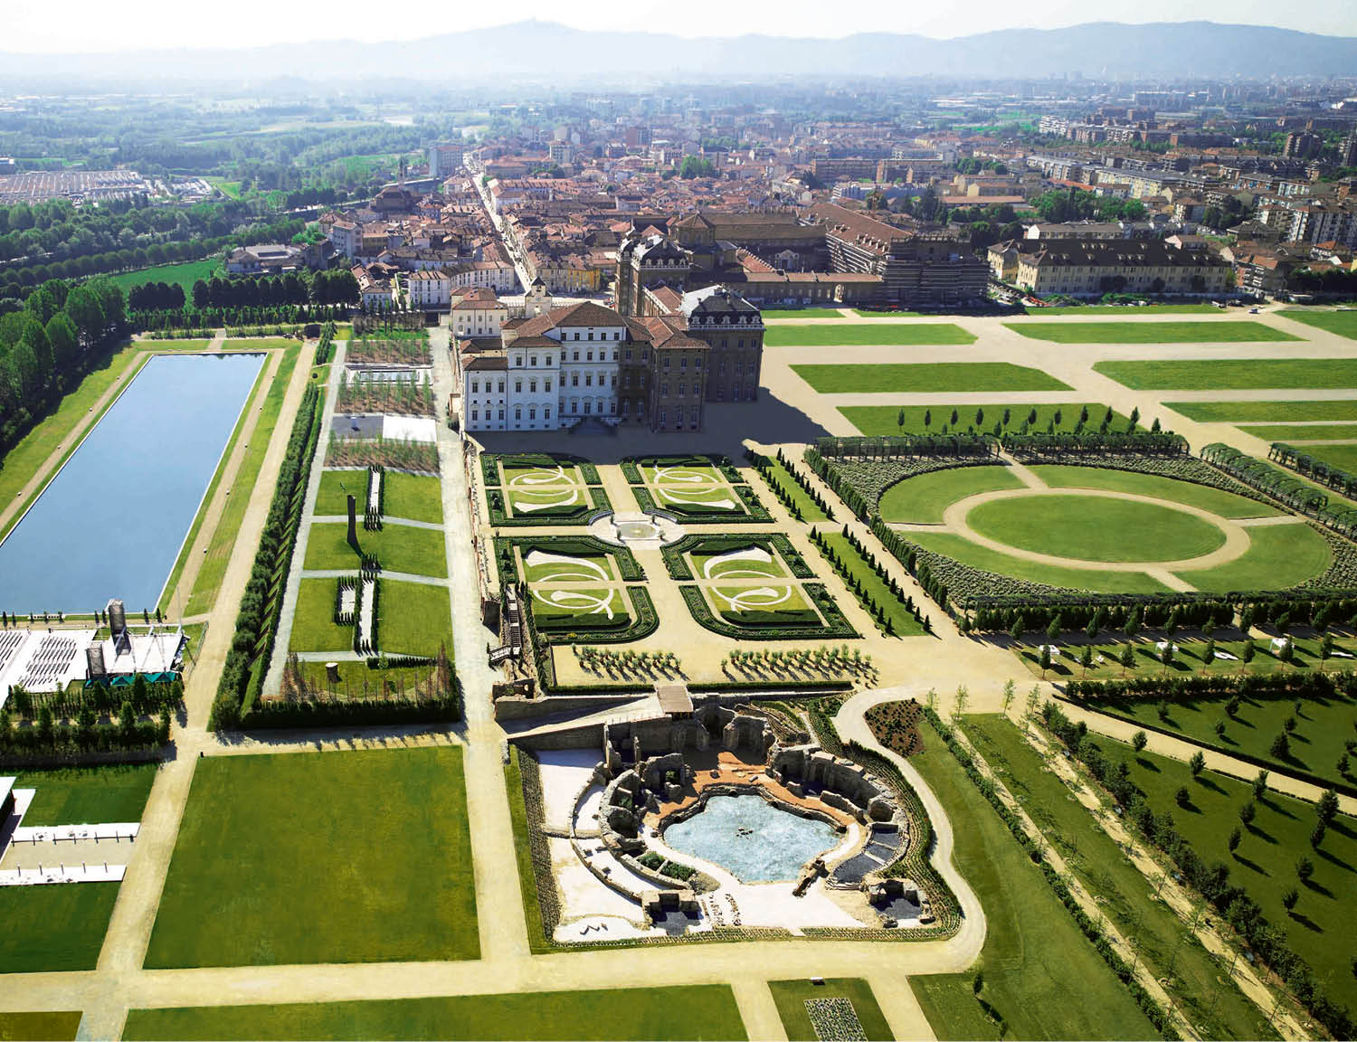

Slide 3
Historical Information
200 years of abandon
One of the Savoy Royal Residences
Since1997 in the UNESCO World Heritage List
2007 Opening

Slide 4
3 key factors for the valorisation
Governance
Budget
People

Slide 5
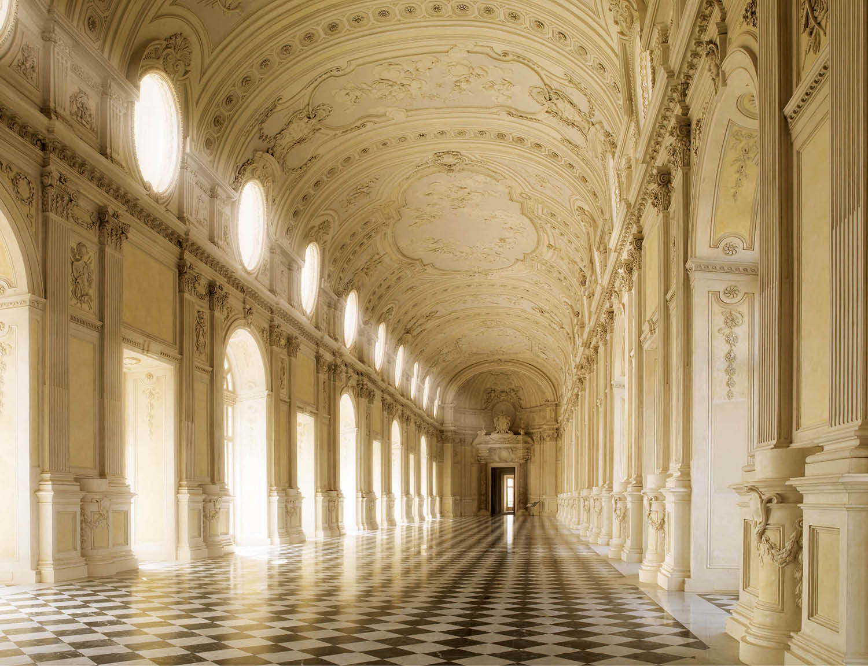
GOVERNANCE
systems and processes

Slide 6
GOVERNANCE
Owner of the palace – Ministry of Cultural Heritage and Tourism
Legal entity - Consortium
Object of activity – cultural development and promotion

Slide 7
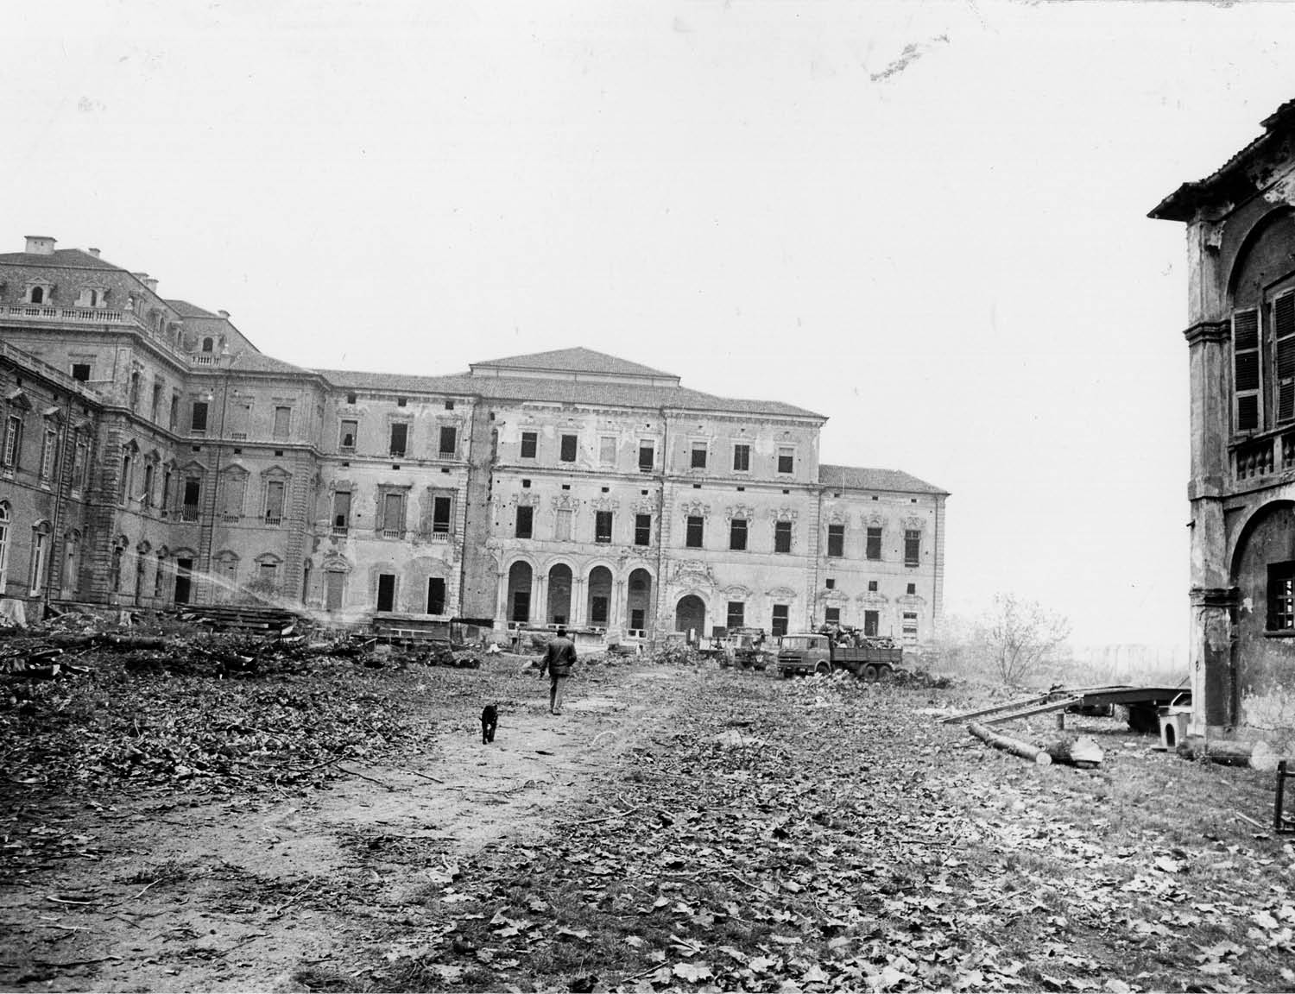
BUDGET
grants and own income

Slide 8
BUDGET
Repair and Restoration Project
200 milion of euro by European Union
Ongoing Project
15 million euros per year
40% own income
60% private and public funds
THE PRESENCE OF THE ROYAL PALACE ON THE TERRITORY BRINGS ECONOMIC BENEFITS TO THE LOCAL COMMUNITY AND LOCAL ACTIVITIES

Slide 9
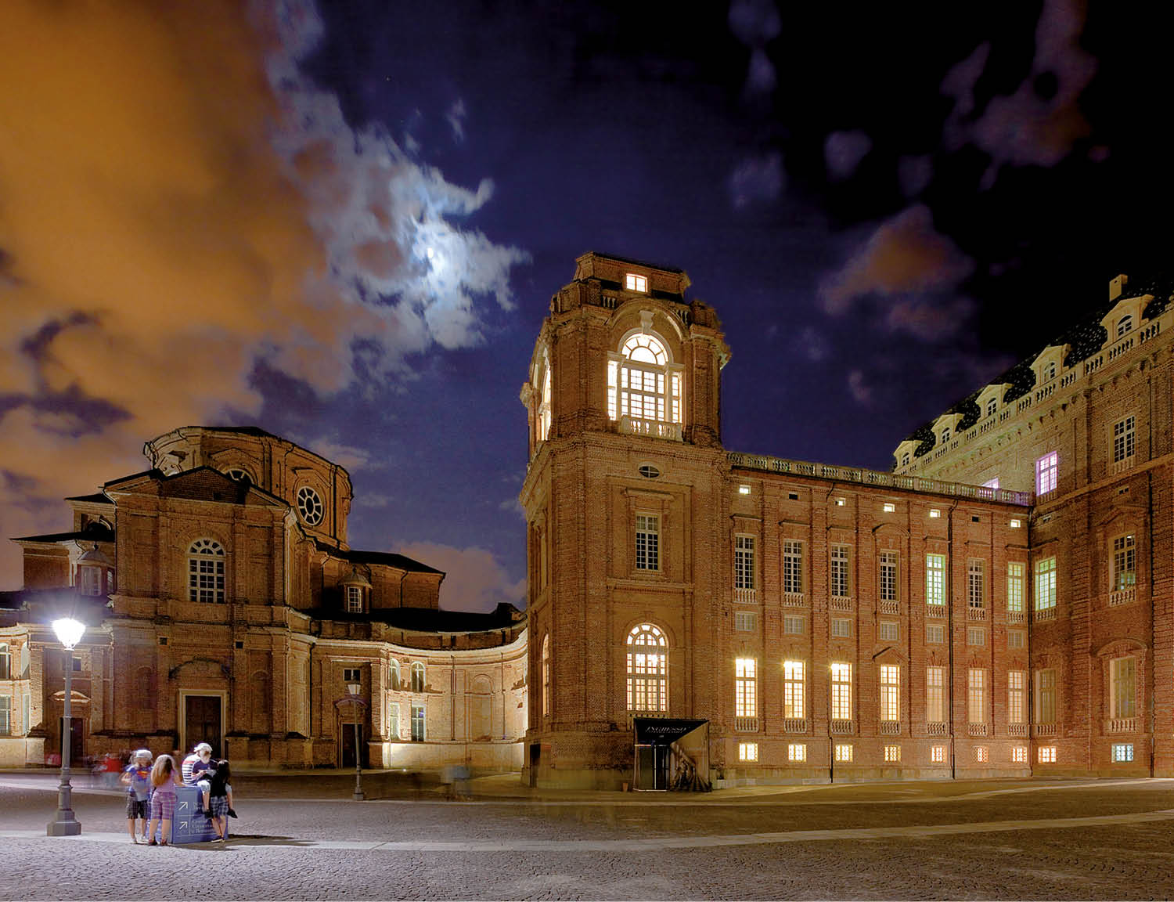
PEOPLE
roles and responsabilities

Slide 10
PEOPLE
Innovative management model
Semplification/no burocraty
Independent Study Center
Independent Exhibition Production Area
Few external staff

Slide 11
Where we are going
Increase the number of visitors
Creation of the circuit of Savoy Royal Residences
Celebrations for the 10 years anniversary

Slide 12
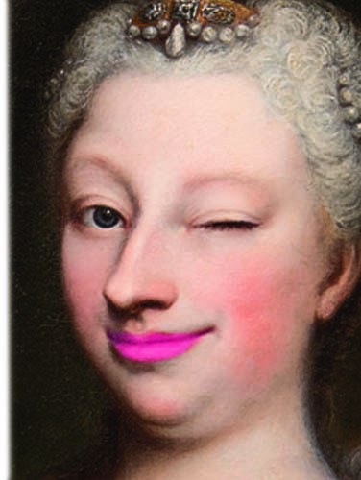
Thank you.
presidente@lavenariareale.it

