Slide 1
RE-CONFIRM
Steering Committee Smart Specialisation Platform for Industrial Modernisation
17th March 2017
Roelof Jan Molemaker (Ecorys)

Slide 2
Outline
Our consortium
Approach of RE-CONFIRM
Philosophy of our approach and positioning
Project approach
Timeline & key features
Format of our support
Next steps

Slide 3
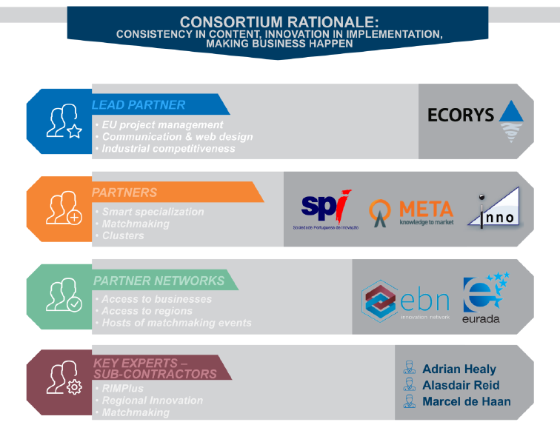
Our Consortium
Experts in EU projects, regional projects, business support, events organisation that are based across Europe with wide network to regions, businesses and people along the value chains
creates synergies to push regional and industrial development to a new level

Slide 4
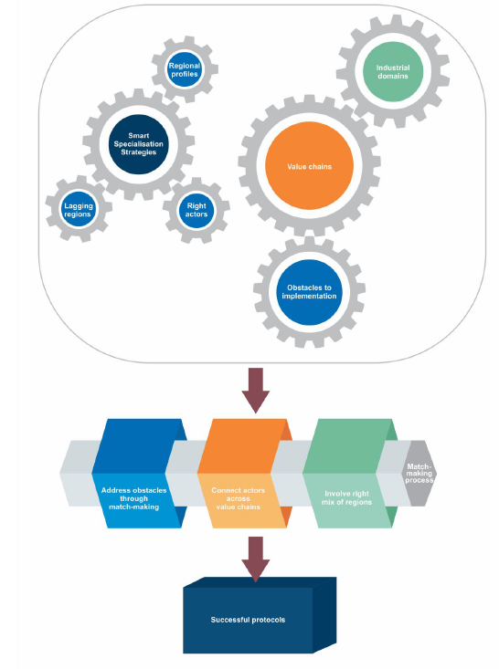
Philosophy of RE-CONFIRM
Objectives:
Establish and support concrete co-operation networks/partnerships
Pool regional efforts and bring about cooperation
Identify investment needs
Support regions
The outcome of the activities of RE-CONFIRM are successful (investment) protocols.
Well structured matchmaking is central to address obstacles, connect right actors, involve right mix of regions

Slide 5
RE-CONFIRM positioned within a number of related initiatives
RE-CONFIRM is ‘action based’ = targets concrete actions (matchmaking, development of protocols) and does not act as a purely passive platform.
Ensuring synergies of:
1) Monitoring and provision of updated background information and data;
2) Action-based activities targeted at businesses and industrial stakeholders, and;
3) Platform-based activities providing networking, communication and exchanges of relevant
stakeholders.
RE-CONFIRM is built into the Thematic Smart Specialisation Platform for Industrial Modernisation

Slide 6
Operationalisation of our approach
3 Work Packages
WP 1
Monitoring
Analysis
Identification of domains
RIM+ update
WP 2
Action based
Assess gaps
Create matches
Support development of 10 protocols
WP 3
Horizontal
Communication
Develop community
Create synergies

Slide 7
Operationalisation of our approach
1.2 Methodology for selecting & mapping industry partnerships
3.1 Effective promotional and communication strategy
1.1 Inventory of S3 policies
2.1 Prepare collaboration support & analyses of gaps and opportunities
2.2 Create matches / complement (existing) partnerships
1.3 Updating RIM+
3.2 Ensuring synergies with all other initiatives
2.3 Prepare the protocols
Protocols

Slide 8
Timeline & key features
Project just started (KO: January): 2 (+2) years
Background analysis + regular update of RIM+
2 launch events (one/year) + 12 matchmaking events => 10 protocols
Integrated in Thematic Smart Specialisation Platform (Industrial Modernisation)

Slide 9
Format of our support
Support both existing partnerships and new partnership
New partnerships: identify new domains for Platform, activate expressions of interest via Thematic Platform
Existing partnerships: tailor made depending on needs

Slide 10
Support activities
Content support: Regional smart specialisation strategies (mapping), background research, fleshing out collaboration areas (building on Regio experts);
Composition support: identification of gaps in partnerships (regions, intermediairies, industries) and solutions (matchmaking). Building communities and active reach out to regions.
Expert (broker) support in developing projects and resulting investment protocols. Combined with matchmaking events
Visibility and activation support: communication and launch events
Cross-over support: link with other initiatives (WATIFY, Cluster Observatory etc. etc.)

Slide 11
Thank you for your attention!

Slide 12
Contact details
Roelof Jan Molemaker
Project director
Tel: +32 2 743 89 49
Roelof-jan.molemaker@ecorys.com
www.ecorys.eu
Andreas Pauer
Project coordinator
Tel: +32 2 743 85 60
andreas.pauer@ecorys.com
www.ecorys.eu

