Slide 1
Monitoring RIS3 at the EU Level
Reflections and Challenges
Ken Guy
Wise Guys Ltd.
Barcelona, 6 July 2017

Slide 2
Reflections
What are the pros and cons of regional monitoring from the perspective of the EU?
Much depends on the EU’s rationale for regional monitoring and the objectives it hopes regional monitoring can fulfil
But can we believe the professed rationale and objectives to be derived from public sources or do we need to delve deeper?
What do we mean by the EU? What do we think it really is?
Let us look at five widely held but vastly different perspectives on the EU

Slide 3
The Evil Empire
All monitoring is a tool for the control and exploitation of the innocent regions by the wicked bureaucrats in Brussels

Slide 4
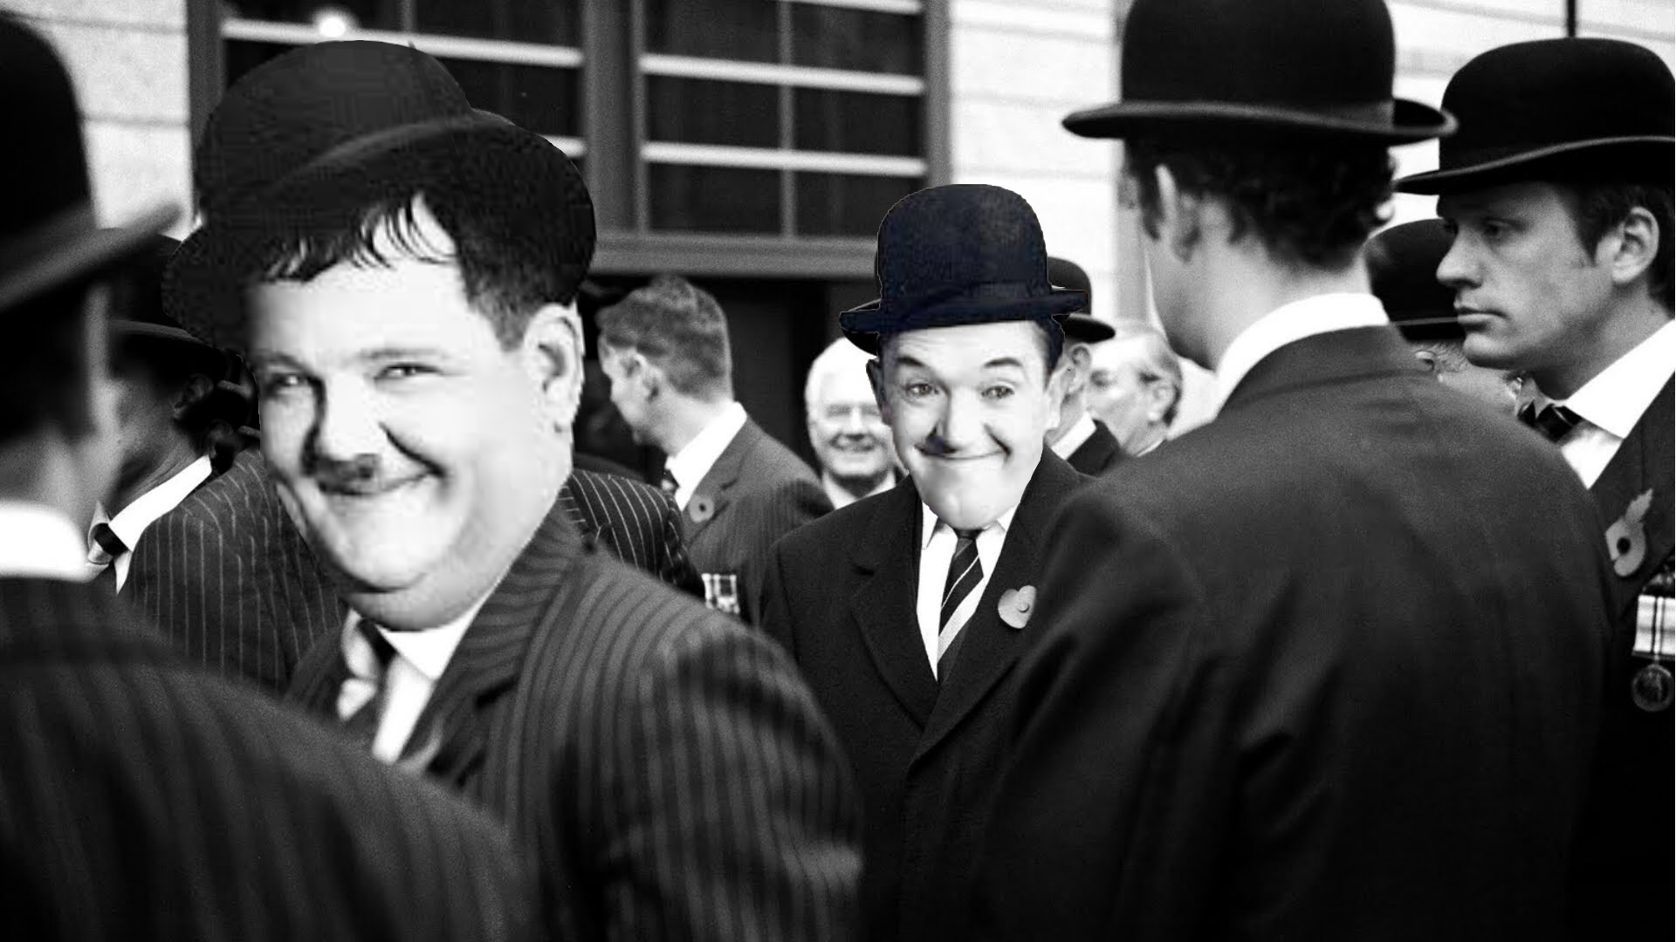
The Bureaucratic Bumblers
Monitoring is a pointless exercise because moronic bureaucrats in Brussels wouldn’t know what to do with the data

Slide 5
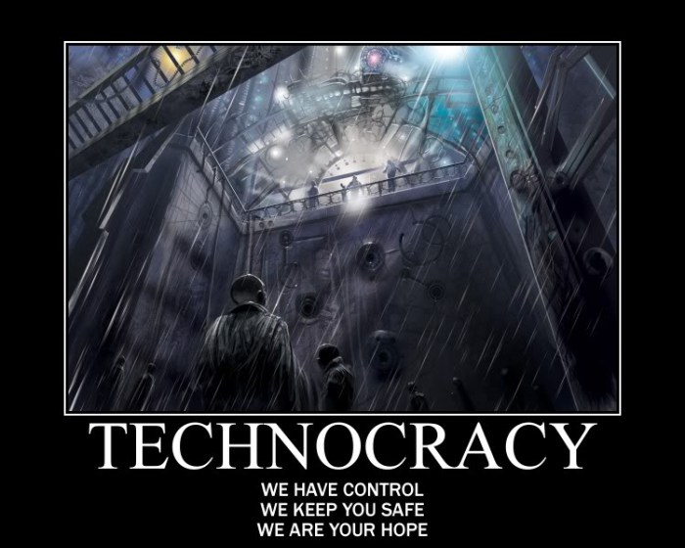
The Trusted Technocrats
Monitoring is an input to rational decision-making concerning the allocation of resources across the EU as a whole

Slide 6
The Cunning Catalysts
Support by Brussels for regional monitoring stems from a desire to catalyse intelligent decision-making by sensible regional policymakers

Slide 7
The Merry Muddlers
Monitoring is a lubricant that allows bureaucrats in Brussels and the regions to flip and flop merrily from one policy muddle to another

Slide 8
Challenges
The challenges confronting the EU depend on which perspective is the closest to reality
The truth, however, is that reality has many co-existing facets
The main challenges for the EU, therefore, are to clearly articulate its aspirations for regional monitoring systems
And to convince very different publics that monitoring is in the best interests of all sectors of society when its outputs are used responsibly

