Slide 1

S3P AGRIFOOD on
TRACEABILITY AND BIG DATA
Ispra, 24-26 January 2018
rovere pierpaolo
FVG Agrifood&Bioeconomy Cluster Agency
via Fagagna, 1, 33038 San Daniele del Friuli
Tel. 0432.954495 – 3283296577
e-mail: rovere@parcoagroalimentare.it

Slide 2

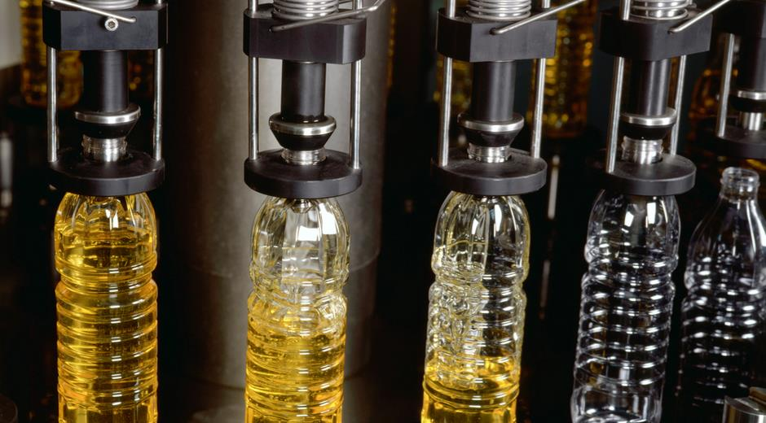


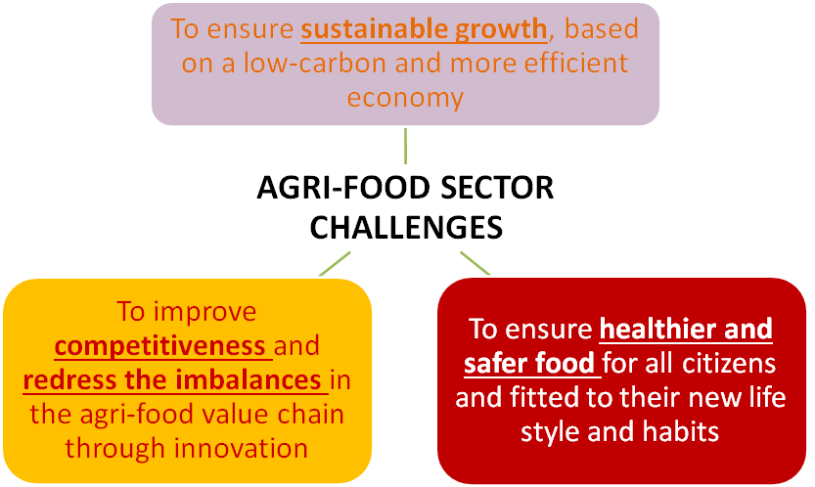
The European Agri-food sector
10,8 MILLION FARMS
290.000 AGRI-FOOD INDUSTRIES
EXPORTS €129 BILLIONS (2015)
TO THE REST OF THE WORLD
EU: 500 MILL. CONSUMERS
Challenges of the Agri-food sector

Slide 3

Mission of the S3P Agri-Food on T&BD
The thematic partnership on “Traceability and Big Data” encourages the creation of an ecosystem to support innovation and digitisation of the agri-food sector in Europe

Slide 4
Framework of the S3P Agri-food on T&BD
TRACEABILITY
Traceability of data or set of data for a specific purpose (prediction, price…)
Traceability of a process for a specific purpose (e.g. cold chain)
Traceability of a product (e.g. consumer information)
BIG DATA
Technologies based on data
Technologies based on applications
Enabling tools (KETs)
Cognitive and content aggregation technologies and decision making tools
IoT, data mining, sensors, drones, robotics, artificial intelligence, machine learning, Open Data, Cloud, Blockchain, Interoperability, measuring and predicting behaviour
Notes:
4

Slide 5
Thematic Partnership building. How?
Approval of Governance: Helsinki Smart Regions 2.0 Conference (1-2 June 2017)
Digital Innovation Hubs, Kilkenny (1-2 June 2017)
Call for expression of interest for "Thematic partnerships to pilot interregional innovation projects" launched last 29th September 2017.

Slide 6
The S3P Agri-food T&BD is more than a network of Regions
LEAD REGION
PARTICIPATING REGIONS
  Andalusia (ES)
  Aragon (ES)
  Basque Country (ES)
  Brittany (FR)
  Central Macedonia (GR)
  Extremadura (ES)
  Friuli Venezia-Giulia (IT)
  Galicia (ES)
  Hajdu Bihar (HU)
Limburg (NL)
Middle Black Sea (TR)
Navarre (ES)
Pays de la Loire (FR)
Pazardzhik (BG)
Sardinia (IT)
Satakunta (FI)
South Ostrobothnia Region (FI)
South Savo (FI)
South Transdanubian (HU)
CO-LEAD REGION
  Emilia Romagna (IT)
ASSOCIATE MEMBERS
  Ribatejo (PO)
  Agrigo (IT)
  AFBI (IE)
  Greenport West-Holland (NL)
  Wageningen University (NL)
  CENSE (PO)
  INOVISA (PO)
20 regional nodes
7 associate members
11 countries

Slide 7
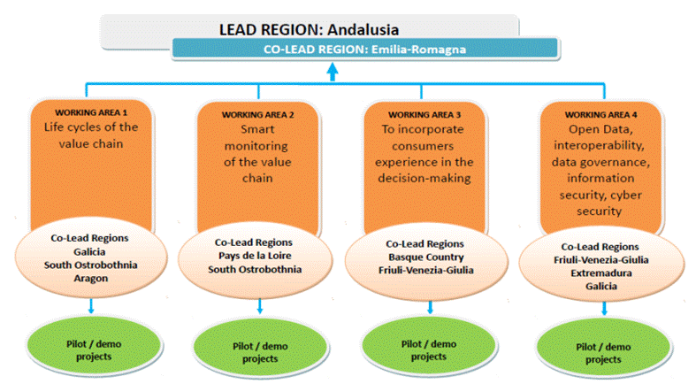
S3P Agri-food T&BD Interregional Governance

Slide 8
Regional governance: clusters, nodes, hubs …

Slide 9
S3P Agri-food on T&BD: Results

Slide 10
S3P Agri-food on T&BD: Impact
Political commitment of 20 regions and their research centres, clusters, universities and enterprises
Political priority for the Lead Region to the highest level
Specific task force at regional level, in both the Lead and Co-lead regions
Involvement and shouldering of responsibilities and funding of 9 regions throughout the four working areas
Positioning the agri-food sector as the cornerstone of the European Political Agenda in innovation and digitisation
S3P Agri-food on T&BD: Difficulties
Improving connections between these partnerships and other European policies and putting in place collaboration and links with different DGs of the EU Commission.
The member regions agree on the need of having specific financial support for these partnerships and related-activities.
Regions have different priorities, speed, structure and competence and also different capacity to allocate funds.
S3P Agri-food on T&BD: Proposals for action
Specific funding and redirecting and adapting European funds and programmes, such as Interreg and H2020: INTERREG EUROPE REGIONS 4FOOD 4.0 presented June 2017
Coordination structures and tools. European contact points with EU Commission
Online web platform for working together

Slide 11
The Call for EoI for Thematic Partnerships to Pilot Interregional Innovation Projects
T&BD Has Been one of the Selected Partnerships that will receive
EU Commission support
(technical assistance)
to facilitate the commercialisation and scale-up of interregional innovation projects and to incentivise business investment.
Kick-off Meeting (Brussels, 23 January 2018)
No direct grant!!!

Slide 12

Contacts&info
Judit Anda Ugarte - Regional Ministry of Agriculture, Fisheries and Rural Development of Andalusia (Technical Advisor of Vice Minister),
Email: judit.anda@juntadeandalucia.es
http://s3platform.jrc.ec.europa.eu/traceability-big-data
S3P AGRIFOOD on
TRACEABILITY AND BIG DATA
@DataAgriS3

Slide 13
S3P AGRIFOOD on
TRACEABILITY AND BIG DATA
dr. rovere pierpaolo
FVG Agrifood&Bioeconomy Cluster Agency
via Fagagna, 1
33038 San Daniele del Friuli
Tel. 0432.954495 – 3283296577
e-mail: rovere@parcoagroalimentare.it

