Slide 1
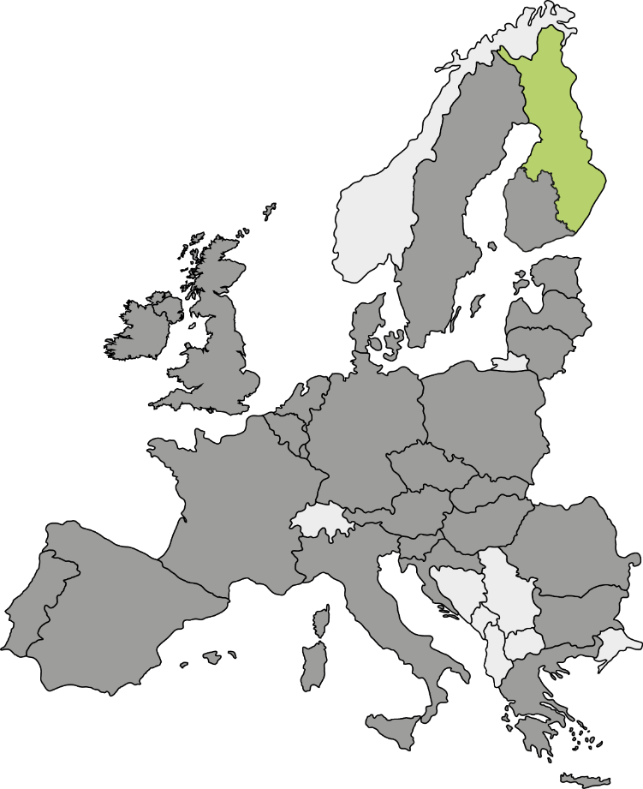
Peer eXchange & Learning
Entrepreneurial Discovery Process
for Smart Specialisation Strategies (EDP)
North Karelia, Finland
Magdeburg, 8 March 2018 Anniina Kontiokorpi
Pia Pitkänen
www.pohjois-karjala.fi/english

Slide 2
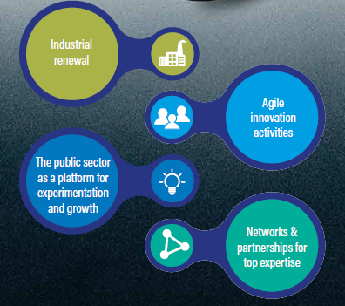
Questions for PXL
Question 1: How to engage (rural/peripheral) SME´s to innovation initiatives?
Question 2: How to capitalize research results?
Question 3: What new methods could be used when monitoring and evaluating the outputs of S3/EDP?

Slide 3
Regional Councils of Finland
18 NUTS 3 regions (regional councils, RC) on mainland Finland
RC's are statutory joint municipal authority; every local authority must be a member of a regional council
Two main functions laid down by law:
1) regional development (Strategy work including S3, international activities, Structural Funds)
2) regional land use planning.
3) in addition, regional councils have a broad scope of other functions that are determined by the region’s special characteristics.
RC´s have a key role in overseeing the region's interests and networking with the regional stakeholders for promotion of well-being and the economy
Ongoing reform of regional government in Finland – New regional level organisation responsible for healthcare and social welfare, rescues services, environmental healthcare, regional development duties and tasks related to the promotion of business enterprise, planning and steering of the use of regions as well as promoting the identity and culture of the regions.

Slide 4
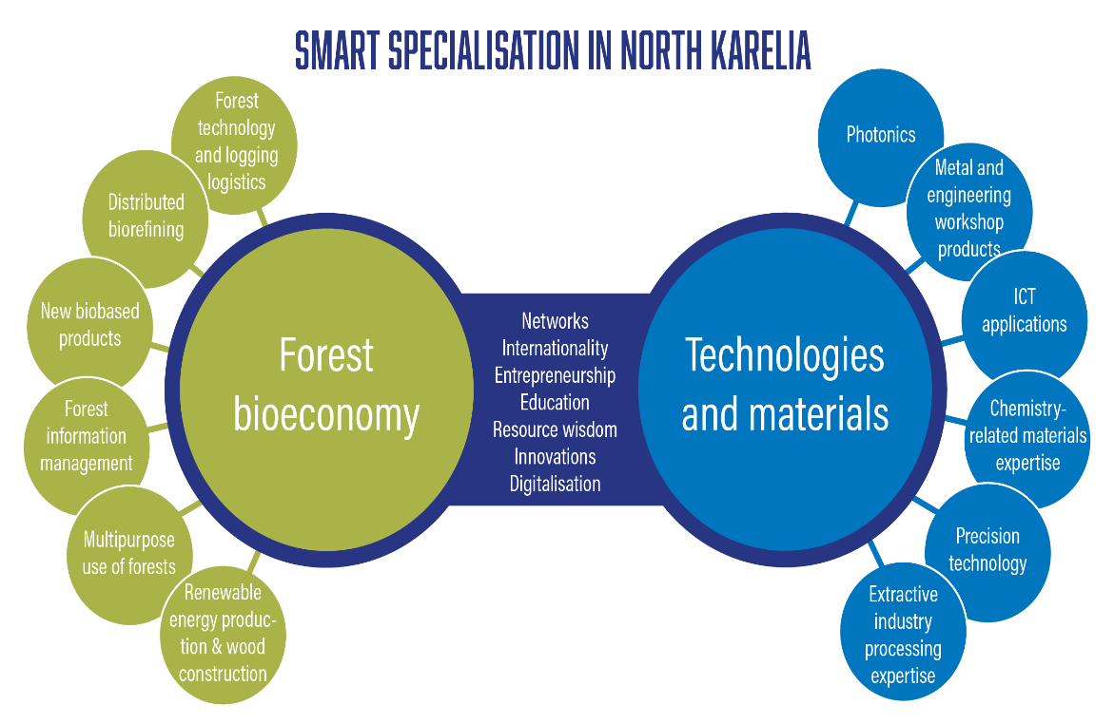
Overview of your RIS3
Main regional characteristics
Forestry capital of Europe (Forest Bioeconomy)
Main export sector is Technology Industry (metal and machinery)
70 % of the total area of the region is forests and 17 % lakes
Governance
Responsible for the RIS3: Regional Council of North Karelia
How is the governance set-up of RIS3:
Political level: Assembly of the Regional Council of North Karelia, Board of the Regional Council of North Karelia
Coordination level: Regional Council of North Karelia
Operational level: Strategic working groups of S3
Resources for implementation: Funding (mainly EU), other initiatives
Priorities
New solutions for the forest bioeconomy and
Technologies and materials as enablers of growth
Notes:
In order to make the discussion at the workshop as efficient and useful as possible, it is important to move out of the ‘classical’ presenting mood and head towards a more concrete approach to issues that need to be faced on the ground, while establishing and implementing your strategy. For this reason it is important to define a focus of your presentation, which would act as a ‘red thread’ in your presentation.
Please remember that the more linked to your presentation the questions are, the more relevant feedback you might get. By presenting the questions up front, you allow your peer critical friends to keep them in mind while you give your presentation. The questions should be repeated at the end of the presentation. Questions of a very general character can be made relevant for you specific region only if you give related information in your presentation.

Slide 5
EDP for the RIS3 design
Challenges and reflections
Structures: Cluster Groups (Forest Bioeconomy, Technology Industry, Mining Industry, Tourism etc.) and Smart Growth Forums
Processes: 1) Thematic workshops (Industrial renewal, The public sector as a platform for experimentation and growth, Agile innovation activities, Networks and partnerships for top expertise), 2) Stakeholder forums on “How to activate RDI-work in the region” especially within SMEs
Most useful aspects/incentives for involving stakeholders in the EDP
Regional Council works as a co-operation leader with development organisations (Chamber of Commerce, Regional Development Companies, Science Park, RDI- and educational organisations) → Receiving the information from business life and taking it into account in regional strategy work and in future priorities
Notes:
In order to make the discussion at the workshop as efficient and useful as possible, it is important to move out of the ‘classical’ presenting mood and head towards a more concrete approach to issues that need to be faced on the ground, while establishing and implementing your strategy. For this reason it is important to define a focus of your presentation, which would act as a ‘red thread’ in your presentation.
Please remember that the more linked to your presentation the questions are, the more relevant feedback you might get. By presenting the questions up front, you allow your peer critical friends to keep them in mind while you give your presentation. The questions should be repeated at the end of the presentation. Questions of a very general character can be made relevant for you specific region only if you give related information in your presentation.

Slide 6
EDP for the RIS3 implementation (1)
how the EDP has evolved from a “one-off” process to a continuous one
Collecting and analysing relevant statistics
Foresight activities
Project activities, results and indicators
Involving all the relevant stakeholders into the policy work (preparation, implementation, monitoring)
Monitoring and evaluation as a part of Regional Strategic Programme and through Cluster Groups
how to keep the momentum and stakeholders' motivation
New kind of partnerships (regional, national, EU-level) and co-operation methods
Requisition for regional funding
Possibility to participate into the development work
Notes:
In order to make the discussion at the workshop as efficient and useful as possible, it is important to move out of the ‘classical’ presenting mood and head towards a more concrete approach to issues that need to be faced on the ground, while establishing and implementing your strategy. For this reason it is important to define a focus of your presentation, which would act as a ‘red thread’ in your presentation.
Please remember that the more linked to your presentation the questions are, the more relevant feedback you might get. By presenting the questions up front, you allow your peer critical friends to keep them in mind while you give your presentation. The questions should be repeated at the end of the presentation. Questions of a very general character can be made relevant for you specific region only if you give related information in your presentation.

Slide 7
EDP for the RIS3 implementation (2)
Changes and innovations introduced in the "EDP" during the RIS3 implementation (as compared to the RIS3 design)
New way of analysing and presenting innovation indicators will be developed and it will be an important tool for knowledge based management in the future
Active work on EU-level networks (regional authority together with specialist and companies)
Implications and expected results
Public sector organisations will work together on creating enabling environment for innovation ecosystems (e.g. infrastructure and ecosystemic funding)
Piloting opportunities for new products and services on EU-level
Notes:
In order to make the discussion at the workshop as efficient and useful as possible, it is important to move out of the ‘classical’ presenting mood and head towards a more concrete approach to issues that need to be faced on the ground, while establishing and implementing your strategy. For this reason it is important to define a focus of your presentation, which would act as a ‘red thread’ in your presentation.
Please remember that the more linked to your presentation the questions are, the more relevant feedback you might get. By presenting the questions up front, you allow your peer critical friends to keep them in mind while you give your presentation. The questions should be repeated at the end of the presentation. Questions of a very general character can be made relevant for you specific region only if you give related information in your presentation.

Slide 8
EDP for the RIS3 implementation (3)
What are the main factors influencing the sustainability of the EDP
Stakeholders and decision-makers from various levels and from different areas of the region
Mutual commitment on implementing S3
Updating of the S3 every four years, but active EDP work will be carried on also between these cycles
Financial resources from ERDF
Challenges and reflections on the behaviour of the different actors during the EDP, in particular, the role of the SMEs.
SMEs have quite low interest on export activities and on internationalisation. SMEs are often subcontractors especially in the field of technology industry and their inputs to RDI are rather low.
Development organisations are “competing” over funding and customers and might not be giving all the information needed during EDP process.
Notes:
In order to make the discussion at the workshop as efficient and useful as possible, it is important to move out of the ‘classical’ presenting mood and head towards a more concrete approach to issues that need to be faced on the ground, while establishing and implementing your strategy. For this reason it is important to define a focus of your presentation, which would act as a ‘red thread’ in your presentation.
Please remember that the more linked to your presentation the questions are, the more relevant feedback you might get. By presenting the questions up front, you allow your peer critical friends to keep them in mind while you give your presentation. The questions should be repeated at the end of the presentation. Questions of a very general character can be made relevant for you specific region only if you give related information in your presentation.

Slide 9
Summary & next steps
Conclusions - Successes
Determination of the:
Roles for different development organisations
Strenghts and know-how of different development organisations
Regional Council of North Karelia together with Joensuu Science Park Ltd has started a project “Smart Ecosystems in North Karelia” which is implementing S3 and continuously working with EDP process, evaluating development activities, producing information on innovation activities and directing innovation work of SMEs and other RDI-organisations into innovation ecosystems (regional, national and EU-level)
Utilising interfaces between Forest Bioeconomy and Technologies&Materials
North Karelia has created an annual Forets&Photonics event which brings together experts and companies on the fields of photonics and forests and the aim of the event is to find new ideas which can be developed through “European Photonics Alliances” (S3 partnership on Photonics) pilot lines.
Notes:
In order to make the discussion at the workshop as efficient and useful as possible, it is important to move out of the ‘classical’ presenting mood and head towards a more concrete approach to issues that need to be faced on the ground, while establishing and implementing your strategy. For this reason it is important to define a focus of your presentation, which would act as a ‘red thread’ in your presentation.
Please remember that the more linked to your presentation the questions are, the more relevant feedback you might get. By presenting the questions up front, you allow your peer critical friends to keep them in mind while you give your presentation. The questions should be repeated at the end of the presentation. Questions of a very general character can be made relevant for you specific region only if you give related information in your presentation.

Slide 10
Summary & next steps
Conclusions - Challenges
Companies do not understand the concept of Smart Specialisation.
→ How to communicate with companies? How to speak the language of companies instead of the language of regional development?
Most of the companies in North Karelia are microenterprises or SMEs, there are only few bigger companies that for example have their own product design or other RDI related activities in the region.
→ Joining to EDP is a challenge

Slide 11
Question 1: How to engage (rural/peripheral) SME´s to innovation initiatives?
Why: Need to support SME´s access to RDI-work and funding / need to aid local microenterprises and SMEs to build scale and access opportunities in external markets, and support them in accessing national research and innovation resources
What has been done: Business incubation, business idea competitions in educational organisations DRAFT and EPIC Challenge (experimenting and inspiring methods)
What worked: Innovation vouchers (national funding), Green HUB open innovation platform
What did not work: At the moment innovation activities are directed mostly to the regions “capital city”
Notes:
This slide focuses on your question: try to formulate on this slide your answers to the following questions:
What is your question/issue?
Has something been done by policymakers in your region to address this issue or is it a completely new issue?
If you have done something in this area, what are the things that worked well for you?
If there was anything you have done to address this issue and it did not work, it would be useful for other participants to learn from your experience.

Slide 12
Question 2: How to capitalize research results?
Why: Need to create an innovation ecosystem where research results are utilized in businesses. Lots of top-level research activities but lack off spin-offs and start ups especially on forest bioeconomy sector.
What has been done:
Green HUB is a community of North Karelian experts from key research and education operators. It is an open innovation platform. Solutions are systematically searched for the challenges of business operations and development especially on the field of bioeconomy
Smart Ecosystems in North Karelia Projects objective is to develop regional forest bioeconomy and technology industry clusters towards ecosystemic approach where open co-operation and co-creation are even more important factors. 1.1.2018-31.12.2019.
What worked: Research, education and development organisations are collaborative in nature.
What did not work: Including an entrepreneurial angle especially to Forest Bioeconomy sector’s development work has been challenging.
Notes:
This slide focuses on your question: try to formulate on this slide your answers to the following questions:
What is your question/issue?
Has something been done by policymakers in your region to address this issue or is it a completely new issue?
If you have done something in this area, what are the things that worked well for you?
If there was anything you have done to address this issue and it did not work, it would be useful for other participants to learn from your experience.

Slide 13
Question 3: What new methods could be used when monitoring and evaluating the outputs of S3/EDP?
Why: Monitoring and evaluation phase is often seen as “necessary evil” but it actually has a huge potential for the development of the EDP in the future.
What has been done: Evaluation and monitoring of S3/EDP is connected to Regional Strategic Programmes evaluation process. Indicators have been determined for S3 and to Regional Strategic Programme and for the projects that are implementing regional strategies.
What worked: Evaluation is done by the external specialist and it includes questionnaires and workshops for key stakeholders (delfoi).
What did not work:
Notes:
This slide focuses on your question: try to formulate on this slide your answers to the following questions:
What is your question/issue?
Has something been done by policymakers in your region to address this issue or is it a completely new issue?
If you have done something in this area, what are the things that worked well for you?
If there was anything you have done to address this issue and it did not work, it would be useful for other participants to learn from your experience.

