Slide 2
Entrepreneurial Discovery Process:
An introduction
Elisabetta Marinelli, PhD
Magdeburg, 8th March 2018

Slide 3
JRC work on Smart Specialisation
Areas of work
Analytical tools

Slide 4
Structure of the presentation
Origin and evolution of the concept
Survey: 4-ple helix
Survey: Continuous EDP
Survey: Self-evaluation

Slide 5
EDP: the legal basis
Legal basis
S3s shall be developed through involving […] managing authorities and stakeholders […] in an entrepreneurial discovery process.
ERDF Regulation

Slide 6
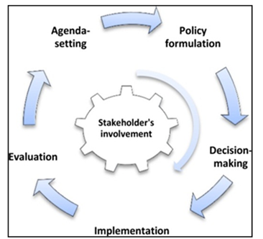
Entrepreneurial Discovery Process (EDP) – Evolution of the concept
EDP – Evolution of the concept
  An intact logic of the EDP… as interactive and inclusive process to:
  open new technological and market domains
  inform governments’ policy and decision-making
  …for an evolved concept:
  The continuous nature of the EDP
  The cyclical nature of the EDP;
  The EDP is embedded in the strategy
Notes:
The cyclical nature of the EDP: Discovering or learning what a country or a region is good at requires an investment in a concrete process of exploration. However, the experience accumulated over the past five years has shown that this is only the initial step of EDP. In other words, the EDP in practice goes beyond the prioritisation phase and the subsequent related investments. Hausmann & Rodrik (2003). It is critical to ensure continuity to the EDP. Breaking the EDP means disrupting a trust-building process that is crucial for the sustainability of the S3 itself.
The new role of government: The inclusive governance and evidence-based policy, required for the EDP, demands that the public sector acts as a platform to enable targeted stakeholders’ interaction and policy coordination. This should sustain and guide stakeholders’ participation across the entire policy cycle. Here, the government operates as a service provider enabling its user community. As such, the EDP brings new opportunities to policy- makers, as well as important challenges. O’Reilly, (2010).
The need to adapt EDP to contextual factors: The afore-mentioned challenges need to be addressed starting from the contextual factors. At the core of the S3 concept lays the conviction that development paths are place-based, which is why one EDP size does not fit all. A place-based approach is about extracting and building on local knowledge with the aim to mobilise it nationally and internationally, taking into account local specificities and constraints McCann and Ortega-Argilés (2015).
The local, regional, national or transnational structures for EDP: The EDP approach has triggered new institutional arrangements beyond the regional scale. Such structures are based on the awareness that ‘bottom-up approaches’, which mobilise stakeholders in the pursuit of innovation and which requires multiple points of view to combine technology with market opportunities, have the potential to add value at different levels.

Slide 7
Defining and testing the concept of continuous EDP
RIS3 Strategies, policy literature, JRC Activities
RIS3 Handbook
Chapter 1
Conceptual Model
Operationalisation of concept
Feedback with JRC and experts
Development of the survey
based on good practice
Feedback with JRC and FORO ADR
Identification of learning opportunities
Model validation
EDP Survey

Slide 8
The EDP survey – Key components
EDP in
RIS3 Design
EDP in
RIS3 Implementation
EDP:
Self-evaluation
Role of stakeholders
EDP mechanisms
Test the concept of Continuous EDP

Slide 9
EDP in the design phase: key features
  Informative: Surveys, Bilateral dialogue, Public meetings
  Interactive: Workshops, Participatory methods
  6 regions only informative
  Collect views on regional development - 83
  Build consensus on investment - 76
  Both – 63
Methods
Aims -
use (%)
Assessment
(% yes)
Structures: (%)
  Effective for identification of priorities 93.2
  Positive experience 96.6
  Conflicts 39
  Adapted - 37.3
  New - 25.4
  New & adapted - 13.6
  None of the above - 23.7
Notes:
Informative: Surveys, Bilateral dialogue, Public meetings
Interactive: Workshops, Participatory methods
(6 regions only informative)

Slide 10
Stakeholders in the EDP – Design phase
Regional Large firms
Clusters organisations
Regional SMEs
Foreign firms
Higher education institutions
Incubators, accelerators, etc.
Business associations
Research organisations
Business
Research
National firms
Societal
actors
Regional government and agencies
Labor unions
Public
sector
Civil society organisations (NGOs, etc.)
Local government
European Commission
User-centered communities and labs
National government

Slide 11
Stakeholders in the EDP – Design phase
Invited?
Yes
No

Slide 12
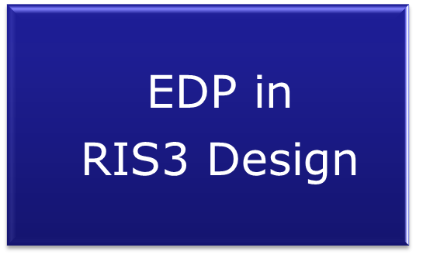
Stakeholders invited to the EDP – Design phase
EDP often a triple helix business
Interesting dynamics for civil society and citizenship
Public
Other
RTI
Private
Notes:
Frequency of stakeholders as expected.,. Virtually everyone invited HEIs and Research sectors… in fact I think there is a mistake about Emilia Romagna.
Public and Business sector – clear preference for local/regional actors and institutionalised ones (business associations/clusters)
"Other" unsurprisingly less represented! Civil Society and Users' centered most interesting to follow-up. They are closer to citizenship . Unions – institutionalised presence they are often invited.
Other includes a mix of civil society and various socio-economic actors, peripheral to the innovation systems.
Frequency is correlated with the role stakeholders are expected to have in the EDP process as indicated in the next slide

Slide 13
Stakeholders in the EDP – Design phase
Invited?
Yes
No
Expected
Actual
Desired
Engagement

Slide 14
Stakeholders in the EDP: – Design phase
First glimpse
The usual suspects
Top 4 Actual, Desired, Expected engagement
You don't always get what you want!
On average Desired engagement>Expected engagement >Actual engagement
Clusters, Research org, Universities and regional gov.
But…

Slide 15
Stakeholders in the EDP – Design phase
Invited?
Desired
Expected
Yes
No
Engagement
Actual
Do regions understand the EDP actors?

Slide 16
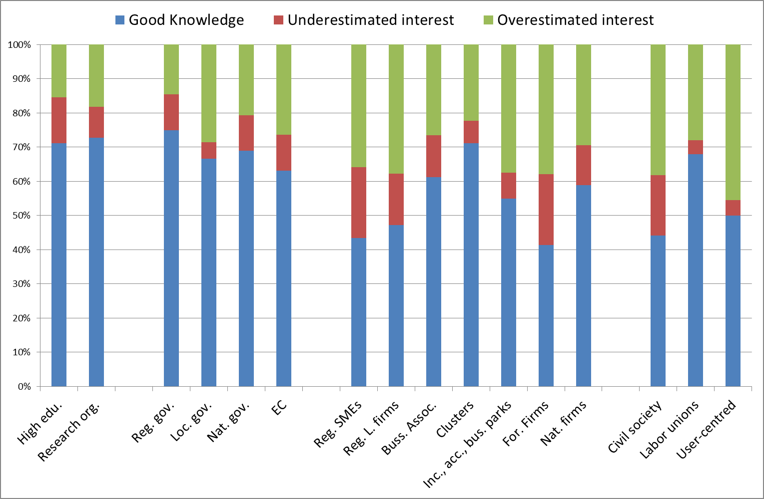
Stakeholders in the EDP – Design phase
Actual-Expected
Top 4: most often good knowledge
Good: research, public sector, national firms, private associations
So-So: individual firms, civil society or user-centered facilities

Slide 17
Stakeholders in the EDP – Design phase
Invited?
Desired
Expected
Yes
No
Engagement
Actual
What is the quality of the relationship between regions and actors?

Slide 18
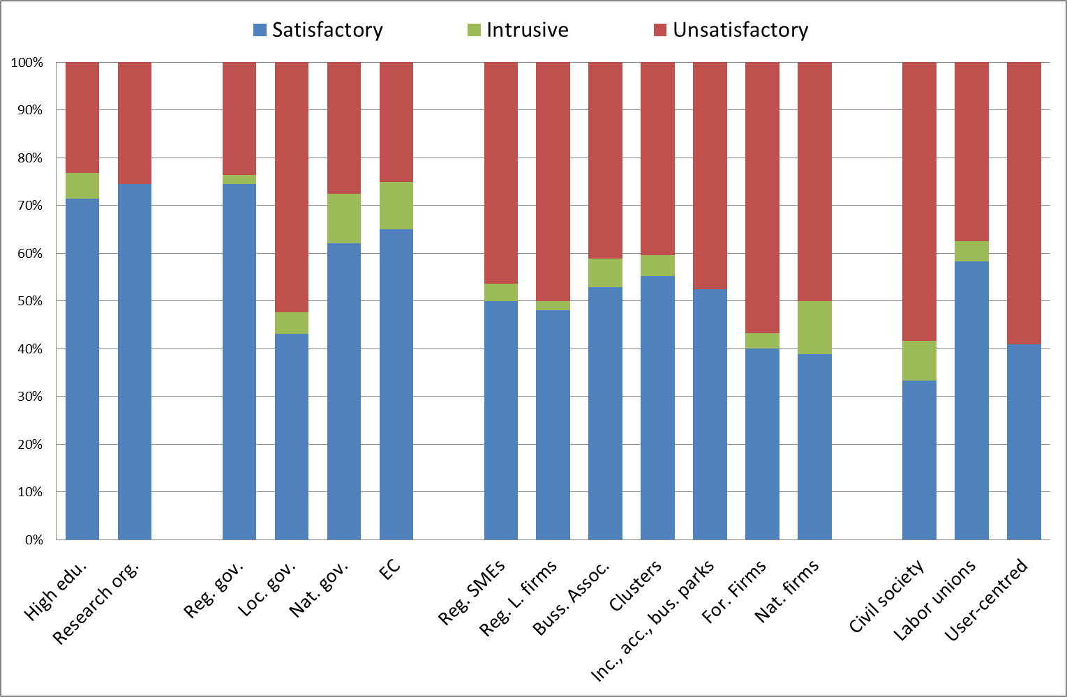
Stakeholders in the EDP: – Design phase
Actual- Desired
Top 4: most often satisfactory
So-So: individual firms
Civil society: difficult situation
Notes:
TOP

Slide 19
Stakeholders in the EDP: – Design phase
Often invited
Rarely invited
Not so-secret love
Unsatisfactory relationship
Individual firms
Local government
Civil society & user-centred
The decent rival
Actor not well-understood
Actor well-understood
Unexplored potential
Unions
Peripheral actor
Satisfactory relationship

Slide 20
PART II
EDP survey – results in the RIS3 implementation

Slide 21
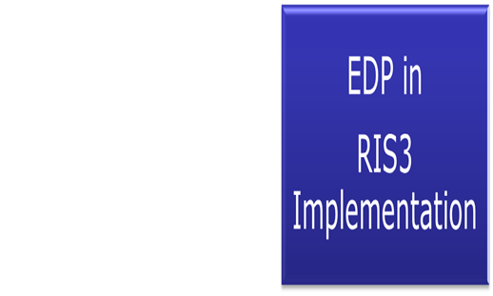
EDP in RIS3 Implementation – Investment decision

Slide 22
Governance
EDP in RIS3 Implementation – Governance

Slide 23
EDP in RIS3 Implementation – Monitoring
Role of stakeholders in monitoring
Direct involvement
Indirect
Involvement

Slide 24
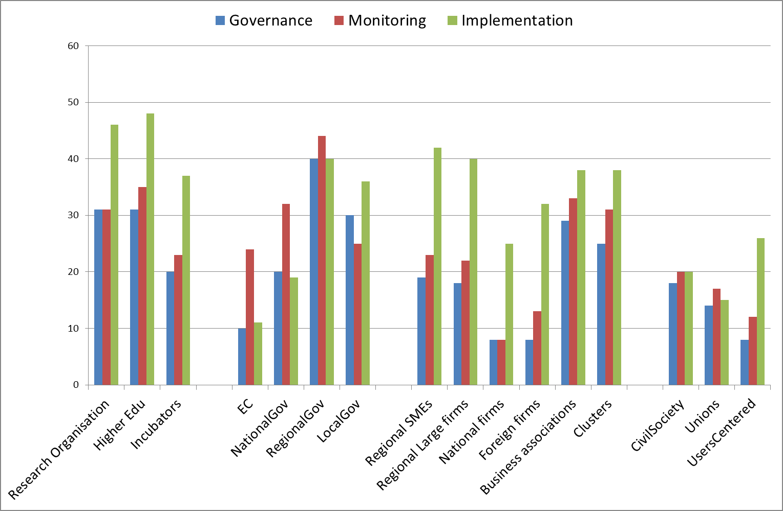
Stakeholders in the EDP
Private sector mainly involved in implementation
Civil society -similar engagement to firms in monitoring and governance
Notes:
Local firms more than 50% would like them more engaged. Same with Civil society (i.e. fairly frequent invited stakeholders). Approx 25% want local firms substantially more involved. Opportunity – get those who are satisfied with the involvement to chat with those who are not
It seems that there were some bad experiences in relation to Risk Capital (anyways not frequently invited).
EC – more than 50% Equally engaged or less engaged!

Slide 25
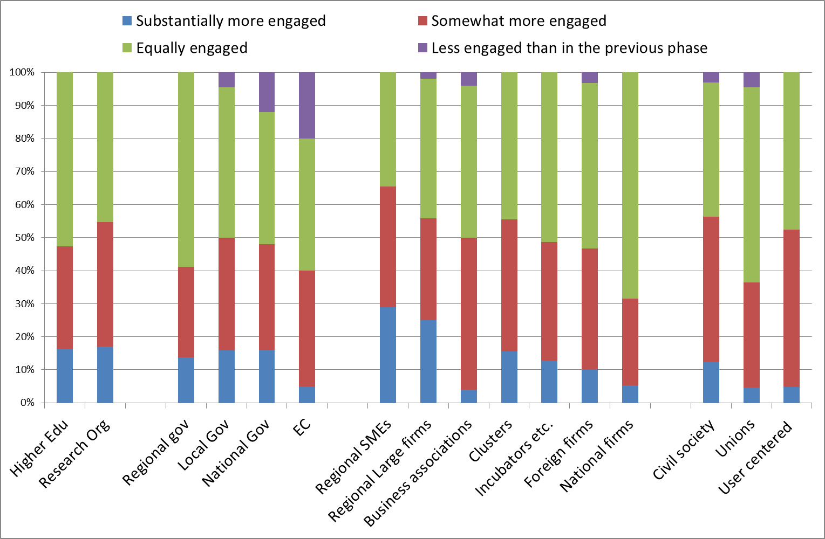
Stakeholders in the EDP
Across most actors (EC, Regional gov, National firms, Unions, Risk, Other) approx 50% would like more engagement in the future.

Slide 26
Self-evaluation of the EDP
Notes:
High levels of satisfaction across 5 dimensions. Though 3.4% unsatisfied with ability of EDP to improve decision making.

Slide 27
Self-evaluation of the EDP
Is mainly internal
Infrequent outsourcing
Is positive and effective
High satisfaction
Has tangible impacts
Changed or adapted structures
Is continuous
Stakeholders involved through the policy cycle
Has some core actors and non-core actors
Different roles
Demands more engagement
From all stakeholders through the cycle

Slide 28
Many thanks!
Any question?

