Slide 1
Background information
Notes:
This slide focuses on your question: try to formulate on this slide your answers to the following questions:
What is your question/issue?
Has something been done by policymakers in your region to address this issue or is it a completely new issue?
If you have done something in this area, what are the things that worked well for you?
If there was anything you have done to address this issue and it did not work, it would be useful for other participants to learn from your experience.

Slide 2
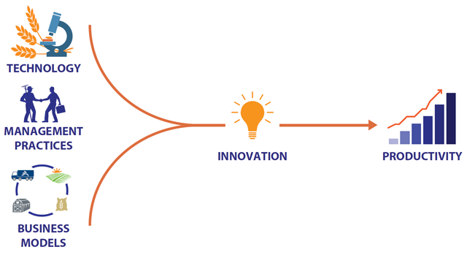
Smart Specialization of Latvia (RIS3)
RIS3 CONCEPT
ECONOMIC TRANSFORMATION
Knowledge and technology
Education
Innovation
Increased product and process technology capacity in businesses
Economic growth
Buisness models
The challenge is the creation of new competitive advantages: investing in cutting edge technologies, innovation, research, human capital, i.e. efficient allocation and redistribution of resources.

Slide 3
RIS3 and specialization areas and their relation with the economy
RIS3 Specialization areas Economic Activities |  | Knowledge intensive bio-economy | Biomedicine, medical technologies and biotechnology | Smart materials, technology and engineering | Smart Energy | Advanced ICT
A | AGRICULTURE, FORESTRY AND FISHING
BDE | Other industry
C | Food Industry
C | Light Industry
C | Wood Industry
C | Paper and paper products
C | Chemical industry
C | Non-metalic minerals
C | Metal manufacturing
C | Manufacture of computer, electronic and optical products
C | Manufacture of machinery and equipment
C | Manufacture of other transport equipment
F | Construction
G, I | Trade, Tourism
H | TRANSPORTATION AND STORAGE
J-S | OTHER SERVICE ACTIVITIES
OPQ | Public Services
 |  |  | Medium potential for technology transfer |  | Innovative products can be used in areas of economy
 |  |  | High potential for technology transfer

Slide 4
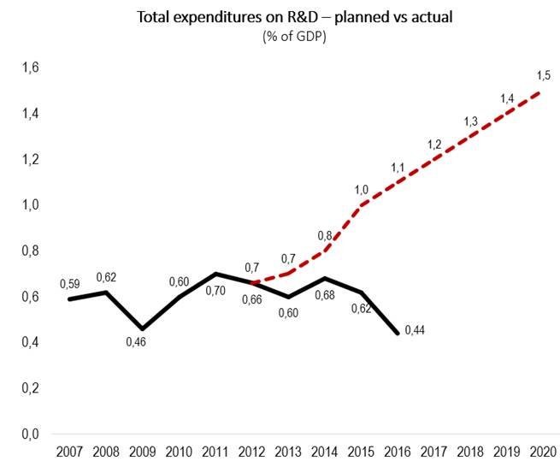
Low R&D investment interferes with successful RIS3 implementation
R&D expenditure is not enough to reach the 1,5 % target defined in our RIS3 strategy.
Low R&D expenditure is hampers the achievement of other RIS3 indicators (number of researchers, success rate in framework project programs etc.)
R&D expenditure in 2016 lags behind EU-28 in all mojor positions

Slide 5
Industry specialisation towards low-tech
Latvia 2013 EU-27 2012

Slide 6
RIS3 monitoring: main results
Employed R&D personnel is too low to achieve the RIS3 values. In 2016 this indicator decreased considerably mostly related to lack of EU R&D funding.
R&D employment correlates with the amount of ordered R&D projects so without proper and stable state investment in this indicator will remain low.
Currently Latvia’s R&D personnel (as % of total labour force) is one of the lowest in EU.

Slide 7
Public investment in R&D
State investment in R&D is considerably lower than was planned in RIS3.
In recent years the total state funding has increased from 29 MEUR in 2010 to 53 MEUR but this increase is not enough to transform the economy towards higher added value.

Slide 8
Incentives in funding programmes towards RIS3 indicators (1)
RIS3 indicator
Private sector co-funding of R&D projects (EUR)
Incentives
Linkage with industry associations
Priority for projects with higher co-funding from the private sector
Co-funding from the private sector as on of the results of the project
Priority for projects with higher socioeconomic impact
Results
74 signed research contracts for practical research projects that plans to achieve 2,7 MEUR private co-funding
141 aproved project proposals in post-doctoral grants that plans to achieve -0,4 MEUR private co-funding
RIS3 programme
Practical research in scientific groups
Post-doctoral grants
Innovation grants for students

Slide 9
Incentives in funding programmes towards RIS3 indicators (2)
RIS3 indicator
Number of business enterprises that received funding for introducing new products or technologies
Incentives
Priority for projects with higher involvement with the private sector
Linkage with industry associations
Number of supported businesses as on of the results of the project
Priority for projects with higher socioeconomic impact
Results
74 signed research contracts for practical research projects that plans to achieve 18 suported business enterprises
141 aproved project proposals in post-doctoral grants plans to achieve 28 suported business enterprises
RIS3 programme
Practical research in scientific groups
Post-doctoral grants

