Slide 1
Smart Specialisation: monitoring and evaluation Marek Przeor DG Regional and Urban Policy 24 January 2019
#CohesionPolicy #EUinmyRegion

Slide 2
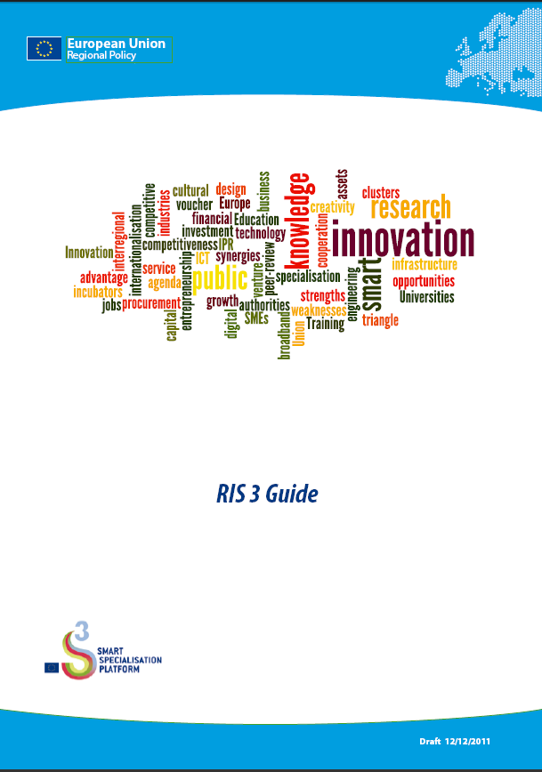
Monitoring was from the very beginning one of fundamental methodological elements of Smart Specialisation (S3)
1: Analysing one's strengths, weaknesses, competitive advantages and potential for excellence
2: Involving innovation stakeholders, in particular the business community
3: Elaboration of an overall vision for the future of the region
4: Selection of priorities for S3 + definition of objectives
5: Definition of coherent policy mix, roadmaps and action plans
6: Integration of monitoring and evaluation mechanisms
S3
(1)
Analysis
(2)
Process
(3)
Vision
(4) Priorities
(5)
Policy mix
(6)
Monitoring
Política de cohesión
Notes:
Smart specialisation strategies are based on six fundamental methodological elements, any country or region has to undertake:
1. Analysing one's strengths, weaknesses, competitive advantages and potential for excellence
2. Involving innovation stakeholders, in particular the business community for validation, buy-in and leverage of the strategy and its priorities
3. Developing a joint vision for the region and identifying priority areas for innovation support
4. Setting a limited number of innovation- and knowledge-based development priorities in line with existing or potential activities identified in an enterpreneurial discovery process
5. Defining a coherent policy mix, roadmaps and action plans including external links to maximise cooperation potential and position in global value chains
6. Setting clear, measurable and realistic targets, monitoring their achievement and, adjusting policies and funding flows, if needed.
Such smart specialisation strategies have to be developed and then implemented in an inclusive process, that creates real ownership. It’s the famous ‘triple helix’ with academia (universities, research institutes), government/public sector and of course industry/business who jointly identify these future growth areas for the regions. This so-called 'entrepreneurial discovery' process is based on the assumption that entrepreneurs know best where their future opportunities lie.
This sounds like common sense, but it reflects cutting edge research into the factors of regional growth.

Slide 3
A range of support has been prepared to help regions/member states build a monitoring
Specific for monitoring smart specialisation strategies:
Technical Assistance from the Operational Programmes
AMI-list experts
Handbook „Implementing Smart Specialisation Strategies”
S3online
Workshops and seminars on monitoring for smart specialisation
Peer learning
Cohesion policy:
Guidance document on monitoring and evaluation – March 2014
EVALSED: The resource for the evaluation of Socio-Economic Development - Sept 2013

Slide 4
Common understanding of key concepts is helpful
Monitoring is a tool serving foremost the management purpose. To monitor means to observe. Monitoring of outputs means to observe whether intended products are delivered and whether implementation is on track. Monitoring also observes changes in the result indicators (policy monitoring). Tracking the values of result indicators allows a judgement on whether or not the indicators move in the desired direction.
Evaluation is the systematic collection and analysis of information about programmes and projects, their purpose and delivery, it derives knowledge on their impact as a basis for judgments. Evaluations are used to improve effectiveness and inform decisions about current and future programming: Did the public intervention have an effect? Why and how it works?

Slide 5
Thematic ex-ante conditionalities (2014-20)
Thematic objectives | Ex ante conditionality | Criteria for fulfilment
1. Strengthening research, technological development and innovation (R&D target) (referred to in Article 9(1) ) | 1.1. Research and innovation: The existence of a national or regional research and innovation strategy for smart specialisation in line with the National Reform Program, to leverage private research and innovation expenditure, which complies with the features of well-performing national or regional research and innovation systems. | A national or regional research and innovation strategy for smart specialisation is in place that: is based on a SWOT analysis to concentrate resources on a limited set of research and innovation priorities; outlines measures to stimulate private RTD investment; contains a monitoring and review system. A Member State has adopted a framework outlining available budgetary resources for research and innovation; A Member State has adopted a multi-annual plan for budgeting and prioritization of investments linked to EU priorities (European Strategy Forum on Research Infrastructures -ESFRI).

Slide 6
Policy objectives post 2020
A smarter Europe (innovative & smart economic transformation)
A greener, low-carbon Europe (including energy transition, the circular economy, climate adaptation and risk management)
A more connected Europe (mobility and ICT connectivity)
A more social Europe (the European Pillar of Social Rights)
A Europe closer to citizens (sustainable development of urban, rural and coastal areas and local initiatives)

Slide 7
A smarter Europe by promoting innovative and smart economic transformation
A smarter Europe
Enhance R&I capacities and uptake of advanced technologies
Digitalisation – for citizens, companies and government
Development of skills for smart specialisation,
Competitiveness and growth of SMEs
Interregional cooperation in value chains

Slide 8
Enabling conditions for smart specialisation
Policy objective | Specific objective | Name of enabling condition
1. A smarter Europe by promoting innovative and smart economic transformation | ERDF: All specific objectives under this policy objectives | Good governance of national or regional smart specialisation strategy
Fulfilment criteria for the enabling condition
Smart specialisation strategy(ies) shall be supported by: Up-to-date analysis of bottlenecks for innovation diffusion, including digitalisation Existence of competent regional / national institution or body, responsible for the management of the smart specialisation strategy Monitoring and evaluation tools to measure performance towards the objectives of the strategy Effective functioning of entrepreneurial discovery process Actions necessary to improve national or regional research and innovation systems Actions to manage industrial transition Measures for international collaboration

Slide 9
Thank you!

