Slide 1


Luc Hulsman :
Engaging SMEs in S3 monitoring
Experiences from the Northern Netherlands

Slide 2
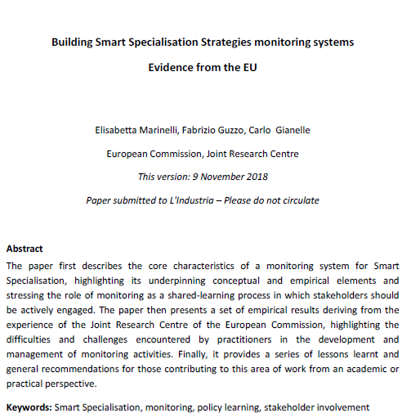

“Key observations related to the process of building and RIS3 monitoring system.” (p.13)
No ‘one size fits all’
“Bad indicators .. often the result of a vague logic of intervention”
→ “well-defined logic of intervention and objectives”
  Yes:
  but .. intervention logic issues:
    How to define specific objectives for priority areas?
    Fostering the development of an area ? Probably not →
    Discoveries within areas or at edges? How to translate into result indicators ?
    How to catch dynamics in the logic (iterative process) ?
Opsomming nummer vier

Slide 3
“Key observations related to the process of building and RIS3 monitoring system.” (p.13)
“adequate data .. reflection on data collection capacity needs to accompany the definition of the monitoring system itself”
  Yes
↓
Issues we faced in the Northern Netherlands

Slide 4

N-NLs RIS3
Extensive EDP in design phase →
Conclusion:
Not enough evidence yet to make sharp choices
↓
prioritize societal challenges
sharp choices to be made along the way
↓
process of refinement
↓
continuous stakeholder involvement !

Slide 5
N-NLs RIS3
Continuous stakeholder involvement
↓
Starting conditions relatively favourable:
Tradition of collaboration
Clear stakeholder landscape
↓
Monitoring → stakeholder participation obvious

Slide 6
Monitoring N-NLs RIS3
RIS3-issues we faced:
Intervention logic
Governance of strategy
↓
Pragmatic approach, ‘bottom up’ →
Main questions (initially):
“What drives our SME’s? What are they working on? New developments, new technologies?“
We knew:
existing data not sufficient
we needed external partner: university

Slide 7
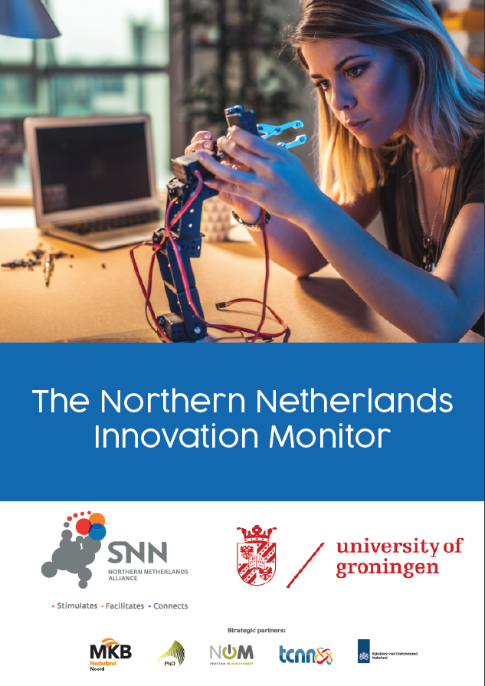


N-NLs Innovation Monitor
↓
Reciprocity-element key characteristic of monitor

Slide 8
N-NLs Innovation Monitor
→ Basis: survey among SME’s
Long term vision:
  annually
  PhD-position created
combination of monitors: consolidation of survey efforts →
‘approach SME’s only once’
involve stakeholders → strategic partners

Slide 9
N-NLs Innovation Monitor
SME’s

Slide 10
N-NLs Innovation Monitor
Strategic partners
(e.g. Employers Federation, Development Agency)

Slide 11
N-NLs Innovation Monitor
Successful:
> 5.000 SME’s approached; response rate 15%
Deep insights into characteristics, behaviour, motivations business sector
Recommendations policy (instruments)
Growing success → visibility, publicity → reinforcing trend
↓
Monitor becoming more and more tool and incentive to communicate with stakeholders
→ systematically involve them in
implementation RIS3

Slide 12
N-NLs Innovation Monitor
Successful, but ..
still building
  fixed format survey → closed ended questions How to find out about something new ?
link monitoring system - intervention logic
→ results – objectives ? Iterative process ?
Policy learning ?
Potentially Yes ! But, still world to be won ..
(not only in N-NLs)

Slide 13
Conclusions
“A good monitoring system is a pre-condition for policy learning”;
Yes, but
clear intervention logic pre-condition for good monitoring →
Means: more narrow choices, acceptance choices by policymakers and stakeholders, coherent set of policy instruments aimed at objectives, trial and error element in strategy ..
Not many regions have reached that stage yet.
+: new/revised strategies will be much better than the existing ones → working on it, but takes time
(acceptance, capacity building)

Slide 14
Conclusions
“ Policy learning requires that stakeholders contribute to and engage with the monitoring process itself.”;
Yes & engage in the overall implementation of the strategy – whole policy cycle

Slide 15



Thank you!
+31 50 5224 945
hulsman@snn.eu

