Slide 1
Smart Specialisation: monitoring and evaluation
RIS3 Galicia
Smart Specialisation: monitoring and evaluation. State of the play and next steps
Committee of Regions
24th January 2019

Slide 2
PRIORITIES: THEMATIC AND INSTRUMENTAL/OPERATIVE
BOTTOM UP
EDP PROCESS
WHAT IS A RIS3?
WHAT IS A RIS3?
WHAT IS A RIS3?
ESIF FUNDS 2014-2020:
ERDF
NATIONAL / REGIONAL COORDINATION
WHAT IS INNOVATION?
POST 2020...
MONITORIA AND EVALUATION APPROACH
MONITOR. AND EVALUATION APPROACH
RIS3 GALICIA CONCEPT
ANSWERS MONITORING CHALLENGES

Slide 3
1. RIS3 Galicia concept
RIS3 = Galicia Innovation Strategy
Public support to efficient R+D+i as the engine for growth
Thematic and instrumental concentration of resources (specialization)
Result-oriented support instruments
Instruments coordinated with other public support items
Objetives GSP – RIS3
REPORT COHERENCE RIS3
GSP | RIS3
Axis 1. Employability and smart growth Action priority 1.1: Enhancing the consolidation investment policies linked to R+D+i. Integrating Galicia in the virtuous circle of innovation for growth | Smart Spec Strategy: Smart, sustainable and integrating growth
SO.1.1.01 Promoting R+D+i by: | Programmes:
Enhancing innovation in SMEs | Sme Innovate
Mobilizing and attraction of private capital for Galician innovation processes | Innovate in Galicia
Promoting the transfer of research-based knowledge to the market | Galicia Transfers
Supporting entrepreneurship discovery in all areas | Innovative entrepreneurship

Slide 4
1. RIS3 Galicia concept
SYSTEMATIC AND CROSS APPROACH OF R+D+i ACROSS THE DIFFERENT THEMATIC OBJECTIVES OF ESI FUNDS 2014-2020

Slide 5
1. RIS3 Galicia concept
RIS3 = R+D+i as a tool for competitiveness
Instrumental specialisation
Guiding principles to promote growth
1.
2.
3.
4.
Innovative
SMEs to be competitive
Public investment to attract private investment
Promote the transfer of research to market
Opportunities for research and entrepreneurial talent
INNOVA SMEs
INNOVA IN GALICIA
GALICIA TRANSFERS
INNOVATIVE
ENTREPRENEURSHIP
Action programme
Attraction of PRITATE and EUROPEAN FUNDS

Slide 6
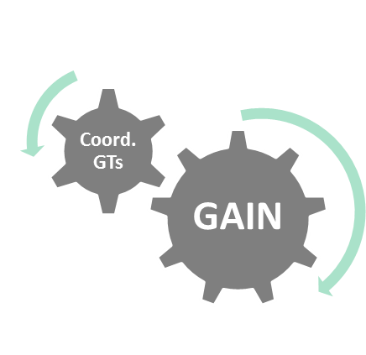
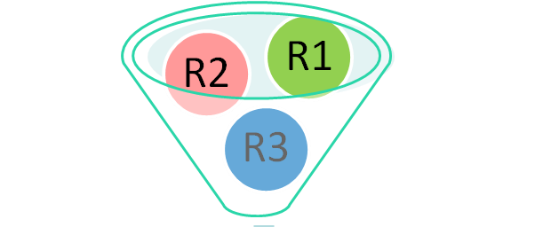
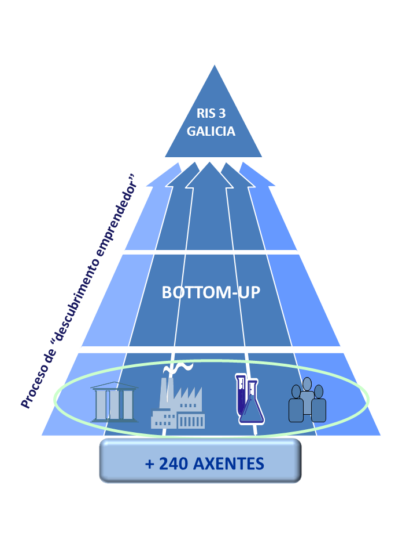
1. RIS3 Galicia concept
RIS3 = R+D+i as a tool for competitiveness
Thematic Specialisation
New model for innovative of natural and cultural resources based on innovation
R1
Generating growth through…
New industrial model based on competitiveness and knowledge
R2
R3
New healthy lifestyle based on the population active ageing

Slide 7
2. RIS3 Galicia: monitoring and evaluation approach concept
RIS3 = Galicia Innovation Strategy
RIS3 = R+D+i as a tool for competitiveness
MULTI-FUND APPROACH: ESIF (ERDF, EARDF, EMFF, ESF), own funds
MULTI-AGENT:
Galicia Administration Bodies (GAIN and other)
Central State Administration Bodies
EC (H2020): assessment improvement of competitiveness of Galicia Innovation Ecosystem
THEMATIC MULTI-AIM: not only TO1 of ESIF
EDP DURING THE IMPLEMENTATION OF THE STRATEGY
POST 2020: STEP FORWARD IN SMART SPECIALISATION

Slide 8
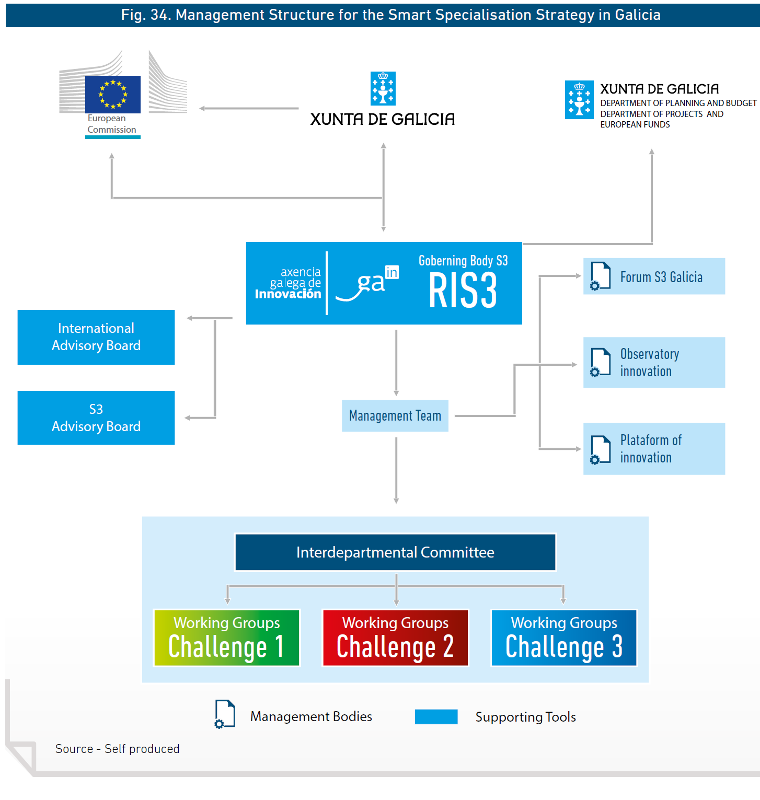
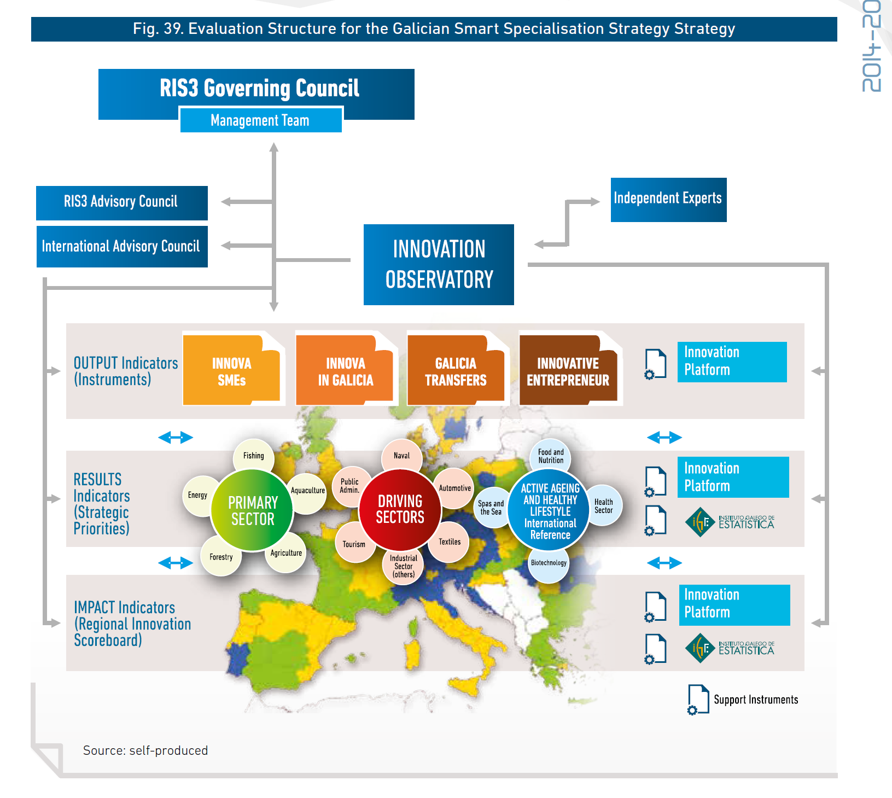
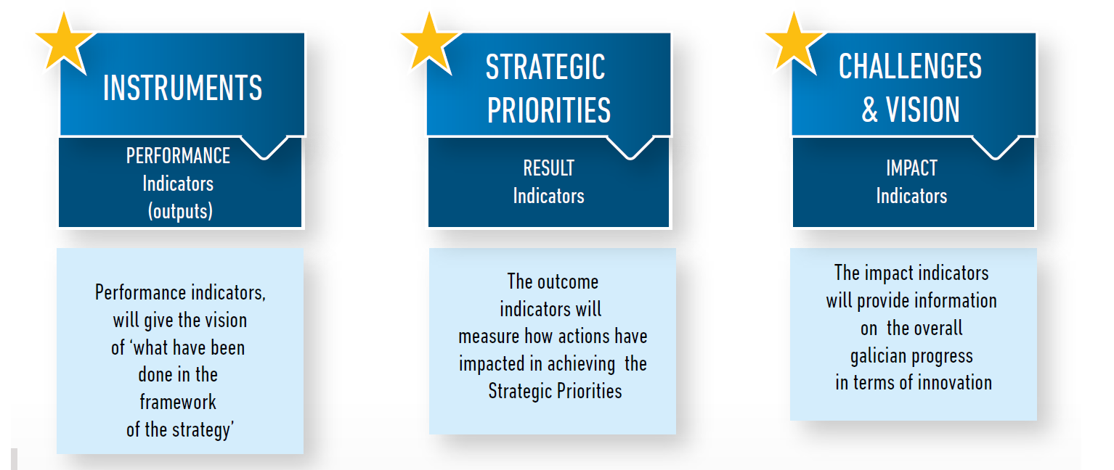
Governance: implementation / evaluation: EDP
-Quantitative and QUALITATIVE evaluation within EDP
-Specific governance: RIS3 Advisory Board / International Advisory Board and Thematic WGs
-Combined indicators: execution, results, impact

Slide 9
3. Some support actions:
Improving monitoring of RIS3 by peer-learning and identifying Good Practice in other regions
HOW? THROUGH
Interregional Thematic Seminars
Identification and exchange of Good Practices
Study visits
The implementation of Action Plans

Slide 10
6 European Regions
Galicia, Spain
West Region of Romania
Dubrovnik-Neretva Region, Croatia
Veneto Region, Italy
Norland County Council, Norway
Norte Region, Portugal
Project Period: 1 January 2017 - 31 December 2021

Slide 11
Thanks

