Slide 1

From Monitoring to Evaluation: What, How and Why?
What makes S3 evaluations necessary?
Dr Yannis Tolias
Managing Partner, Innovatia Systems
tolias@innovatiasystems.eu

Slide 2
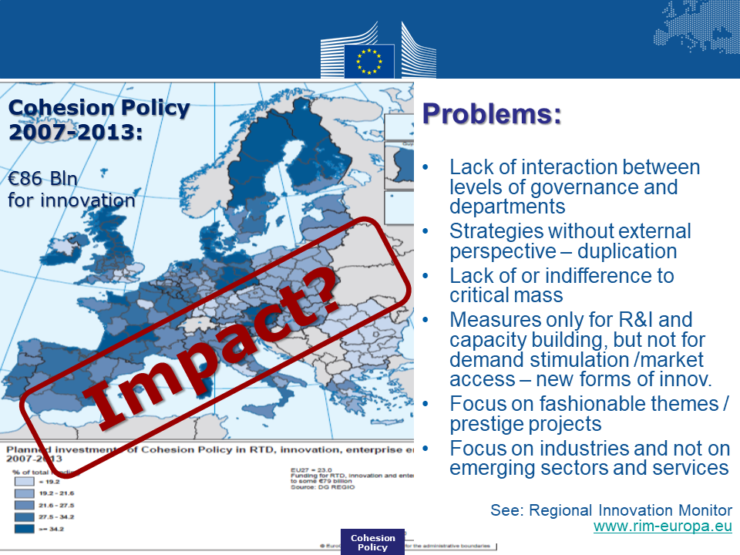
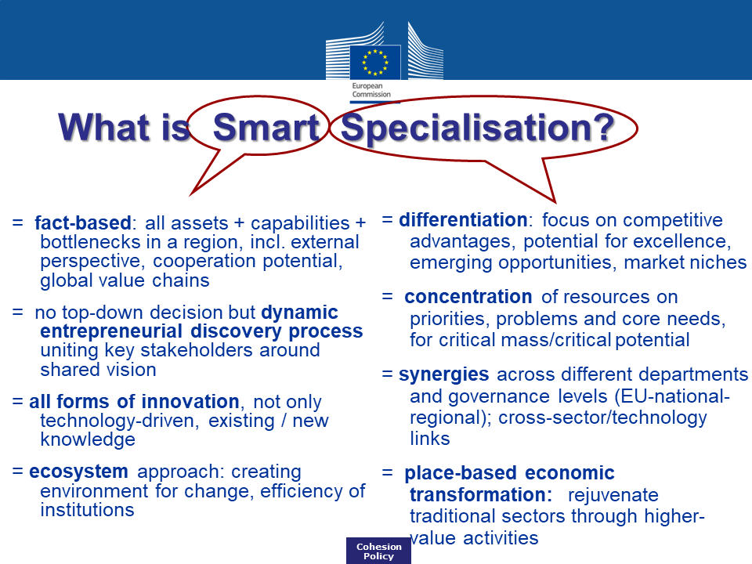
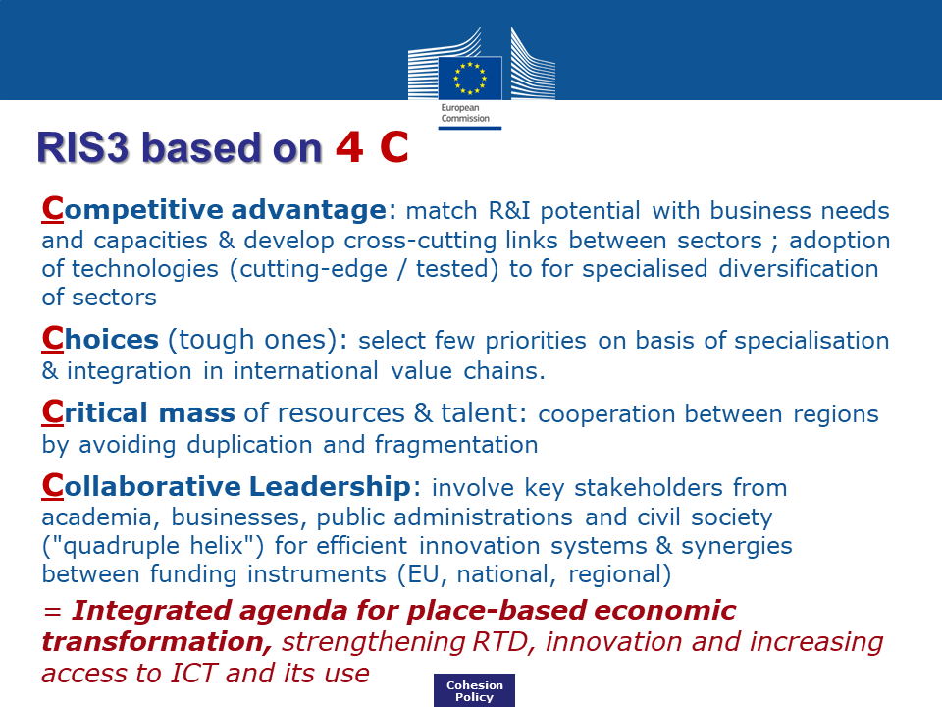
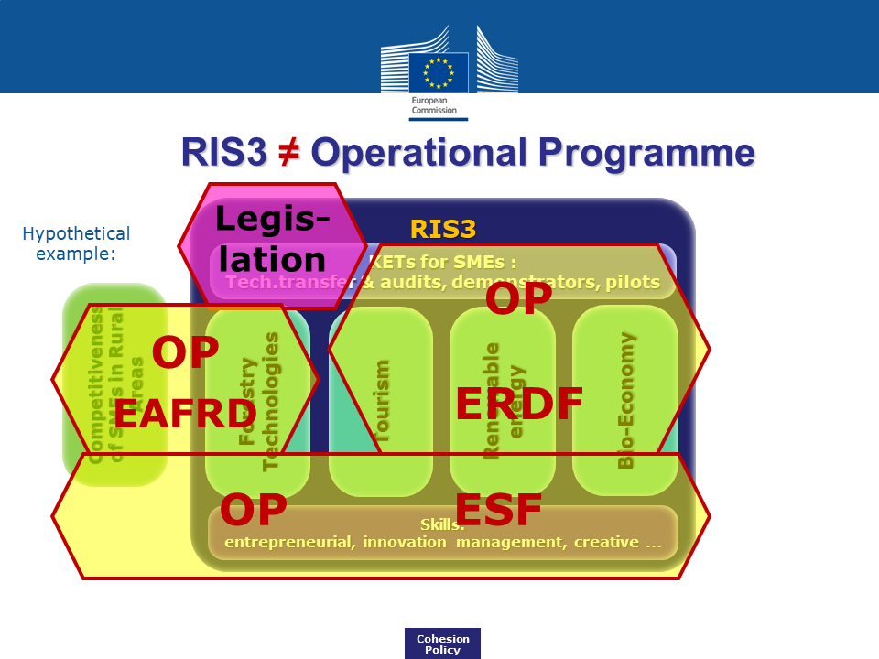
The context of S3 (I)

Slide 3
The context of S3 (II)
Foray & Rainoldi, 2013

Slide 4
The context of S3 (III)

Slide 5
The €66,142,049,068 question:
Is Smart Specialisation the cure of all diseases plaguing Europe’s Smart Growth?

Slide 6
What attributes make S3 different?
S3s are meta-programmes
S3s are organisational innovations
Coordination, complementarity and leverage are the main challenges
  Did the Common Strategic Framework work for the territories?
  Did the upstream and downstream synergies with H2020 materialise?
  How successfully did ESIF complement other funds available to the territories?
  Did territories manage the complex process of governance?
The scope of S3s extends beyond thematic objective 1
Which are the diffusion dynamics?
  Early adopters in 2014: 20% of 169 programmes [SWD(2018)264]
  “100%” adoption by June 2017 [ibid]
  How many S3s in EU today? What is their scope? (TO1 or wider?)
What drives/inhibits adoption?
How much change did S3 introduce across the dimensions of:
  Capacity (skills, capabilities, resources)
  Performance (transformative activities)

Slide 7
What makes S3 evaluations different?
OP Evaluations
S3 Evaluations
To what extent did a single OP contribute to the achievement of (OP-specific) results?
To what extent did the territory meet its agenda of economic transformation by exploiting all the available resources and introducing reforms?
Territory
(Region or MS)

Slide 8
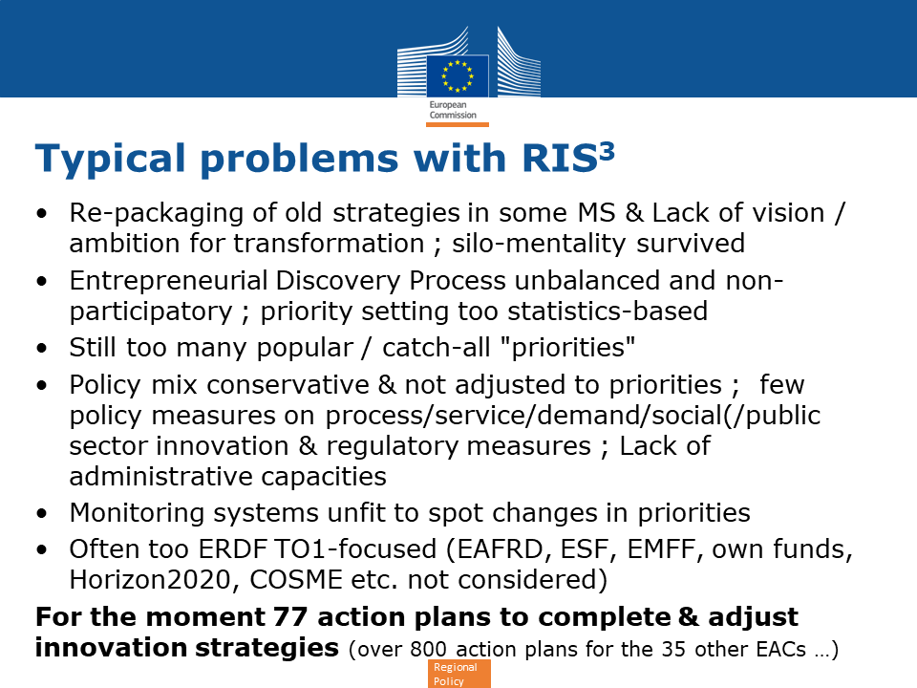
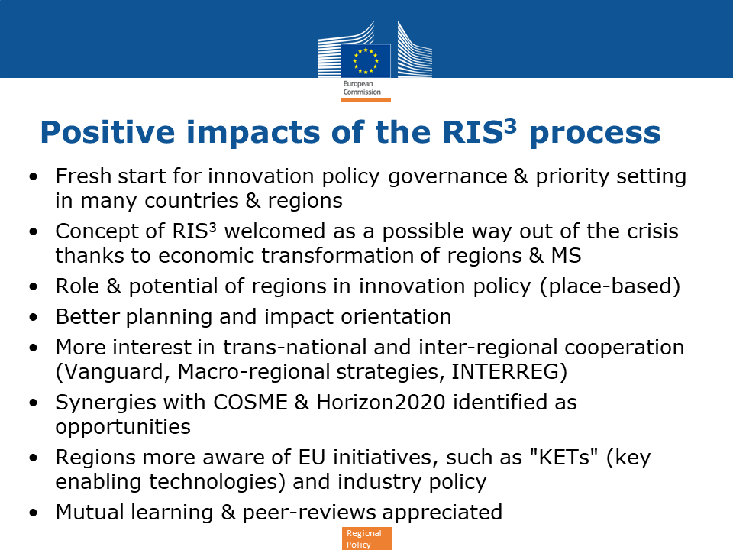
Early evidence circa 2015…

Slide 9
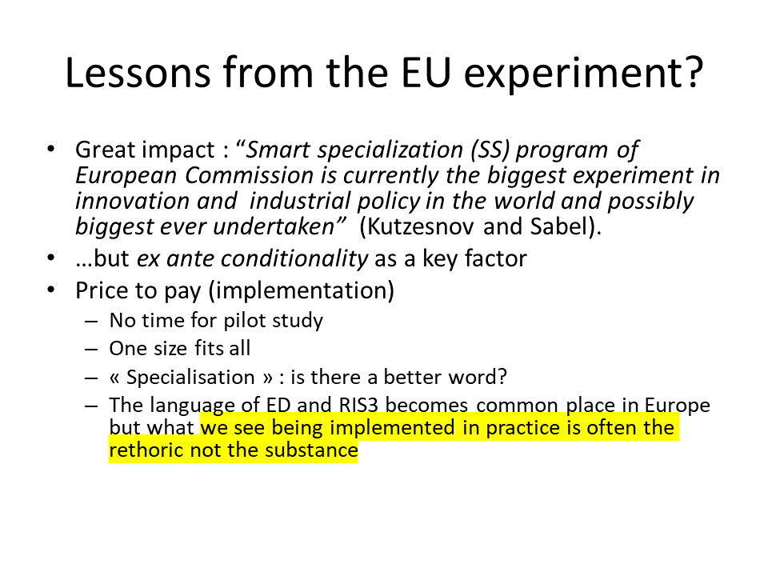
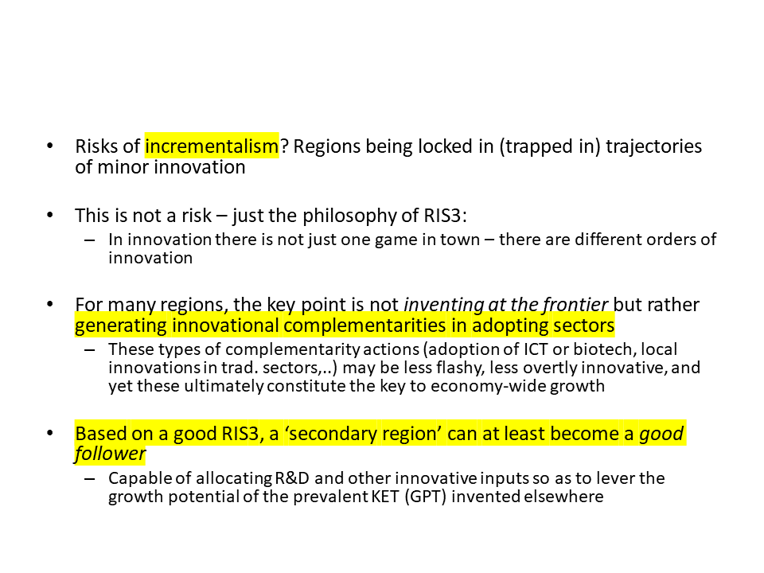
…and more recent debates
D. Foray, March 2016
R. Boschma, Oct 2017

Slide 10
What do we really want to know from S3 evaluations?
Issue | Question | EU | Member States -Regions | Stake-holders
Appropriateness | Was it the right thing to do? | ? | ? | -
Economy | How much did it cost? | ? | ? | -
Effectiveness | Has it lived up to expectations? | ? | ? | ***
Efficiency | What’s the return on investment? | ? | ? | **
Efficacy | What’s the ROI vs the expectations? | ? | ? | *
Process efficiency | Is it working well? | ? | ? | **
Quality | How good are the outputs? | ? | ? | ***
Impact | What has happened as a result of it? | ? | ? | ***
Additionality | What has happened over and above what would have happened anyway? | ? | ? | ***
Displacement | What hasn’t happened which would have happened in its absence? | ? | ? | *
Process Improvement | How can we do it better? | ? | ? | ***
Strategy | What should we do next? | ? | ? | ***

Slide 11
The new stick, this time in continuous application!

Slide 12
What is the relationship between monitoring and evaluation?
Good S3 monitoring systems already help Regions / Member States understand what is actually happening in the ground and drive, if appropriate, corrective action
They will eventually help evaluators understand the logic of intervention and (partially) relieve the burden of data collection
However, the maturity, the sophistication and the quality of S3 monitoring systems still varies across Europe

Slide 13
Timing of S3 evaluations
2014-2020:
  We missed the opportunity for an ongoing evaluation in this period – it might have helped given the novelty of the approach
  Thematic evaluations have been planned for all OPs, due 31/12/2022 – must make sure S3s get the appropriate focus in them
  → Is a EU-wide ToR template for S3 evaluations the answer?
2021-2017:
  Art. 39 of the CPR explicitly mentions programme evaluations – ex ante evaluation is dropped: risk of S3 losing evaluation support in the transition
  → Should S3 evaluations (instead of “evaluation tools”) be explicitly mentioned in the CPR?
  → Should S3 evaluations be scheduled and budgeted on top of programme evaluations?

Slide 14

Thank you for your attention!

