Slide 1
Against the motion:
"It is best for the development of S3 to focus mainly on stakeholders directly engaged in R&D"
Dimitrios PONTIKAKIS
JRC.B3 Territorial Development
dimitrios.pontikakis@ec.europa.eu
Madrid, 20th February 2019
* VIEWS ARE PERSONAL *

Slide 2
What is innovation?
OECD/Eurostat definition:
Novelty tiers
    New-to-the-world
      New-to-the-market (/ -country)
        New-to-the-firm
“An innovation is the implementation of a new or significantly improved product (good or service), or process, a new marketing method, or a new organisational method in business practices, workplace organisation or external relations.” OECD and European Commission, Oslo Manual (2005), p. 46 | "An innovation is a new or improved product or process (or combination thereof) that differs significantly from the unit’s previous products or processes and that has been made available to potential users (product) or brought into use by the unit (process)". OECD and European Commission, Oslo Manual (2018), p. 20
Notes:
Not enough for a technology to be available. It must be implemented in production.
Implementation is not just "diffusion". It takes a lot of thinking and even R&D to adapt knowledge to a local niche.
Implementation costs money. The first company to do so does not always reap the full reward.

Slide 3
What is innovation?
A formal definition of R&D:
“…creative and systematic work undertaken in order to increase the stock of knowledge – including knowledge of humankind, culture and society – and to devise new applications of available knowledge.”
OECD, Frascati Manual (2015, p. 44)
Notes:
When distinguishing R&D from other forms of innovation, the degree of novelty (“an appreciable element of novelty”, OECD and European Commission, 2005, p.97) is a key criterion.
R&D activities are ambitious, setting objectives that are well beyond the horizon of the firm and expected to result in innovations that are, if not new-to-the-world, then least new-to-the-market.
The twin-faces of R&D: R&D is also important for learning or “absorbing” cutting-edge knowledge originating outside the firm (Cohen and Levinthal, 1990).

Slide 4
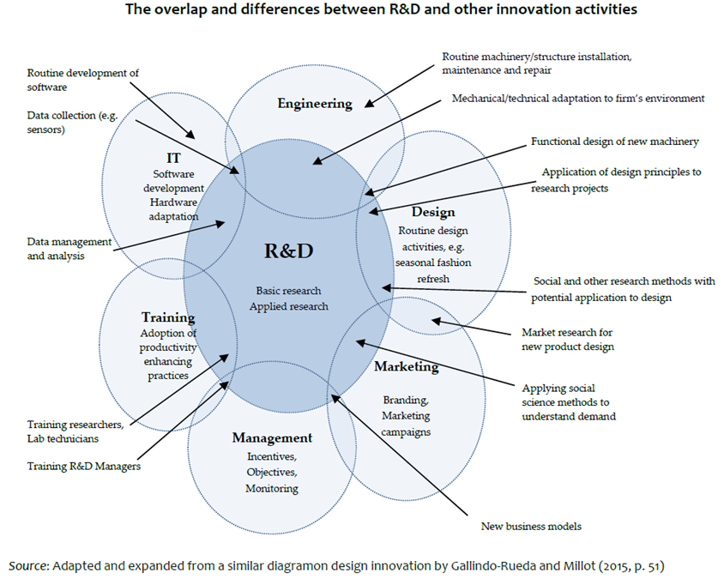
Non-R&D innovation activities and capabilities: What are they?
Source: Pontikakis, D. (work in progress ), Business Innovation: What it is, how to measure it and how to get more of it.
Notes:
Non-R&D innovation are especially important for firms in services sectors and for firms engaging in new-to-the-firm and new-to-the-market innovation
Non-R&D innovation activities tend to be assumed away in much contemporary literature, they are not costless nor fully responsive to changes in market prices
Empirical studies find that non-R&D innovation activities produce spillovers, correlate with the economic value of innovation and that they are complementary to R&D.

Slide 5







Non-R&D innovation is valuable in its own right
Notes:
This is of course self-evident. Globally-leading firms and even entire industries thrive on innovation that is non-R&D. More commonly however, economically useful innovation consists of bundles of R&D and non-R&D innovation.

Slide 6



Non-R&D innovation is complementary to R&D
Photocopiers - Invented: Xerox, Popularised by: Mostly others (Henderson and Clark, 1990)
Graphical User Interfaces (GUIs) – Invented: Xerox, Popularised by: Apple/Microsoft/Commodore
Notes:
The invention of the photocopier can be traced directly back to the R&D efforts of Xerox, first commercialised in 1959. However other companies reaped comparatively greater gains, by offering smaller and more reliable photocopiers.
It took Xerox several years, and significant losses in market share, before they could offer similarly competitive products (Henderson and Clark, 1990).
Xerox never benefitted from its invention of the GUI.
Benefits accrued to those who performed the complementary design, marketing and organisational innovations that permitted economic exploitation.

Slide 7
Non-R&D innovation is complementary to R&D
Non-R&D investments can be the precursors of R&D (e.g. IT systems that generate data for researchers to analyse).
In biotechnology, R&D projects require large co-investments in marketing to succeed (Corrado and Hulten, 2010, p. 100)
Novel organisational structures and business models may prompt R&D in completely new avenues
Non-R&D engineering activities, including observations and challenges encountered during “routine” construction, installation and maintenance, are frequent inspiration for R&D
Design thinking – incl. but not just graphics, fashion, industrial, systems design – can result in architectural innovation, inspire new business models.

Slide 8
Evidence on the value of non-R&D innovation activities
Micro-level studies
Arundel et al. (2008, p. 30-31) find no statistically discernible differences in the revenue performance of R&D-performing versus non-R&D-performing innovating firms, suggesting that the contribution of the two modes are comparable.
The most valuable individual examples of innovations reported by firms can often be non-R&D innovations (O'Brien, 2016; CIS analysis)
Design expenditures alone contribute to new-to-the-firm/-market innovation by as much 30% as R&D (Ciriaci, 2011; CIS analysis; elasticities).
Elasticity of sales of new products with respect to marketing innovation expenditure about twice as strong as that of R&D (Garcia, 2011; CIS analysis).
References
Arundel, A., Bordoy, C., Kanerva, M. (2008), “Neglected innovators: How do innovative firms that do not perform R&D innovate?”, INNO-Metrics Thematic Paper, MERIT, March 31
O'Brien, K. (2016) “Is newest always best? Firm-level evidence to challenge a focus on high-capability technological (product or process) innovation”, Economics of Innovation and New Technology, 25:8, pp. 747-768
Garcia, A. (2011), “The relevance of marketing in the success of innovations”, IPTS Working Paper on Corporate R&D and Innovation, No. 09/2011, doi: 10.2791/75736
Ciriaci, D. (2011), “Design and European firms’ innovative performance: A less costly innovation activity for European SMEs?”, IPTS Working Paper on Corporate R&D and Innovation, No. 08/2011, doi:10.2791/72880
Notes:
Individual examples of extremely successful innovations, whether products or services, tell rich stories of creative combinations of R&D, design, marketing and organisational novelties, not necessarily in this order.
The runaway success of Apple’s mass-market products can be traced at the intersection of cutting edge technology, product design, ergonomics and social-positioning marketing.
Other notable recent innovators combined technology with novel business models in ways that presented bold challenges to legal and regulatory frameworks (Netflix and Airbnb/Uber with regard to intellectual property rights and industry regulation), or to established frameworks and platforms for identification and communication (e.g. PayPal, WhatsApp using email in lieu of banking information, and phone number in lieu of email respectively).

Slide 9
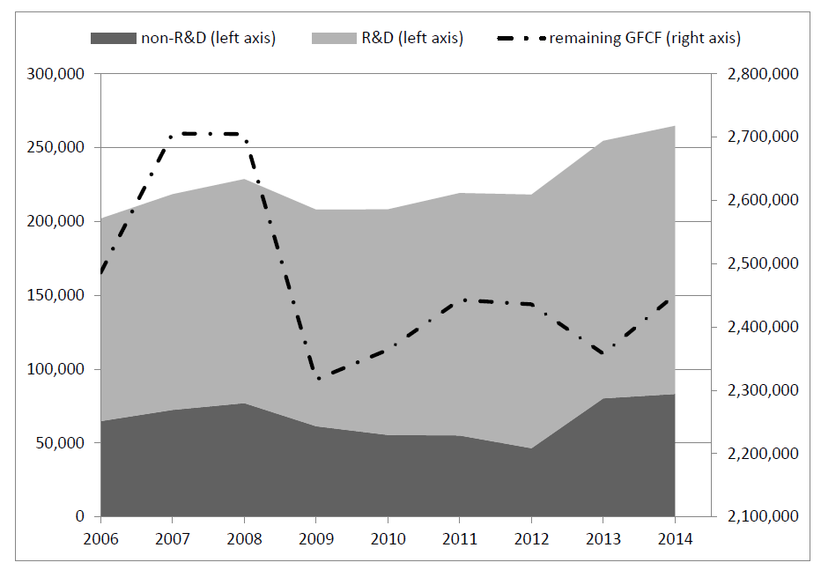
Non-R&D innovation can be measured (and influenced)
EU total expenditures on business R&D, non-R&D innovation (acquisition of machinery and other external knowledge only) and remaining Gross Fixed Capital Formation (millions of current EUR)
Source: Own elaboration of Eurostat CIS, R&D and National Accounts Data
Notes:
CIS-derived figures almost certainly underestimate the true magnitude of business investment in innovation – not covering design, marketing, training, information technology or non-R&D engineering innovation.
Even the limited range of non-R&D innovation expenditures covered by the CIS suggest that investment is substantial: somewhere between a third and a quarter of all reported innovation expenditures were non-R&D.
Rapid rebound following the crisis suggests that these investments are strategically important, just like R&D, and unlike other investments (notice double-dip in remaining GFCF).

Slide 10
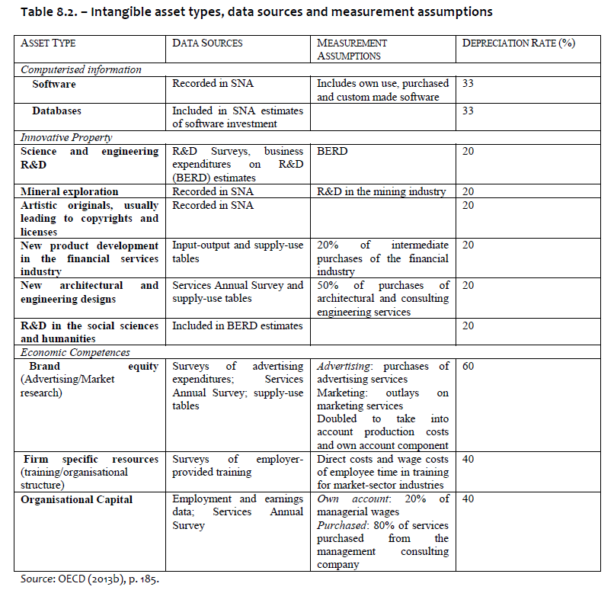
Non-R&D innovation can be measured (and influenced)
Non-R&D innovation registers (partially) as intangible investment
Simplest way to support non-R&D innovation: include (at least some classes of) intangibles in reimbursable allowances

Slide 11
Non-R&D innovation is complementary to R&D: Why?
Non-R&D innovation provides the in-house apparatus necessary for R&D, including:
→ measurement, instrumentation, prototyping and quality control capabilities, proprietary data for experimentation and analysis, knowledge of sources of financing and investment possibilities, project scheduling, procurement, management and bargaining of contracts
Such complementarity may be why firms spend more on R&D as their total innovation intensity increases (Chuang et al, 2010, p. 45).
Complementarities may be why MNEs locate R&D and other innovation investments in cities where they have previously invested in other core activities of their value chain (Belderbos et al., 2016 p. 27).
Advancement of knowledge is made by both the ‘producers’ and the ‘users’ of knowledge (including knowledge workers closer to routine production)

Slide 12

Non-R&D engineering and technology-inspired science
Far from being exclusively or even mainly about science-based innovation , the historical record is littered with examples of technology-inspired science.
As Joel Mokyr (1992, pp. 169-170) puts it:
“[…] in the past 150 years the majority of important inventions, from steel converters to cancer chemotherapy, from food canning to aspartame, have been used long before people understood why they worked” (emphasis in the original).
Notes:
An extremely common, but underappreciated feature of technological development, especially of radical technological innovations, is that novel technological behaviour is observed “in the wild” before it can be explained by the science of its time.
Serendipity and happenstance are at least as important as a conscious search for specific solutions.

Slide 13
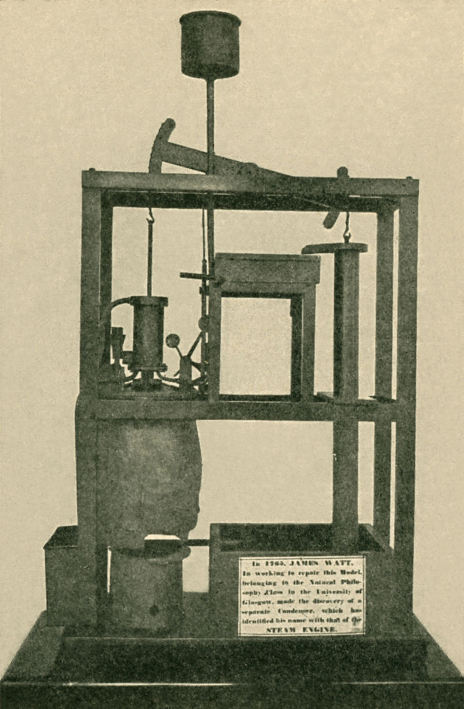
The invention of the Steam Engine
In the 1760s an instrument maker and repairman at the University of Glasgow was asked to repair a model of the Newcomen Pump.
Newcomen Pump was then in limited use for over 6 decades. Piston was expected to be both cold and hot at the same time, which it did poorly.
James Watt the repairman - not the university professor or professional researcher – identified this as a key inefficiency and introduced a separate condenser.
With Matthew Boulton's financing, the Boulton and Watt steam engine would literally power the Industrial Revolution that followed.
Burke, J. (1978), “Connections: An Alternative View of Change”, BBC documentary series, https://archive.org/search.php?query=subject%3A%22connections%22%20creator%3A%22james%20burke%22
Notes:
Not all non-R&D engineers are James Watts. And to paraphrase Louis Pasteur, fortune favours the prepared mind. But among equally capable and dedicated minds, there's no telling who's going to come up with the next breakthrough.

Slide 14
The economic value of innovation is extremely unequally distributed
In drawing implications for technology policy from skew-distributed outcomes, Scherer and Harhoff (2000) conclude that policy intending: “…to support major technological advances must strive to let many flowers bloom”.
Game-changing macro-inventions:
“[they]… do not seem to obey obvious
laws, do not necessarily respond to incentives, and defy most attempts to relate them to exogenous economic variables.” (Mokyr, 1992, p.13)
Silverberg, G., Verspagen, B. (2007), “The size distribution of innovations revisited: An application of extreme value statistics to citation and value measures of patent significance”, Journal of Econometrics, Volume 139, No. 2, pp. 318-339
Scherer, F. M., Harhoff, D. (2000), “Technology policy for a world of skew-distributed outcomes”, Research Policy, Volume 29, No. 4-5, pp. 559-566.
Notes:
Patent citations (Silverberg and Verspagen, 2007) and other estimates of investment returns to innovation (Scherer and Harhoff, 2000) repeatedly turn up fat tail distributions.
Something like 80-90% of all value is accounted for 10-20% of all innovations.
This is *crucially important* as fat tail distributions have no mean and no variance – almost all the value is in the outliers: econometrics/statistics almost useless

Slide 15

Key takeaway: You just cannot predict the most valuable of all innovations
Most valuable innovations are fundamentally unpredictable.
Policy makers will never have a constant return on innovation investment; concentrating on few actors or projects almost guarantee of failure.
The claim that only R&D predicts valuable novelty before it happens is not defensible.
R&D does not have a monopoly on human creativity and the generation of valuable knowledge.
Response: Cognitive diversity and institutional responsiveness as predictors of system-level transformations
Notes:
The degree of novelty or information content of an innovation is only discernible after the fact and cannot be predicted ex ante:
R&D and non-R&D activities are comparably good (or, taking into account uncertainty, comparably bad) predictors.

Slide 16
Why should government support non-R&D innovation?
Same rationale as for R&D:
i.e. spillovers and imitation between firms in same novelty tier (e.g. new to-firm/-market/-world) lead to under-provision
Additional reasons:
→ Valuable innovations do not necessarily come from R&D. In fact the evidence record suggests that value comes from bundles of R&D and non-R&D innovation (Polder et al. , 2010; Evangelista and Vezzani, 2010; and Hervas-Oliver et al., 2015)
→ Evidence of complementarity between R&D and non-R&D: a path for more R&D in a greater number of firms.

Slide 17
Who are the innovation stakeholders who tend to do R&D and tend not to do R&D?
R&D: Universities, public research institutes, a few typically large, manufacturing firms
Non-R&D: All businesses who innovate, companies who take their first steps in routine innovation
Non-R&D innovation particularly important for firms in services sectors (may explain UK and NL paradox of high-innovation but low R&D)

Slide 18
Why support them through S3?
Support stakeholders engaging in non-R&D innovation
They can benefit particularly from S3, as they tend to be disconnected
S3 can promote learning between firms in the same novelty tier (e.g. new to the market/new to the country innovation)
Productivity improvements/new market opportunities in the majority of firms
Supporting non-R&D activities and capabilities can form the basis for R&D in a greater range of firms

Slide 19
Is the current policy mix correct?
Not really:
Disproportionate support to public research (as opposed to businesses)
S3 often hijacked by universities
Among businesses, overrepresentation of R&D performing (hi-tech) businesses
Too much emphasis on university-industry interaction; benefits oversold
Too little attention to the in-house capabilities of businesses

Slide 20
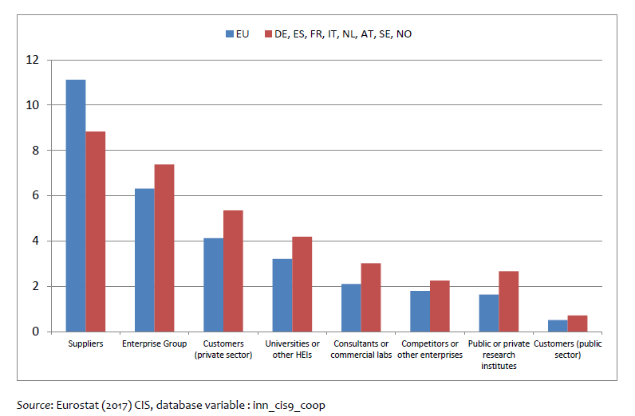
“the most valuable method of cooperation” (% of firms 2014)
Source: Pontikakis, D. (work in progress ), Business Innovation: What it is, how to measure it and how to get more of it.
Notes:
Evidence (e.g. from patenting and from the CIS) suggests that firms overwhelmingly innovate without collaborating with other organisations;
and that even when they do collaborate in the course of their innovation activities they do so primarily with other businesses [on the latter, see in particular Giuliani and Bell (2005); also evidence in OECD (2014a, p. 194); OECD (2014b)].
Situation not different in advanced innovation systems, where typically less than 15% of innovating firms collaborate with universities and other public research organisations.

Slide 21

University-industry linkages without business innovation look like this
Notes:
Importance of absorptive capacity: Otherwise support to public research is a subsidy to those places/countries where absorptive capacity exists.
Assuming you have good universities to begin with. Which is not always the case in lagging regions.

Slide 22

University-industry linkages in lagging regions often look like this
(Technology transfer office in unnamed lagging region)
Notes:
In lagging regions it is important to build in-house capacities in business first, and if necessary upgrade and extend public research. Then build bridges.

Slide 23
Challenges in the development of S3
Engagement with business sector comes up regularly in surveys of S3 implementation (Fraunhofer, JRC horizontal/ JRC Greece)
Development of business innovation capabilities crucial for lagging regions
In developed innovation systems:
→ Businesses perform and finance most R&D
→ Business identify opportunities for economically- useful innovation
→ Commercialisation of public research is a peripheral economic activity

Slide 24
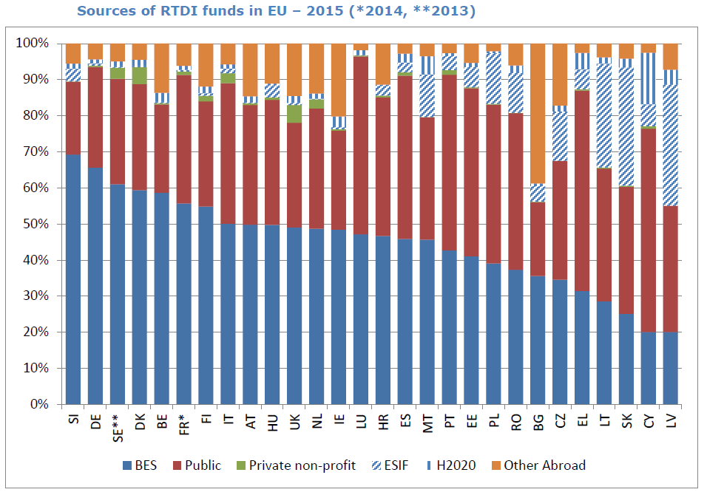
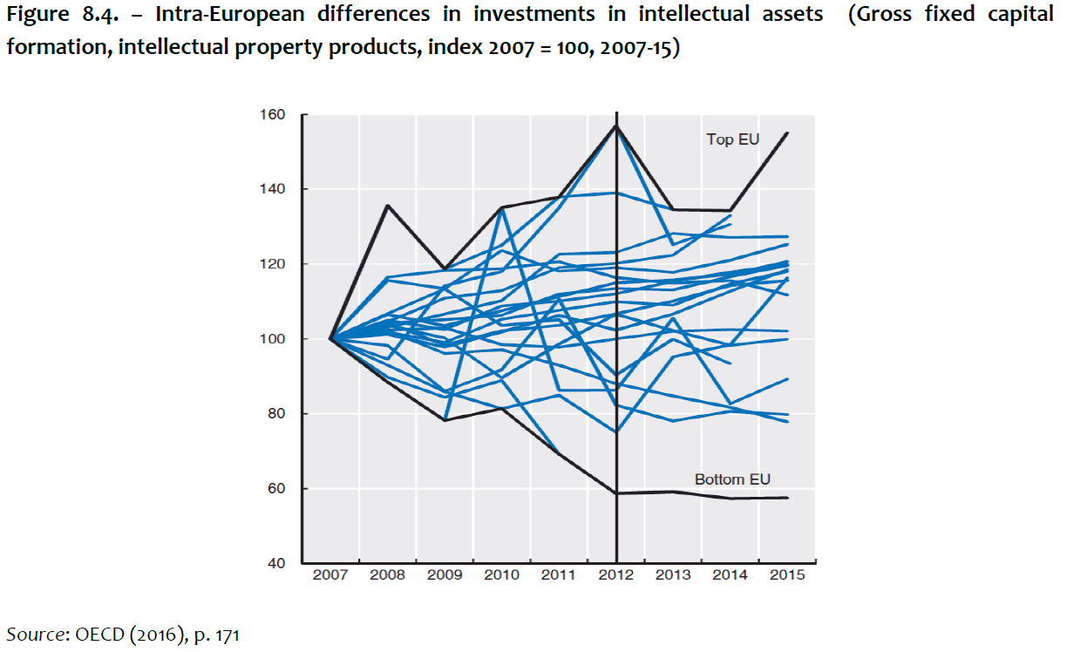
Fundamental problem of Lagging Regions is lack of business innovation capabilities
Source: Pontikakis, D., Doussineau, M., Harrap, N. and Boden, M., Mobilising European Structural and Investment Funds and Horizon 2020 in support of innovation in less developed regions, EUR 29298 EN, Publications Office of the European Union, Luxembourg, 2018, ISBN 978-92-79-89850-1, doi:10.2760/77101
Source: OECD (2016), OECD Science, Technology and Innovation Outlook 2016, OECD Publishing, Paris. http://dx.doi.org/10.1787/sti_in_outlook-2016-en
Notes:
Some evidence of divergence between top and bottom EU countries.

Slide 25
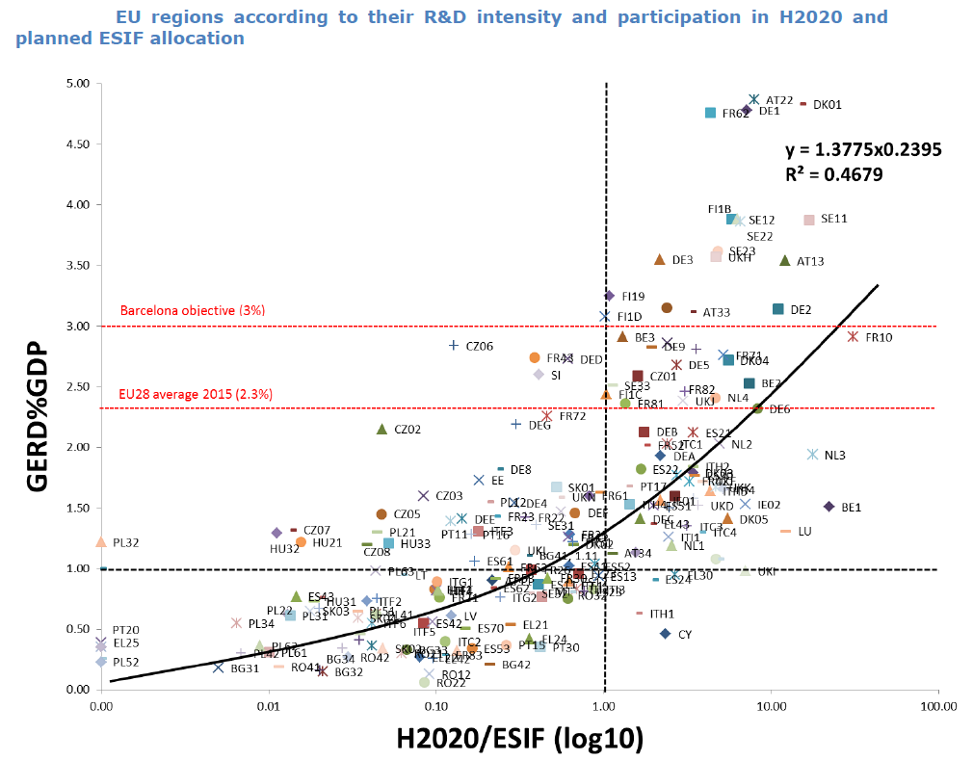
As business innovation capabilities accumulate, regions do more R&D, succeed in H2020
Source: Pontikakis, D., Doussineau, M., Harrap, N. and Boden, M., Mobilising European Structural and Investment Funds and Horizon 2020 in support of innovation in less developed regions, EUR 29298 EN, Publications Office of the European Union, Luxembourg, 2018, ISBN 978-92-79-89850-1, doi:10.2760/77101

Slide 26
How to promote the development of business innovation capabilities?
Support systematic, broad-based, in-house innovation activities and capacities. This means R&D and also:
→ innovation management; design; marketing; training; information technologies and non-R&D engineering (remember overlap with intangibles)
Complementarities suggest that non-R&D innovation can be a stepstone to more, more systematic and more valuable R&D.
No 3/4-ple-helix straightjacket for everyone; leave room for diverse-configuration projects/activities (including between local businesses and globally-leading universities outside the region/country)
Allow collaborative projects only between firms (without universities), and also support non-collaborative innovation in individual firms subject to rigorous evaluation.
Subsidise human resources within firms (e.g. a first-engineer, first-programmer) and on-the-job learning

Slide 27
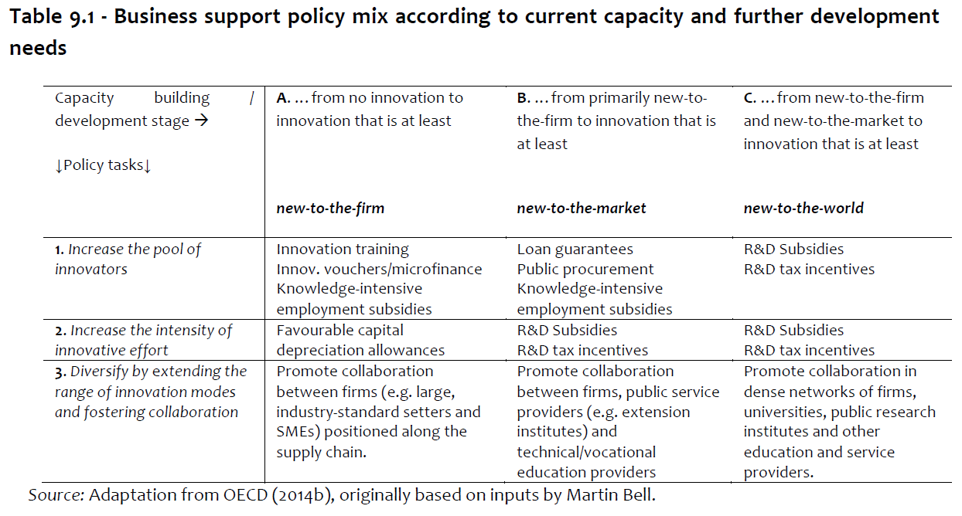
Tailor the policy mix to the needs of different business sector constituencies
Source: Pontikakis, D. (work in progress ), Business Innovation: What it is, how to measure it and how to get more of it.

Slide 28
The new linear model of innovation
Due to (often unfounded) fears of falling foul of state aid rules and (genuine) difficulty identifying other innovation investments public support tends to follow the path of least resistance to R&D
Public funds target isolated islands of public research institutions and few, usually large, R&D-performing companies drowned in oceans of low productivity and low knowledge-intensity businesses
Public research institutes and universities are then handed the heroic task of collaborating with local industry + support for spinoffs and start-ups.
Moreover, all of this expected to play out within (!) the region.
Does it work? Has it ever worked? Where are all the unicorns?

Slide 29
Get rich slowly
In sharp contrast to the near-singular attention that “scale up or fail fast” (!) start-ups attract in contemporary innovation policy, for the vast majority of firms, in-house innovation capabilities take time to accumulate
Supporting start-ups is important and should continue; but it is very far from sufficient, especially in a development setting
Productivity improvements in /new markets for the vast majority of firms an order of magnitude more valuable than uncertain bets in few firms

Slide 30
A plea for greater balance in innovation policy
We need support for R&D and for non-R&D innovation
A broader understanding of innovation in all its economic and social dimensions tells us that S3 should be aiming for:
  Broad-based productivity improvements in the vast majority of firms
  Opening of new markets for the greatest possible number of producers
  Providing sustainable consumption opportunities for most consumers.
This is possible! The assertion that public subsidies need to be concentrated in a few actors or priorities* to have impact is not supported by evidence
Exceptions:
  Major socio-technical transitions / GPTs (and even there most needed public investments outside remit of innovation policy)
  Large public research infrastructures (exceptional, even within science)
Notes:
It is of course legitimate, and useful, for public attention and planning to be concentrated on the most relevant themes or sectors of an economy, as it can help lift regulatory bottlenecks and coordinate with other policy areas. The argument here is about concentrating public subsidies, for which literature overwhelmingly suggests is not a good idea.

Slide 31
Conclusions
Engaging with businesses a key challenge for S3
Exclusive attention to R&D-performers stands in the way of broader engagement; may be disruptive to universities
It is also disproportionate wrt their real importance in the economy, even in developed innovation systems
S3 should promote a wider understanding of business innovation and policy that responds to the needs of the vast majority of firms. Already reflected in 1st criterion of good governance!
S3 can contribute to rebalancing innovation policy to support business capability accumulation more directly (not just collaboratively)

Slide 32


Thank you!
dimitrios.pontikakis@ec.europa.eu

