Slide 1
Squaring the circle lessons from the role-playing exercises on S3 regional and multi-level governance
Elisabetta Marinelli, PhD
Madrid 20th Feb 2019, Seville

Slide 2
Origins: Military trainig
Modelling vs Gaming: Prediction vs learning
Advantages
Real life situation without real-life pressures
Test non-reversible decisions
Communication among conflicting stakeholders
Key elements
real system
real stakeholders
roles
rules
scenario

Slide 3
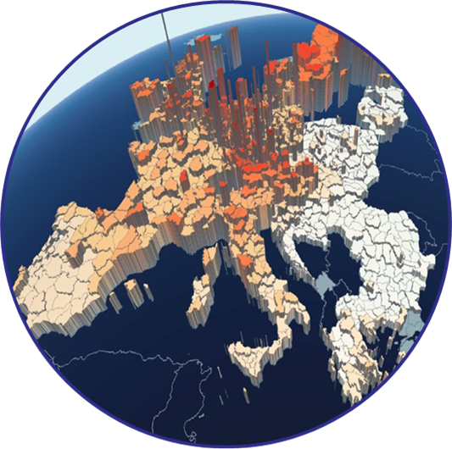
Two role-playing games
Intra-Regional Governance | Multi-level Governance
ESF
MA
National S3 Technical Body
S3 Technical Body
Politic.
ERDF MA
DG REGIO
S3 Technical Body – Capital Region
3-Helix
S3 Technical Body – Peripheral Region

Slide 4
Intra-regional governance scenario:
Background
Less developed, rural region – large agricoltural sector
Incipient innovation system (1 Univ. 1 PRO)
Young researchers more active in TT
Strong potential in dairy and oil.
Key weaknesses
lack of demand/skills for innovation
lack of a strategic research-plan to valorise leading products
limited RTDI collaboration
Preliminary proposal
To invest in vocational/professional training
To invest in Industrial PhDs, especially in leading products
To invest in vouchers for innovation services
To invest in collaborative research grants
Instruments currently used but not all under the S3 umbrella.
Large presence of SMEs;

Slide 5
Intra-regional governance scenario – Rules of interacton
Objective
Renegotiate S3 policy mix for Agrifood and start discussing for 2021-2027
Roles
MAs: focus on administrative and legal constraints (take-up of funds; coming mid-term evaluation; State Aid, etc).
Regional politicians: Next electoral cycle
Stakeholders: support is insufficient and fragmented
Rules
S3 Technical body to negotiate with MAs and Stakeholders
S3 to draft proposal to politicians
Process
Each group has detailed instructions + information (i.e. monitoring, regulations, etc.)
Moderator + Rappourteur
In-built asymetric information and trade-offs

Slide 6
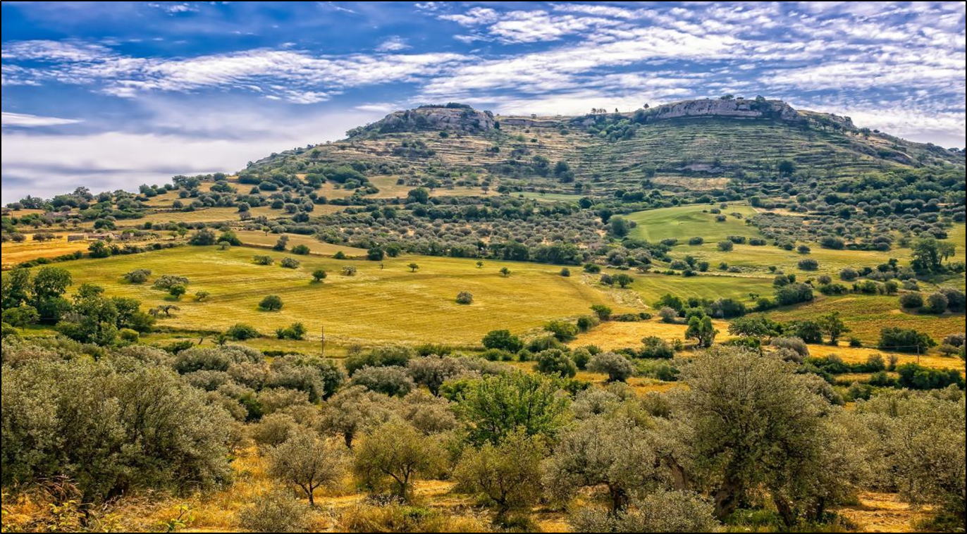
Intra-regional governance scenario: key issues
Operational programme vs S3
Short vs long term
Coordinate
Policy
Training (ESF)
Role of stakeholders
Trust
Policy and political cycle
Role of political support
Rigid vs evolving
Innovation (ERDF)
Type of engagement
Principal-agent dilemma

Slide 7
Intra-regional governance: results
OP vs S3
MAs evaluate new instruments in terms of:
Spending speed
State Aid
Programme objectives (ESF≠S3)
No to narrowing priority
Openness to pilot initiatives
Policy Coordination:
Rules and objectives: ESF ≠ ERDF
Human capital for S3 – Regulation gap
Common incentives and objectives
Burden of proof on S3 T.B.
Understand skills demand.
ESF MA open to work with ERDF, but technical body did not realise it!
Interesting misunderstanding
Policy and political cycles
Align results with re-election in 2021
Link S3 to electoral promises
Export and employment growth
Stir towards environmentally friendly Agrofood products
Role of stakeholders:
Stakeholders are insightful
Need policy to connect
Monitoring as a tool for engagement
Several proposals-> none-accepted (OP agnostics!)

Slide 8
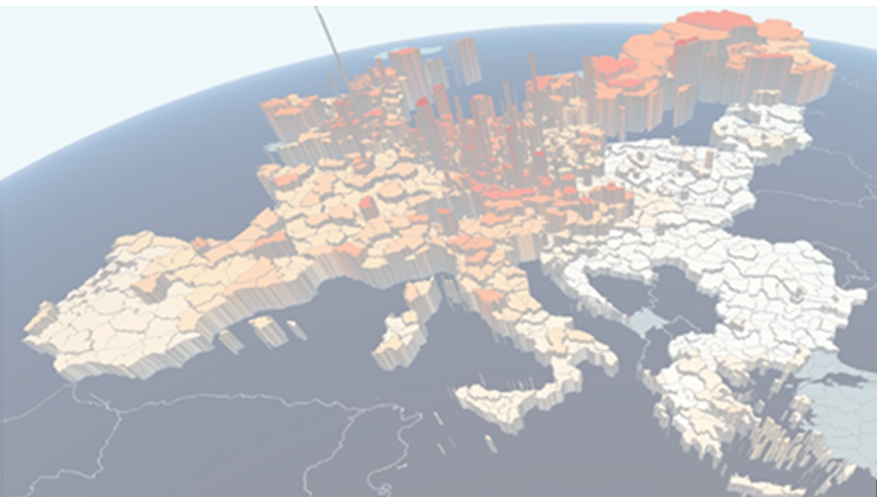
Multi-level governance scenario: background 1
Task 2: Technical assistance
Negotiation of a potential technical assistance project for peripheral
region, financed by DG REGIO.
DG
REGIO
Capital region
Peripheral region
Task 1: Capacity building programme
National level
Definition of a capacity-building programme for S3 coordination at the national and regional level

Slide 9
Multi-level governance scenario: background 2
Economic & Administrative situation
1 country
2 less developed regions
Activities concentrated in capital city
Regional STI competences
National formal checks
S3 and ERDF
Coordination of:
calls
state aid
S3 revision
Objectives of DG REGIO technical assistance to peripheral region
Complement, if needed, national programme
1 National OP & S3 + 2 Regional OP & S3
Inefficiency and delays in issuing calls
Limited take-up of funds, especially from companies
Objectives of National Capacity Building Programmes:
Design governance structure

Slide 10
Multi-level governance scenario: key issues
Co-ordination of S3 functions at the national and regional levels.
Developing a shared understanding of S3, across levels.
Characteristics of a functioning multi-level governance structure

Slide 11
Multi-level governance: results
National-regional coordination:
Collaboration necessary and possible when capabilities unequally distributed
Coordinating calls: essential but virtually impossible
Developing a common understanding of S3
DG REGIO = OP not S3
Un-targeted support opportunities (TAIEX, online tools) of limited value
No technical assistance
Unexploited potential in DG Regio
Governance as capacity building
Need to empower S3 Technical bodies – at least formal consultation
National-regional coordination as learning opportunity

Slide 12
Conclusions
Policy conclusions
Current ESIF framework not suited to S3
Set realistic expectations against administrative complexity
EC Regulations 2021-2027
Skills for S3, entrepreneurship and industrial transitions -> good!
Governance body in ex ante conditionality: need to clarify links to OP MA
Methodological conclusions
Role playing good for learning and exchange
Very cumbersome to prepare
Strike the balance between interesting and difficult
Thanks
Elisabetta.Marinelli@ec.europa.eu

