Slide 2
RIS3 as a catalyst for the development of early-stage regional innovation systems
Marina Ranga
European Commission
Joint Research Centre
20 February 2019

Slide 3
JRC Targeted support to S3 implementation
Five closely complementary JRC activities
STRIVE - Support to Transitions in Regional InnoVation Eco-systems
RIS3 Support to Lagging Regions
RIS3 Support to Romania
Higher Education +VET in Smart Specialisation
Transition regions
Stairway to Excellence
European Parliament
DG REGIO
European Parliament
DG REGIO
DG EAC
DG EMPL
DG REGIO
European Parliament
DG REGIO
2016 - 2020
2016 - 2019
HESS3: 2018-20
2018+
S2E-4: 2018-20

Slide 4
JRC Support to RIS3 in Romania: Staging
Stage 1
(Oct 2016 – June 2018)
Focus on NE and NW regions
Stage 2
(July 2018 – June 2019)
Rollout to all 8 regions
- "Advanced": NE, NW
- "Intermediate": SE, SW, S, Centru, W
- "Beginner": Bucharest-Ilfov

Slide 5
Project timelines 2018-2020
Targeted Support to RIS3 in Romania
(July 2016 – June 2019)
Targeted Support to Lagging Regions (phase I)
(July 2016 –June 2018
Targeted Support to Lagging Regions (phase II)
(July 2018 –June 2020
July 2016
July 2018
July 2019
June 2020

Slide 6
Main JRC activities in Romania: Stage 1 and Stage 2
(specific support actions associated to each of these lines)
STAGE 1 (focus on NE and NW regions) | STAGE 2 (focus on all regions)
a. Setting in motion the EDP process in NW and NE | a. Consolidating the EDP process in NW and NE and developing it in the newcomer regions
b. RIS3 governance and regional-national coordination | b. RIS3 governance and regional-national coordination (funding of regional RIS3 projects, correlation of national-regional RIS3 strategies, better coordination among national and regional authorities involved in RIS3)
c. Developing RIS3 monitoring in NW and NE | c. Developing RIS3 monitoring in all regions
d. Consolidation of competences of NW and NE RDAs' staff involved in RIS3 management | d. Consolidation of competences of RDA staff from all regions in RIS3 management
e. Consolidation of technology transfer and entrepreneurial capacity in NW and NE | e. Consolidation of the technology dimension of RIS3 (technology management, technology transfer and entrepreneurial capacity at regional and national level)
 | f. Support to inter-regional/international collaboration

Slide 7
RIS3 in Romania: Project toolbox
EDP
EDP workshops
Project Development Labs
Project writing training courses
Support to the technical-financial evaluation of projects
RIS3 governance
Better coordination national-regional RIS3 authorities
Consultations in view of the new RDI Strategy and National RIS3 Strategy
Country-specific activities
(in the framework of the "Targeted Support for RIS3 in Romania" project)
Engaging each strand of the QH
Participation in HESS pilot phase (NE)
Studies of the "third mission" in universities (NE and NW)
Thematic Workshops
(S3P Thematic Platforms)
Training course on technology management
Workshop on innovative financial instruments
Support to inter-regional cooperation
Workshop on inter-regional cooperation
Twinning between Leading and Lagging regions
Horizontal activities for all regions
(in the framework of the "Targeted Support to RIS3 in Lagging Regions" project)
Working Groups on RIS3 Monitoring and Governance (LR1)
MOOC on RIS3 Governance
Working Group on RIS3 Governance (LR2)
Other S3P activities (PXL, S2E Learning Lab, etc.)
Board of "Critical Friends"

Slide 8
RIS3 impact on the development of regional innovation systems
1. RIS3 governance
New institutional formats: Regional Innovation Consortia in all regions
RIS3 strategies as precursors for regional innovation policies
Increasing recognition of RDAs' role in regional RIS3 coordination and higher visibility in national RIS3 deliberations
Improved communication/coordination between national and regional RIS3 levels (ministries, RDAs)
2. Capacity-building in RDAs through the country-specific and horizontal project activities
EDP methodological support, RIS3 project writing course, management of RIS3 project portfolio
Inter-regional collaboration
3. EDP process
Generation/selection of RIS3 projects
Clearer definition of regional industrial specialisations (superseding path dependency, lock-ins)
Strengthening the regional knowledge base, dynamic learning process
Network integration mechanisms among key innovation actors
Strengthening social capital, collective identities.

Slide 9
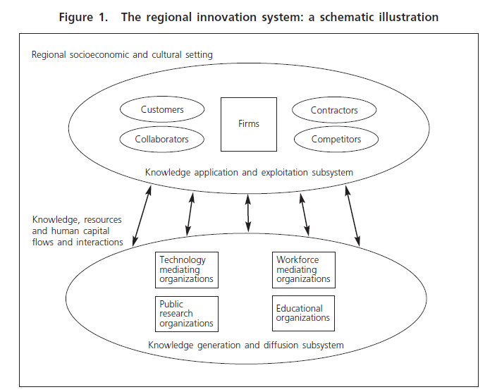
RIS in Romania – a closer look
How are the RIS defined? What are the boundaries?
The region (NUTS2) as a proxy for a RIS, but not necessarily a RIS
RIS defined by the distribution and density of socio-economic and RDI assets (key cities, research infrastructure in universities and PROs, highly qualified workforce, innovative firms, innovation support entities, clusters, incubators, S&T parks, TT centres, etc.)
Regional Constructed Advantage (Cooke and Leydesdorff, 2006) :
a. Economy—regionalization of economic development: ‘open systems’ inter-firm interactions; knowledge generation and commercialization; smart infrastructures; local and global business networks.
b. Governance: multi-level governance; strong policy support and research budgets for innovators; policy leadership; global positioning of local assets.
c. Knowledge infrastructure: universities, PROs, professional consultancy, etc.
d. Community and culture: cosmopolitanism; sustainability; talented human capital; creative cultural environments; social tolerance, innovation culture.
(Cooke and Memedovic, 2006)

Slide 10
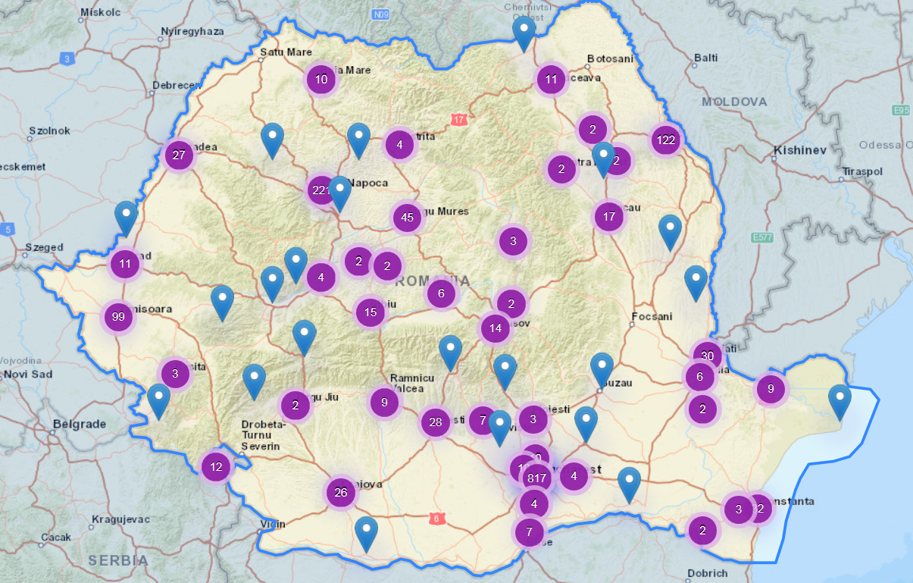
Distribution of RDI assets: Research Infrastructure Map
Search organised by county (NUTS3), not by region (NUTS2)
https://erris.gov.ro/

Slide 11
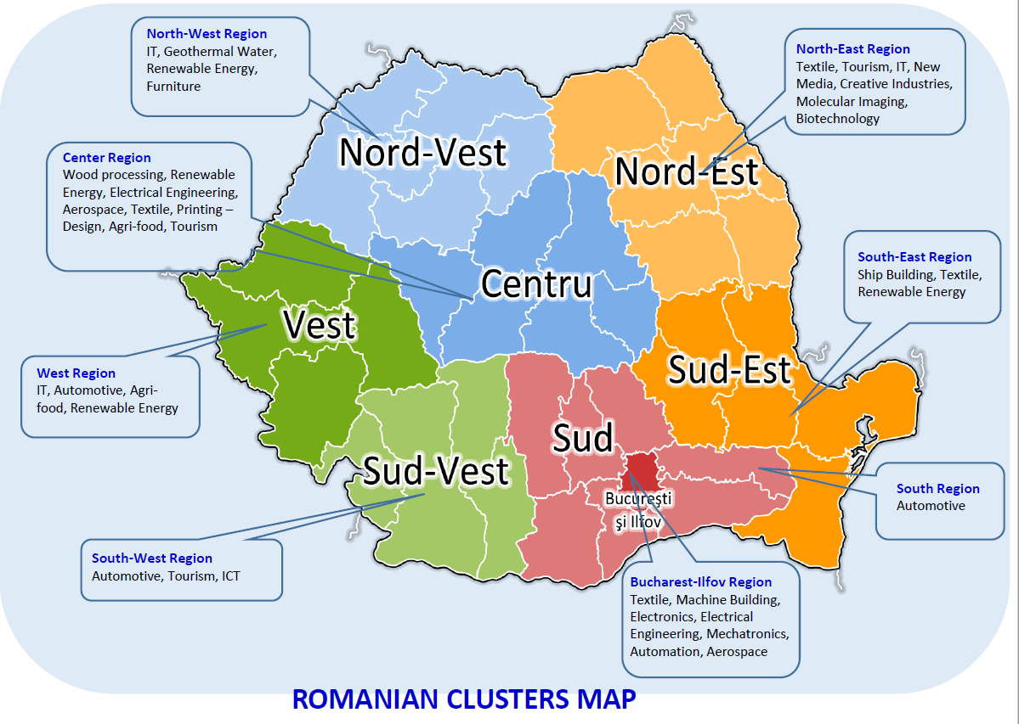
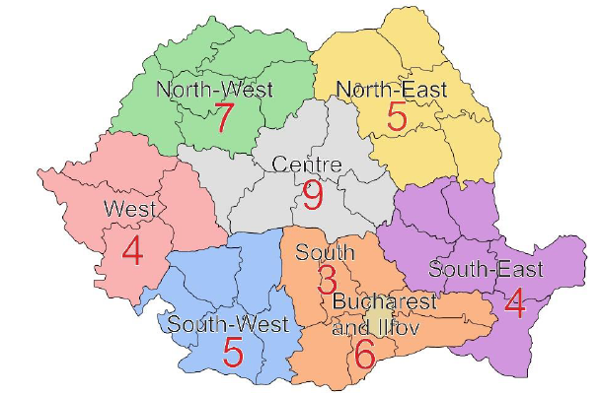
Technological specialisation: clusters
Smart Factory Hub - Regional Mapping Report Romania 2017
http://www.interreg-danube.eu/uploads/media/approved_project_output/0001/09/bfc5cd282081e3fa2187d5ac8eedfc3bf5c5213c.pdf
http://www.clusterpolisees3.eu/ClusterpoliSEEPortal/resources/cms/documents/Romanian_Clusters_Mapping.pdf

Slide 12

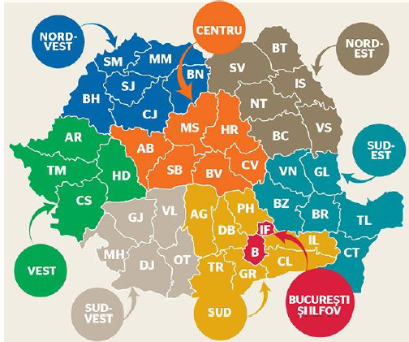
RIS governance: dual approach of smart specialisation
At national level:
National R&I Strategy 2014-2020, with four RIS3 priorities
1. Bioeconomy
2. ICT, space and security
3. Energy, environment, climate change;
4. Eco-nano-technologies and advanced materials
Forthcoming National R&I Strategy and National RIS3 Strategy
Ministry of Research and Innovation: IB for Research for the Competitiveness OP
Funding: PA1 of the Competitiveness OP and National Plan for RDI (NP3)
At regional level:
Seven regional RIS3 Strategies
Bucharest-Ilfov region now starting the RIS3 strategy design
Ministry of Regional Development and Public Administration: MA of Regional OP
RDAs as regional IB for the Regional OP
Funding: PA1 of the Regional OP (Technology Transfer), PA1 COP, NP3

Slide 13
RIS governance
Institutional setup: changes in the structure of the R&I system (regional innovation agencies? Unit in MRI?)
2. Regional innovation policies:
No formal regional innovation policies in Romania
Regional RIS3 strategies can provide a foundation for regional innovation policies – integration into the new RIS3 National Strategy
Regional innovation policies need to take account of the RIS types existing in the country → different logics behind constructing RIS depending on the regional industrial base and knowledge infrastructure
A mapping of the existing RIS is needed, in order to draft most appropriate policies and funding instruments
RIS taxonomy:
  1. Analytical vs. synthetic vs. symbolic knowledge base (Asheim)
  2. Governance dimension vs. business innovation dimension (Cooke)

Slide 14
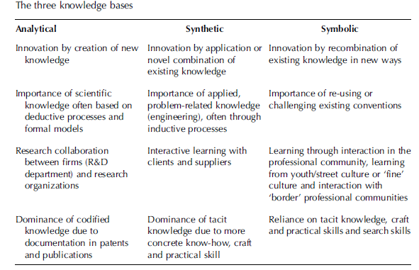
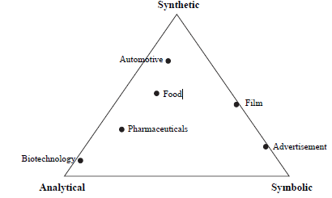
Synthetic, analytic and symbolic knowledge bases
Plant engineering, industrial machinery, shipbuilding
Innovation solves specific problems in client-supplier interaction
Products are often ‘one-off’ or produced in small series
Genetics, biotechnology, nanotechnology, ICT.
Basic and applied research, product/process development
Company R&D departments linked with universities and PROs
More codified knowledge
Cultural and creative industries: media (filmmaking, publishing, music), advertising, design and fashion, product aesthetics, creation of designs and images, economic use of cultural artefacts
Innovation- and design-intensive
Strong tacit knowledge
Asheim (2007)

Slide 15
RIS by synthetic, analytic, symbolic knowledge base
1. Territorially embedded RIS
Innovation based on synthetic knowledge
2. Regionally networked RIS
Combined analytic, synthetic and symbolic knowledge for more advanced technologies
3. Regionalised national innovation system
Innovation based on analytic knowledge
Typically found in the growth phase of an industry
Stronger regional knowledge infrastructure, developed R&D institutions, public–private co-operation
Localised, interactive learning between firms and knowledge infrastructure, support for incremental problem-solving and support to counter technological and cognitive lock-ins
Typically found in emergent industries at the start of their technological life cycle
Weak linkages between local industry and the knowledge infrastructure. Weak local and regional embeddedness, little capability to promote innovativeness and competitiveness within local industries
Typically found in mature industries
Regional knowledge infrastructure mainly directed to industry-specific, hands-on services and concrete, short-term problem solving, i.e. support to clusters
Localised, path-dependent inter-firm learning processes stimulated by geographic, relational proximity
Regional knowledge infrastructure for cluster development through science commercialisation.
Not much direct interaction with R&D institutes and universities
Examples: Italy (networks of SMEs in industrial districts, Emilia Romagna)
Examples: Germany, Austria, the Nordic countries
Examples: planned ‘science parks’ and technopoles (France, Japan and Taiwan)
Strong role of the R&D functions of universities, PROs and corporations, linear model of collaboration, projects for more radical science-based innovations

Slide 16
RIS by governance vs. business innovation dimensions
Governance dimension
(public policy, institutions, knowledge infrastructure)
Grassroots
Network
Dirigiste
2. Business innovation dimension
(production culture and systemic innovation, investment, type of firms, linkages and communication, networking, subcontracting, supply and value chains, links between customers and suppliers)
Localist
Interactive
Globalised
Cooke (2003)
GOVERNANCE OF ENTERPRISE INNOVATION SUPPORT

Slide 17
RIS by governance dimension
1. Grassroots
Local initiation
2. Network
More formalized and integrated at different levels: local, regional and national
3. Dirigiste
Initiation and inspiration are centrally influenced. Funding is specifically programme-based.
Research is highly applied and practical rather than scientific
Interactions are based on social capital rather than formal organizations
Industry specialization may be diverse (several clusters)
Examples: Italy (Tuscany, Marche have at least 10 distinctive clusters)
Funding for innovation from public programmes,
Examples: Germany, Nordic countries
High coordination among actors, with membership systems and effective knowledge circulation through seminars, workshops and associational networks.
Basic scientific research as important as applied research
Far more central government intervention, more large-scale business engagement
Strong coordination and specialization
Examples: France, Canada (Quebec in Canada): technopoles, growth poles
Industry specialization is more flexible than in grassroots systems. Engineering excellence.
Funding may come from family, community, local credit agencies
Scientific inputs from industrial research institutes or universities

Slide 18
RIS by business innovation dimension
1. Localist
Few or no large indigenous firms, relatively few large branches of externally-controlled firms
2. Interactive
Economy is neither particularly dominated by large or small firms but rather by a reasonable balance between them, whether indigenous or FDI in origin
3. Globalised
Domination by global corporations, supported by clustered supply-chains of dependent SMEs
Limited research reach of firms, some links between local PROs and industry clusters
Few major public innovation or R&D resources but may have smaller private ones.
Relatively high degree of association amongst entrepreneurs and between them and local or regional policy-makers
Research reach of this combination will vary between widespread access of regional research resources to foreign innovation sourcing as and when required
Balanced mix of public and private research institutes and labs, reflecting the presence of larger firms with regional headquarters and a regional government keen to promote the innovation base of the economy.
Regions are highly associative vertically and laterally (abundant industry networks, fora, clubs)
Research reach largely internal and highly private - oriented than public,
Larger firms more associative, dictating the rules.
Public innovation infrastructure aimed at helping SMEs may have developed more recently

Slide 19
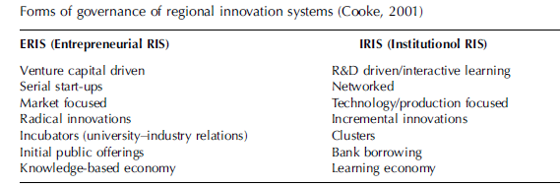
Governance of RIS
New Economy RIS
Both analytic and synthetic knowledge bases
Typical for more liberal economies
No strong systemic elements, less long-term stability
Driven by local venture capital, entrepreneurs, scientists, incubators
RIS is flexible and adjustable, no risk of ‘lock-ins’ caused by dependence on old technological trajectories
Typical of USA, UK and other Anglo-American economies
Traditional RIS
More synthetic knowledge bases
Typical for more coordinated market economies
Systemic relationships between production base and knowledge infrastructure
Regional networking governance structures, supporting regulatory and institutional frameworks at national level
Typical of German, Nordic regions

Slide 20
Thank you!
marina.ranga@ec.europa.eu

