Slide 1
Smart specialisation interactions between the regional and the national
S3 Targeted Support – LAGREG Horizontal Activities
20th February 2019, Madrid, Spain
Insights from the multi-level tensions in the Portuguese case
Hugo Pinto hpinto@ces.uc.pt

Slide 2
Smart specialisation interactions between the regional and the national
Implementation of RIS3 in Portugal
Portugal was one of the EU member-states that implemented a multi-level governance system for the development of its smart specialisation strategy.
From the beginning there were two parallel but somewhat detached processes for the RIS3 development.
At regional level, CCDRs, the regional agencies that manage the regional operational programmes were fast in adapting to the "RIS3 movement" and adopting the principles of smart specialisation to develop more or less robust place-based strategies.
At country level, national agencies, such as IAPMEI, FCT and ANI, tried to retain for themselves some control of the RIS3 process and presented a national strategy, the so-called ENEI - Estratégia nacional de especialização inteligente that worked to fulfil the ex-ante criteria for ESIF access during 2014-2020 in this member-state.
Regional RIS3, even if deeper and consolidated, were presented as an appendix of ENEI.

Slide 3
Smart specialisation interactions between the regional and the national
Implementation of RIS3 in Portugal
Today is consensual among Portuguese key stakeholders that some tensions in the RIS3 process emerged from that initial moment and that the multi-level articulation and governance needs revision.
The challenges for RIS3 in peripheral regions are even greater.
One of these challenges regards obviously governance, as commonly institutional frameworks are not mature, relevant actors lack of key capabilities, often there are actors or functions missing in the ecosystem, and a chronical lack of financial resources to implement an ambitious agenda for structural change such as any RIS3 can be.

Slide 4
The RIS3 Multi-Level Governance in Centro (PT)

Slide 5
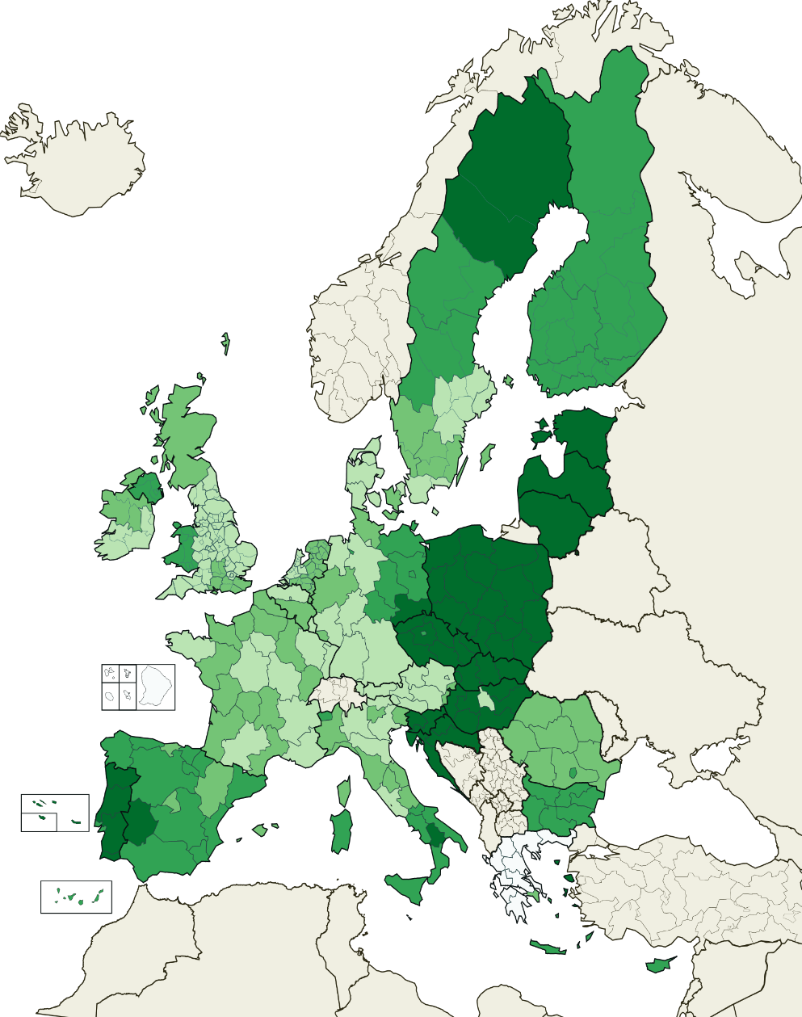
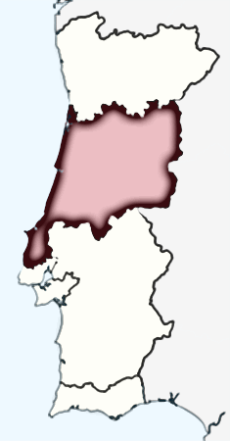
Smart specialisation interactions between the regional and the national
Centro (capital: Coimbra) is spread over 28,000 km² and has around 2.3 million inhabitants, approximately 31% of Portugal's total area and 22% of the population. Centro has a strategic position since it is situated between the two major cities: Lisboa and Porto.
ESIF in R&I per year and per capita
Regional Innovation Scoreboard (RIS) 2017
Centro classified as a “Moderate + Innovator” region, with innovation performance decreasing over time.
Best performing indicators
Non-R&D innovation expenditures
SMEs introducing product/process innovations and marketing/organizational innovations
SMEs innovating in-house
Innovative SMEs collaborating
Lower than EU scores but higher when compared to Portugal
Exports of medium-high/high-tech (MHT) manufacturing
Sales new-to-market innovations
R&D expenditures business sector
Worst performances both relative to Portugal and the EU
Employment in MHT manufacturing and knowledge-intensive services
Design applications
Performed poorly when compared to the EU but similar scores to Portugal
EPO patent applications
Public-private co-publications
Indicator (2016) | CENTRO | PT | EU-28
High-Tech Sectors (employment) | 1,9% | 2,8% | 4,0%
Human Resources in Science and Technology (% total population) | 23,5% | 25,4% | 33,2%
Source: Eurostat

Slide 6
Smart specialisation interactions between the regional and the national
Thematic domains
MATERIALS
ICT
FOREST
TOURISM
HEALTH
BIOTECH
AGRO-INDUSTRY
SEA
Transversal priorities
Sustainability of resources
Qualification of human resources
Territorial cohesion
Internationalization

Slide 7
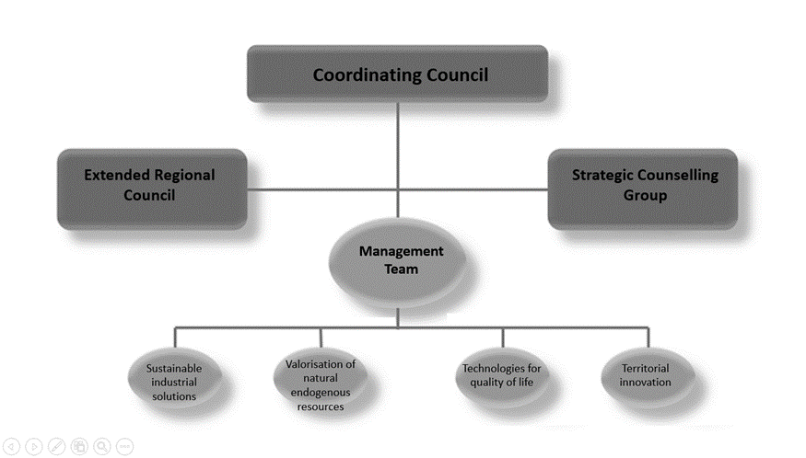
Smart specialisation interactions between the regional and the national

Slide 8
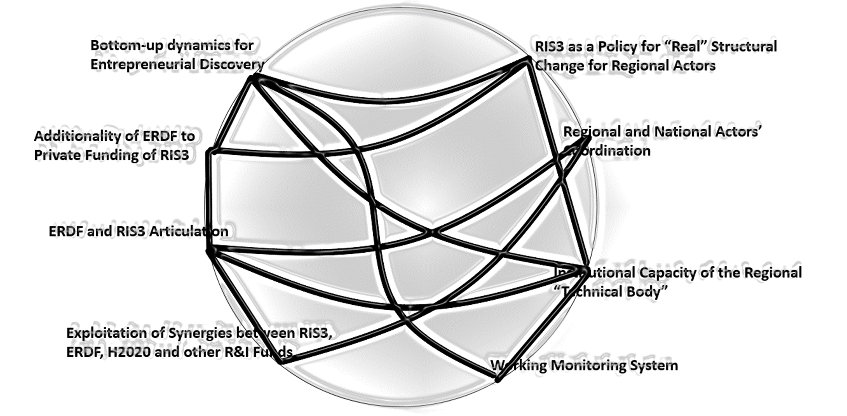
Smart specialisation interactions between the regional and the national
A CONNECTION CIRCLE FOR RIS3 MULTILEVEL GOVERNANCE
Multi-level governance in RIS3 is characterized by a large number of actors, organizations, agendas and policies, at different levels, local-regional-national-European, to be coordinated in order to achieve a coherent strategy and implementation. This can be characterized as a complex situation. We lack of information and have an incomplete understanding about how RIS3 multi-level governance really works (natural complexity). The process also depends on the interaction of multiple variables over time (dynamic complexity).
Based in interviews to key stakeholders at national and regional level content analysis provided insights for the crucial challenges and dimensions to be addressed for the implementation of an effective RIS3 governance system.

Slide 9
Smart specialisation interactions between the regional and the national
CONCLUSIONS
the need of a deeper reflection on the linkages between the priorities at national and regional level.
the continuous revision of the document and implementation of the ENEI.
the actual implementation of multi-level governance mechanisms – including EDP or monitoring - that are referred in the written documents but not yet fully translated into action.

Slide 10
hpinto@ces.uc.pt
CES | Alta
Colégio de S. Jerónimo
Apartado 3087
3000-995 Coimbra
Portugal
T +351 239 855 570
www.ces.uc.pt
ces@ces.uc.pt
CES | Sofia
Colégio da Graça
Rua da Sofia, 136-138
3000-389 Coimbra
Portugal
T +351 239 853 649
www.ces.uc.pt
ces@ces.uc.pt
CES | Lisboa
Picoas Plaza
Rua Viriato, 13 Lj 117/118
1050-227 Lisboa
Portugal
T +351 216 012 848
www.ces.uc.pt/ces-lisboa
ceslx@ces.uc.pt

