Slide 2
Governing RIS3 in a centralised country: Experiences from Bulgaria Elisa Gerussi, Ruslan Stefanov Horizontal WG on Governance 20th of February, Madrid

Slide 3
RIS3 in Bulgaria – state of the art
Main features
National strategy (last revision 2017), 4 priorities A few regional strategies not representative No previous innovation strategies 2 Operational Programs OI/SESG Benefits of calls below potential Inconsistent distribution of funds on the territory EDP: discontinuity in time and space Monitoring system formally established
Notes:
This division between the responsibilities of two ministries is something not new in CEECs, although most of the countries filled the operational gaps by establishing a coordinator body in order to align respective functions.
For the national strategy, see Profile on status of S3

Slide 4
Structural changes and S3 development
Institutional building reforms → weak innovation governance
Role of state and role of knowledge-intensive firms → vertical network
Higher education and R&D system → limited connection

Slide 5
Governance as a priority challenge
VERTICAL DIMENSION
Country with high regional disparities and low decision making power in R&D policies at regional level
HORIZONTAL DIMENSION

Slide 6
The role of decentralisation
6 planning regions (NW, NC, NE, SE, SC and SW)
28 NUTS3 districts
264 LAU1 municipalities
5,278 NUTS5 settlements
Decentralisation
Territorial cohesion
Economic and sectorial development
Reallocation of central authority
Centripetal – centrifugal forces

Slide 7
Vertical dimension
Bottlenecks in the structure:
Leadership and decision making bodies
Coordination within the government
Distribution of functions
Technical body
Ad hoc competences

Slide 8
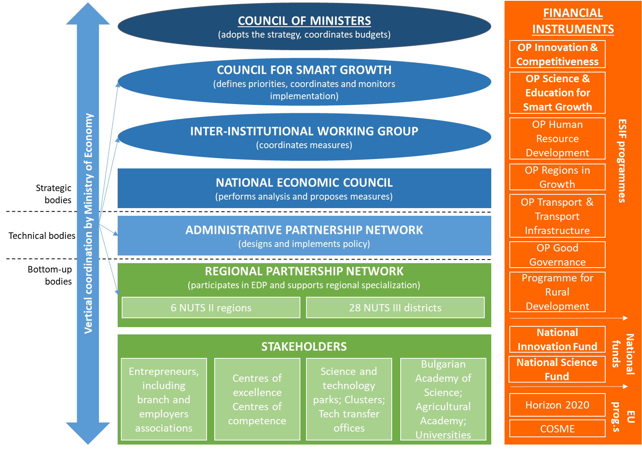
Current S3 governance

Slide 9
Horizontal dimension
Fragmentation of the system:
lack of information centre-periphery (regional strategies? Role of municipalities? Territorial division reform?)
weak linkages between innovation stakeholders (business engagement)
lack of intermediaries (CoE/CoC, RICs, Tech Transfer offices)
lack of trust

Slide 10
Regional Innovation Centres
6 Regional Innovation Centres co-funded by the OP Innovation and Competitiveness
Theoretical model?
Connection with the CoC?
Management?
Funding model?
Private sector engagement?
SUSTAINABILITY: NEED OF ESTABLISHING A LONG STANDING MODEL

Slide 11
Conclusions
Reform of S3 governance structure needed→ overall R&I system
Considering intermediary institutions to build up horizontal linkages
Empowering the role of municipalities
Considering the outward orientation of strategies (GVC)
Policy mix and appropriateness of instruments
Notes:
Foreign Direct Investment (FDI), net inflows, is 2.4% of GDP in 2016 compared to the peak in 2007 (Bulgaria's EU entry) of 31%23 from WB data. There is no statistical evidence that FDI is being attracted by innovation-related incentive schemes or the existing science base, except for possibly ICT-related and outsourcing services. FDI presence seems to be linked to the affordable labour force (esp. with foreign language skills) and the low flat level of corporate tax (10%).

Slide 12
JRC’ s support
Study on intermediary institutions and support to the definition of the CoE + RICs’ establishment
Support to the improvement of the governance along both dimensions of it
Peer learning exercises
Dissemination of national best practices (e.g. Varna agency)

Slide 13
Thank you!
Elisa.gerussi@ec.europa.eu

