Slide 2
Targeted Support to RIS3 Implementation
Mark BODEN
JRC.B3 Territorial Development
mark.boden@ec.europa.eu
Madrid, 12th December 2018

Slide 3
Targeted support to S3 implementation
Five closely complementary JRC activities
STRIVE - Support to Transitions in Regional InnoVation Eco-systems
RIS3 Support to Lagging Regions
RIS3 Support to Romania
Higher Education +VET in Smart Specialisation
Coal and industrial transition regions
Stairway to Excellence
European Parliament
DG REGIO
European Parliament
DG REGIO
DG EAC DG EMPL
DG ENER DG REGIO
European Parliament
DG REGIO
2016 - 2020
2016 - 2019
HESS3 - 2018-20
2018+
S2E-4 2018-20

Slide 4
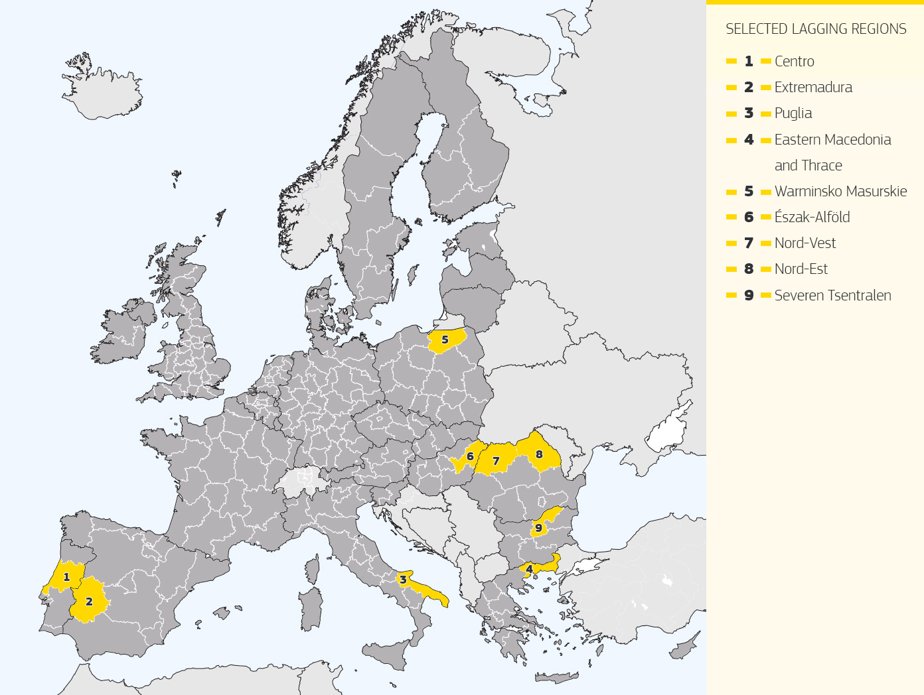
Lagging Regions 1 & 2:
common aims and evolving coverage
Targeted support to RIS3 implementation in selected regions
Support the refinement and implementation of the RIS3 of selected EU regions
Warminsko Masurskie
Észak-Alföld
Nord-Vest
Nord-Est
Generate lessons and a model for other regions
Test-bed for theories on S3 and for understanding RIS3
S3 as entry-point to address wider issues
Puglia
Eastern Macedonia
and Thrace

Slide 5
Lagging Regions 1: Objectives & Outcomes
Trust building and developing working relationships
Enhanced understanding of RIS3
Catalysing the EDP
Developing RIS3 Monitoring
Enhance Governance of RIS3
Capacity building for RIS3 implementation

Slide 6
Lagging Regions: objectives – specific support and horizontal approaches
to develop and provide appropriate and specific support to selected regions in RIS3 implementation, building on EDP
to develop and enhance linkages between RIS3 at regional and national levels
to develop and implement horizontal approaches to key issues in the growth and governance of RIS3 (e.g. monitoring)
to develop and disseminate lessons and tools for other EU regions
meeting the 2021-7 enabling condition of good governance of national or regional smart specialisation strategy with seven fulfilment criteria

Slide 7
Alignment with 5 policy objectives for 2021-7
A smarter Europe (innovative & smart economic transformation)
A greener, low-carbon Europe (including energy transition, the circular economy, climate adaptation and risk management)
A more connected Europe (mobility and ICT connectivity)
A more social Europe (European Pillar of Social Rights)
A Europe closer to citizens (sustainable development of urban, rural and coastal areas and local initiatives)

Slide 8
Policy Objective 1: 4 specific objectives
Enhancing research and innovation capacities and the uptake of advanced technologies
Reaping the benefits of digitisation for citizens, companies and governments
Enhancing growth and competitiveness of SMEs and
Developing skills for smart specialisation, industrial transition and entrepreneurship
Enabling condition PO1: good governance of national or regional smart specialisation strategy

Slide 9
Good governance of S3: 7 fulfilment criteria
Up-to-date analysis of bottlenecks for innovation diffusion, including digitalisation
Existence of competent regional/national institution or body, responsible for the management of the smart specialisation strategy
Monitoring and evaluation tools to measure performance towards the objectives of the strategy
Effective functioning of entrepreneurial discovery process
Actions necessary to improve national or regional research and innovation systems
Actions to manage industrial transition
Measures for international collaboration

Slide 10
Specific support and mutual learning
Up-to-date analysis of bottlenecks for innovation diffusion, including digitalisation
Existence of competent regional/national institution or body, responsible for the management of the smart specialisation strategy
Monitoring and evaluation tools to measure performance towards the objectives of the strategy
Effective functioning of entrepreneurial discovery process
Actions necessary to improve national or regional research and innovation systems
Actions to manage industrial transition
Measures for international collaboration
Crosscutting concerns of the MMF: enhancing administrative capacity building and cooperation

Slide 11
Specific Support in partner territories
 | LR1 | LR2 | Priority Criteria
BG | Severen Tsentralen | national level | 1,2, 4,5
HR |  | national level | 1,3,5
EL | Eastern Macedonia and Thrace, roll-out | Central Macedonia +1, roll-out/national level | 1,3,4,5
HU | Észak-Alföld (Hajdú Bihar County) | national level | 1,3,4.7
IT | Puglia | Puglia & Campania | 1,3,4
PL | Warminsko Mazurskie | Kujawsko-Pomorskie, Lubuskie, Podlaskie | 1,4
PT | Centro | Centro, national level (HESS) | 1,4,7
ES | Extremadura | Extremadura, national/regional linkages | 1,3,4,7
RO | Nord-Est, Nord-Vest, all regions | all regions, national level | 1,2,3,4,5,7

Slide 12
Horizontal support, peer learning & analysis
Issues common to the partner regions and relevance to five policy objectives (especially PO1), associated enabling conditions and fulfilment criteria:
Governance, Monitoring and Evaluation (2,3,4,5)
Managing Industrial Transitions (6)
Transregional and transnational collaboration (7)
Crosscutting concerns - administrative capacity building and cooperation

Slide 13
Monitoring and Evaluation
LR1 Monitoring Working Group
Massive Open Online course
Identification of next steps in furthering monitoring & evaluation of RIS3 outcomes (→LR2)
LR2 Monitoring Working Group (criteria 2,3)
Coordination of national and regional RIS3 monitoring
Use of national and international open data for RIS3
Evaluation of RIS3

Slide 14
RIS3 Governance
LR1 Governance Working Group
Key issues in RIS3 governance RIS3: multilevel governance and sustaining EDP over the long term
identification of key bottlenecks in RIS3 governance, and agenda for future activities (→LR2)
LR2 Governance Working Group (criteria 2,4,5)
Coordination between national and regional level (regulatory aspects, funding synergies, institutional capacity) (criteria 2,5)
Integration of stakeholder input in the governance process (criteria 4,5)

Slide 15
Managing Industrial Transitions
Addressing the challenge of deindustrialisation (DG REGIO Pilot Action: Regions in Industrial Transition)
Exploring the central role of RIS3 strategies in responding to deindustrialisation
How best to support regions in better tailoring RIS3 to the specific challenges of industrial transitions?
Detailed analysis of key issues with hands-on engagement and mutual learning activity with stakeholders in both lagging and transition regions.
Expert review and workshop
Mutual learning working group
Criterion 6

Slide 16
Transregional and transnational cooperation
EC Proposal for Cohesion Policy regulation places significant attention on the issue of transregional cooperation, offering instruments to support it
LR2 – activities to explore and support the development and implementation of transnational collaboration for lagging regions:
feasibility of interregional cooperation instruments as a tool for RIS3 implementation (criterion 7)

Slide 17
Communication and Coordination
Complementarities – STRIVE, S3P and beyond
DG REGIO – competence centre and country desks
Critical Friends
Updated website

Slide 18
Project website – major update in progress!
http://s3platform.jrc.ec.europa.eu/ris3-in-lagging-regions
Thank you!

Slide 19
Targeted Support to Territorial Development in a RIS3 Context
Key issues
JRC projects
Governance
• Need for more participatory (RIS3) governance
• Administrative, legal and technical issues
• Structural bottlenecks in the R&I ecosystem
• Coordination problems
Capacity building
• Need for qualified human resources
• Enhanced business sector capabilities for innovation and entrepreneurship
• Need for openness to overcome weak integration in EU networks
• Infrastructure
Innovation
• Weak links between academia/PROs/ business
• Limited use of available funding for R&I
• Limited use of research infrastructures
Enhance capacity - Lagging Regions
Support implementation of RIS3
Support EDP capacity and RIS3 governance
Develop human resources and mobility
Enhance role of universities – HESS Project
Align higher education with regional economy
Strengthen role of education in RIS3 and regional innovation systems
Access funds - Stairway to Excellence Project
Analytical support: Policy Insights; Joints Statements; Country Reports; Facts & Figures; Synergy Examples
MA training to build capacities
Collaboration between regions and EIT KICs (Regional Innovation Scheme)
Collaboration between MSs/regions & Joint Undertakings

Slide 20
Lagging Regions Toolbox
EDP focus group
Online stakeholder engagement
Specific support WGs
PDL
Horizontal WGs
Online funding guide
Interviews and analysis
Peer review and peer learning
Board of critical friends

