Slide 1
Horizontal Activities Lagging Regions
Madrid 12 December 2018
Lauri Kuukasjävi
lauri.kuukasjarvi@uudenmaanliitto.fi
Tel. +358 440909272

Slide 2
Horizontal Activities Lagging Regions
Madrid 12 December 2018
HELSINKI-UUSIMAA REGION
REGIONAL DEVELOPMENT STRATEGY
RIS3
PEER REGIONS & INTERREGIONAL COOPERATION
SPECIALISATION vs. SMART SPECIALISATION
Ref CENTRE OF EXPERTISE PROGRAMME 1994 - 2010
S3 REVIEW
ORGANISATION
CRITICAL ISSUES
POST 2020
MISTAKES / BAD EXPERIENCES

Slide 3
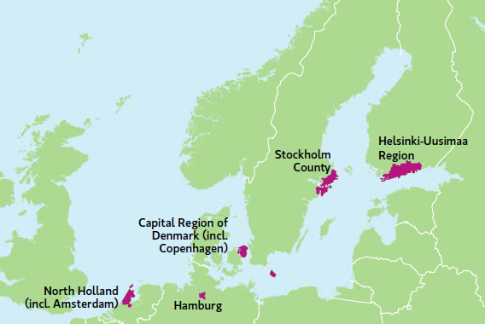
Primary European reference regions for Helsinki-Uusimaa
To monitor the progress of the Helsinki - Uusimaa Regional Programme, the Region is compared with other medium-sized European metropolises with similar resources and challenges
Region’s primary European reference regions are Stockholm County, the Capital Region of Denmark (incl. Copenhagen), North Holland (incl. Amsterdam), and Hamburg.

Slide 4
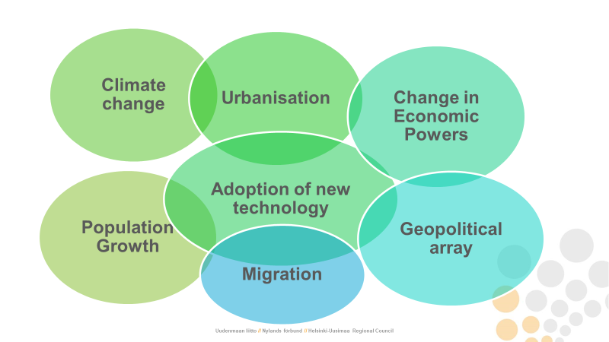
Notes:
Näiden lisäksi ”normaalit” väestön ja talouden tunnusluvut

Slide 5
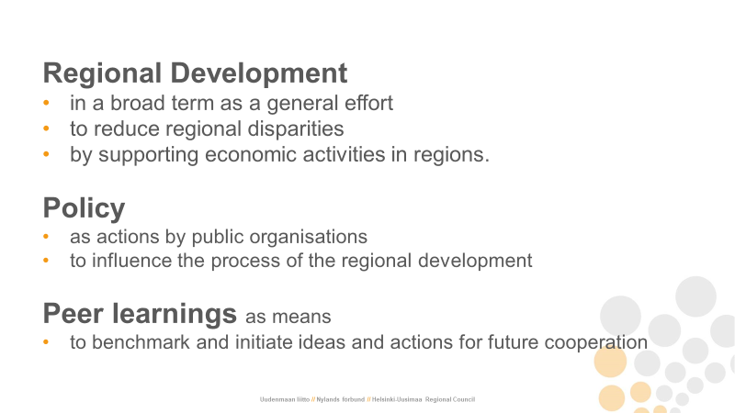
Notes:
Näiden lisäksi ”normaalit” väestön ja talouden tunnusluvut

Slide 6

Vision 2050
”Cool and the Most Vibrant Region in Europe”
Notes:
Virkein= aktiivinen, yrittäjyys, teknologiakehitys=edelläkävijyys, matkailu
Viilein = ilmasto, hiilineutraalisuus, matkailu, cool=pöhinä

Slide 7

Strategic choice:
Happy and
capable people

Slide 8

Strategic choice:
Affordable and
responsible
Business

Slide 9

Strategic
choice:
Climate smart
and
versatile
Region

Slide 10
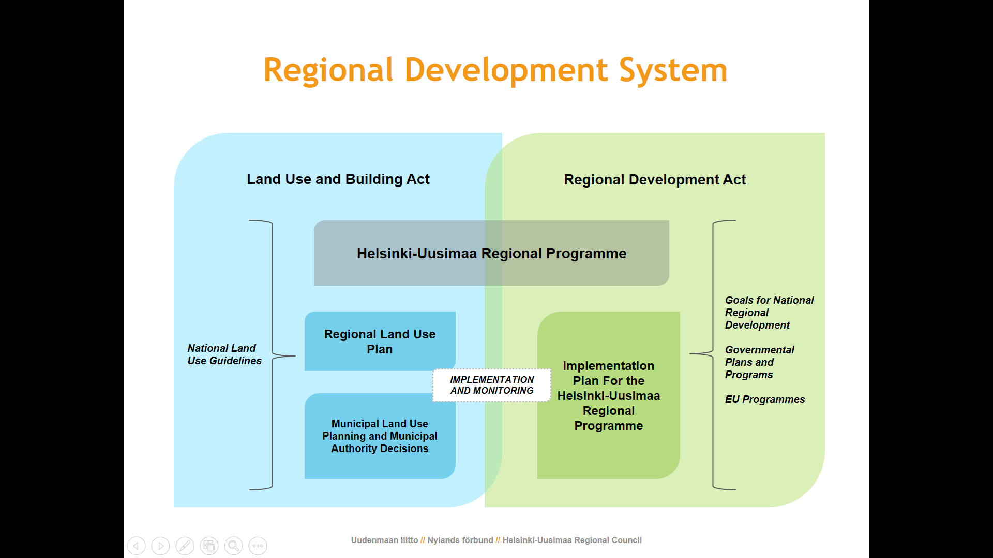
RIS3 in Helsinki-Uusimaa regional development
Regional Research and Innovation Strategy for Helsinki-Uusimaa
Notes:
The Helsinki-Uusimaa Reigonal Council is mandated by law for the land use and building act and regional development act.
The RIS3 in Helsinki-Uusimaa was publised in 2016. The strategy itself is much based on the Uusimaa regional programme since it was only then requsted by the Commision. Helsinki-Uuimaa is the Managing authorty of the ERDF funding for the soruthern finland programme and thus, the prioritues of the RIS3 are respected while UML making finanicning decsion on ERDF and own reigonal programme.

Slide 11
Specialisation vs. Smart Specialisation
Centre of Expertise Programme = OSKE 1994 - 2013

Slide 12
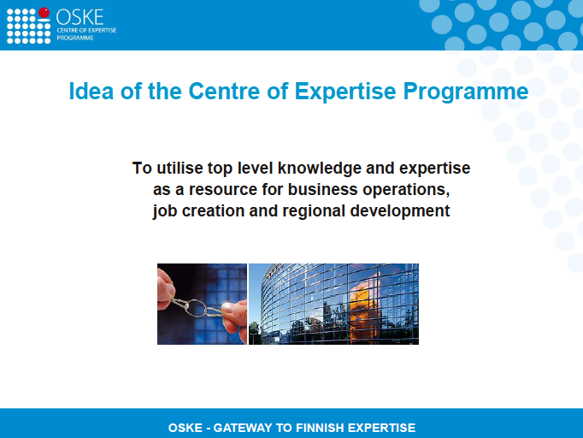

Slide 13
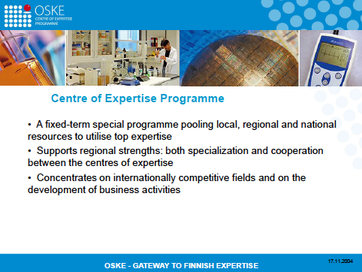

Slide 14
Partners of
Centres of Expertise
at regional level
Joint strategy

Slide 15
The Centres of Expertise and the fields of expertise in Finland, 1999 - 2006
Lapland - Centre of Expertise for
Experience Production
Oulu Region Centre of Expertise
Information and telecommunication technology
Medical technology
Biotechnology
Centre of Expertise for Western Finland
Energy technology and economy
Seinäjoki Region Centre of Expertise for
Food Technology and Industry
Tampere Region Centre of Expertise
Mechanical engineering and automation
Information and communication technology
Health care technology
Media services
Satakunta Centre of Expertise
Material technology
Distance technology
South-West Finland Centre of Expertise
Biomaterials-, diagnostics- and
pharmadevelopment
Materials surface technology
Cultural production
Centre of Expertise for Wood Technology
Centre of Expertise for Food Development
Kuopio Region Centre of Expertise
Pharmaceutical development
Agrobiotechnology
Health care technology
Kuhmo – Virtuosi Centre of Expertise for
Chamber Music
North Karelia Centre of Expertise
Moulding and tooling engineering
Forestry and wood technology
Jyväskylä Region Centre of Expertise
Information technology
Papermaking technology
Energy and environmental technology
Southeast Finland Centre of Expertise
High technology metal constructions
Forest industry systems
Economics and logistics of Russian transition
Päijät-Häme Centre of Expertise
Design, quality and environmental technologies
Helsinki Region Centre of Expertise
Gene technology and molecular biology
Adaptive microsystems
Software product business
Cultural industry
New media

Slide 16
Innovation promotion in Finland 1980’s to 2000’s
in 1980’s
University
Company
in early 1990’s
Universities
Science Park
Companies
in late 1990’s and 2000’s
Universities
OsKe - Centres of Expertise
Polytechnics
Science Park
Companies

Slide 17
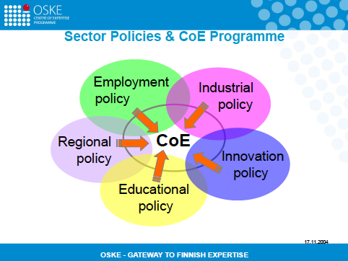

Slide 18
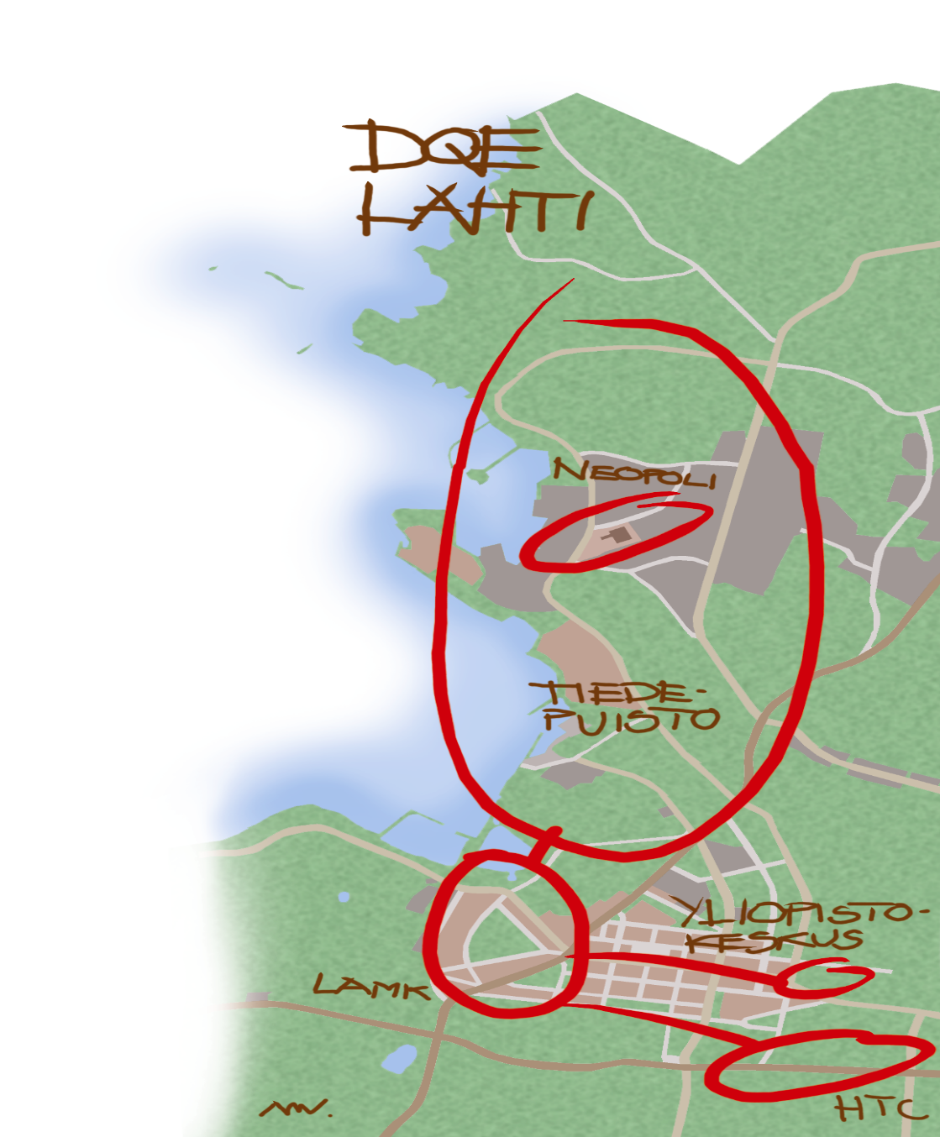

Slide 19
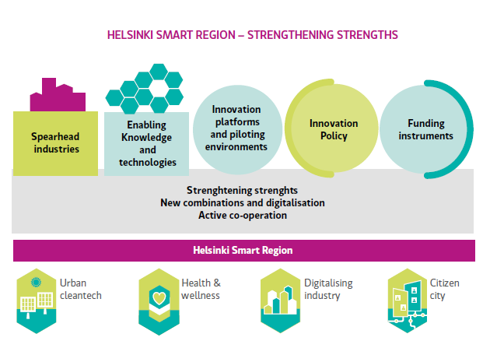
Helsinki RIS3 Strategy – An Overview
Goal: Double innovation effects of the region
Notes:
By bringing together exsiting elments of speardhead industries, Key enblaing knowelege and technology, plateforms and policys and funding insturments. The RIS3 serves an intermidate platform to support the development of the four key areas of Helsinki-Uusimaa. That is

Slide 20




RIS3 focus areas in Helsinki-Uusimaa
Urban Cleantech | Health & Wellness | Digitalising Industry | Citizen cities
energy and resource efficiency, circular economy, bio economy, consumer cleantech | healthcare solutions, processes, technologies, services and taking care of yourself | logistics, robotics, the Internet of things | the wellbeing of all citizens, open urban development, citizen participation, usability of services, co-creation

Slide 21
S3 Review in Helsinki-Uusimaa
Current RIS3 – So far
Helsinkismart.fi
AIKO,
ERDF
update
1. How to organise the review?
Evaluation & Comparative report → lessons learned
Joint operation with regional partners
Revision of RIS3 in 2019
  In relation to the development of the region
  In relation to ERDF 2021

Slide 22
S3 Review in Helsinki-Uusimaa
2. Critical issues
Indicators needed
Improved means to compare
Skills to design & work
Resources for implementation

Slide 23
S3 Review in Helsinki-Uusimaa
3. S3 – Post 2020
Increased importance
→ ERDF
→ Regional renewal

Slide 24
S3 Review in Helsinki-Uusimaa
4. Mistakes
Complicated approach
Unclear definition of smart specialisation areas
  merge and rename
Limited resources
  → ”Have we had resources, we’d be happy to make mistakes, too”

Slide 25
For the future
How to keep focus?
How to motivate players?
How to keep it simple?
How to organise collaboration among regions?

