Slide 1
“We should revise our S3 now!”
Against the motion
Yannis Tolias

Slide 2
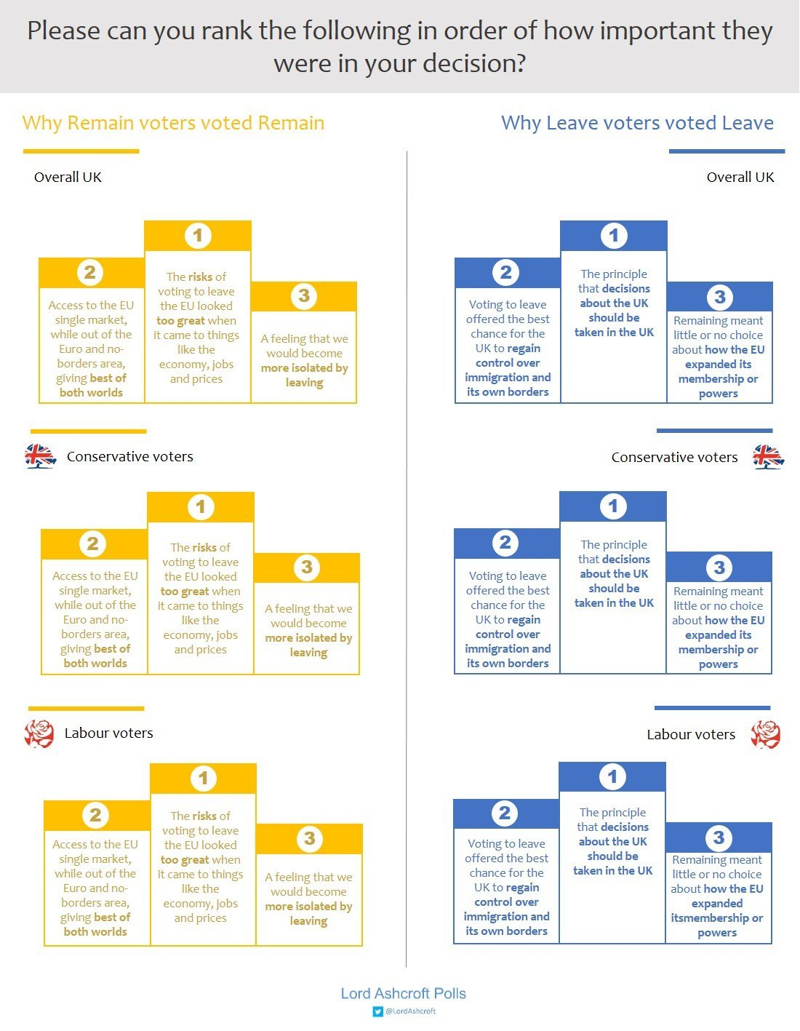
On 23 June 2016, UK decided to leave the EU citing “stupid regulations drafted in Brussels” as the main reason for doing so…

Slide 3

…however, a regulation requiring member-states or regions to carry out a S3 mid-term review was not one of them!
There is no such regulation.

Slide 4

NEVER consider doing something that you don’t have to!

Slide 5

UNIT FOR EXCELLENCE IN BOTTOM-UP STRATEGY MAKING
Stakeholders deserve to
become empowered
and drive change
in the light of evidence
from a monitoring system…

Slide 6

The assumptions of monitoring being able to drive change are over-exaggerated
Sometimes, it’s better to be ignorant

Slide 7
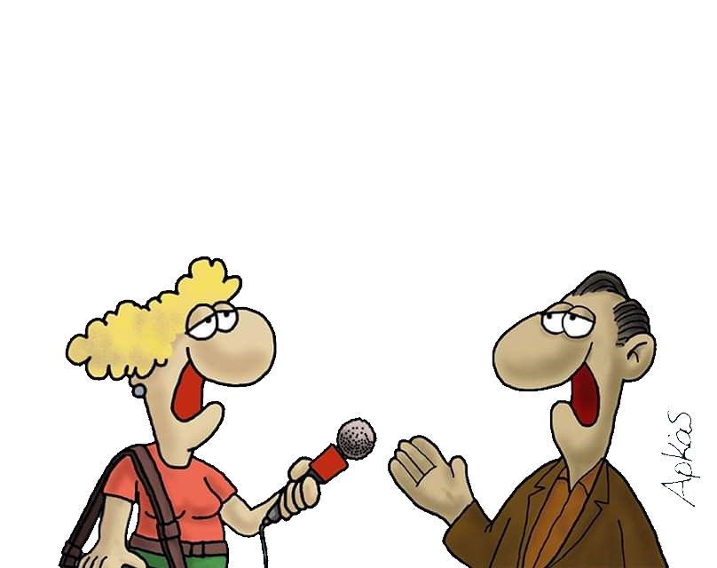
MINISTRY OF SCIENCE
As any constituent can see and feel, we are on track to exceed our S3 objectives by 2023; all concerns that have been raised are totally unfounded.

Slide 8

S3 is back in the new regulations
Sequels suck

Slide 9

Don’t tell anyone that you cannot get funded by a S3…

Slide 10

My stakeholder interests were utterly neglected last time
Fancy yet another participatory process?

Slide 11

After waiting so many years for a call, you can’t imagine how hard is the paperwork for applying for a R&D&I project…
You’ll hate your post-approval life!

Slide 12

REGIONAL
UNIVERSITY
…therefore, we got 85% of the budget for TO1…
…and now they’re asking back a share of our tech transfer revenues!
Our active participation in the EDP guaranteed that regional priorities are sooooo wide and vague…

Slide 13
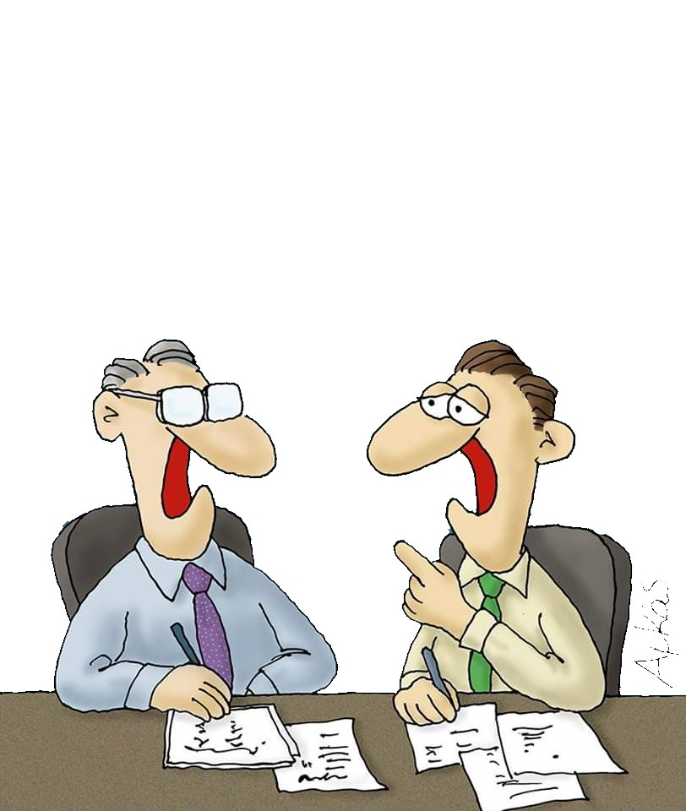
Do we really need a S3 mid-term review to know what’s wrong?
RIS3 MANAGEMENT UNIT
Are you serious? Hanging our dirty laundry in the open?

Slide 14
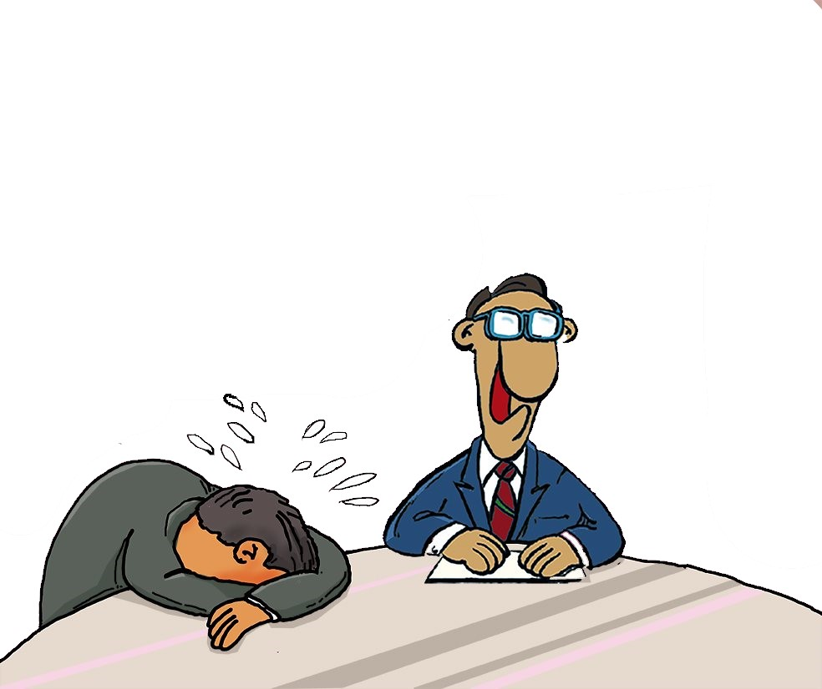
OP MANAGING AUTHORITY
The S3 team is considering a mid-term review

Slide 15

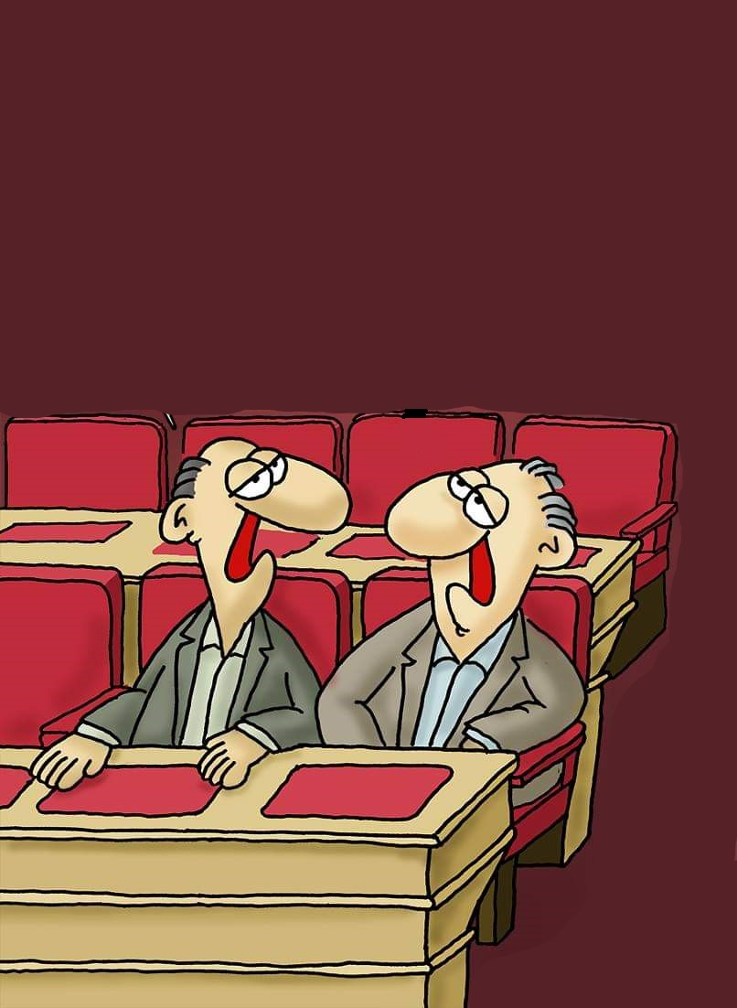
REGIONAL ASSEMBLY
They’re considering a S3 mid-term review…
God, they’re highly innovative in finding ways to delay payments to our voters!
Guess who’ll get the blame for that if we let it happen…

Slide 16

RIS3 MANAGEMENT UNIT
IT OFFICE
An army of bots will make our Monitoring Website the most visited page in the country

Slide 17
Q: What do you expect from the mid-term review of your S3?
% of votes for “NOTHING”

Slide 18
Face the truth!
NOBODY CARES FOR YOUR S3 MID-TERM REVIEW!

Slide 19

RIS3 MANAGEMENT UNIT
…but we promised to have one and we should keep our promises!

Slide 20

Just consider the odds
The Law of Irrelevant Changes
100%
Odds for implementation
0%
Trivial
Huge
Impact of proposed recommendation

Slide 21
There’s a huge difference between having one and doing one; be creative!

Slide 22




Some trivial ideas
Hide in plain view
Claim unforeseen events
Re-purpose another document
Procrastinate
(until it becomes irrelevant)

Slide 23

Deceive and conquer.

Slide 24
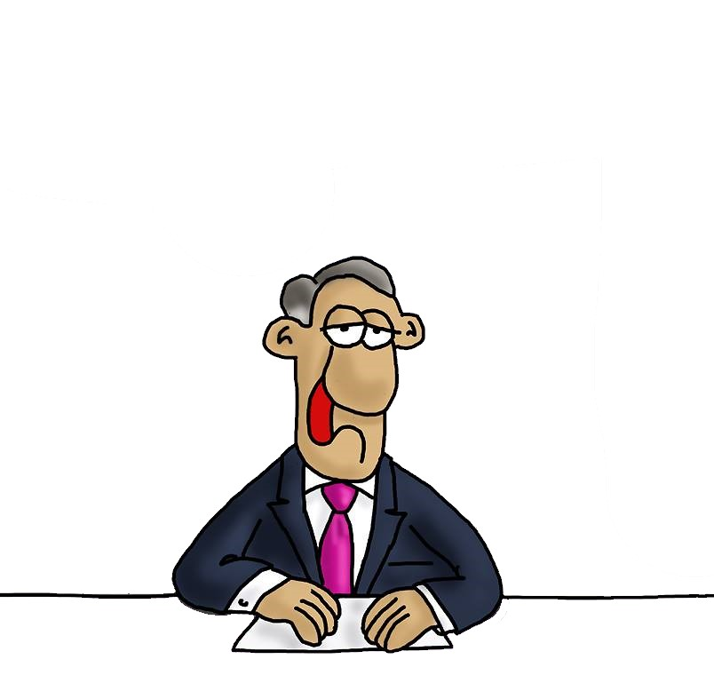
I can’t believe you’re still having doubts!
VOTE
NO

